Slide 1

TEAM : Cohabitants
JanVastu
From citizen voice → smarter infrastructure → public accountability
A multilingual, AI-powered platform making citizen demand visible, comparable, and actionable for India's infrastructure planning.
VOICE-FIRST
OFFLINE-CAPABLE
EXPLAINABLE
SOVEREIGN
DPDP-ALIGNED

Slide 2


THE GAP
India hears citizens BUT Infrastructure planning still struggles to hear them together.
Fragmented Demand
Requests sit across MPLADS, e-District, CPGRAMS, PWD, and CSC never spatialised against infrastructure supply.
Top-Down Prioritisation
Citizen demand is not systematically mapped to existing infrastructure gaps.
Accountability Gap
Citizens cannot see contractor, cost, timeline, or whether an asset functions.
Digital Exclusion
Text-first systems exclude low-literacy and non-smartphone populations.
9,000+ NIP projects · ₹160+ trillion
The opportunity: make demand visible, comparable, and actionable.

Slide 3






THE SOLUTION
JanVastu turns scattered citizen signals into an accountable planning loop.
Collect
Understand
Locate
Voice, Text, app, volunteer, CSC
Multi- language AI, intent, entities, image/video
Geo-code demand, connect to assets
Prioritise
Account
Demand-Supply Gap Ratio + explainable recommendations
Contractor, cost, timeline, officials, outcome trail
The Core Shift: From "collect complaints" → map unmet need → guide investment → prove outcomes.

Slide 4



INCLUSIVE BY DESIGN
A citizen should not need a smartphone, English, or typing skills to be heard.
Ramesh ( Rural / Low Literacy)
Priya ( Collector / Decision Maker)
Anjali (Urban / Digital)
IVR in local language. Volunteer photo capture. Offline household collection with GPS-verified sync.
App-based feedback with voice input. Real-time project tracking and outcome verification.
WhatsApp + geo-tagged photo. Public project details. Hotspots and Gap Ratios with explainable recommendations.
22 LANGUAGES
OFFLINE-FIRST
CODE-SWITCHING
HUMAN FALLBACK FOR LOW-CONFIDENCE ASR

Slide 5

AI ENGINE
Multilingual AI converts raw citizen media into structured planning signals.
Speech
Example Signal
Meaning
ASR + language ID — IndicConformer / Vak
Intent + NER — IndicBERT / MuRIL
"Broken handpump near the school"
Raw voice → structured, geo-tagged, severity-ranked planning signal — in seconds.
Vision
Location
Defect + severity — YOLOv8
Reverse geocoding — OSM + Bhuvan
Quality
Dedup + anomaly — GPS plausibility checks

Slide 6

ARCHITECTURE
Federated data + sovereign deployment + explainable decision support.
INPUT
IVR • WhatsApp/SMS • React Native • Volunteer • CSC
AI
ASR • NLU • NER • Vision • Geo • Dedup
DATA FUSION
PostgreSQL/PostGIS • Kafka • Debezium • Redis • MinIO
DECISION
Gap Ratio • Recommender • Contractor/Agency tracking
OUTPUT
Policymaker dashboard • Transparency portal • Grievance integrations

Slide 7


DECISION INTELLIGENCE
The platform measures where demand and infrastructure supply diverge.
Demand-Supply Gap Ratio
What the Decision Layer Produces
Demand Intensity ÷ (Infrastructure Stock + Planned Investment) × Vulnerability Weighting
Source architecture defines this ratio to produce explainable, spatially-grounded investment recommendations.
Demand hotspot heatmaps
Priority project recommendations with explainable attribution
Contractor and agency responsiveness views
Feedback → action → outcome ledger

Slide 8





ACCOUNTABILITY LAYER
A project should be traceable from public need to public outcome.
Who
How Much
When
Contractor / vendor and responsible officials
Sanctioned + actual cost
Planned + actual timeline
Who Owns It
What Happened
Responsible department and agency
Feedback → action → outcome trail
Public Transparency Portal: Search by location → view asset/project → inspect accountability fields → track status

Slide 9
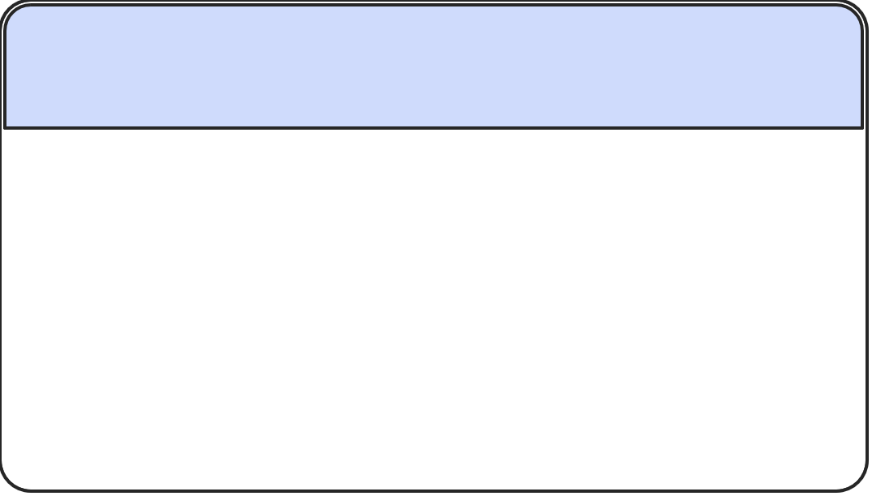
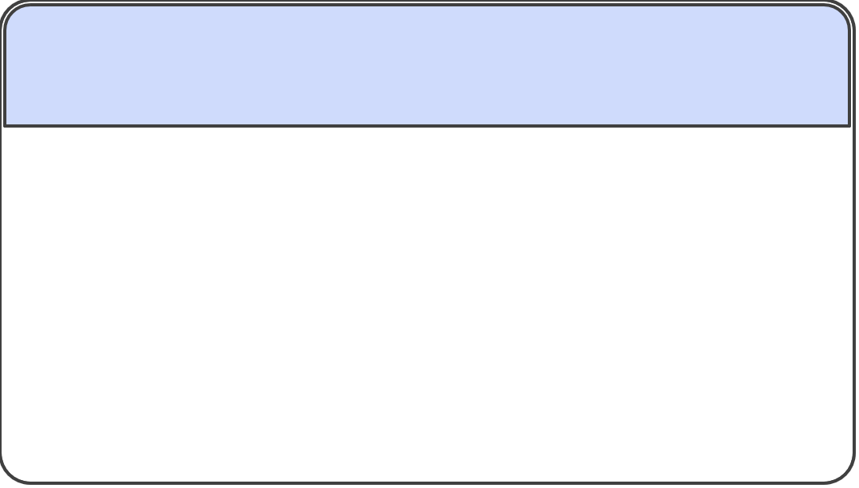






TRUST IS A FEATURE
Privacy, consent, explainability and auditability are built into the architecture.
Consent
Privacy
Local-language notice with timestamp, purpose, and language. Consent ID linked to feedback not identity.
PII stripping at ingestion. No retention beyond consent scope.
Security
Audit
AES-256 at rest. TLS 1.3 in transit. RBAC access controls.
Immutable logs. Explainable attribution. No black-box decisions affecting citizens.

Slide 10
BUILT TO SCALE
The roadmap starts measurable and grows toward national coverage.
22
28
Languages
States
Full Indic language coverage by Year 3
National rollout across all states
50M
10K
Citizens
Priority Projects
Target reach at full scale
Explainable recommendations generated
Year 3 — National
Year 1 — Pilot
22 languages, 28 states
50M citizens, 50M feedback items
10K priority projects with accountability trails
5 languages, 3 states
1M citizens, 500K feedback items
500 priority projects identified
Technical scaling: Kafka partitioning · GPU autoscaling · sharded PostgreSQL · horizontal API pods · regional deployments

