Slide 1
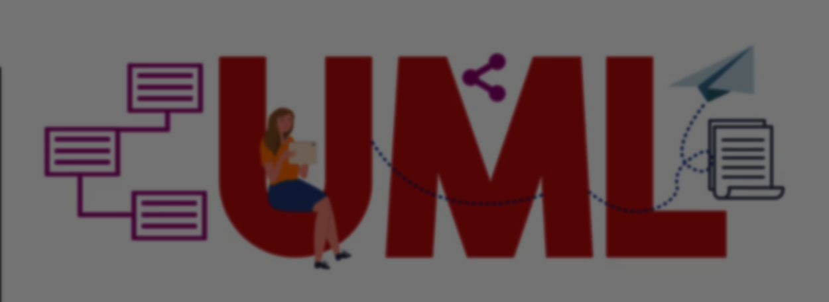
Unified Modelling Language (Structure Diagram)
Presenter: Ayush Tuladhar
Subject: System Analysis & Design
BSc. CSIT V

Slide 2
Introduction to UML
Standard visual language used to model software systems
Helps develops design, visualize & document system architecture
Divided into:
Structural Diagrams
Behavioural Diagram

Slide 3
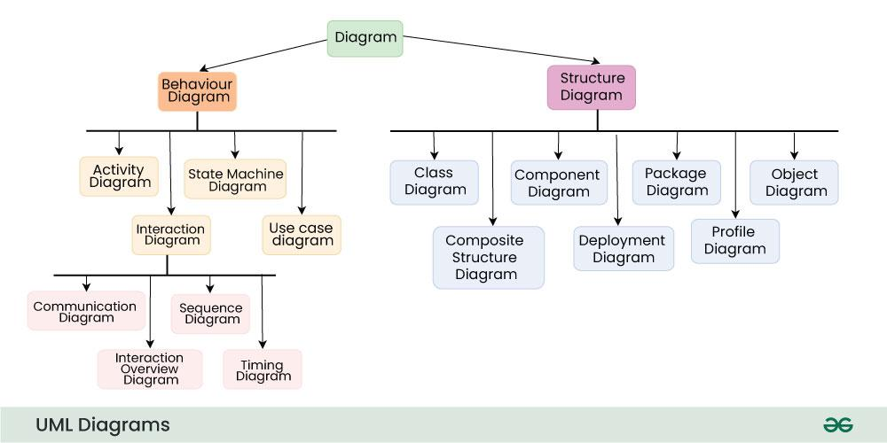

Slide 4
Structural Diagrams in UML
Show static structure of a system
Represent objects, classes, components & relationships
Focus on how the system is organized, not how it behaves
Used to design architecture & system components

Slide 5
Types of UML Structural Diagrams
Class Diagram
Object Diagram
Component Diagram
Deployment Diagram
Package Diagram
Composite Structure Diagram

Slide 6
Class Diagram
Most commonly used UML diagram
Represents classes, attributes, methods & relationships
Relationships include:
Association
Inheritance
Aggregation
composition
Used for object-oriented design

Slide 7
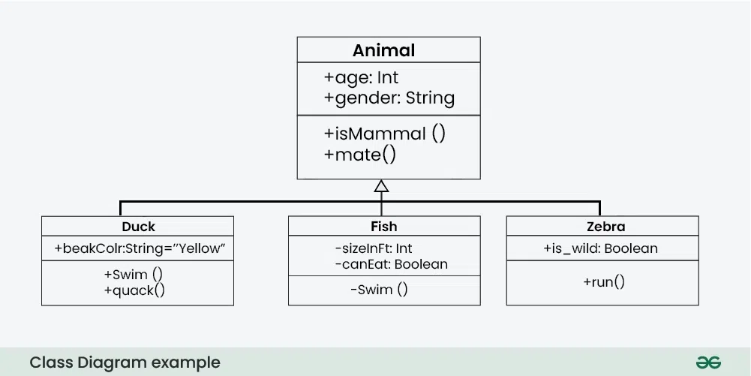

Slide 8
Object Diagram
Shows instances of classes at a particular moment
Represents real objects created from class
Used to understand data structures & object relationships
Show how objects interact in the system

Slide 9
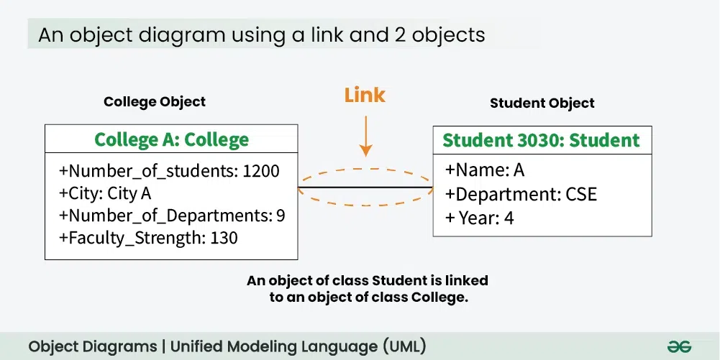

Slide 10
Component Diagram
Represents physical components of system
Shows software modules & their dependencies
Examples:
Libraries
Executables
Database modules
Used for large systems & modular software design

Slide 11
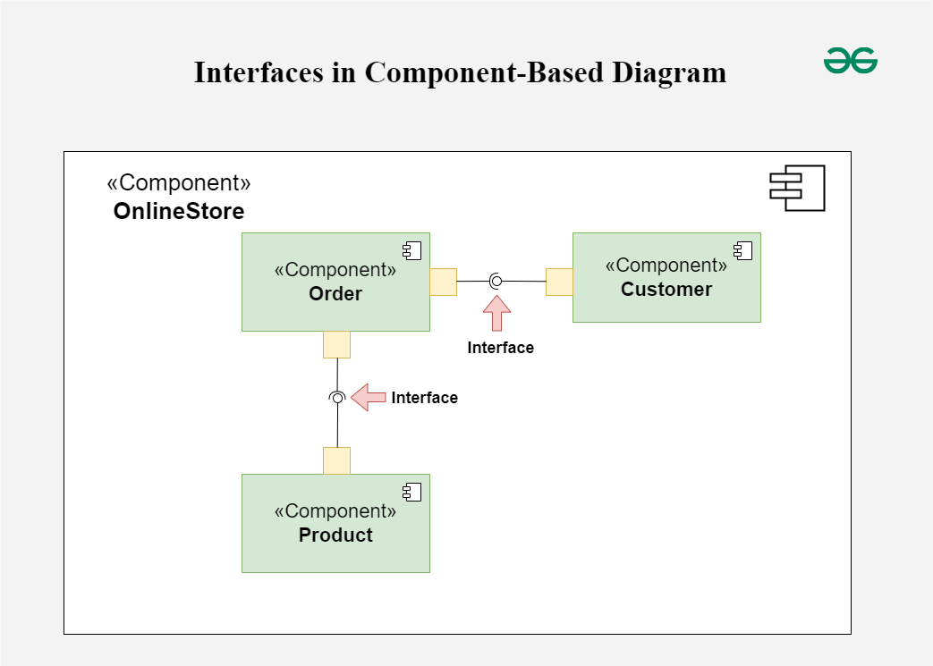

Slide 12
Deployment Diagram
Shows hardware & software deployment
Represents how software components are installed on hardware
Elements include:
Nodes (servers, devices)
Artifacts (software files)
Communication links
Common in network based systems

Slide 13
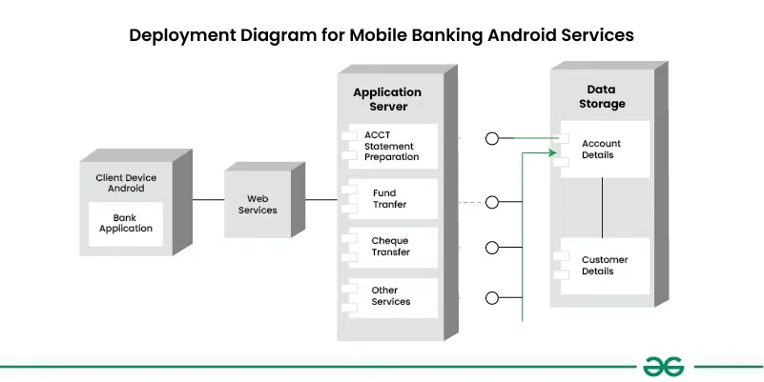

Slide 14
Advantages of Structural Diagrams
Helps visualize system architecture clearly
Improves communication among developers
Makes system documentation easier
Helps identify relationships & dependencies
Useful for planning & maintain software systems

Slide 15
Conclusion
Describes static structure of a system
Important diagram include Class, Object, Component & Deployment diagrams
Help designers organized, scalable software systems
Key part of modern software engineering

Slide 16
THANK YOU

