Slide 1
SMART INVENTORY
& LOW STOCK PREDICTION SYSTEM
Presented By:
Kamana Shrestha
6th semester
Bsc. CSIT

Slide 2
INTRODUCTION
What is Smart Inventory?
A web-based inventory management system built with ASP.NET Core MVC and Entity Framework Core.
Tracks products, records every sale, and keeps stock levels accurate automatically.
Adds a predictive layer on top of standard inventory tracking. It estimates each product's daily sales rate and identifies products likely to run out soon.
Designed as a practical that demonstrates MVC in a real-world inventory system.
Product
Catalog
Sale
Recorded
Stock
Updated
Every sale automatically adjusts stock in real time.
BUILT WITH
ASP.NET Core MVC (.NET 10)
Entity Framework Core + SQL Server
Razor Views, Bootstrap
Smart Inventory & Low Stock Prediction System
2

Slide 3
PROBLEM STATEMENT
Why This Project?
Manual, spreadsheet-based stock tracking is slow, error-prone, and quickly falls out of date.
Businesses often discover a stock-out only after it happens by then it's too late to reorder smoothly.
A fixed “reorder level” treats a slow-moving and a fast-moving product the same way, even though they run out at very different speeds.
There is no simple, built-in way to see which products are about to become a problem before they do.
Manual Tracking
1
Spreadsheets drift out of sync with real stock.
Reactive Restocking
2
Action only starts after stock is already low.
Lost Sales
3
Unexpected stock-outs mean missed revenue.
Smart Inventory & Low Stock Prediction System
3

Slide 4
PROPOSED SOLUTION
What Smart Inventory Does About It
Centralizes product and sales data in one system.
Every recorded sale automatically deducts from stock and editing or deleting that sale automatically reverses the change, so figures never drift.
A dedicated Prediction module calculates each product's average daily sales rate from its sales history.
Predicts days of stock left and alerts before stock runs out.
CORE IDEA
Daily Sales Rate
Total Units Sold ÷ Days Since First Sale
Days of Stock Remaining
Current Stock ÷ Daily Sales Rate
A simple, transparent statistical estimate — not a trained ML model — used consistently across the Dashboard and Prediction modules.
Smart Inventory & Low Stock Prediction System
4

Slide 5
SYSTEM MODULES
Five Modules, One Workflow
01
Dashboard
At-a-glance stock health and a ranked restock list.
02
Product Management
Add, edit, delete, and view product records.
03
Sales Management
Record sales; stock is deducted automatically.
04
Sales Edit & Delete
Corrections safely reverse and reapply stock changes.
05
Low Stock Prediction
Forecasts days of stock left per product.
Smart Inventory & Low Stock Prediction System
5

Slide 6
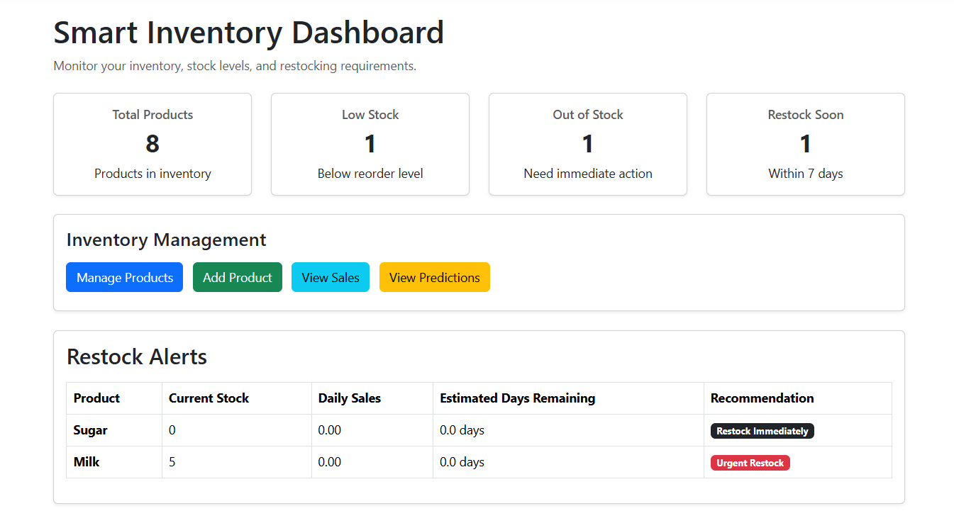
MODULE
Dashboard Module
Gives an at-a-glance view of inventory health: total products, low-stock count, and out-of-stock count.
Creates a priority restock list based on how many days of stock are estimated to be left.
Uses live database data through the Controller whenever a page is loaded, ensuring the information is always up to date.
KEY LOGIC — DashboardController.cs
dailySales = totalSold /
daysSinceFirstSale;
Smart Inventory & Low Stock Prediction System
6

Slide 7
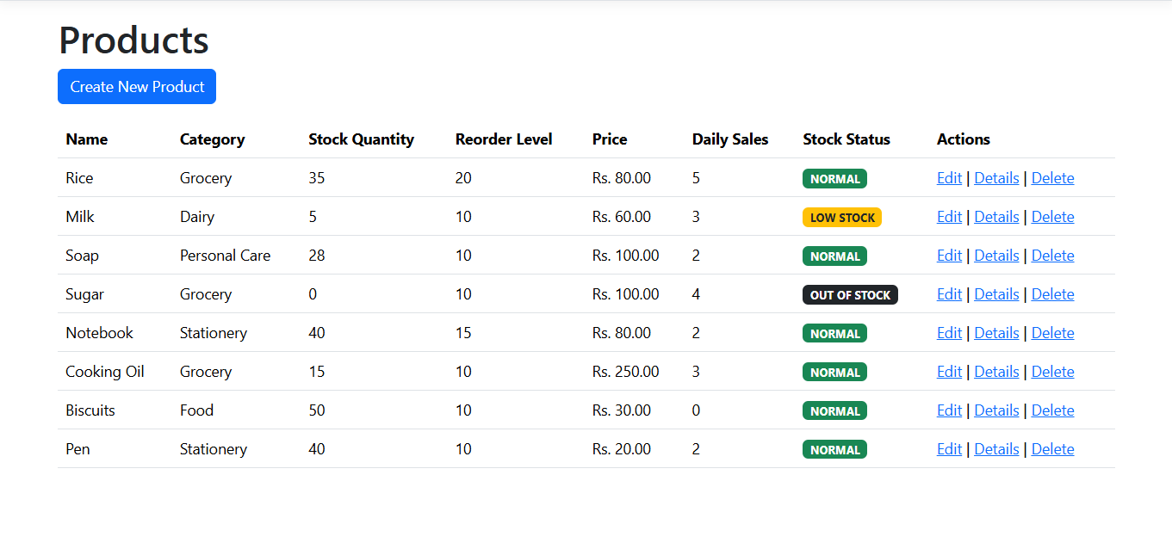
MODULE
Product Management Module
Supports CRUD operations — Create, Read, Update, and Delete products.
Stores important product details such as name, category, stock quantity, reorder level, and price
Uses data validation to make sure only correct and valid product information is saved.
A product with existing sales records cannot be deleted, protecting the integrity of past transactions.
KEY LOGIC — ProductsController.cs
if (ModelState.IsValid) {
_context.Add(product);
await _context.SaveChangesAsync();
}
Smart Inventory & Low Stock Prediction System
7

Slide 8
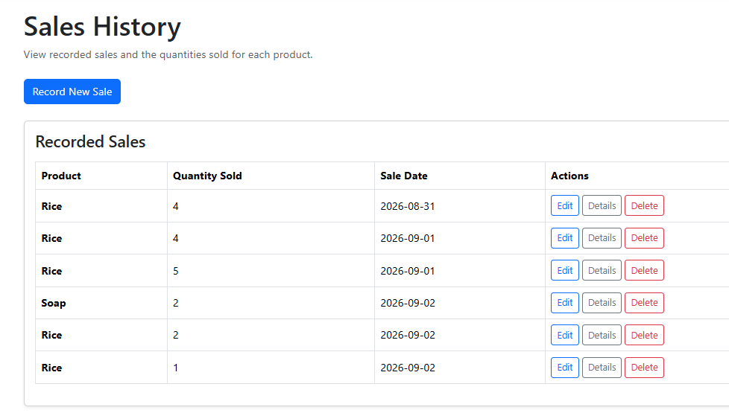
MODULE
Sales Management Module
Records each sale transaction with product, quantity, and date.
The moment a sale is saved, the related product's stock is deducted automatically.
Keeps Sales and Products in sync at all times, which provides accurate data for Dashboard and Prediction figures.
KEY LOGIC — SalesController.cs
product.StockQuantity -=
sale.Quantity;
_context.Sales.Add(sale);
Smart Inventory & Low Stock Prediction System
8

Slide 9
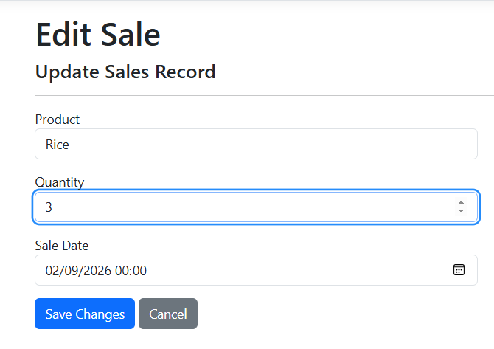
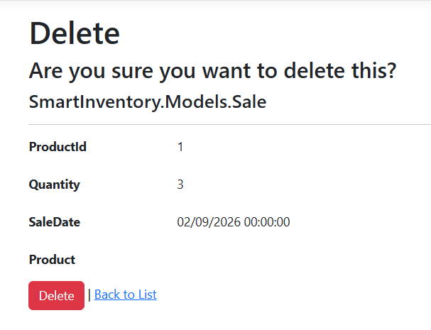
MODULE
Sales Edit & Delete
When a sale is edited, the original quantity is first added back to stock, then the new quantity is deducted.
When a sale is deleted, the deducted quantity is automatically returned to stock.
The stock updates must happen in the correct order to keep the inventory accurate.
KEY LOGIC — SalesController.cs (Edit)
product.StockQuantity +=
existingSale.Quantity;
product.StockQuantity -=
sale.Quantity;
Smart Inventory & Low Stock Prediction System
9

Slide 10
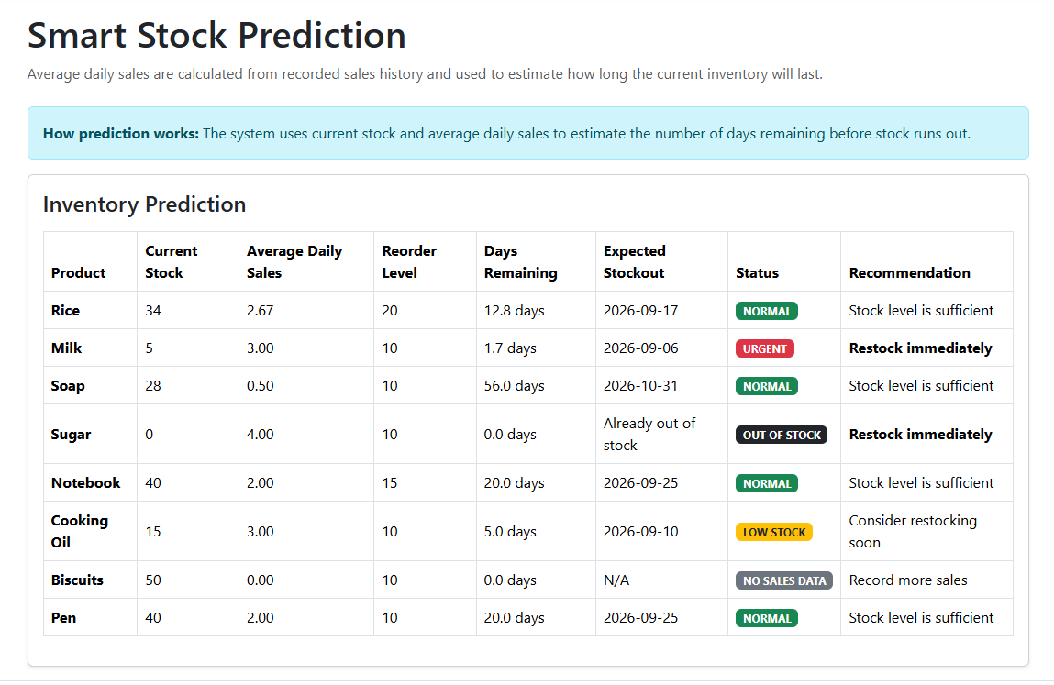
MODULE
Low Stock Prediction Module
Reuses the same daily-sales-rate formula as the Dashboard, but presents it as a full table for every product.
Estimates the number of days of stock remaining based on each product’s actual sales history.
Provides an early reorder warning, helping staff restock before products run out.
KEY LOGIC — PredictionController.cs
daysOfStock =
stockQuantity / dailySales;
Smart Inventory & Low Stock Prediction System
10

Slide 11
ARCHITECTURE
How MVC Works in This Project
CONTROLLER
MODEL
VIEW
ProductsController / SalesController
Handles requests & logic
Product.cs / Sale.cs
EF Core entities + validation
Razor .cshtml pages
What the user sees
reads/writes
chooses
Request flow: Browser → Controller → Model (database) → Controller chooses a View → View is rendered back to the Browser.
EXAMPLE — SAVING A SALES EDIT
User clicks Save on /Sales/Edit → SalesController.Edit(POST) adjusts stock → SaveChangesAsync() → RedirectToAction("Index") → Sales/Index view re-rendered.
Smart Inventory & Low Stock Prediction System
11

Slide 12
ARCHITECTURE
MVC Component Mapping
Layer | Files in This Project | Responsibility
Model | Product.cs, Sale.cs, ApplicationDbContext.cs | Define data shape, validation rules, and talk to SQL Server via EF Core.
View | Views/Products/*.cshtml, Views/Sales/*.cshtml, Views/Dashboard/Index.cshtml | Razor templates that render HTML shown to the user.
Controller | ProductsController, SalesController, DashboardController, PredictionController | Receive HTTP requests, apply business logic, choose which View to return.
Smart Inventory & Low Stock Prediction System
12

Slide 13
FUTURE WORK
Future Implementations
1
Machine Learning Forecasting
2
Automated Alerts
Replace the average-rate formula with a trained model that accounts for seasonality and trends.
Email or SMS notifications when a product crosses its predicted reorder point.
3
Role-Based Access
4
Supplier & Purchase Orders
Separate permissions for staff (record sales) vs. admins (manage products, view reports).
Link low-stock items directly to suppliers and auto-generate purchase orders.
5
Sales Trend Charts
6
Barcode Scanning
Visual weekly/monthly trends per product, not just a single daily-rate number.
Speed up stock entry and sales recording on a warehouse floor.
Smart Inventory & Low Stock Prediction System
13

Slide 14
Conclusion
SmartInventory demonstrates a complete ASP.NET Core MVC application: Models, Views, and Controllers working together with Entity Framework Core.
Product and Sales data stay automatically synchronized, removing the manual reconciliation that causes most inventory errors.
The Prediction module moves restocking decisions from reactive (“stock hit zero”) to proactive (“this product will run out in N days”).
The project shows both correct CRUD implementation and awareness of edge cases — such as reversing stock on edit/delete that many simple inventory apps overlook.
Smart Inventory & Low Stock Prediction System
14

Slide 15
Thank You

