Slide 1
CSE3203: Software Engineering
M.M.A. Hashem, PhD
Professor
Dept. of Computer Science and Engineering
Khulna University of Engineering and Technology (KUET)
Khulna 9203, Bangladesh
Email:mma.hashem@gmail.com
Cell Phone: +880 1714 003949
CSE 3203: Software Engineering

Slide 2

Chapter 1 : Introduction to Software Engineering
Ref. book :
Software Engineering by Roger S. Pressman

Slide 3
Chapter 1 : Topic Covered
Evolving Role of Software
Hardware vs. Software
Software characteristics
Changing nature of software
Evolution of Software
Software Myths
CSE 3203: Software Engineering

Slide 4
Evolving Role of Software
Software is a product
Transforms information - produces, manages, acquires, modifies, displays, or transmits information
Delivers computing potential of hardware and networks
Software is a vehicle for delivering a product
Controls other programs (operating system)
Effects communications (networking software)
Helps build other software (software tools & environments)
CSE 3203: Software Engineering

Slide 5
What is Software ?
Software can define as:
  Instruction – executed provide desire features, function & performance.
  Data structure – to adequately manipulate operation.
  Documents – operation and use of the program.
Software products may be developed for a particular customer or may be developed for a general market.
  Software products may be
    Generic - developed to be sold to a range of different customers e.g. PC software such as Excel or Word.
    Bespoke (custom) - developed for a single customer according to their specification.
CSE 3203: Software Engineering

Slide 6
Hardware vs. Software
Hardware | Software
Manufactured wear out Built using components Relatively simple | Developed/ engineered deteriorate Custom built Complex
CSE 3203: Software Engineering

Slide 7
Manufacturing vs. Development
Once a hardware product has been manufactured, it is difficult or impossible to modify. In contrast, software products are routinely modified and upgraded.
In hardware, hiring more people allows you to accomplish more work, but the same does not necessarily hold true in software engineering.
Unlike hardware, software costs are concentrated in design rather than production.
CSE 3203: Software Engineering

Slide 8
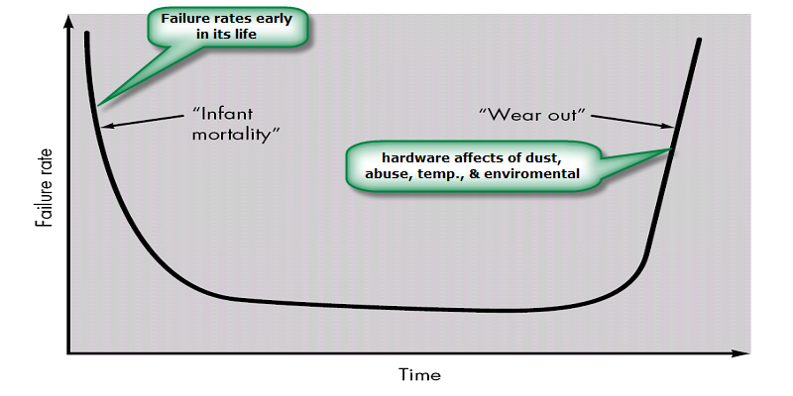
Failure curve for Hardware
CSE 3203: Software Engineering

Slide 9
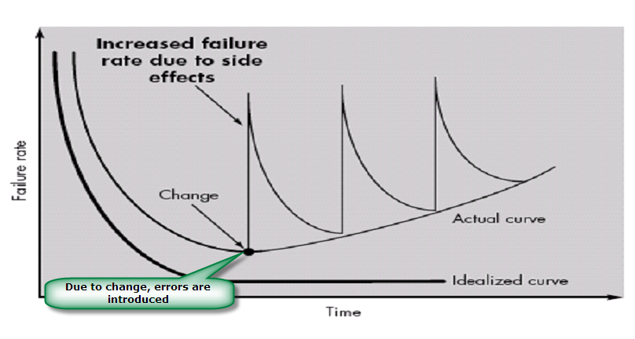
Failure curve for Software
When a hardware component wears out, it is replaced by a spare part.
There are no software spare parts. Every software failure indicates an error in design or in the process through which design was translated into machine executable code. Therefore, software maintenance involves considerably more complexity
CSE 3203: Software Engineering

Slide 10
Component Based vs. Custom Built
Hardware products typically employ many standardized design components.
Most software continues to be custom built.
The software industry does seem to be moving (slowly) toward component-based construction.
CSE 3203: Software Engineering

Slide 11
Software characteristics
Software is developed or engineered; it is not manufactured.
Software does not “wear out” but it does deteriorate.
Software continues to be custom built, as industry is moving toward component based construction.
CSE 3203: Software Engineering

Slide 12
Changing nature of software
System software
Application software
Engineering/scientific software
Embedded software
Product line software
Web applications
Artificial intelligence software
CSE 3203: Software Engineering

Slide 13
System Software:
System software is a collection of programs written to service other programs.
It is characterized by heavy interaction with computer hardware; heavy usage by multiple users; concurrent operation that requires scheduling, resource sharing, and sophisticated process management; complex data structures; and multiple external interfaces.
Ex. Compilers, operating system, drivers etc.
Application Software :
Application software consists of standalone programs that solve a specific business need.
Application software is used to control the business function in real-time.
Engineering /Scientific software:
Characterized by "number crunching" algorithms.
Applications range from astronomy to volcano logy, from automotive stress analysis to space shuttle orbital dynamics, and from molecular biology to automated manufacturing.
Ex. Computer Aided Design (CAD), system stimulation etc.
CSE 3203: Software Engineering

Slide 14
Embedded Software:
It resides in read-only memory and is used to control products and systems
Embedded software can perform limited and esoteric functions.
Ex. keypad control for a microwave oven.
Product line software:
Designed to provide a specific capability for use by many different customers, product line software can focus on a limited and esoteric marketplace.
Ex. Word processing, spreadsheet, CG, multimedia, etc.
Web Applications:
Web apps can be little more than a set of linked hypertext files.
It evolving into sophisticated computing environments that not only provide standalone features, functions but also integrated with corporate database and business applications.
Artificial Intelligence software
AI software makes use of non-numerical algorithms to solve complex problems that are not amenable to computation or straightforward analysis
Ex. Robotics, expert system, game playing, etc.
CSE 3203: Software Engineering

Slide 15
Software Evolution
The Law of Continuing Change (1974): E-type (Real world implemented) systems must be continually adapted else they become progressively less satisfactory.
The Law of Increasing Complexity (1974): As an E-type system evolves its complexity increases unless work is done to maintain or reduce it.
The Law of Self Regulation (1974): The E-type system evolution process is self-regulating with distribution of product and process measures close to normal.
The Law of Conservation of Organizational Stability (1980): The average effective global activity rate in an evolving E-type system is invariant over product lifetime.
CSE 3203: Software Engineering

Slide 16
Software Evolution
The Law of Conservation of Familiarity (1980): As an E-type system evolves all associated with it, developers, sales personnel, users, for example, must maintain mastery of its content and behavior to achieve satisfactory evolution.
The Law of Continuing Growth (1980): The functional content of E-type systems must be continually increased to maintain user satisfaction over their lifetime.
The Law of Declining Quality (1996): The quality of E-type systems will appear to be declining unless they are rigorously maintained and adapted to operational environment changes.
The Feedback System Law (1996): E-type evolution processes constitute multi-level, multi-loop, multi-agent feedback systems and must be treated as such to achieve significant improvement over any reasonable base.
CSE 3203: Software Engineering

Slide 17
Software Myths
Definition: Beliefs about software and the process used to build it. Myths have number of attributes that have made them insidious (i.e. dangerous).
Misleading Attitudes - caused serious problem for managers and technical people.
Management myths
Managers in most disciplines, are often under pressure to maintain budgets, keep schedules on time, and improve quality.
Myth1: We already have a book that's full of standards and procedures for building
software, won't that provide my people with everything they need to know?
Reality :
Are software practitioners aware of existence standards?
Does it reflect modern software engineering practice?
Is it complete? Is it streamlined to improve time to delivery while still maintaining a focus on quality?
CSE 3203: Software Engineering

Slide 18
Myth2: If we get behind schedule, we can add more programmers and catch up
Reality: Software development is not a mechanistic process like manufacturing. Adding people to a late software project makes it later.
People can be added but only in a planned and well-coordinated manner
Myth3: If I decide to outsource the software project to a third party, I can just relax and let that firm build it.
Reality: If an organization does not understand how to manage and control software projects internally, it will invariably struggle when it outsource software projects
CSE 3203: Software Engineering

Slide 19
Customer Myths
Customer may be a person from inside or outside the company that has requested software under contract.
Myth: A general statement of objectives is sufficient to begin writing programs— we can fill in the details later.
Reality: A poor up-front definition is the major cause of failed software efforts. A formal and detailed description of the information domain, function, behavior, performance, interfaces, design constraints, and validation criteria is essential. These characteristics can be determined only after thorough communication between customer and developer.
Myth: Project requirements continually change, but change can be easily accommodated because software is flexible.
Reality: Customer can review requirements and recommend modifications with relatively little impact on cost. When changes are requested during software design, the cost impact grows rapidly. Below mentioned figure for reference.
CSE 3203: Software Engineering

Slide 20
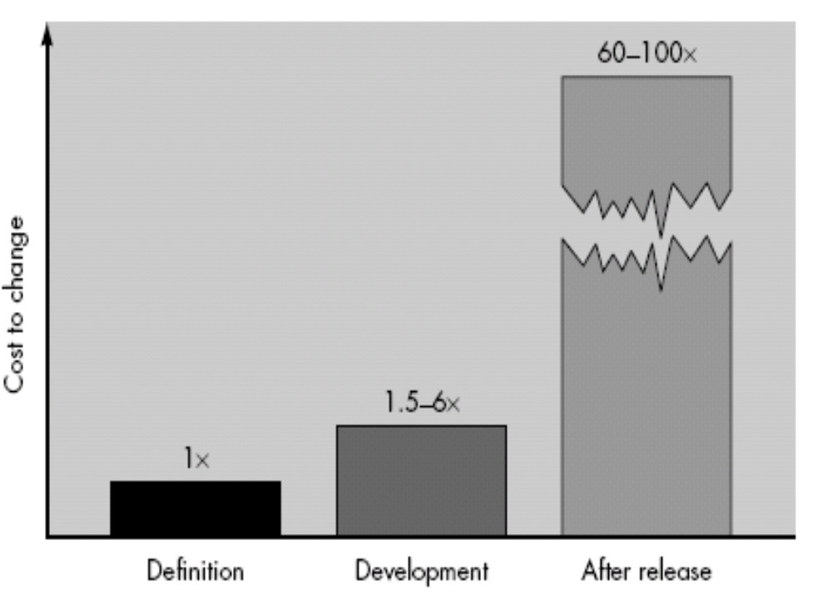
CSE 3203: Software Engineering

Slide 21
Practitioner's myths
Myth1: Once we write the program and get it to work, our job is done.
Reality: Someone once said that "the sooner you begin 'writing code', the longer it'll take you to get done." Industry data indicate that between 60 and 80 percent of all effort expended on software will be expended after it is delivered to the customer for the first time.
Myth2: Until I get the program "running" I have no way of assessing its quality.
Reality: One of the most effective software quality assurance mechanisms can be applied from the inception of a project—the formal technical review.
Myth3: The only deliverable work product for a successful project is the working program.
CSE 3203: Software Engineering

Slide 22
Reality: A working program is only one part of a software configuration that includes many elements. Documentation provides a foundation for successful engineering and, more important, guidance for software support.
Myth4 : Software engineering will make us create voluminous and unnecessary documentation and will invariably slow us down.
Reality: Software engineering is not about creating documents. It is about creating
quality. Better quality leads to reduced rework. And reduced rework results in faster delivery times.
CSE 3203: Software Engineering

