Slide 1
College Knowledge
-A networking portal
19251A1202 Aishwarya Dhande
19251A1203 Manaswini Akula
19251A1205 B.Saraswathi
19251A1221 Kamaneeya Kadari
Internal Guide: V.Usha

Slide 2
PROBLEM STATEMENT
The project aims to develop a website to make students aware of the opportunities available around them, know about the opportunities is as important as knowing about them at the right time. Any person in the organization can write a blog to share details about their interview experience, notify their fellow students about off campus placement opportunities, answer each others doubts and many more. This web application has two types of login- admin login and user login, the admin can manage the users, the admin has authority over the users, which can be handled by a senior student of the institution. Users can write blogs, and view the blogs written by other users.
The project aims to develop a website to make people aware of the opportunities available around them, know about the opportunities is as important as knowing about them at the right time. Any person in the organization can write a blog to share details about their interview experience, notify their fellow students about off campus placement opportunities, answer each others doubts and many more. This web application has two types of login- admin login and user login, the admin can manage the users, the admin has authority over the users, which can be handled by a senior student of the institution. Users can write blogs, and view the blogs written by other users.

Slide 3
Functional requirements
General Functional Requirements:
Users can register and login to the website.
Users can search for interview experiences based on companies.
Users can view the blogs uploaded by the students.
Functional Requirements for Admin
Admin can update the website.
Admin can delete the irrelevant blogs.

Slide 4
FUNCTIONAL REQUIREMENTS
Functional Requirements for Students:
Students can upload their blogs and interview experiences.
Students can view the blogs and interview experiences
Students can view the comments(suggestions) given by the faculty and other students.
Functional Requirements for Faculty:
Faculty can upload study materials.
Faculty would give comments(suggestions) and reviews on the blogs uploaded.

Slide 5
NON FUNCTIONAL REQUIREMENTS
The application is easy to operate by the users.
The application is consistent and have descriptive UI.
The application has Privacy
The application User Friendliness

Slide 6
REQUIREMENTS
SOFTWARE:
Frontend: HTML,CSS,react,Javascript
Backend:Node
Database:MySQL
HARDWARE:
System :i5 processor
Ram: minimum 4GB

Slide 7
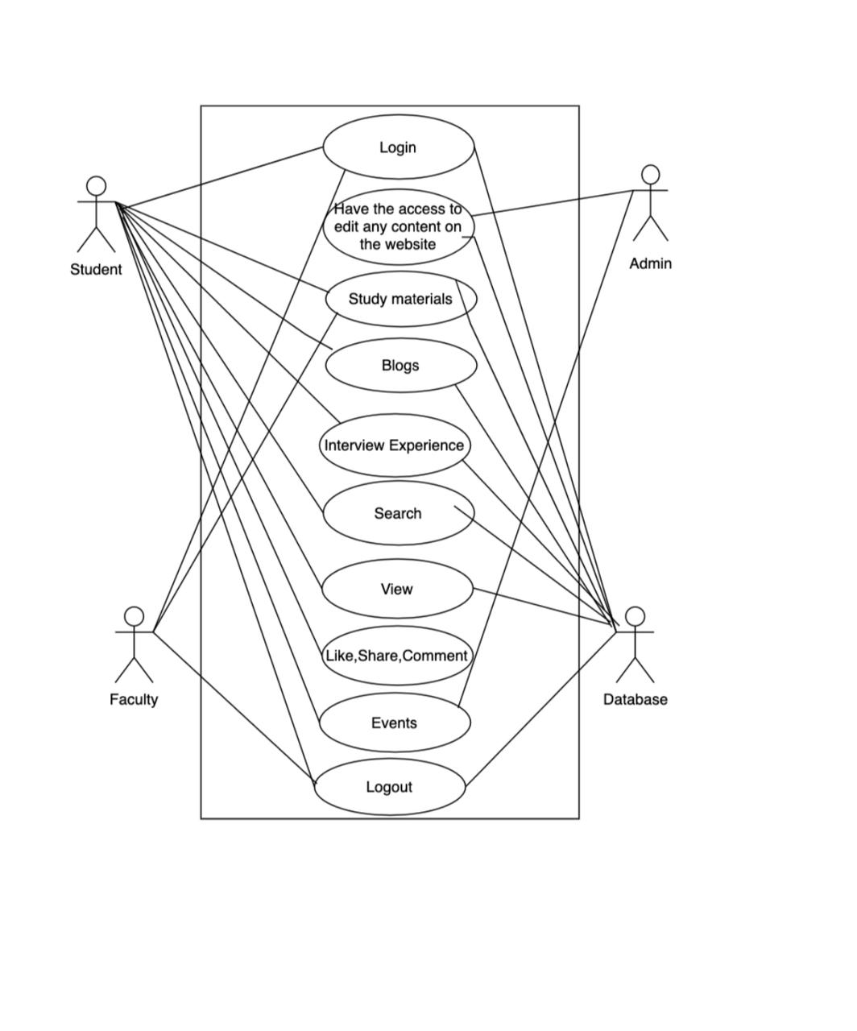
Use case diagram:

Slide 8
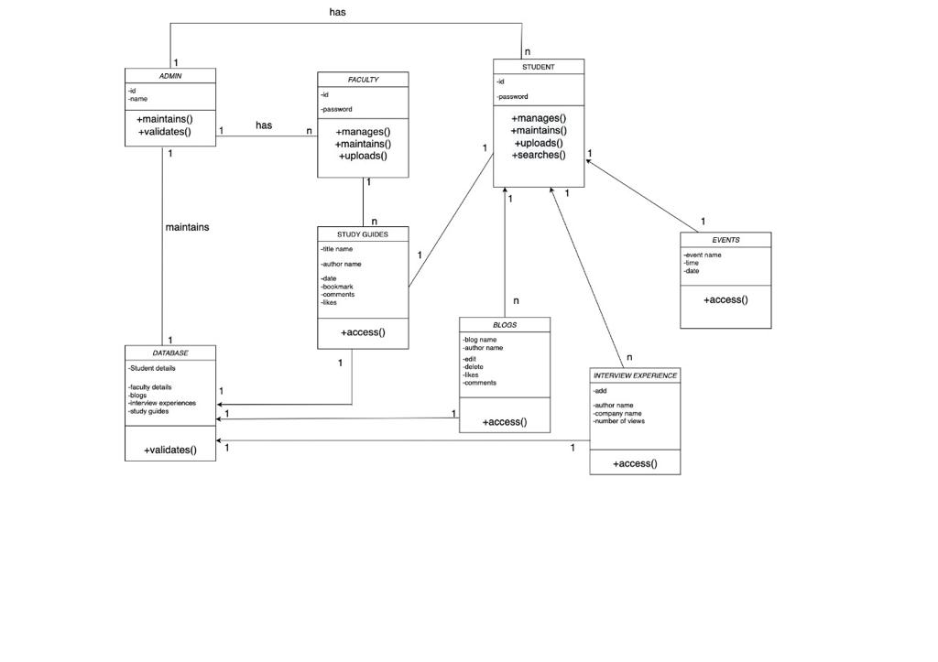
Class Diagram

Slide 9
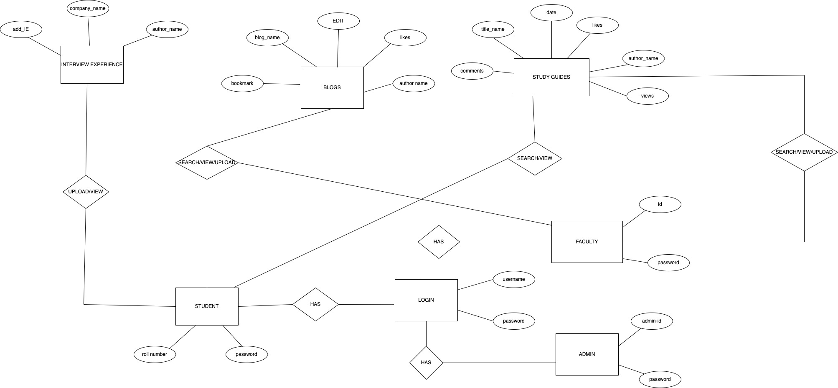
ER Diagram:

Slide 10
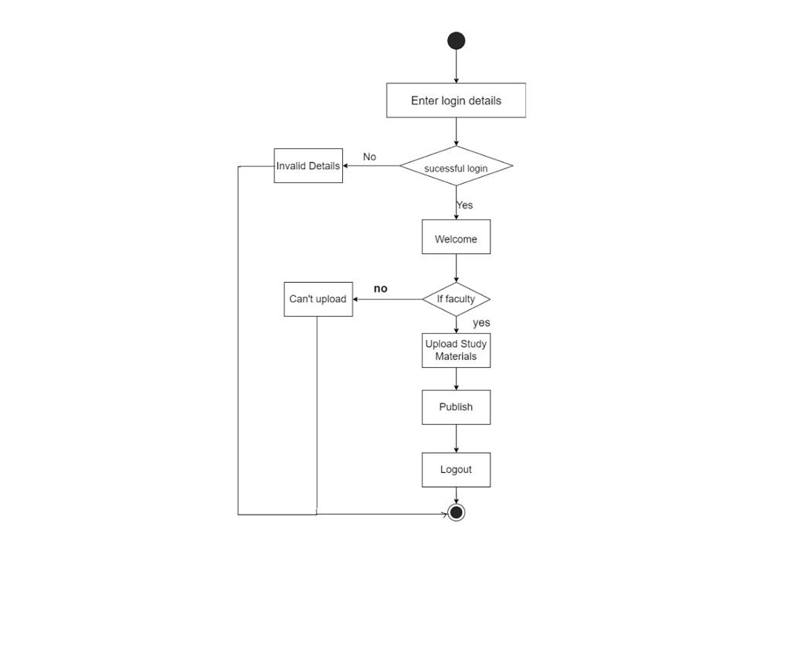
Activity Diagram:

Slide 11
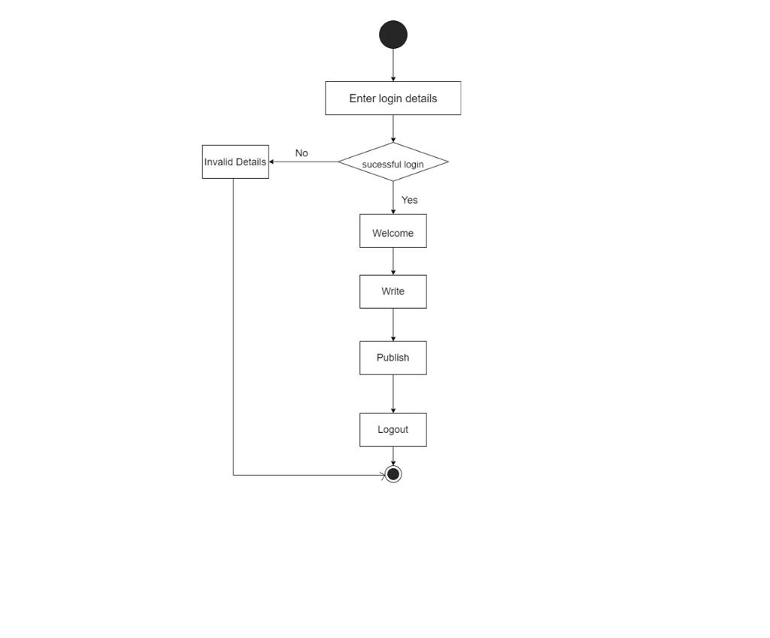
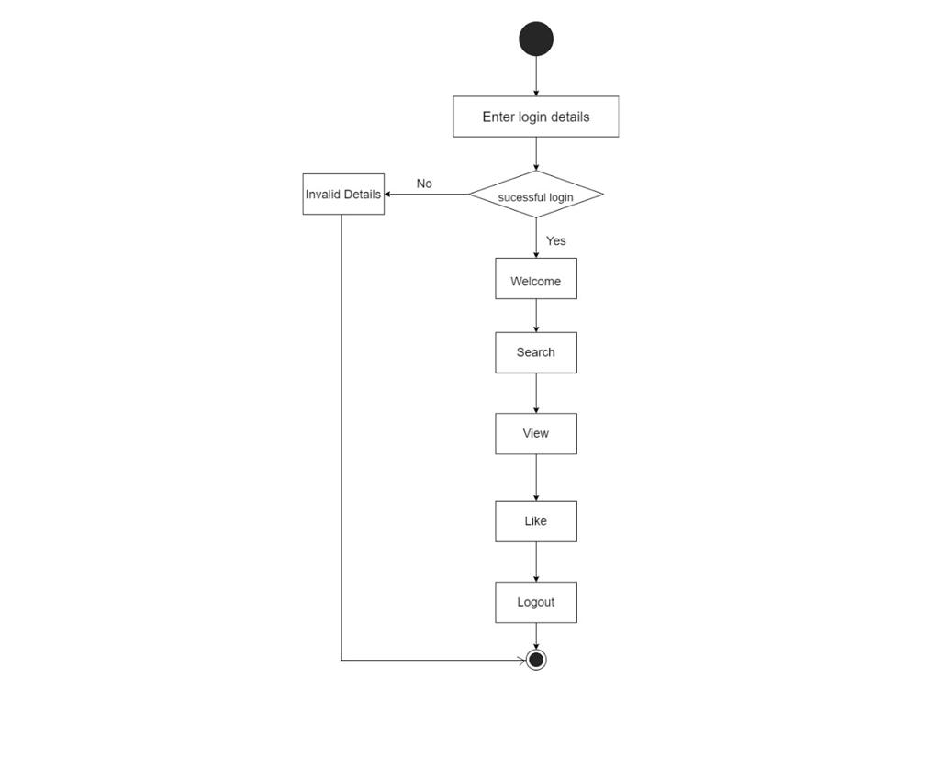

Slide 12
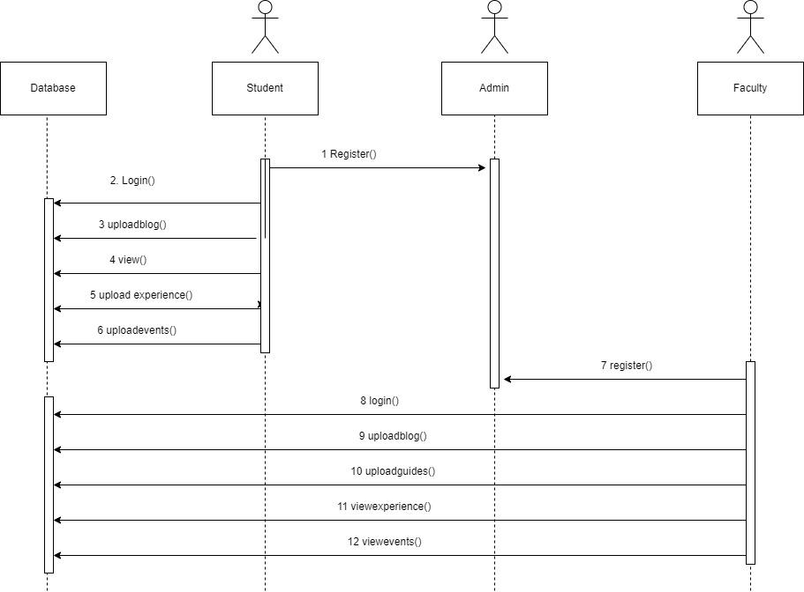
Sequence Diagram:

Slide 13
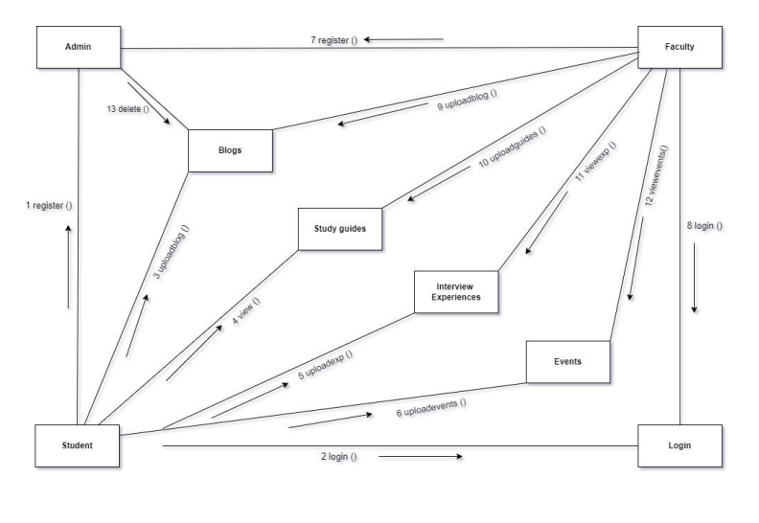
COLLABORATION DIAGRAM

Slide 14
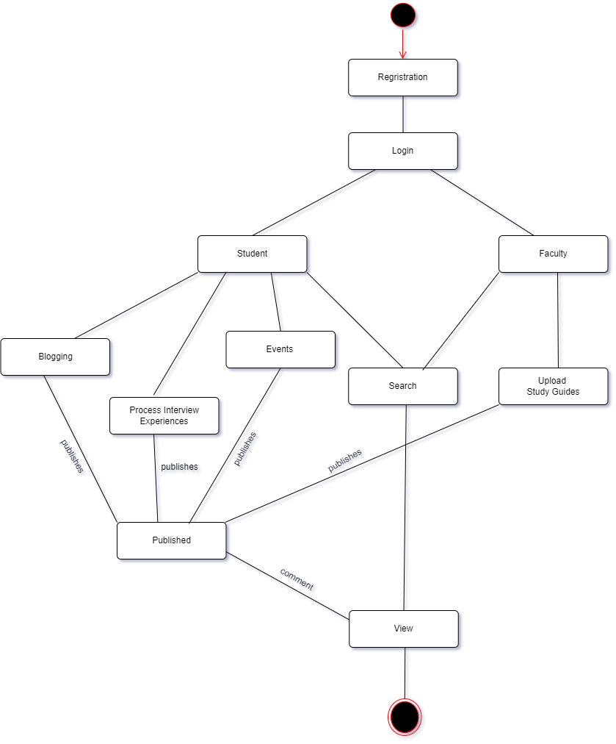
STATE CHART DIAGRAM

Slide 15
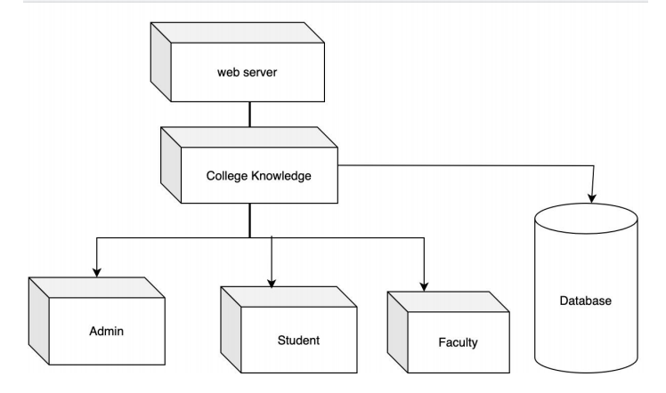
DEPLOYMENT DIAGRAM

Slide 16
THANK YOU

