Slide 1
Green Irrigation Management System (GIMS)
Student: Milliam Kamanzimilliam
Database Systems & PL/SQL
Institution / Course
Year: 2025

Slide 2
PROJECT OVERVIEW
Smart irrigation monitoring system
Tracks water and energy usage
Prevents unauthorized system changes
Supports business intelligence analysis

Slide 3
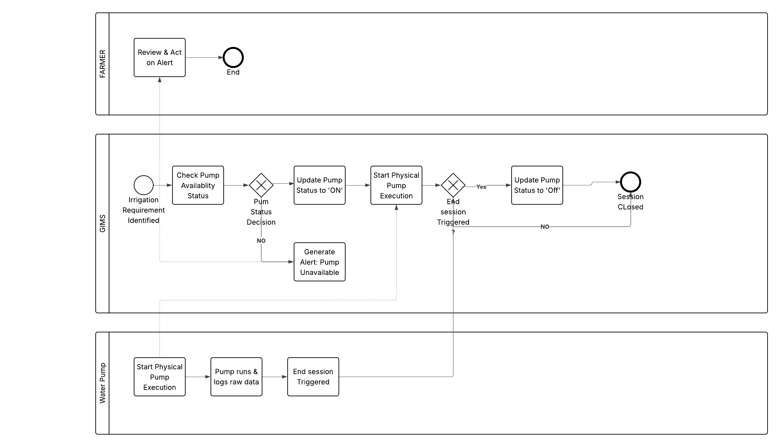
PHASE I: SYSTEM ANALYSIS
Identified irrigation problems
Defined system users & operations
Designed business rules
Defined KPIs

Slide 4
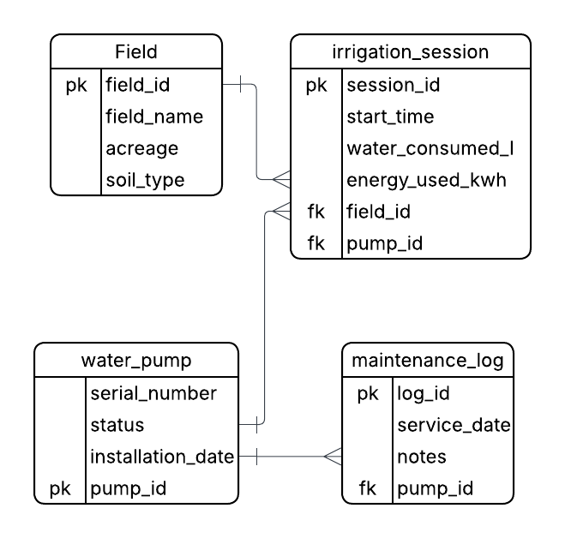
PHASE II: DATA MODELING
Created ER Diagram
Defined entities & relationships
Primary & foreign keys designed
Normalized tables

Slide 5
PHASE III: DATABASE STRUCTURE
Tables created with constraints
Indexes implemented
Referential integrity enforced
Oracle data types used

Slide 6
PHASE IV: DATABASE CONFIGURATION
Pluggable Database (PDB)
Admin user created
Tablespaces configured
Auto extend enabled

Slide 7
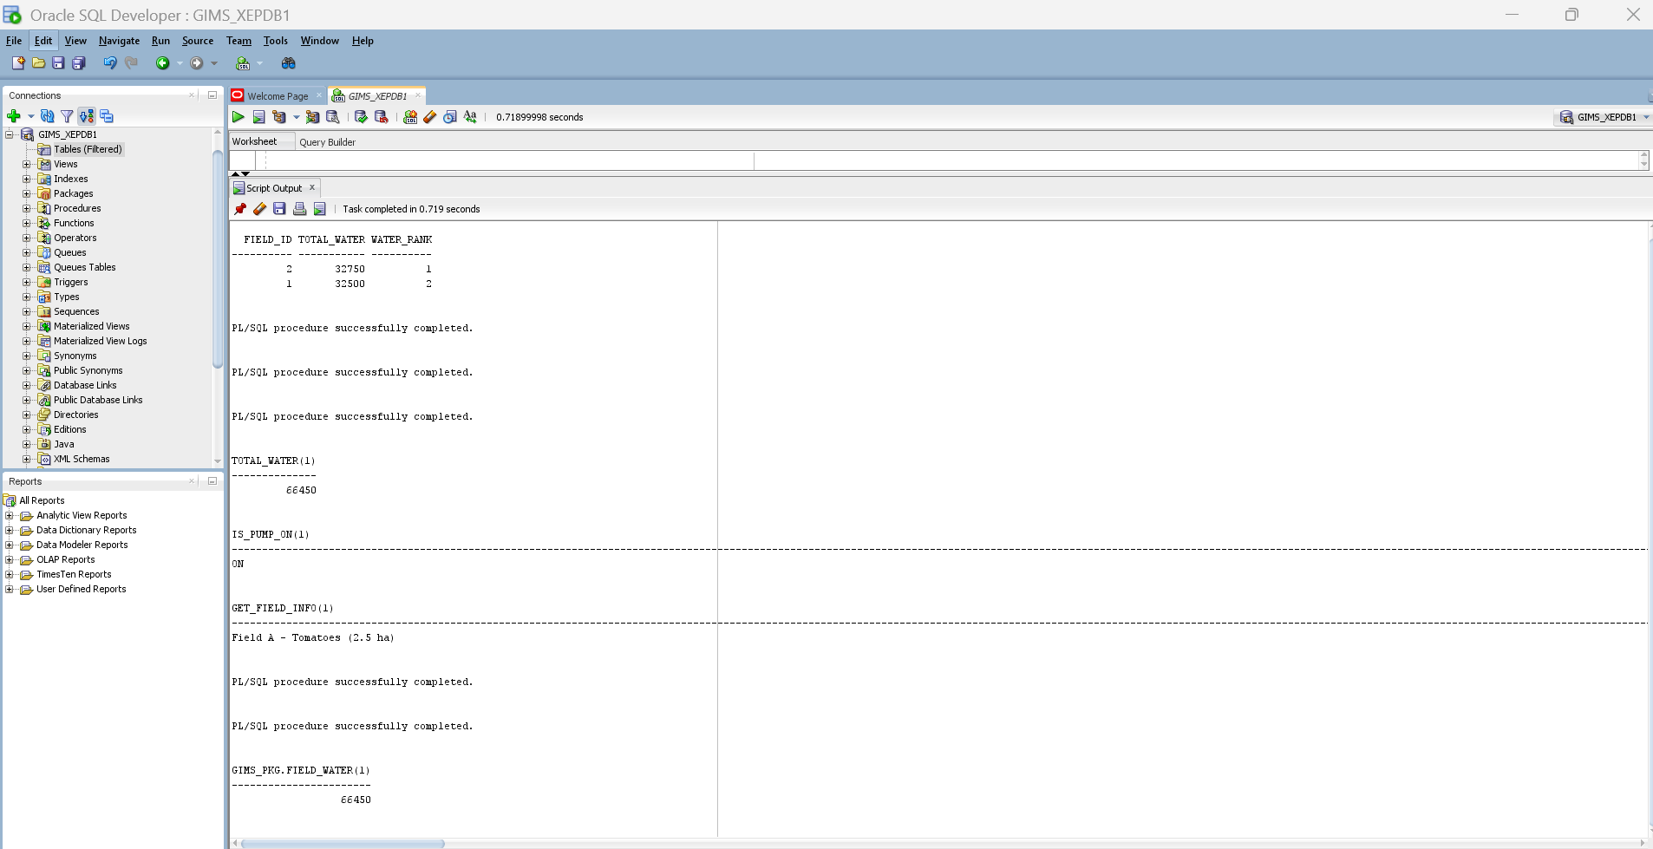
PHASE V: DATA INSERTION & TESTING
50+ realistic session records
Edge cases handled
Data integrity verified
Validation queries executed

Slide 8
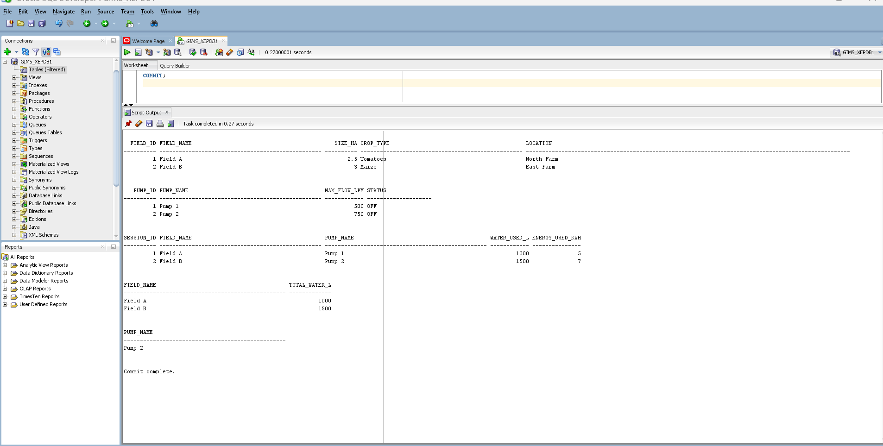
PHASE VI: PL/SQL PROGRAMMING
Procedures for insert & delete
Functions for validation
Packages implemented
Exception handling applied

Slide 9
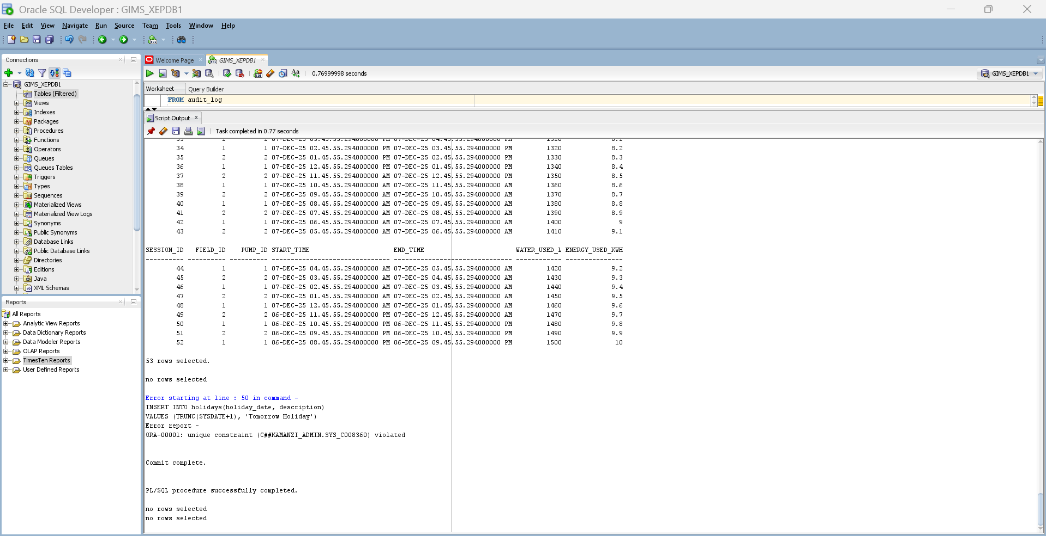
PHASE VII: TRIGGERS & AUDIT
Weekday & holiday restriction
Audit logging implemented
All actions tracked
Security enforced

Slide 10
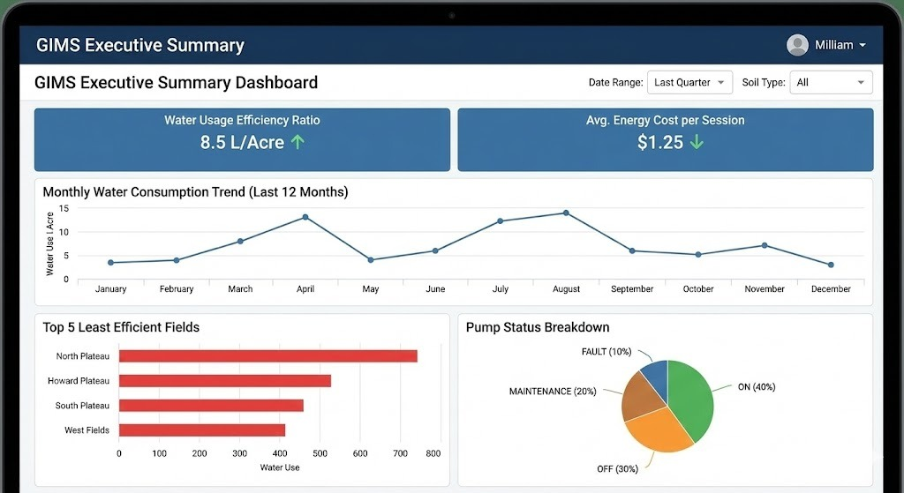
CONCLUSION
Built full Oracle smart system
Implemented security rules
Applied BI concepts
Gained real-world PL/SQL skills

