Slide 1
Artificial Intelligence
Problem solving by searching
CMT 208

Slide 2
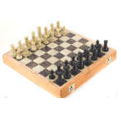
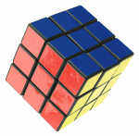
Problem Solving by Searching
Why search ?
Early works of AI was mainly towards
  proving theorems
  solving puzzles
  playing games
All AI is search!
  Not totally true (obviously) but more true than you might think.
  All life is problem solving !!
  Finding a good/best solution to a problem amongst many possible solutions.

Slide 3
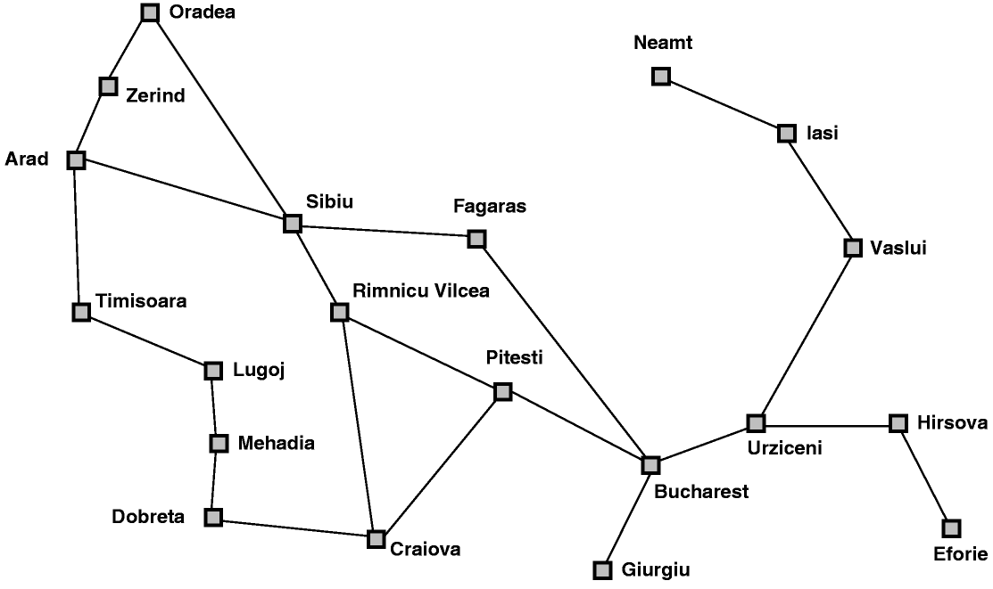
Classic AI Search Problems
Classic AI search problems
Map searching (navigation)

Slide 4
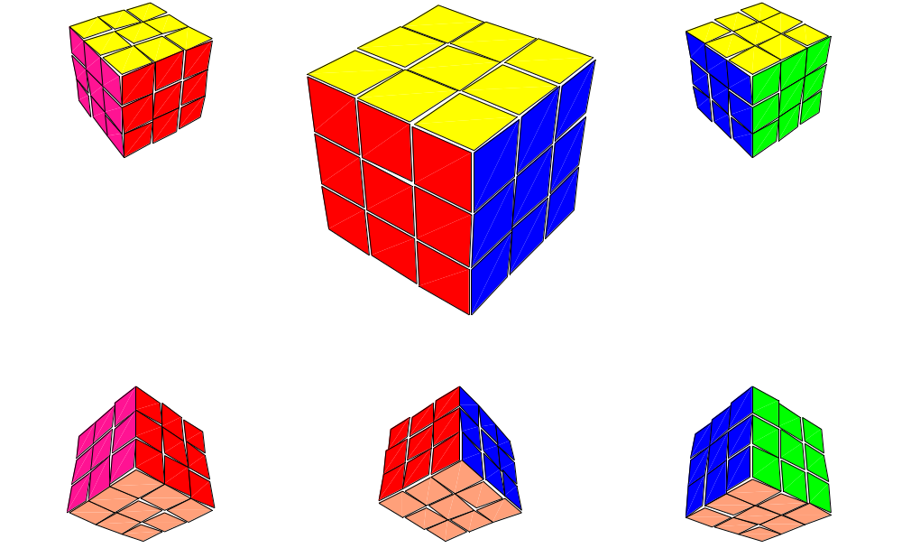
Classic AI Search Problems
3*3*3 Rubik’s Cube

Slide 5
Missionaries and cannibals
Three missionaries and three cannibals are on the left bank of a river.
There is one canoe which can hold one or two people.
Find a way to get everyone to the right bank, without ever leaving a group of missionaries in one place outnumbered by cannibals in that place.

Slide 6

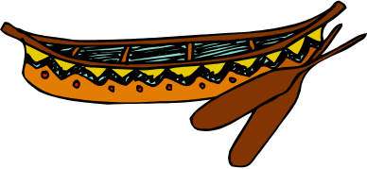
Missionaries and Cannibals
Initial State

Slide 7
Missionaries and Cannibals
Goal State

Slide 8
The River Problem
A farmer wishes to carry a wolf, a duck and corn across a river, from the south to the north shore. The farmer is the proud owner of a small rowing boat called Bounty which he feels is easily up to the job. Unfortunately the boat is only large enough to carry at most the farmer and one other item. Worse again, if left unattended the wolf will eat the duck and the duck will eat the corn.
How can the farmer safely transport the wolf, the duck and the corn to the opposite shore?
Farmer, Wolf,
Duck and Corn
River
River
boat
boat
Farmer, Wolf,
Duck and Corn

Slide 9
Problem Solving by Searching
A toy problem:
Missionaries and Cannibals

Slide 10
Missionaries and cannibals
Three missionaries and three cannibals are on the left bank of a river.
There is one canoe which can hold one or two people.
Find a way to get everyone to the right bank, without ever leaving a group of missionaries in one place outnumbered by cannibals in that place.

Slide 11
Missionaries and cannibals
States: three numbers (i,j,k) representing the number of missionaries, cannibals, and canoes on the left bank of the river.
Initial state: (3, 3, 1)
Operators: take one missionary, one cannibal, two missionaries, two cannibals, one missionary and one cannibal across the river in a given direction (I.e. ten operators).
Goal Test: reached state (0, 0, 0)
Path Cost: Number of crossings.

Slide 12
Missionaries and Cannibals
(3,3,1): Initial State

Slide 13
Missionaries and Cannibals
A missionary and cannibal cross

Slide 14
Missionaries and Cannibals
(2,2,0)

Slide 15
Missionaries and Cannibals
One missionary returns

Slide 16
Missionaries and Cannibals
(3,2,1)

Slide 17
Missionaries and Cannibals
Two cannibals cross

Slide 18
Missionaries and Cannibals
(3,0,0)

Slide 19
Missionaries and Cannibals
A cannibal returns

Slide 20
Missionaries and Cannibals
(3,1,1)

Slide 21
Missionaries and Cannibals
Two missionaries cross

Slide 22
Missionaries and Cannibals
(1,1,0)

Slide 23
Missionaries and Cannibals
A missionary and cannibal return

Slide 24
Missionaries and Cannibals
(2,2,1)

Slide 25
Missionaries and Cannibals
Two Missionaries cross

Slide 26
Missionaries and Cannibals
(0,2,0)

Slide 27
Missionaries and Cannibals
A cannibal returns

Slide 28
Missionaries and Cannibals
(0,3,1)

Slide 29
Missionaries and Cannibals
Two cannibals cross

Slide 30
Missionaries and Cannibals
(0,1,0)

Slide 31
Missionaries and Cannibals
A cannibal returns

Slide 32
Missionaries and Cannibals
(0,2,1)

Slide 33
Missionaries and Cannibals
The last two cannibals cross

Slide 34
Missionaries and Cannibals
(0,0,0) : Goal State

Slide 35
Missionaries and Cannibals
Solution = the sequence of actions within the path : [ (3,3,1)→ (2,2,0)→(3,2,1) →(3,0,0) →(3,1,1) →(1,1,0) →(2,2,1) →(0,2,0) →(0,3,1) →(0,1,0) → (0,2,1) →(0,0,0)]; Cost = 11 crossings

Slide 36
Problem Solving by Searching
The River Problem:
Farmer, Wolf, Duck and Corn

Slide 37
The River Problem
Let’s consider the River Problem:
A farmer wishes to carry a wolf, a duck and corn across a river, from the south to the north shore. The farmer is the proud owner of a small rowing boat called Bounty which he feels is easily up to the job. Unfortunately the boat is only large enough to carry at most the farmer and one other item. Worse again, if left unattended the wolf will eat the duck and the duck will eat the corn.
How can the farmer safely transport the wolf, the duck and the corn to the opposite shore?
River
boat
Farmer, Wolf,
Duck and Corn

Slide 38
The River Problem
The River Problem:
F=Farmer W=Wolf D=Duck C=Corn /=River
How can the farmer safely transport the wolf, the duck and the corn to the opposite shore?
-/FWCD
FWCD/-

Slide 39
The River Problem
Problem formulation:
  State representation: location of farmer and items in both sides of river
  [items in South shore / items in North shore] : (FWDC/-, FD/WC, C/FWD …)
  Initial State: farmer, wolf, duck and corn in the south shore FWDC/-
  Goal State: farmer, duck and corn in the north shore
  -/FWDC
  Operators: the farmer takes in the boat at most one item from one side to the other side
  (F-Takes-W, F-Takes-D, F-Takes-C, F-Takes-Self [himself only])
  Path cost: the number of crossings

Slide 40
The River Problem
Problem solution: (path Cost = 7)
While there are other possibilities here is one 7 step solution to the river problem
F
D
D
F
W
D
F-Takes-D
F-Takes-S
F-Takes-W
F
W
D
C
W
C
F
W
C
C
Initial State
WC/FD
FWC/D
C/FWD
F-Takes-D
F
W
D
C
W
C
F
W
C
W
F-Takes-D
F-Takes-S
F-Takes-C
F
D
D
F
D
C
Goal State
FD/WC
D/FWC
FDC/W

Slide 41
Summary
Search: process of constructing sequences of actions that achieve a goal given a problem.
It is assumed that the environment is observable, deterministic, static and completely known.
Goal formulation is the first step in solving problems by searching. It facilitates problem formulation.
Formulating a problem requires specifying five components: State representation, Initial state, Goal state, Operators (actions), and Path cost function.

