Slide 1

Beyond The @Mention
When sentiments tell a product story
Kamau Waithaka
Moringa School Consulting

Slide 2
Presentation Outline
01
Executive Summary
04
Modelling
02
Business and Data Understanding
05
Insights
03
EDA
06
Recommendations

Slide 3






Project Overview
Business Case
Transform massive volumes of unstructured, noisy social media text into structured, actionable business intelligence.
Key Objectives.
Baseline Development.
Benchmark Performance.
Interative Optimization
Propose Retention strategy
Business Case.
Social media provides real-time customer feedback, making sentiment analysis valuable for product development, customer support, and brand monitoring.
Turning every emotion into business insights .

Slide 4
Load, Explore, Clean
Load.
Necessary libraries were loaded .
The dataset “Tweet_NLP” was used for the analysis
Python Language on Jupyter Notebook platform.
Explore
The data had 9,093 rows and 3 columns.
Data had float, float and integers .
Duplicates(22) and missing data (5,082)
Clean.
Dropping redundant columns
Converting into customer usage patterns and rations
Adding missing columns.
Creating column to check customer behaviour
Analyze what you know!

Slide 5

Data Exploration

Slide 6
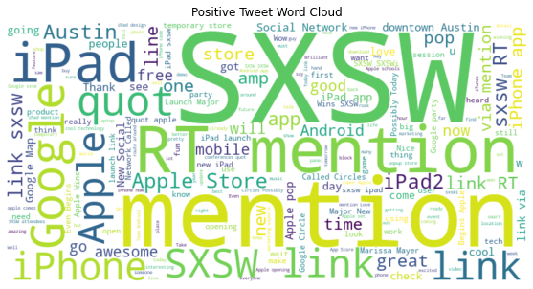
Word Cloud
•
High Engagement Around Events and Locations (SXSW & Austin).
Apple Ecosystem Dominates the Conversation.
Clear Intentions of Sharing, Community, and Emotion.

Slide 7
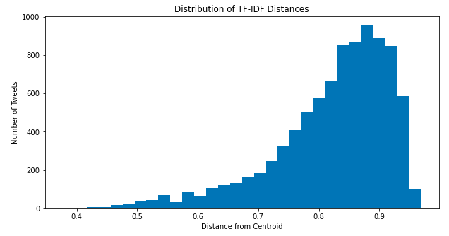
Checking Outliers
The dataset exhibits relatively consistent vocabulary and thematic content, with no tweets being exceptionally distant from the overall corpus.

Slide 8
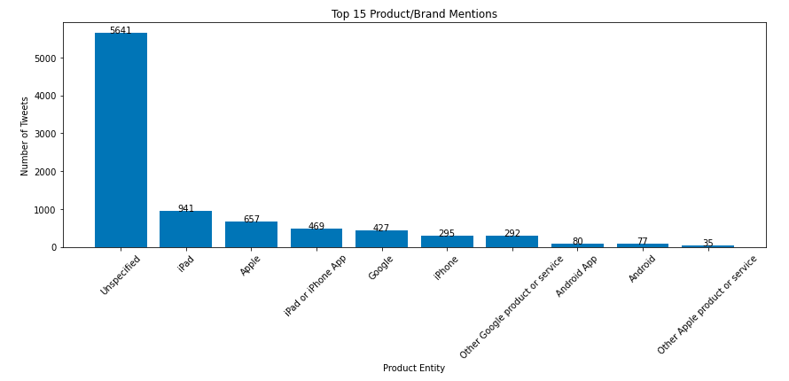
Top 15 Product/Brand Mention
The most frequent words across all sentiment classes were product and brand names rather than emotional terms. Apple dominated Google

Slide 9
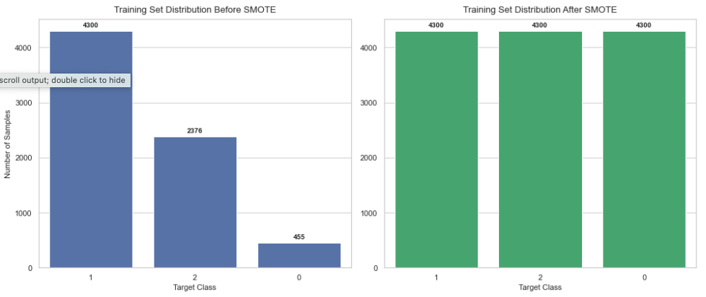
Checking Data Imbalance
SMOTE balanced dataset of 12,900 samples and increased the training set size by approximately 81%.
Thereby improving balanced decision and enhancing minority-class prediction performance.

Slide 10

Data Modeling

Slide 11
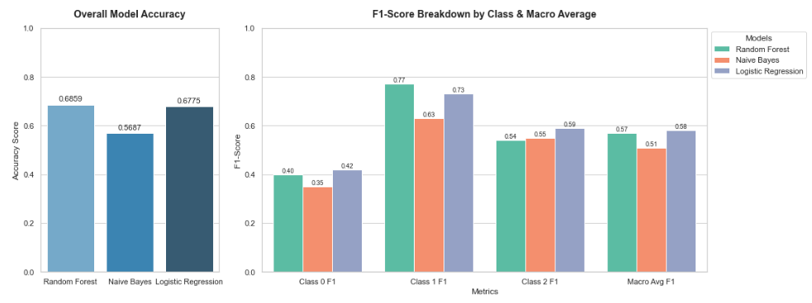
Model Comparison
The "Imbalanced Test Set" Trap: Even though SMOTE balanced instances, there still exists highly imbalance.
Logistic Regression was chosen for tuning because, it handles Class 0 significantly better and Higher Macro Average and lots of room for Optimization.

Slide 12
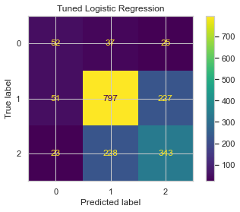
Tuned Logistic Regression.
The Trade-Off (Accuracy vs. Balance): Raw accuracy dropped 67.75% to 66.85%.
Macro Average F1-score increased from 0.58 to 0.59 confirming the model is better.
Class 1 (Majority) stabilized precision (0.75) and recall (0.74)). Class 2 precision and recall of 0.58.
.

Slide 13
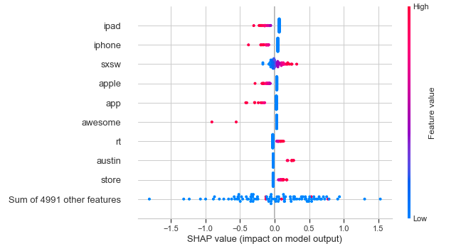
SHAP Explainability
Words like "ipad", "iphone", "apple", and "app" have a strong negative impact, when they appear in a text.

Slide 14
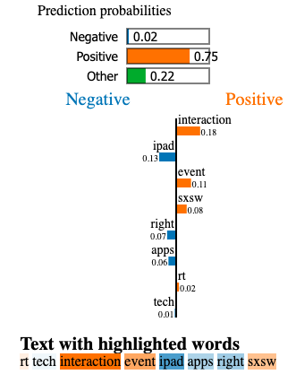
Lime Explainablity.
The word "ipad” previously associated with negative emotions dragging predictions down.
In LIME when paired with positive content the model combines them to score it as a highly positive sentiment.
.
Class 1 (Majority) stabilized precision (0.75) and recall (0.74)). Class 2 precision and recall of 0.58.
While SHAP shows how a word's meaning shifts depending on the company it keeps in a specific sentence

Slide 15

Insights

Slide 16
Business Perspective Insights
Deploy the Automated Alert Engine Immediately.
Prioritize the "Negative Class" Guardrails.
Build Live Corporate Brand Health Dashboards.
Exploit the Real-Time Competitive Edge.
Bridge the Communication Gap Between Tech and Business.
Optimize Human Resource Allocation to customer experience teams to follow up.

Slide 17
Questions?

