Slide 1
Blood Donation Database
CSE 111 Project
Rajdeep Gill, Kambi Dubey

Slide 2
What it does
Builds connection among the blood bank, donor and doctors for easy communication
Banks:
Add doctors to create login information
Add donors to access their login information
Reject/accept requests for blood depending on availability and urgency
Doctors:
Can make requests for blood to be sent to particular banks for the patients
They can add and search for their patients and all patients if needed
Access patient history which includes the disease name and urgency
Donors:
Can access info on how many lives they have saved from donations

Slide 3
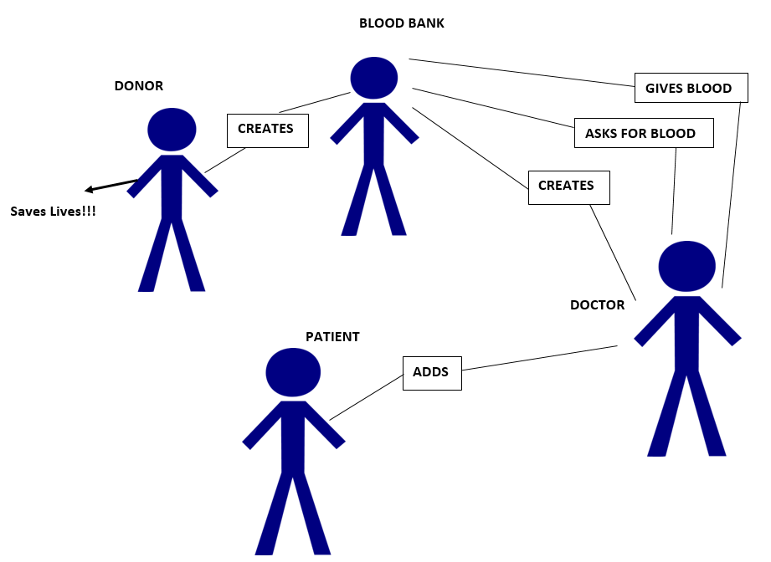
Use-Case diagram

Slide 4
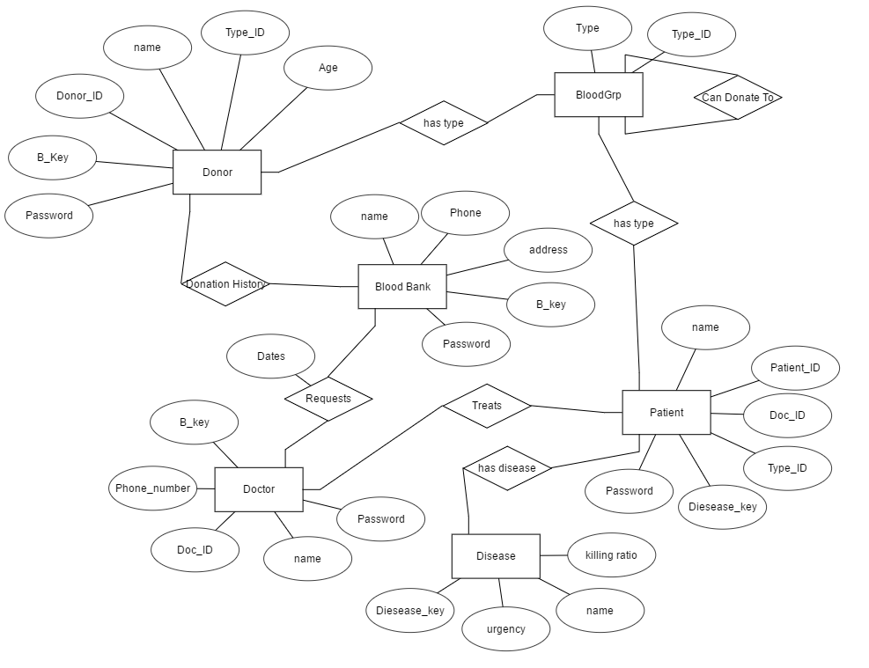
E/R Diagram

Slide 5
Relational Schema
Bankblood (phone, name, address, password)
Donor (DonorID, name, password)
Patient (PID, name)
Doctor (DocID, name, password)
Disease (name, urgency)
Bloodgrp (type)
hasDoctor (PID, DocID)
hasDisease (PID, Disease)
hasType (PID, type)
DonatesType (DonorID, type)
Request (DocID, granted, PID, B_key, Daterequested, Dategranted)
CanDonate (typeID, candonateto)
Availability (B_key, availability, type_ID, quantity)

Slide 6
DATABASE Implementation
SQLite and Java
Javafx (Build GUI)
JDBC (Connect to Database)

Slide 7
DEMO TIME!!!!

