Slide 1



            Breaking the Binary: Understanding the Kibi, Mébi, and Beyond
CORDINATOR : Dr CHANA
BY KPIHX

Slide 2

SUMMARY
II. The Need for Binary Units
I. The Binary Number System
PRESENTATION
III. Kibi, Mebi, Gibi, and Beyond
IV. Binary Units in Practice

Slide 3
In today's world, where technology is advancing at an unprecedented pace, understanding the binary system of units has become more important than ever before. From computers to smartphones, from data storage to networking, the binary system of units is at the heart of everything we do.
But what exactly is the binary system of units? In simple terms, it is a system of numbering that uses only two digits 0 and 1. This may seem like a strange way of counting to those unfamiliar with it, but it has proven to be incredibly useful in modern computing. So, let's dive into the world of binary units and see how they work!
INTRODUCTION

Slide 4
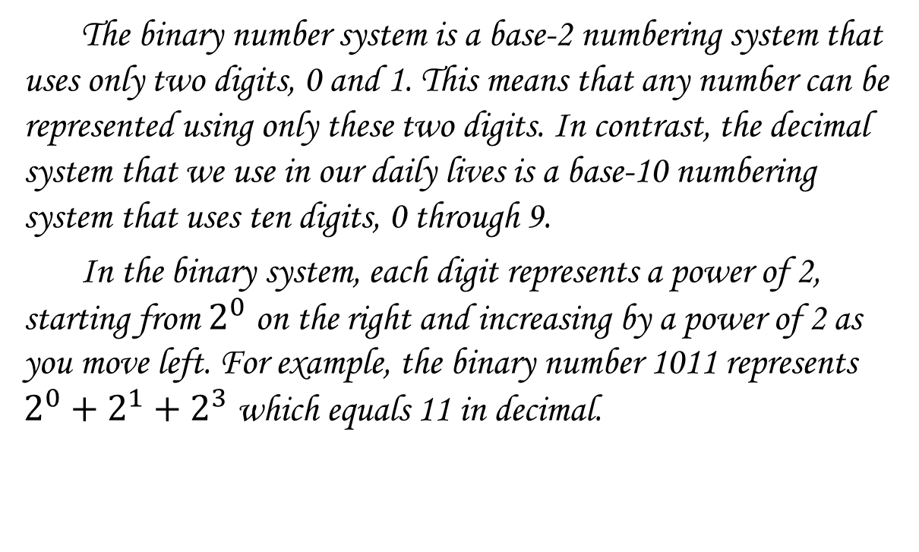
The binary number system is a base-2 numbering system that uses only two digits, 0 and 1. This means that any number can be represented using only these two digits. In contrast, the decimal system that we use in our daily lives is a base-10 numbering system that uses ten digits, 0 through 9.
In the binary system, each digit represents a power of 2, starting from $2^{0}$ on the right and increasing by a power of 2 as you move left. For example, the binary number 1011 represents $2^{0}+2^{1}+2^{3}$which equals 11 in decimal.
THE BINARY NUMBER SYSTEM

Slide 5
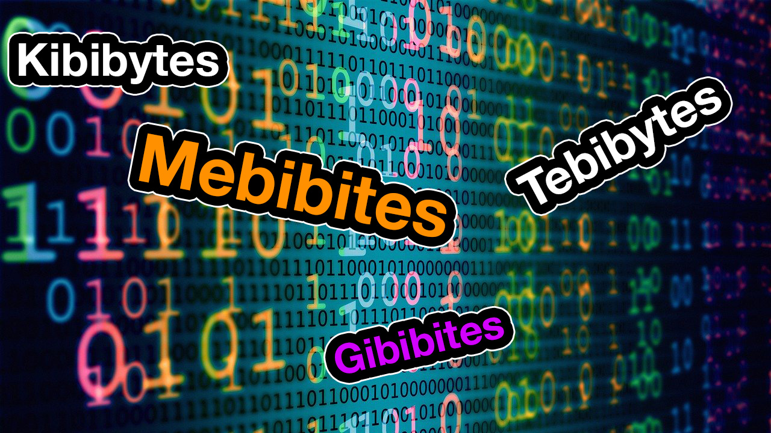
Using decimal units in computing can lead to inaccuracies and inefficiencies. This is because computers use binary code to process information, which means that decimal values must be converted into binary before they can be processed.
For example, when a computer stores a file with a size of 1 kilobyte (KB), it actually stores 1024 bytes, which is the closest power of 2 to 1000. This means that if you try to store a file that is exactly 1000 bytes, it will take up 2 KB of storage space instead of 1 KB.
THE NEED FOR BINARY UNITS

Slide 6
When it comes to measuring digital storage, the traditional decimal system falls short. Enter the binary system, which uses powers of two instead of ten. The most commonly used binary units are the kibibyte (KiB), mebibyte (MiB), and gibibyte (GiB).
To put this in perspective, 1 KiB is equal to 1024 bytes, while one kilobyte is only 1000 bytes. This may not seem like a significant difference, but when you're dealing with large amounts of data, it can add up quickly. For example, a file that is 1 GB in size, is actually 931 gibibytes (GiB) in size. Understanding these differences is crucial in modern computing.
KIBI, MEBI, GIBI, AND BEYOND

Slide 7
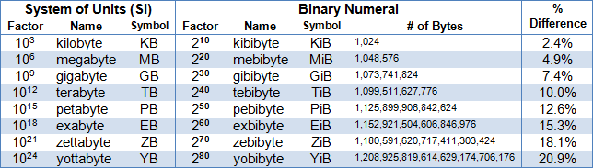
The standardization of binary prefixes in 1998 by the International Electrotechnical Commission specifies the following prefixes to represent multiples calculated in powers of 2: kibi for "binary kilo" , mebi for "binary mega" , gibi for "binary giga" , tebi for "binary tera" , and so on.
Binary prefixes have the following order relation:
BINARY UNITS IN PRACTICE

Slide 8
In short, we have learned that the binary system of units is essential in modern computing. It allows us to represent data more efficiently and accurately, which is crucial in today's fast-paced digital world.
We have also seen how using binary units such as kibibyte, mebibyte, and gibibyte can help overcome the limitations of decimal units in computing and data storage. By understanding these units, we can make better decisions when it comes to managing and storing our digital information.
As we continue to rely more on technology, it becomes increasingly important to understand the fundamental principles behind it. By grasping the concept of binary units, we can unlock new possibilities and push the boundaries of what is possible in the digital realm.
Sources : * https://en.wikipedia.org/wiki/Byte
* www.bard.com
CONCLUSION

