Slide 1

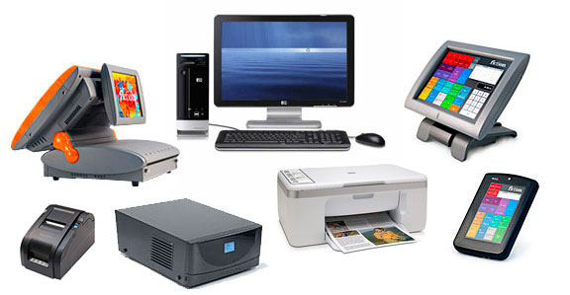
ANGLAIS (STI-2003-1)
Coordinator : Dr ambe
COMPUTERS

Slide 2
Group Members
KAMDEM POUOKAM IVANN HAROLD. N°21P254
KAMGA DEFO THIERRY JOEL. N°21P032
KAMTE MOAFO AMSTRONG. N°21P017
KANGA MARTHE VANINA N°21p201

Slide 3
Plan
Introduction
I- History
II- presentation of a computer
III- Types of computers
iV- Benefits of using a computer
V- Some curiosities about computers
Conclusion

Slide 4
Introduction
Since antiquity, men have tried to set up machines, in order to automate some recurring tasks, such as counting and math operations. Starting with the Abacus, the engineers have developed over centuries, more and more sophisticated machines, thanks to progress in mechanics and electronics. Today, computers are true do-it-all machines and are present in almost all domains of life. Exploring this essential tool of this world, will constitute the subject of this presentation.

Slide 5
I - History
Before the invention of computers, people used sticks, stones and bones as counting tools. It all started with the Abacus, designed by the Chinese around 4000 years ago, It’s a wooden rock with metal rods and beads attached to them. The operations were realised following some guidelines, on how to move the beads to complete arithmetic computations. The mayor advancement that follows, was the Pascaline, invented by Blaise Pascal in 1642. It is thought to be the first mechanical and automated calculator. Progress had followed in this domain, until 1822, the year during which Charles Babbage developed the first mechanical computer. This machine contained an arithmetic and logical unit (ALU), some chart principles and the concept of integrated memory. Then, more than one century later, we got the first Electronic computer : it is the ENIAC (Electronic Numerical Integrator and Computer), which was designed by John Mauchly and Eckert. With time, technology evolved, and computers became smaller, thanks to the invention of transistors, to the modern theory of information of Claude Shannon, and to the notion of bit (binary digit), introduced by Alan Turing. This process of evolution reached its peak, with the creation of Programming Languages, the advent of the Internet and more recently the birth of Artificial Intelligence.

Slide 6
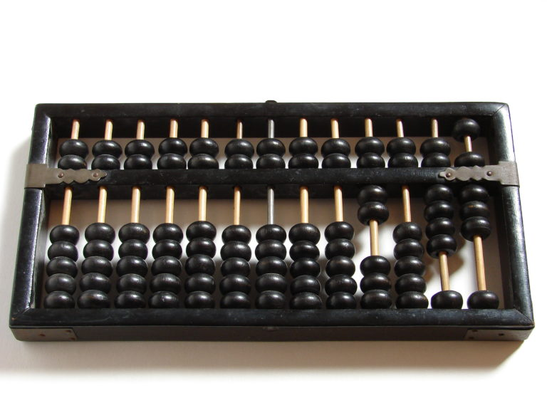
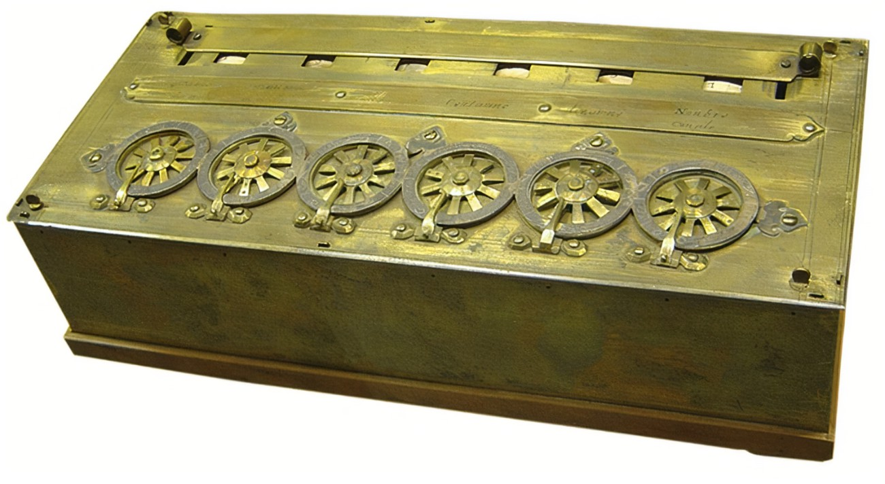
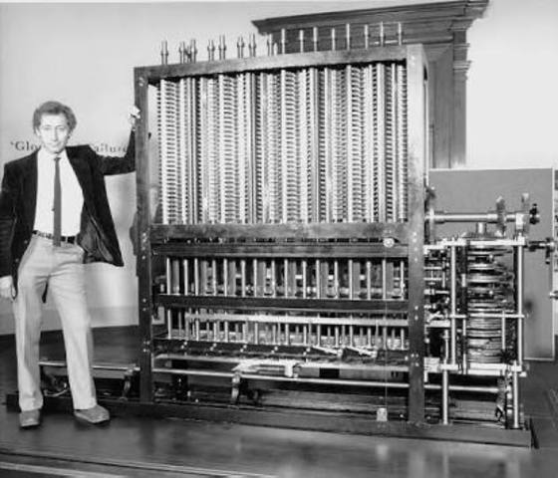
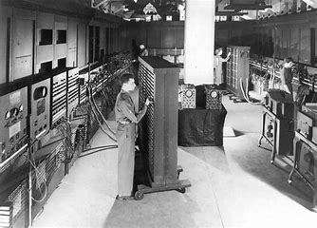
Abacus
Pascaline
ENIAC
First Mechanical Computer of Babbage

Slide 7
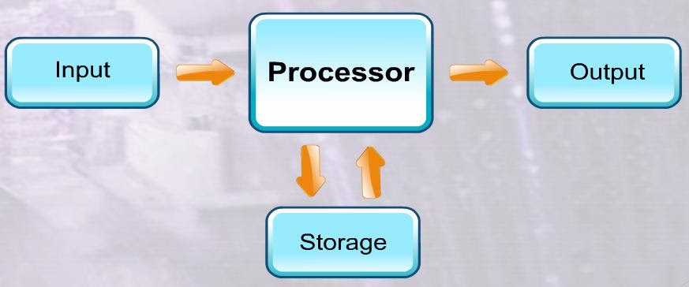
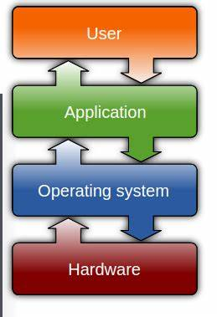
ii - Presentation of a computer
Today, a Computer is an electronic machine, which collects information, stores it, processes it according to user instructions, and then returns results. In other words, it is a programmable electronic device, that performs arithmetic and logical operations automatically, using a set of instructions provided by the user. In general, a computer functions following the process on the right.
Modern computers are made up of a hardware part and a software part, managed by an operating system which establishes the connection with the user. To expand its functionalities, a modern computer can count on external input and output devices such as a printer, a mouse, a keyboard and so on.

Slide 8
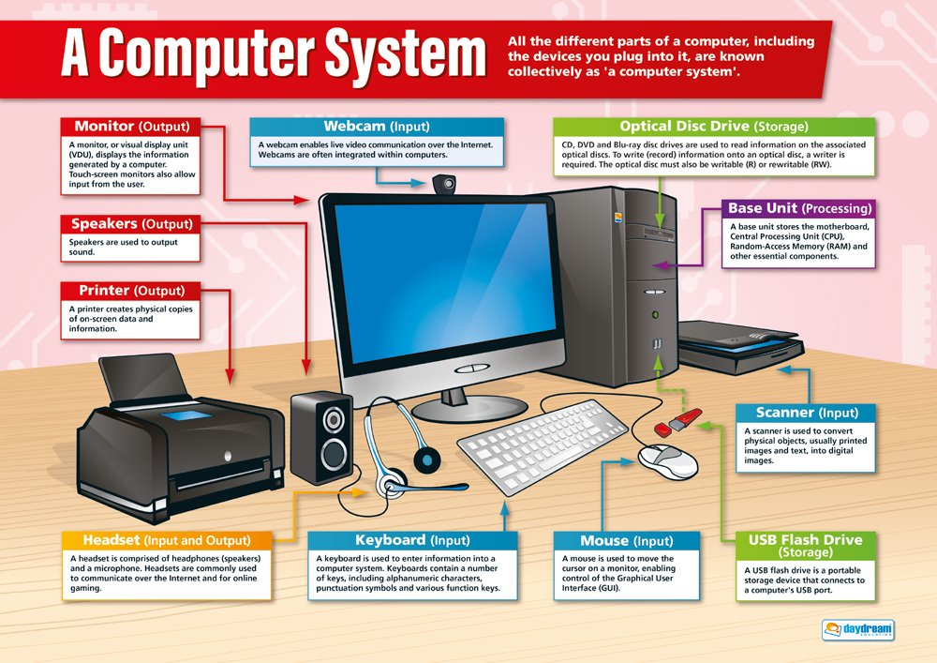

Slide 9
Iii - Types of computer
Computers can be categorised into many different types :
Microcomputer : It is a single user computer, which has less speed and storage than the other types. It includes Laptops, Desktops, Tablets and Smartphones. This type of computer is used for general usage like browsing, office automation and entertainment.
Minicomputer : It is designed to support multiple users simultaneously ; so they are generally used by small businesses like schools and hospitals, in order to manage the staff.
Mainframe computer : It is also a multi-user computer able of supporting thousands of users simultaneously. They are used by large firms and governments like banks, in order to store their customer’s data.
Supercomputers : They are the fastest and the most expensive computers among all types. They can perform millions of instructions per sec. They are used in scientific and engineering domains like research. For example, the NASA uses supercomputers for launching space satellites.
Workstation : It is similar to a personal computer ; however, it has a more powerful microprocessor. In terms of storage capacity and speed, it comes between a personal computer and a minicomputer. Workstations are generally used for specialised applications such as software development.

Slide 10
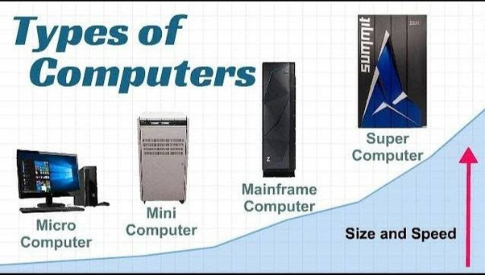
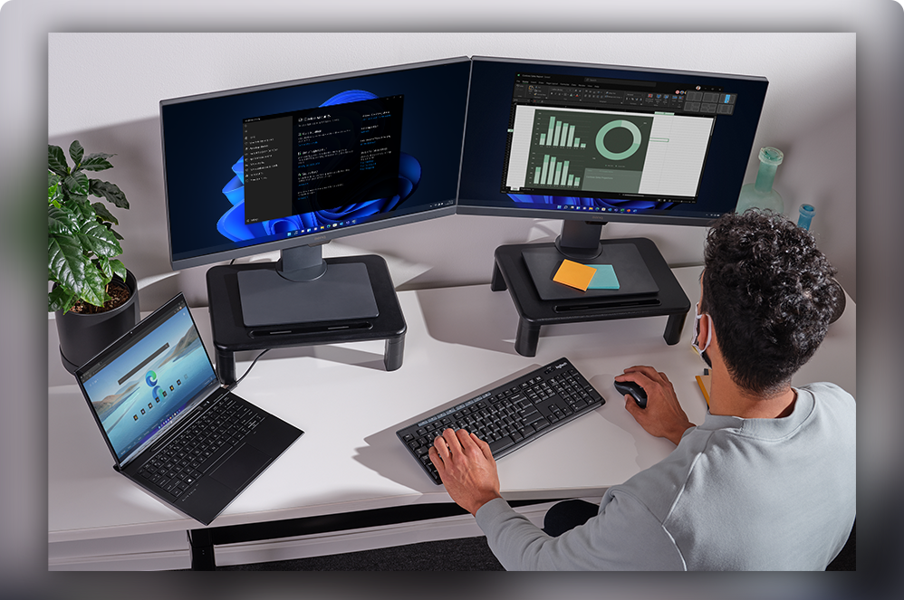
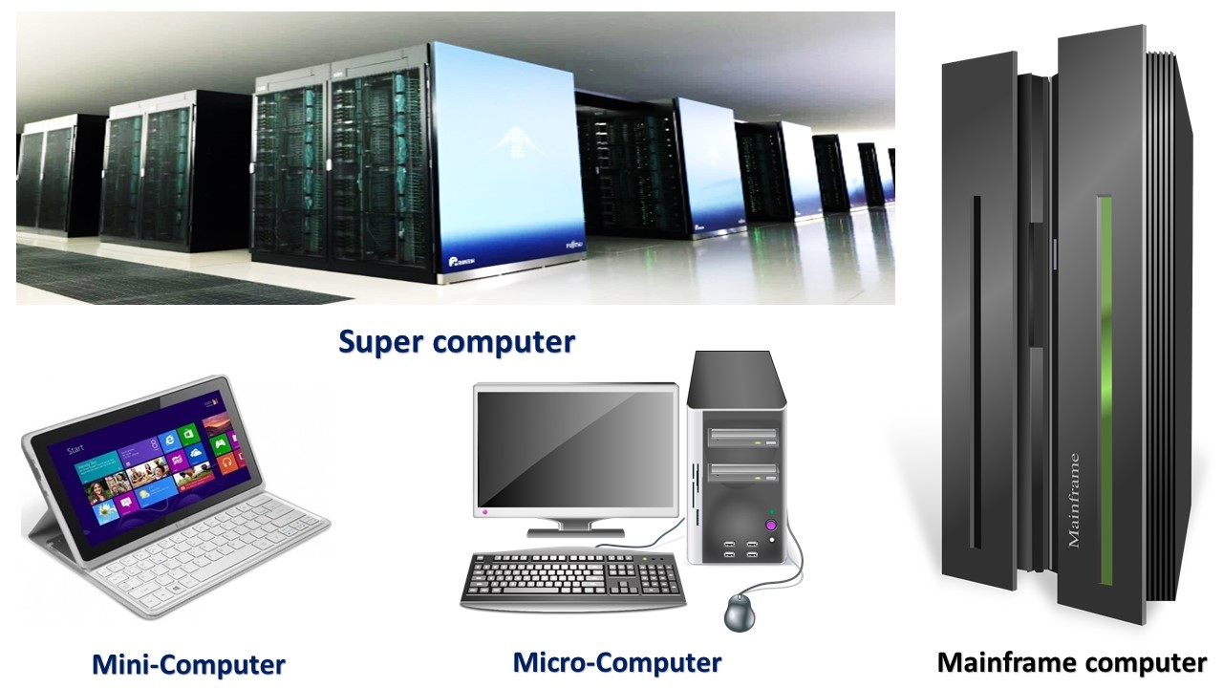
Workstation

Slide 11
Iv - Benefits of using a computer
Computers increases your productivity ; for instance, you can create, edit and print documents easily with them.
Computers connect you to the Internet ; thanks to them, you can send emails, gain information, browse content, communicate through social medias and so on.
At the level of storage, computers allow you to store a large amount of information, like movies, pictures and documents indefinitely and without deterioration.
Computers keep you entertained with movies and games.
They helps you to organise your data and information ; for example, you have the possibility to create folders in order to classify your information, with a computer.

Slide 12
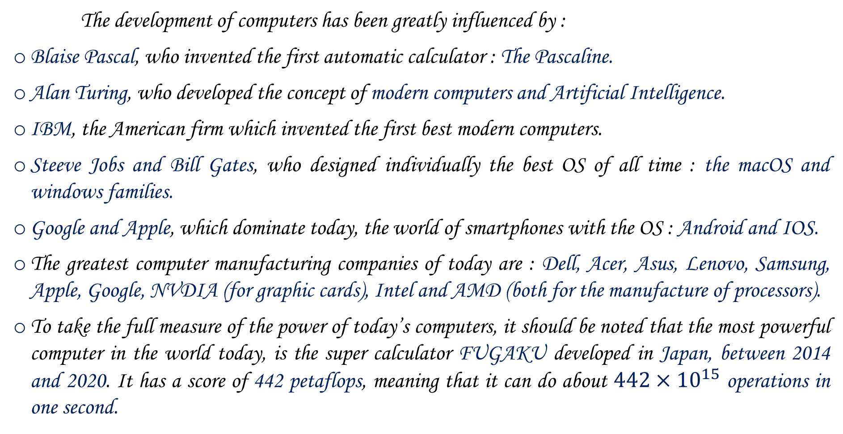
Some curiosities about computers
The development of computers has been greatly influenced by :
Blaise Pascal, who invented the first automatic calculator : The Pascaline.
Alan Turing, who developed the concept of modern computers and Artificial Intelligence.
IBM, the American firm which invented the first best modern computers.
Steeve Jobs and Bill Gates, who designed individually the best OS of all time : the macOS and windows families.
Google and Apple, which dominate today, the world of smartphones with the OS : Android and IOS.
The greatest computer manufacturing companies of today are : Dell, Acer, Asus, Lenovo, Samsung, Apple, Google, NVDIA (for graphic cards), Intel and AMD (both for the manufacture of processors).
To take the full measure of the power of today’s computers, it should be noted that the most powerful computer in the world today, is the super calculator FUGAKU developed in Japan, between 2014 and 2020. It has a score of 442 petaflops, meaning that it can do about $442×{10}^{15}$ operations in one second.

Slide 13
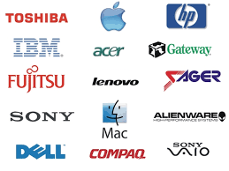
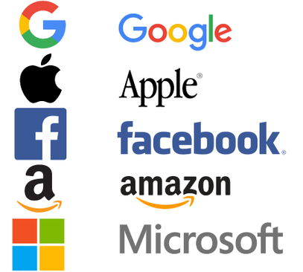
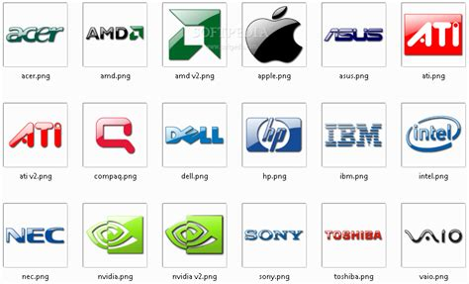
BIG 5 TECH GIANTS : GAFAM - FAAMG

Slide 14
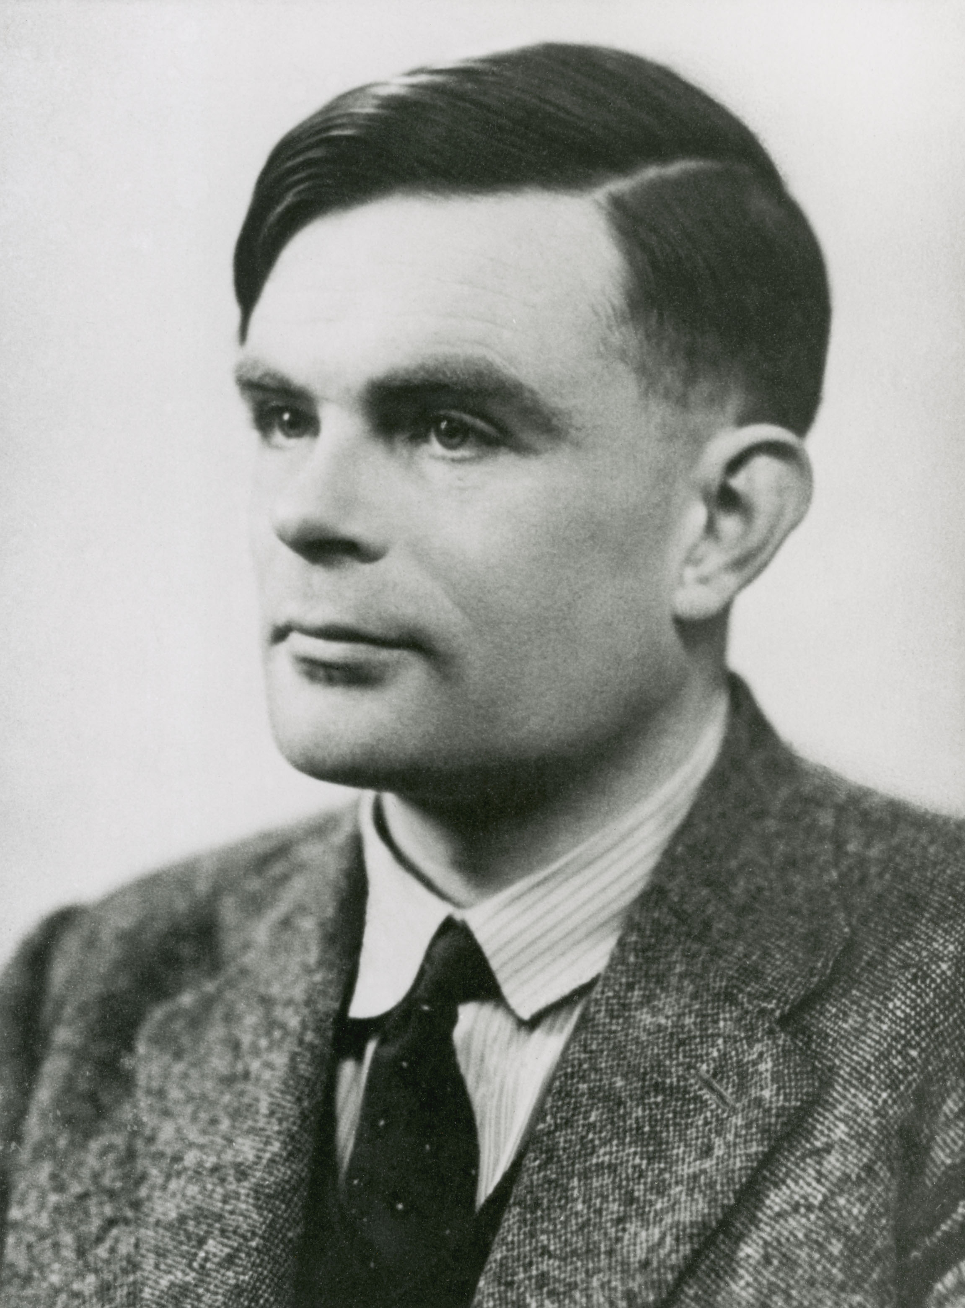
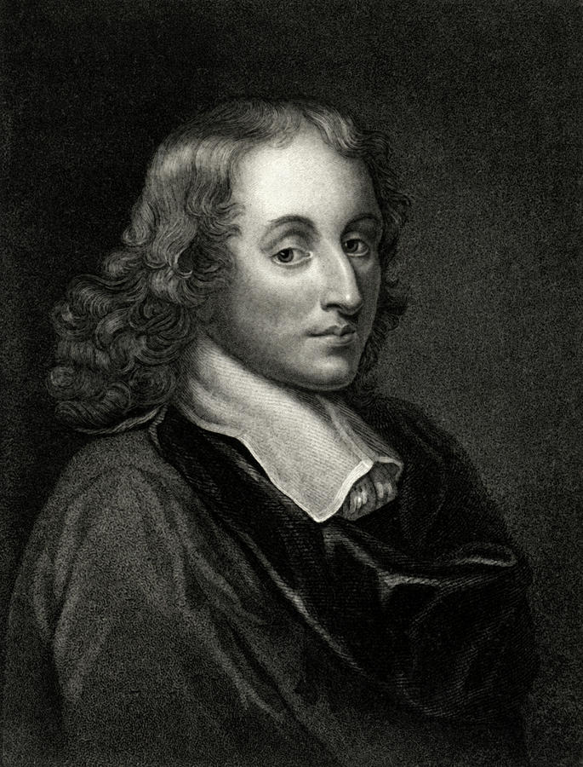
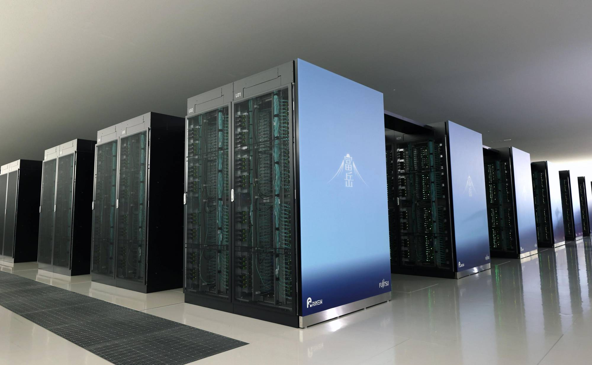
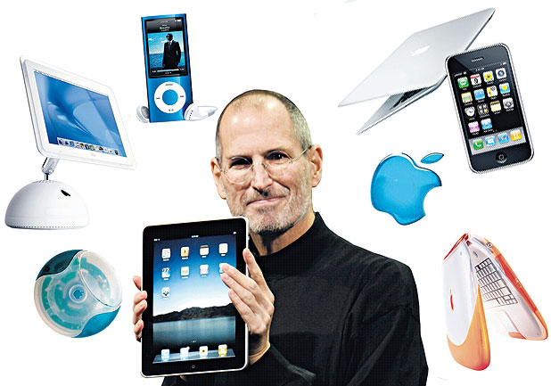
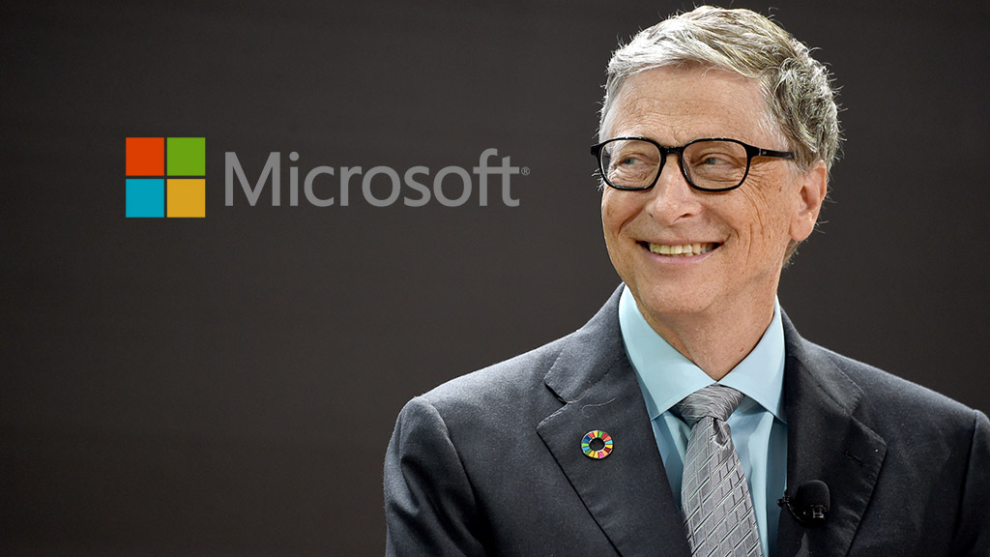
Alan Turing
Fugaku
Blaise Pascal
Steeve Jobs
Bill Gates

Slide 15
Conclusion
In short, computers are the most indispensable gadgets of this century. They allow us to automate and quickly perform almost any type of task. To end, it is rightly said that : “The illiterate of this century is the one who does not master the computer devices.
This presentation benefited mainly from the valuable information of the websites and search engines :
  https://www.bing.com/
  https://www.google.com/
  https://edu.gcfglobal.org/en/computerbasics/what-is-a-computer/1/
  https://www.toppr.com/guides/computer-aptitude-and-knowledge/basics-of-computers/history-of-computers/
  https://www.rtbf.be/article/l-ordinateur-le-plus-puissant-du-monde-peut-calculer-44201-millions-de-milliards-d-operations-a-la-seconde-10881878

