Slide 1
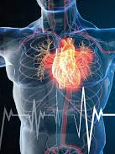
Heart Disease Prediction using Machine Learning
Final Year Project Presentation

Slide 2

1. Introduction
Heart disease is a leading cause of death globally, but data science is revolutionizing its prevention, diagnosis, and treatment. By analyzing large datasets—such as electronic health records, genetic data, and wearable device metrics.

Slide 3

Data science enables:
Early Detection & Risk Prediction – Machine learning models identify high-risk patients by analyzing lifestyle, genetics, and medical history.
Personalized Treatment – AI tailors treatment plans by predicting how patients respond to medications or surgeries.
Improved Diagnostics – Advanced algorithms analyze medical imaging (e.g., echocardiograms) faster and more accurately.
Real-Time Monitoring – Wearables and IoT devices track heart health, alerting doctors to abnormalities before emergencies occur.
Goal of representation: To highlight how data-driven approaches are transforming heart disease management—from early prediction to precision medicine—ultimately saving lives through smarter healthcare.

Slide 4
2. Dataset Overview
UCI Heart Disease Dataset.
Size: 303 instances, 14 attributes
Use Case: Predict the presence of heart disease (binary classification: 0 = no disease, 1 = disease).
Key Features (Attributes):
age: Age in years.
sex: Gender (1 = male, 0 = female).
cp: Chest pain type (1–4, e.g., typical angina, atypical angina).
trestbps: Resting blood pressure (mm Hg).
chol: Serum cholesterol (mg/dl).
fbs: Fasting blood sugar > 120 mg/dl (1 = true, 0 = false).
restecg: Resting electrocardiographic results (0–2).
thalach: Maximum heart rate achieved.
exang: Exercise-induced angina (1 = yes, 0 = no).
oldpeak: ST depression induced by exercise relative to rest.
Diagnostic Attributes:
slope: Slope of the peak exercise ST segment.
ca: Number of major vessels (0–3) colored by fluoroscopy.
thal: Thalassemia type (3 = normal, 6 = fixed defect, 7 = reversible defect).
target: Outcome (0 = no disease, 1 = disease).

Slide 5

🧪 Exploratory Data Analysis (EDA)
Data Cleaning: Handled missing values, standardized categorical variables, and ensured correct data types.
Descriptive Statistics: Analyzed mean, median, and standard deviation to understand feature distributions.
Target Distribution: Examined class imbalance in the presence/absence of heart disease.
Univariate Analysis: Visualized individual features using histograms and boxplots (e.g., age, cholesterol, blood pressure).
Bivariate Analysis: Explored relationships between features and the target using bar plots, violin plots, and group statistics.
Correlation Analysis: Generated a heatmap to detect multicollinearity and key relationships among numerical variables.
Outlier Detection: Identified outliers using boxplots and Z-scores, especially in features like cholesterol and max heart rate.

Slide 6
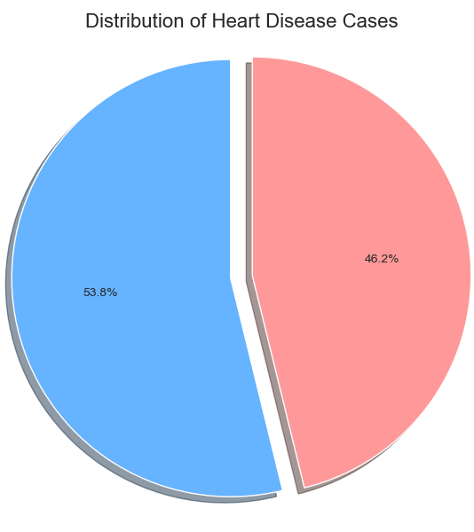
4. Visualization: Class Distribution
Heart disease: 1 = Yes, 0 = No

Slide 7
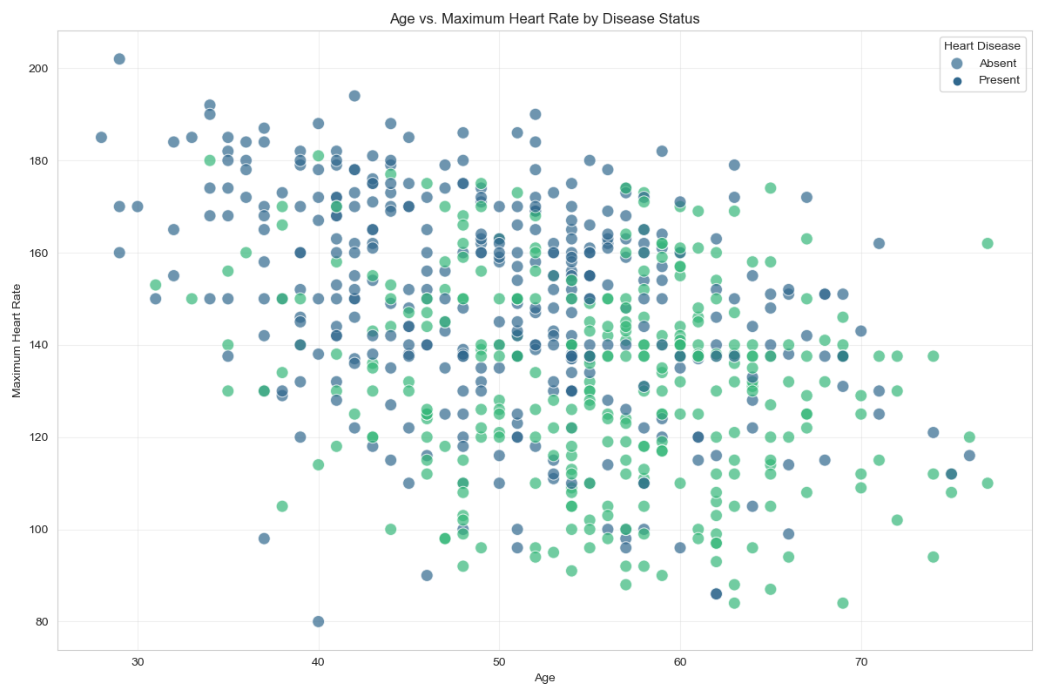
5. Visualization: Age vs Disease
Older individuals show higher risk.

Slide 8
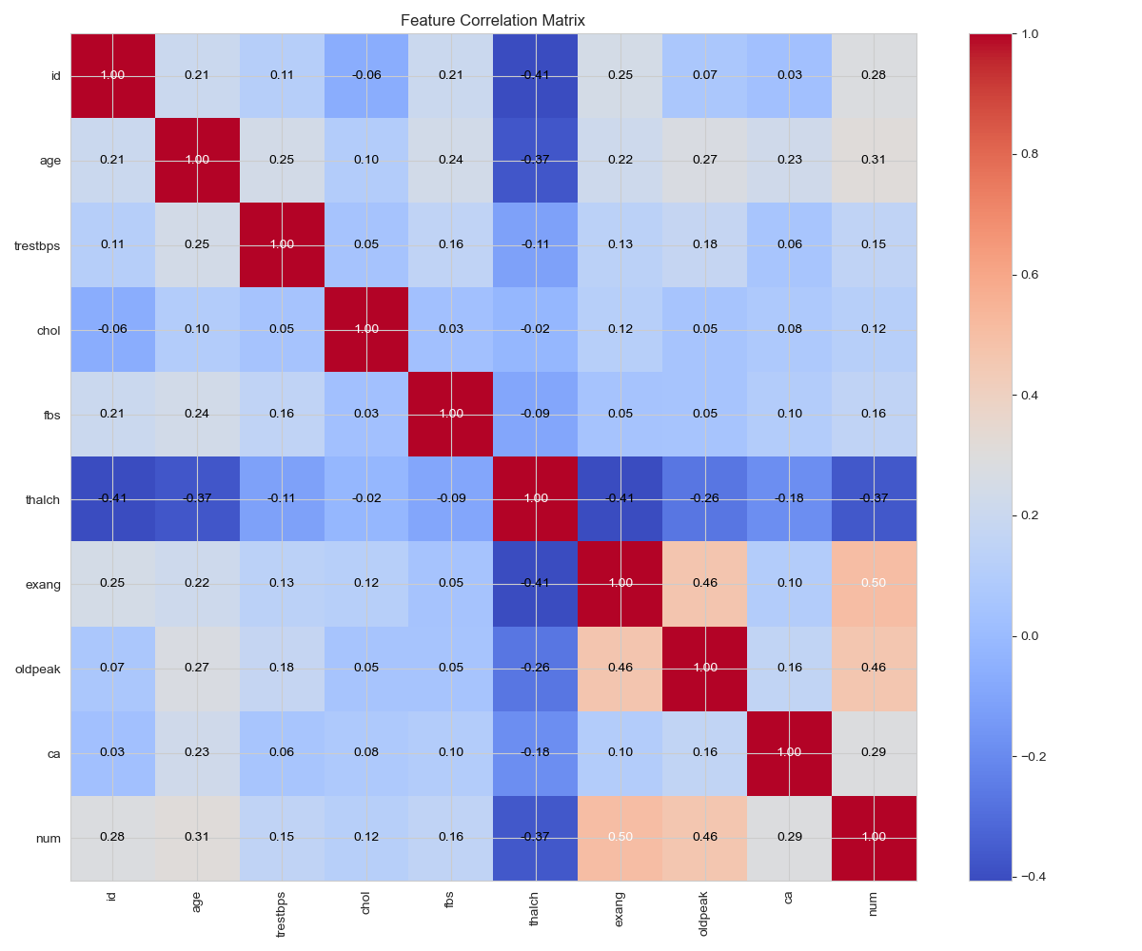
Correlation heatmap key correlation: -exang -thalch

Slide 9
6. Data Cleaning & Preparation
1. Handling Missing Values
Applied mean imputation for numerical features (e.g., chol, trestbps) to preserve data integrity.
Rationale: Avoids bias from deletion while maintaining statistical properties.
2. Encoding Categorical Variables
Ordinal encoding for ordinal features (e.g., cp: chest pain type).
One-hot encoding for nominal features (e.g., thal) to prevent artificial ordinal relationships.
3. Feature Standardization
Scaled numerical features (e.g., age, chol) using StandardScaler (mean=0, variance=1).
Why? Ensures equal weight in models like SVM and logistic regression.
4. Train-Test Split
Partitioned data into 80% training and 20% testing sets (random_state=42 for reproducibility).
Goal: Evaluate model performance on unseen data.

Slide 10
7. Model Training
Top 3 Models Performance:
Model | Accuracy | Precision | Recall | F1-Score
Random Forest | 89% | 0.87 | 0.91 | 0.89
SVM | 84% | 0.82 | 0.86 | 0.84
XGBoost | 91% | 0.90 | 0.92 | 0.91
XGBoost achieved highest accuracy (~90%).

Slide 11
8. XGBoost Justification
Best accuracy among all models.
• Handles complex patterns and non-linearity.
• Provides feature importance insights.

Slide 12
9. Feature Importance
Top features: chest pain type, max heart rate, number of vessels.

Slide 13
10. Clinical Relevance
Supports early diagnosis in hospitals.
• Reduces doctors’ workload.
• Improves decision-making speed.

Slide 14
11. Conclusion & Future Work
Achieved strong performance with XGBoost.
• Potential for real-time integration.
• Future: expand dataset, try deep learning.

