Slide 1
Adaptive Digital Filter
An adaptive filter is essentially a digital filter with self-adjusting characteristics. It adapts, automatically, to change in its input signal. The LMS (least mean square) and RLS (recursive least square) a are two most widely used algorithms in adaptive signal processing.

Slide 2
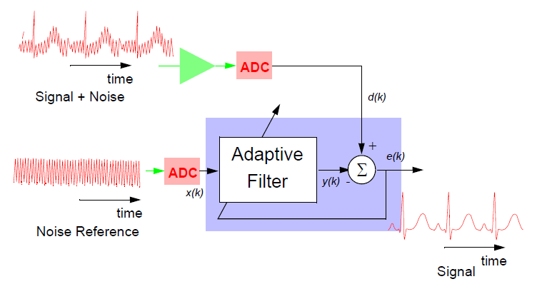
Adaptive Filter
An adaptive filter consists of two distinct parts: a digital filter with adjustable coefficients, and an adaptive algorithm which is used to adjust or modify the coefficients of the filter.

Slide 3
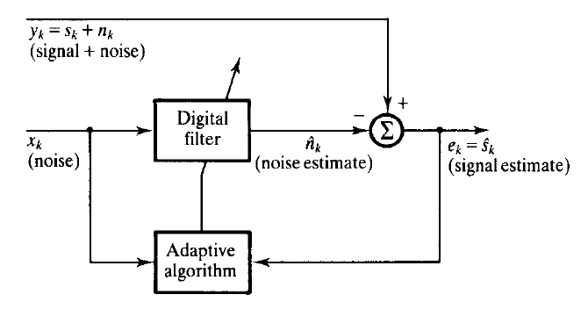
Fig.1 Block diagram of an adaptive filter as noise canceller
x_{k} (noise)
x_{k-1}
x_{k-2}
x_{k-(N-1)}
z⁻¹
z⁻¹
… … … …
z⁻¹
w(0)
w(1)
w(2)
w(N-1)
×
×
×
×
... …
… … …
Σ
y_{k} (signal + noise)
̶
+
Σ
e_{k} (output)
Fig.2 FIR filter structure

Slide 4
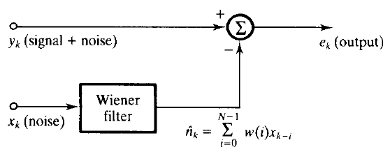
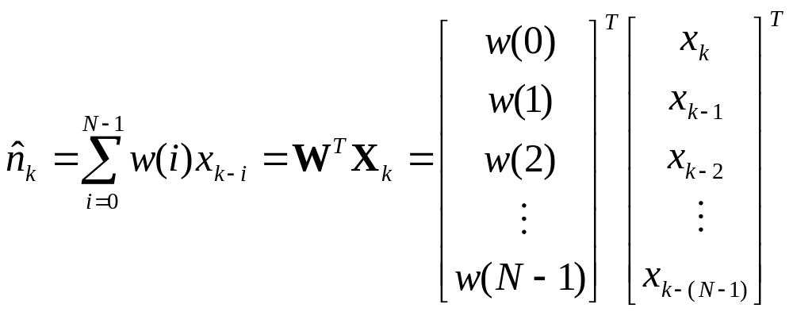
Fig.3 The basic Wiener filter
Let us assume an FIR filter with N coefficients. The output of the filter,

Slide 5
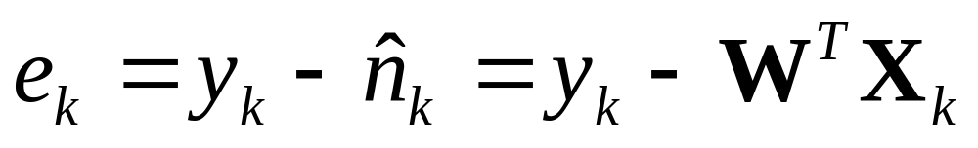
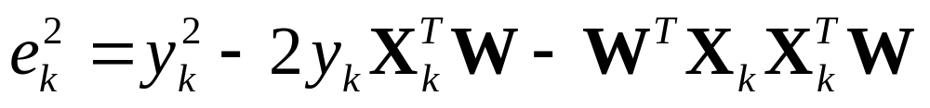
The error e_{k} between Wiener filter output and the primary signal y_{k} is,
The square of the error,

Slide 6
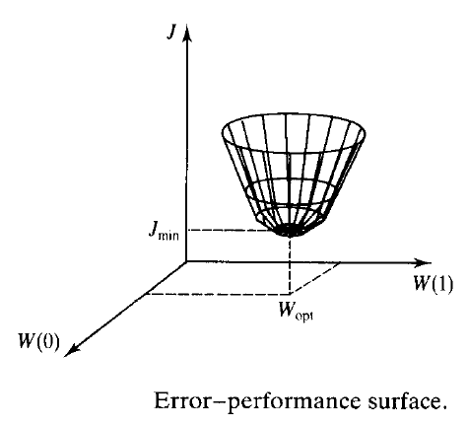
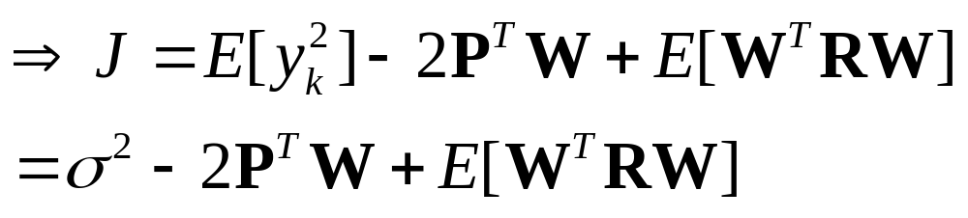
The mean square error (MSE), J is obtained taking expectation on
both side,

Slide 7
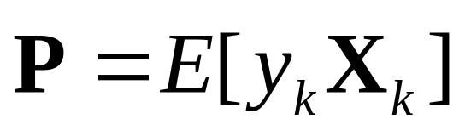
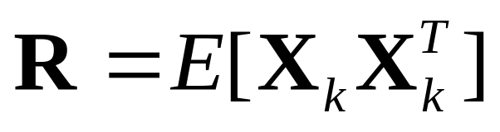
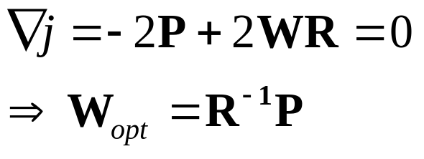
where,
,the auto correlation matrix of N×N
,the cross correlation vector of N×1
The plot of MSE against weighting factor w(i); i = 0,1, …, N-1 is bowl shaped with unique bottom known as performance surface.
Taking gradient of performance surface,

Slide 8
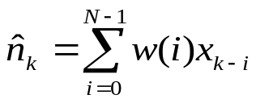


LMS Algorithm
LMS algorithm is the simplest adaptive algorithm for updating the coefficients of a digital filter. The LMS algorithm can be described as follows:
Parameters:
μ = step size
k = sampling instant
Computation:
for i = 0, 1, …. N-1, initialize the weight w_{k}(i).
calculate the output of filter,
calculate the error,
update filter weights for next iteration
if error not minimized repeat step 2.
else stop.

Slide 9
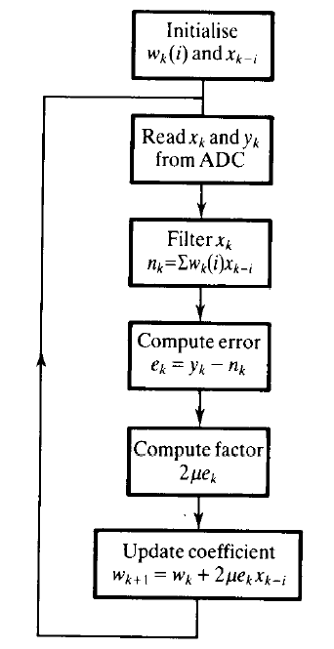
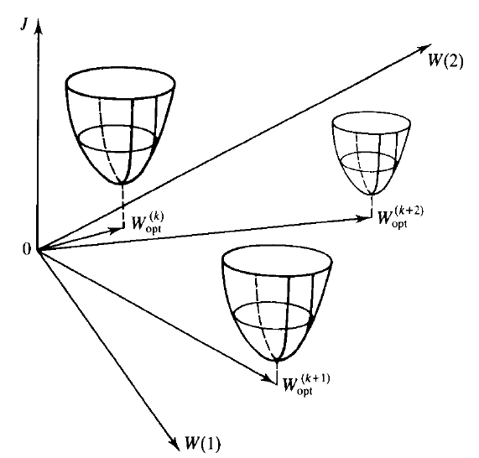
LMS Algorithm

Slide 10
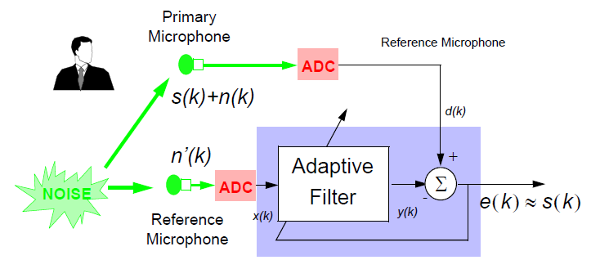
Inside, for example, a car or helicopter, background engine noise can be reduced from a radio or telephone signal if an uncorrelated
reference signal is available:

Slide 11
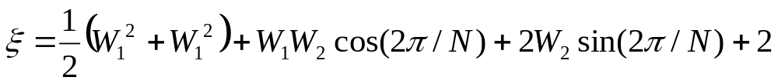
Adaptive filter with two weighting factor
Input signal,
X_{k} = sin(2πk/N)
Z⁻¹
X_{k-1}
Desired signal, d = cos(2πk/N)
W₁
W₂
+
+
Error, ε
Σ
Σ
The mean square error:

Slide 12
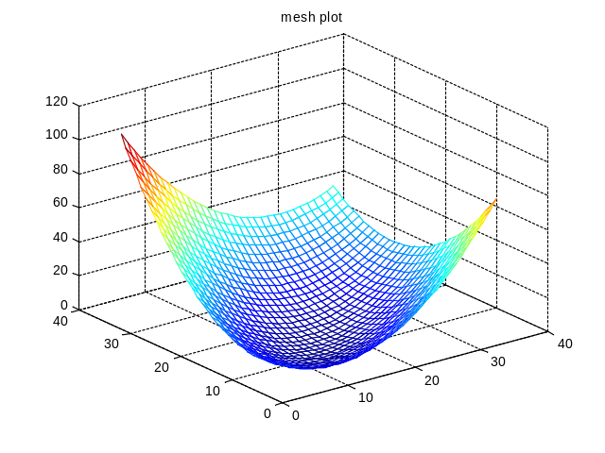
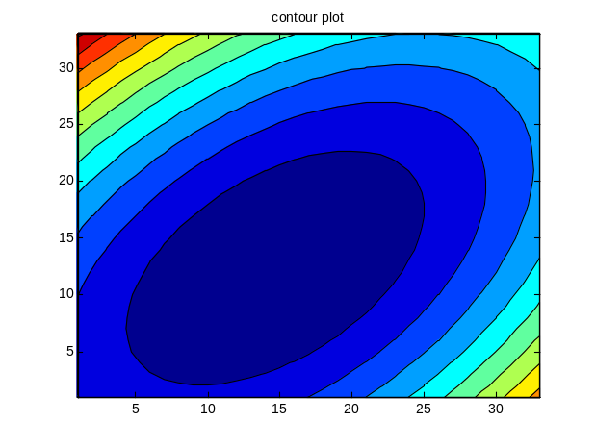
Error Surface
N=3;% here N=3
[W1,W2]=meshgrid(-8:0.5:8);
% grid lines lies between -8 to 8 with intervals of 0.5
z=(0.5)*(W1.^2+W2.^2)+W1.*W2*cos(2*pi/N)+2*W2*sin(2*pi/N)+2;
mesh(z); %mesh plot of z
title('mesh plot')
figure
contourf(z); %contour plot of z
title('contour plot')
y=min(z);
emin=min(y) %minimum value of error
e_{min} = 0.0359

Slide 13
Now we will determine: (a) the profile of weighting factors W₁ and W₂ against the number of iteration steps k (b) values of weighting factors W₁ and W₂ on W₁ -W₂ plane (c) the profile of mean square error against the number of steps to observe the converge rate (number of steps required to attain minimum error) based on LMS algorithm.

Slide 14
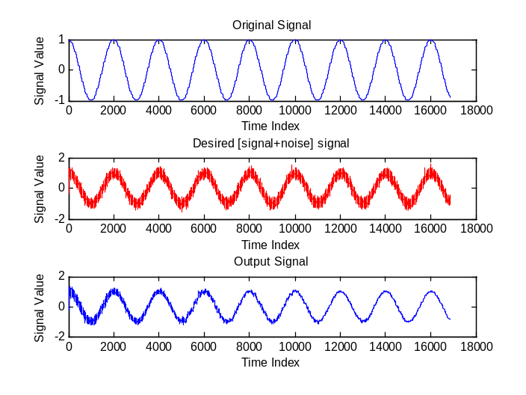
De-noising of Signal Using LMS algorithm
%LMS Filter
t=1:0.0005:3*pi;
x=cos(2*pi*t);%Original Signal
N=31; Wn=0.5;
b = fir1(N,Wn); % FIR filter using window
%The cut-off frequency Wn must be between 0 < Wn < 1.0
n = 0.15*randn(1,length(t)); % noise signal
d = filter(b,1,x)+n; % Desired signal i.e. Signal+noise
mu = 0.01; % LMS step size.
ha = adaptfilt.lms(32,mu);
[y1,e1] = filter(ha,n,d);
subplot(3,1,1)
plot(1:length(t),x, 'b');
title('Original Signal');
xlabel('Time Index'); ylabel('Signal Value');
subplot(3,1,2)
plot(1:length(t),d, 'r');
title('Desired [signal+noise] signal');
xlabel('Time Index'); ylabel('Signal Value');
subplot(3,1,3)
plot(e1);
title('Output Signal');
xlabel('Time Index'); ylabel('Signal Value');

Slide 15
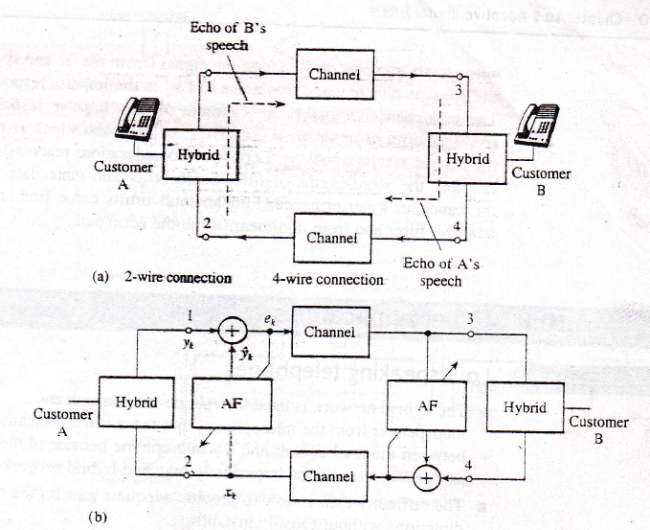
Adaptive Telephone Echo Cancellation
(a) Simplified long distance telephone circuit (b) echo cancellation in long distance voice telephony

Slide 16
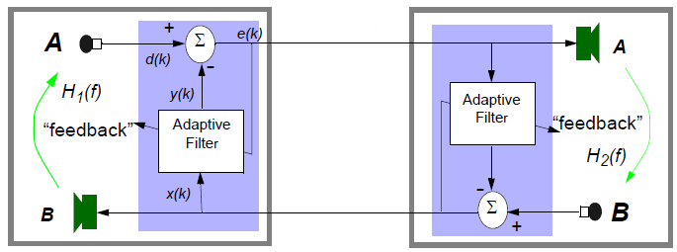
Echo due to feed back signal (from speaker to microphone)

Slide 17
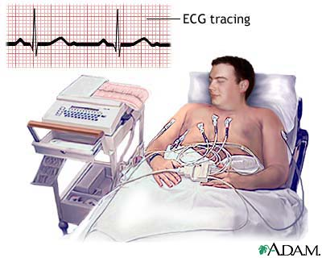
Electrocardiogram (ECG)

Slide 18
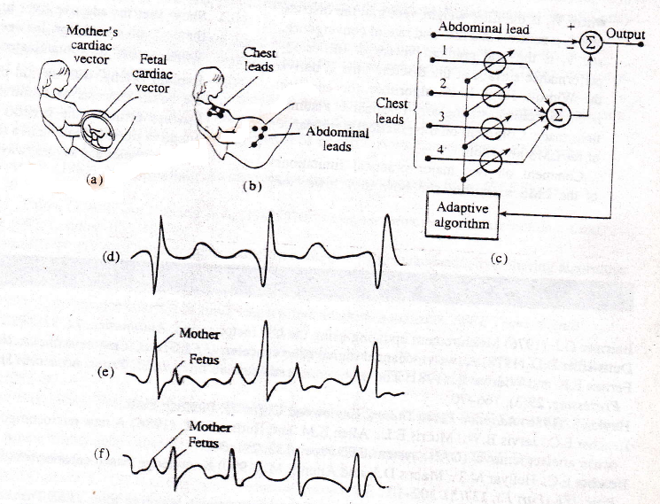
Fetal monitoring-cancelling of maternal ECG during labour
(b) Placement of leads
(c) Adaptive filter
(d) Idealized mother’s ECG (chest leads)
(e) Contaminated fetal ECG
(f) Output of noise canceller showing reduced mother’s ECG.

Slide 19
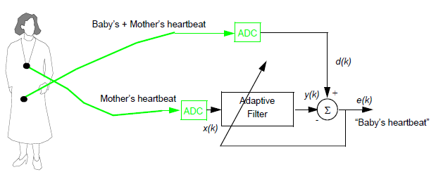
Elimination of mother’s ECG

Slide 20
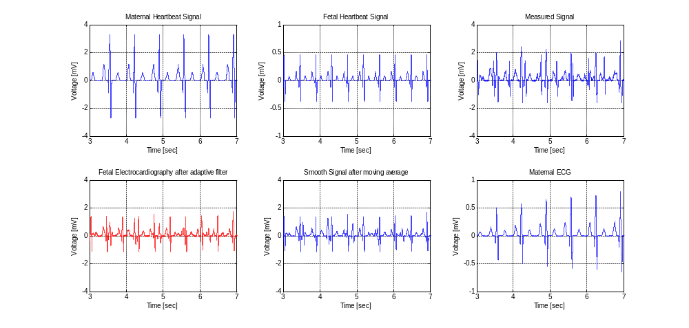

Slide 21
Electroencephalogram (EEG)
The human electroencephalogram (EEG) is the electrical activity of the brain and contains useful diagnostic information on a variety of neurological disorder. Normal EEG signals are measured from electrodes placed on scalp and are often very small in amplitude of the order of 20μV
Blinking or moving eyes produces large electrical potential around the eyes called electrooculogram (EOG). The EOG spreads around the scalp to contaminate the EEG.

Slide 22
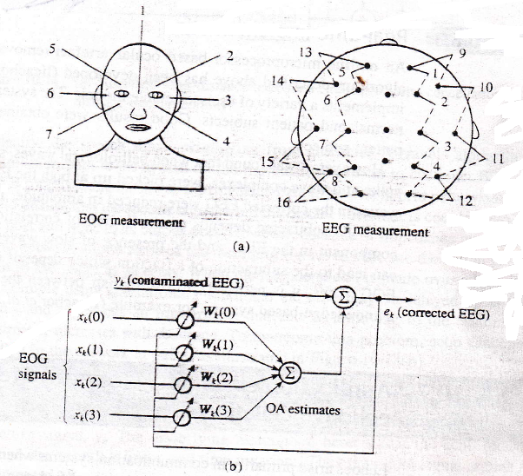
(a)Electrode positions for EOG and EEG (b) Adaptive filter

Slide 23
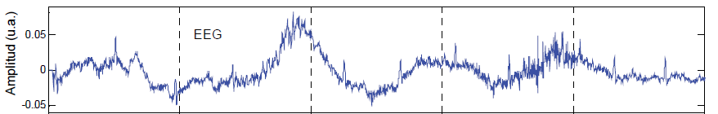
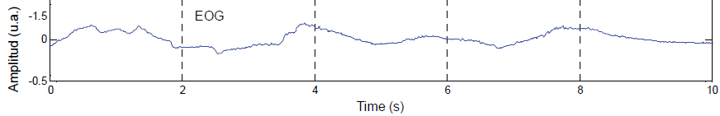
The electroencephalogram (EEG) and the electro oculogram (EOG),

Slide 24
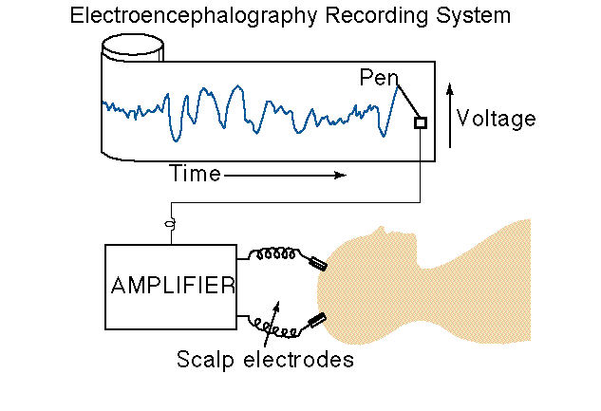
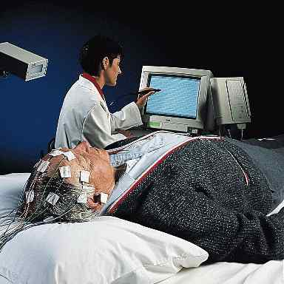
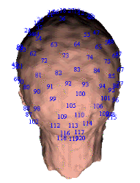
EEG: Instrument

Slide 25
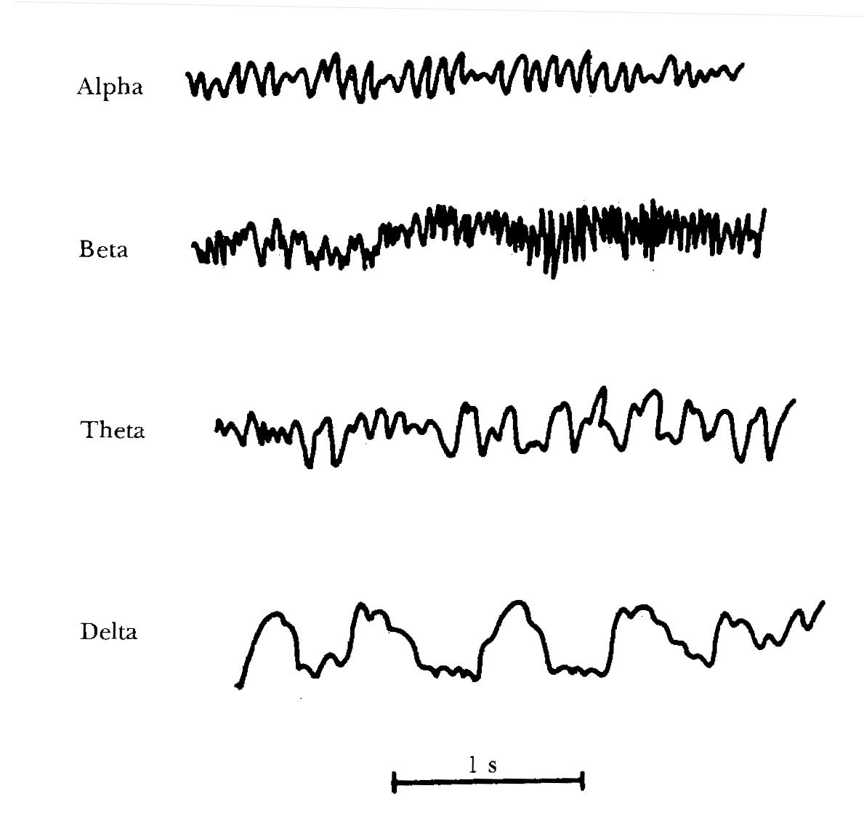
EEG Classification

Slide 26
EEG Classification
Alpha:
  8 to 13Hz.
  Normal persons are awake in a resting state.
  Alpha waves disappear in sleep.
Beta:
  14 to 30Hz.
  May go up to 50Hz in intense mental activity.
  Beta I waves: frequency about twice that of the alpha waves and are influenced in a similar way as the alpha waves.
  Beta II waves appear during intense activation of the central nervous system and during tension.

Slide 27
EEG Classification
Theta waves:
  4 to 7Hz.
  During emotional stress.
Delta waves
  Below 3.5Hz.
  Deep sleep or in serious organic brain disease.

Slide 28
