Slide 1
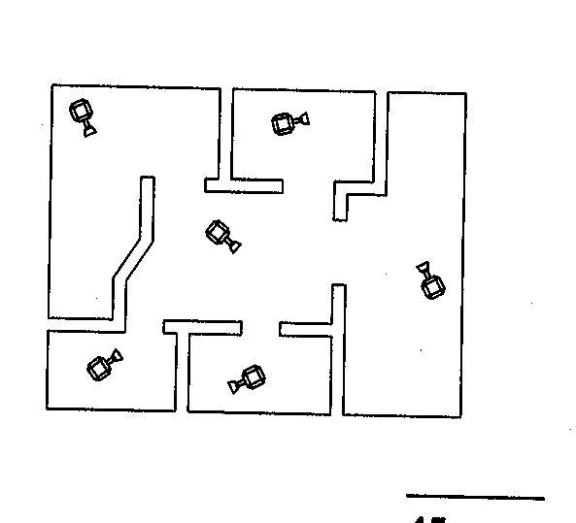

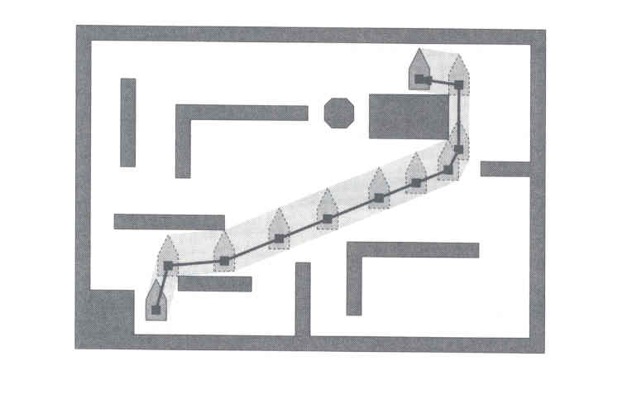
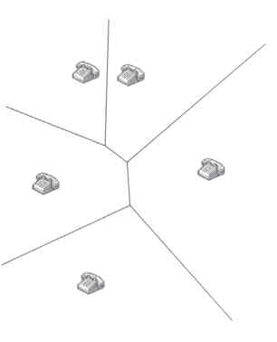
Computational Geometry

Slide 2
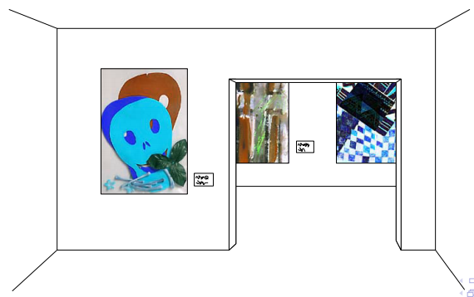
Art Gallery Problem

Slide 3
Art Gallery Problem
How many guards or cameras are required?
How do we decide where to place the cameras?

Slide 4
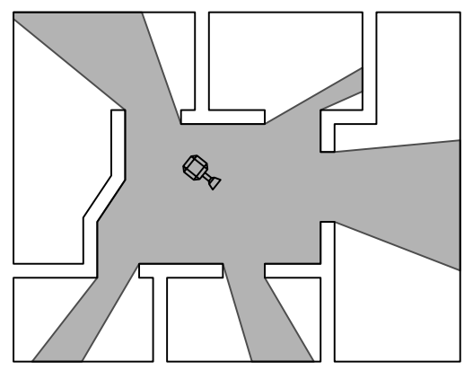
Art Gallery Problem
How many guards or cameras are required?
How do we decide where to place the cameras?

Slide 5
Polygon
A polygon is the region of a plane bounded by a finite collection of line segments forming a simple closed curve.
Polygon
Not a polygon

Slide 6
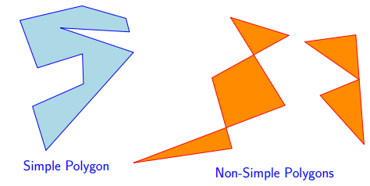
Simple Polygon
We call a polygon a simple polygon if the region is closed by a closed polygonal chain that does not intersect itself.

Slide 7
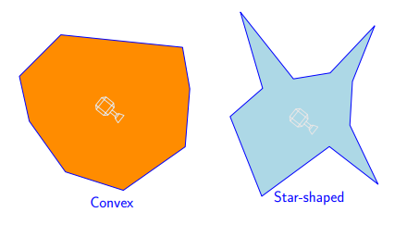
Convex Polygon
Question: How many cameras do we need to guard
a simple polygon?
Answer: Depends on the polygon
Convex Polygon
Non-Convex Polygon
Notes:
One solution: Decompose the polygon to parts which are simple to guard.

Slide 8
Diagonal of a Polygon
A diagonal of a polygon P is a line segment between two of its vertices a and b that are clearly visible to one another.
a
b

Slide 9
Visibility
y is visible to x if and only if the closed segment xy is nowhere exterior to polygon.
Clear visibility
xy cannot touch or intersect any other point of the polygon.

Slide 10
Diagonal of a Polygon
A diagonal of a polygon P is a line segment between two of its vertices a and b that are clearly visible to one another.
a
b

Slide 11
Diagonal of a Polygon
A diagonal of a polygon P is a line segment between two of its vertices a and b that are clearly visible to one another.
a
b

Slide 12
Diagonal of a Polygon
A diagonal of a polygon P is a line segment between two of its vertices a and b that are clearly visible to one another.
a
b

Slide 13
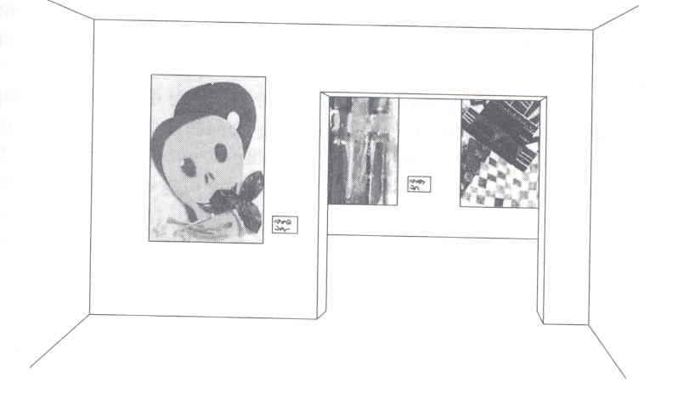
Art Gallery Problem
We assume the floorplan of the art gallery is a simple polygon.
How many guards or cameras are required?
How do we decide where to place the cameras?
Bad news: finding the minimum number of cameras for a
given polygon is NP-hard (exponential time).

Slide 14
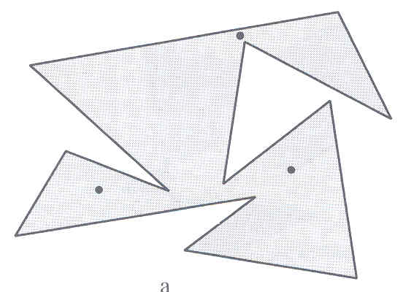
A polygon of 12 vertices
Requires 3 guards.
Are 3 guards sufficient for any polygon of 12 vertices?

Slide 15
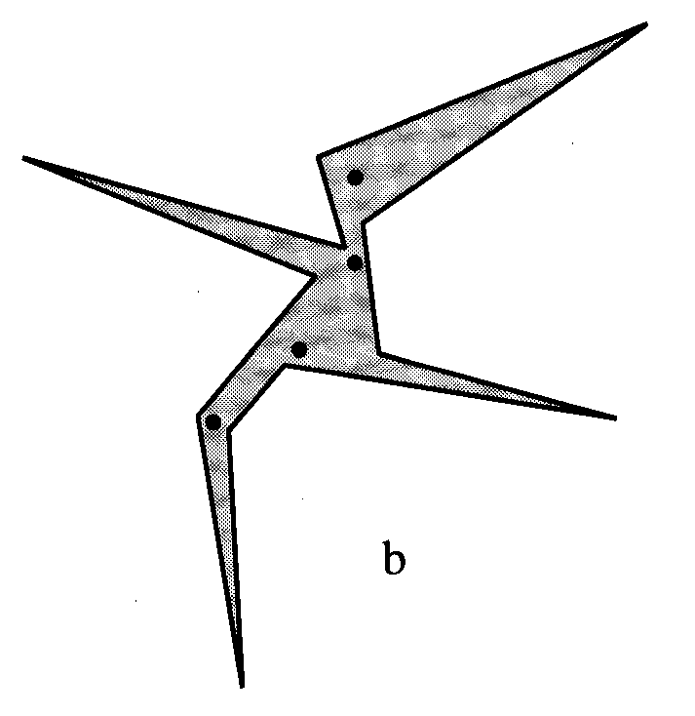
A polygon of 12 vertices
Requires 4 guards.

Slide 16
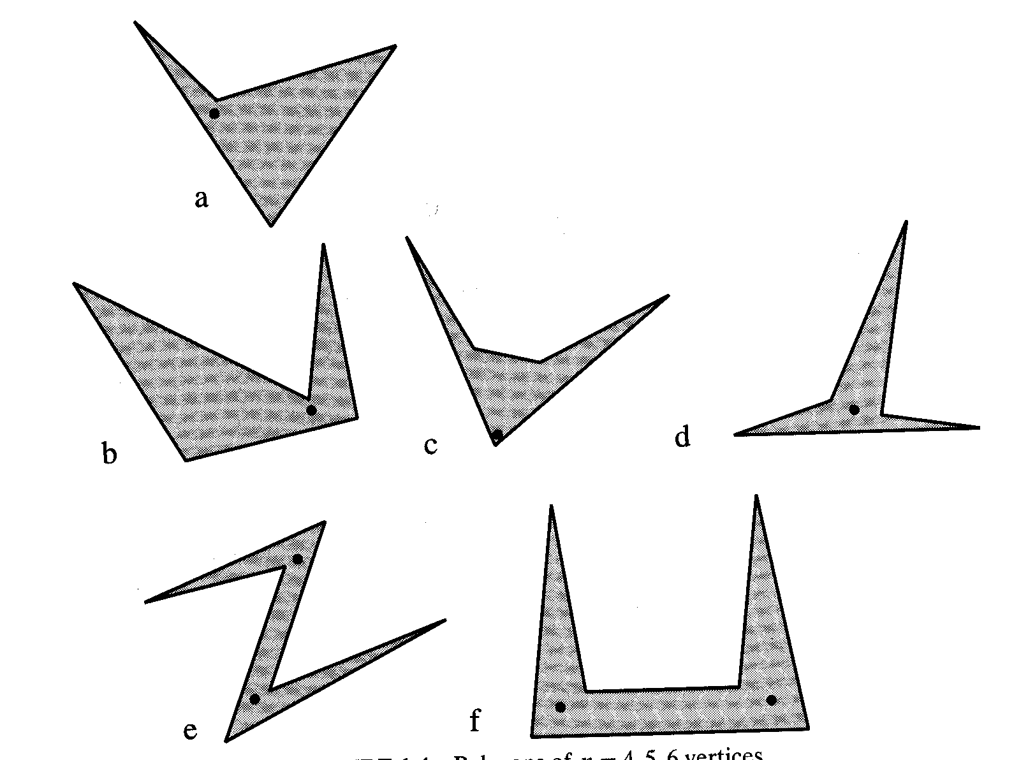
Polygon of 4 vertices
Polygons of 5 vertices
Polygons of 6 vertices

Slide 17
To make things easier, we decompose a polygon into pieces that are easy to guard.
Polygon is a triangle
One guard is sufficient.
We divide the polygon into triangles and set a guard for each polygon.

Slide 18
Triangulation
A decomposition of polygon into triangles by a maximal set of non-intersecting diagonals is called a triangulation of the polygon.
Does every simple polygon admit a triangulation?
What is the number of triangles in a triangulation?

Slide 19
Theorem
Every simple polygon admits a triangulation, and any triangulation of a simple polygon with n vertices consists of exactly n-2 triangles.
Proof : by induction on n

Slide 20
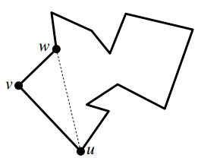
Theorem
Proof [First Part]
By induction.
Trivial for n = 3.
Assume true for all m < n.
Let n >3
Assume v be the leftmost vertex and u and w its two neighbors.
• uw in the interior of P ⇒ it is a diagonal.

Slide 21
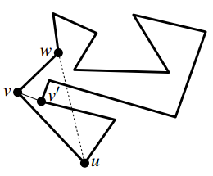
Theorem
Proof [First Part]
Otherwise, the triangle determined by u, v, w contains at least one vertex. Let v′ be the one closest to v. Then vv′ is a diagonal.
So a diagonal exists.
The diagonal splits the polygon into two subpolygons
(which by induction can be triangulated).

Slide 22
Theorem
Proof [Second Part] Any triangulation of Polygon consists of n−2 triangles
Any diagonal splits P into two simple polygons with m1 and m2
vertices, respectively.
By induction these two subpolygons can be triangulated.
They are decomposed into m₁ – 2 and m₂ – 2 triangles, resp.
Every vertex of P occurs in exactly one of the two subpolygons, except for the vertices defining the diagonal, which occur in both subpolygons
Thus m₁ + m₂ = n + 2.
By induction, any triangulation of Pi consists of mi −2 triangles
(m₁ −2)+(m₂ −2) = m₁ + m₂ −4 = n + 2 – 4 = n - 2
By induction, the triangulation of Poygon has (m₁ – 2) + (m₂ – 2) = n – 2 triangles.

Slide 23
Any simple polygon with n vertices can be guarded with n -2 cameras.

Slide 24
By placing the cameras on wel-chosen diagonals,
We might be able to reduce the number of cameras to roughly n/2.
Placing cameras at vertices seems even better, because a vertex can be incident to many triangles, and a camera at the vertex guards all of them.

Slide 25
Placing cameras at vertices seems even better, because a vertex can be incident to many triangles, and a camera at the vertex guards all of them.

Slide 26
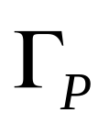
Let be a triangulation of P.
Select a subset of the vertices of P such that any triangle in has at least one selected vertex, and place the cameras at the selected vertices.
We can find such a subset by 3-coloring of vertices.

Slide 27
We can find such a subset by 3-coloring of vertices.

Slide 28
Red, Green, Blue
3-coloring : coloring of vertices by 3 colors.
Any two vertices connected by an edge or an diagonal have different colors.
Every triangle has a red, a green and a blue color.
We can find such a subset by 3-coloring of vertices.

Slide 29
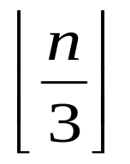
Choosing cameras at one of the color need at most
Cameras.

Slide 30
Does a 3-coloring always exist?
How to find a 3-coloring of triangulated polygon if it exists?
Constructive Proof

Slide 31
Triangulation Dual
Dual Graph

Slide 32
Lemma. The dual of a triangulation is a tree with each node of degree at most three.

Slide 33
Triangulation Dual T
We can compute 3-coloring of the triangulated polygon by using depth first search on T starting from any vertex.
Notes:
Dual graph: This graph G(TP ) has a node for every triangle in TP .
There is an arc between two nodes ν and µ if t(ν) and t(µ) share a diagonal.
G(TP ) is a tree.

Slide 34
Notes:
Find 3-coloring by DFS traversal of G:
– Start from any triangle and 3- color its vertices –
--When reaching new triangle we cross an already colored diagonal
– Choose the third color to finish the triangle

Slide 35
Triangulation Dual T
µ
v
Notes:
For 3-coloring: Traverse the dual graph (DFS).
Invariant: so far everything is nice. Start from any node of G(TP ); color the vertices.
When we reach a node ν in G, coming from node µ.
Only one vertex of t(ν) remains to be colored. [we denote a triangle corresponding to a node v by t(v)]

Slide 36
Triangulation Dual
Dual Graph

Slide 37
Triangulation Dual
Dual Graph

Slide 38
Thus the vertices of every triangle will be in three different colors.
Choose the smallest color class to place the cameras.
⇒ ⎣n/3⎦ cameras.

Slide 39
Theorem
For a simple polygon with n vertices
cameras are occasionally necessary and always sufficient to have every point in the polygon visible from at least one of the cameras.
Sufficiency: we have proved by construction.
Necessity?

Slide 40
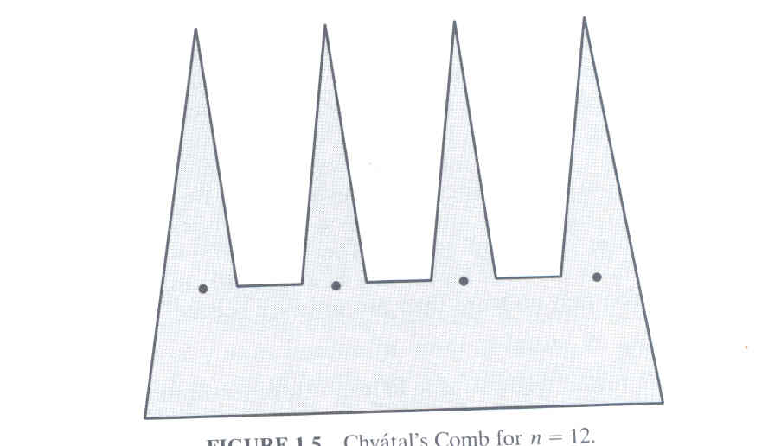
A Worst Case
There exists no position at which a camera can oversee two prongs.
⎣n/3⎦ cameras are needed.
⎣n/3⎦ prongs
Polygon of 12 vertices
The 3-coloring approach is optimal in the worst case.

Slide 41
Art Gallery Theorem
For a simple polygon with n vertices, ⎣n/3⎦ cameras are
sufficient to have every interior point visible from at least
one of the cameras.
Solution to the Art Gallery Problem
1.. Triangulate a simple polygon with a fast algorithm.
2. Construct the triangulation dual and Generate a
3-coloring by DFS (as presented earlier).
3.. Take the smallest color class to place the cameras.
Time Complexity ? ➔ O(nlogn)
How to find a triangulation of a polygon?➔Study
Notes:
Now we know that n/3 cameras are always sufficient. But we don’t have
an efficient algorithm to compute the camera positions yet.

Slide 42
References
“Computational Geometry
Algorithms and Applications”
—Mark de Berg
  Chapter-3:Polygon Triangulation

Slide 43

Thank You

