Slide 1
Uber ride numbers vs weather conditions
Comparing the number of Uber rides vs, the weather during a six-month period in New York City. Made by Group 6 (Kam Deol, Will Abate, Vanessa Gonzales).

Slide 2
Interesting Questions About the data:
Did certain weather conditions effect the total number of Uber rides taken in a city (New York City)?
During which weather conditions were Uber rides requested most?
Did holidays effect Uber rides purchased?

Slide 3
Where & how we found the data to answer our questions
Link 1(Uber ride data): https://www.kaggle.com/datasets/fivethirtyeight/uber-pickups-in-new-york-city?resource=download&select=uber-raw-data-jul14.csv
Found while Googling Uber’s ride numbers.
Alternative (weather data): https://www.wunderground.com/history/monthly/us/ny/new-york-city
We found this data set while looking for a weather API that would give us data from April 2014 through September 2014.
Data set we found that we were able to write csv’s for and split by month.

Slide 4
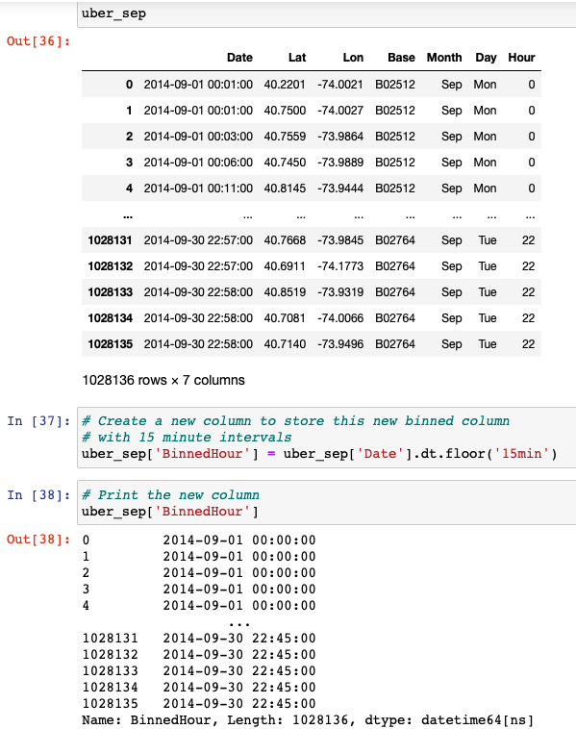
Data Exploration process
During our initial exploration of the data, after we merged our six data sets, we noticed we had over 4.5 million rides to sort through. During the process of identifying how best to present the data to the group but then also during the presentation it was decided to bin the data into 15-minute increments.

Slide 5
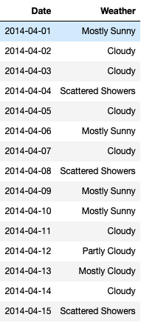
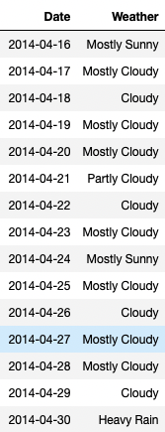
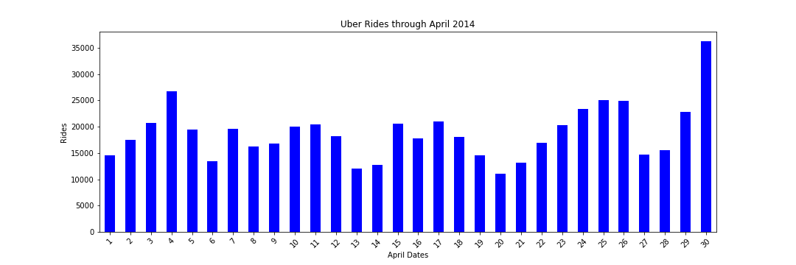
Analysis of data (April)
Rain on both days that have a spike on the graph.
Easter Sunday had the least number of total rides in April.

Slide 6
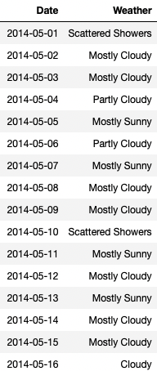
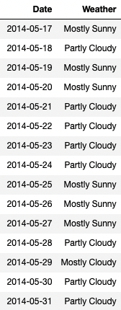
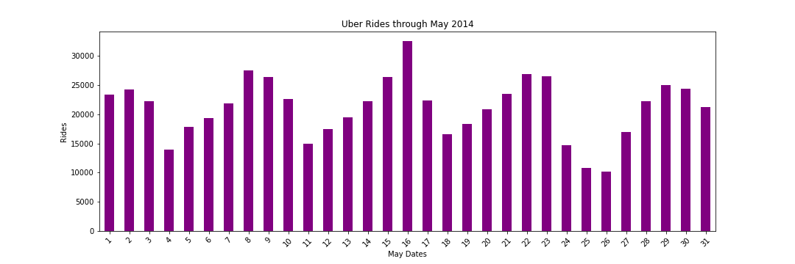
Analysis of data (MAY)
The peak number of rides was the 16th , the weather was partly cloudy
Memorial Day (26th) had the least number of total rides.

Slide 7
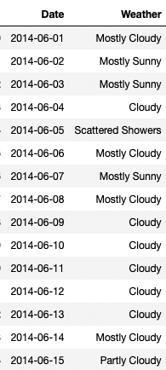
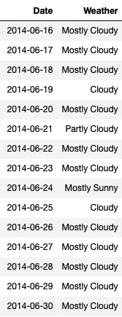
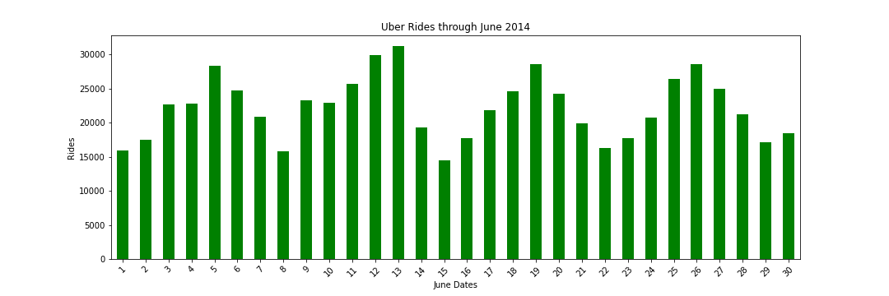
Analysis of data (June)
No holidays impacted the number of total rides.
Thursdays are consistently the highest number of total rides in June.

Slide 8
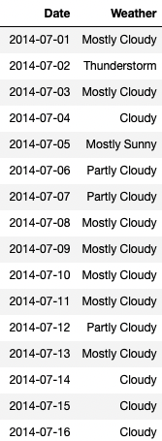
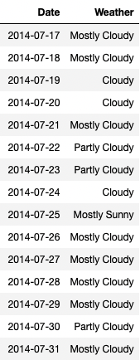
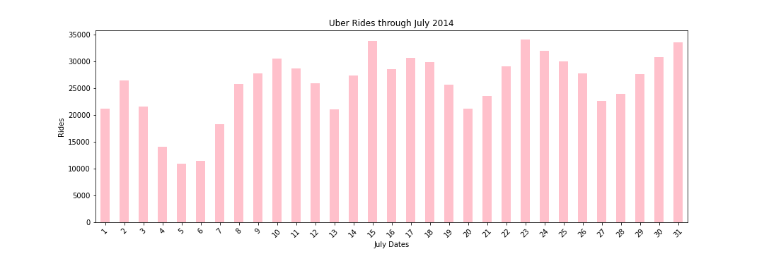
Analysis of data (July)
Independence weekend was a low point for the whole month of July.

Slide 9
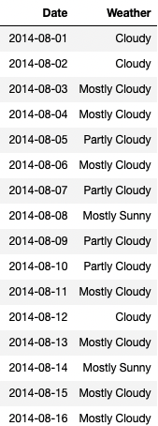
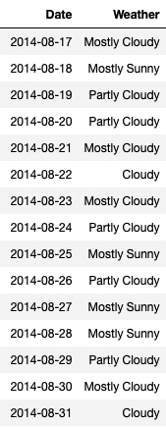
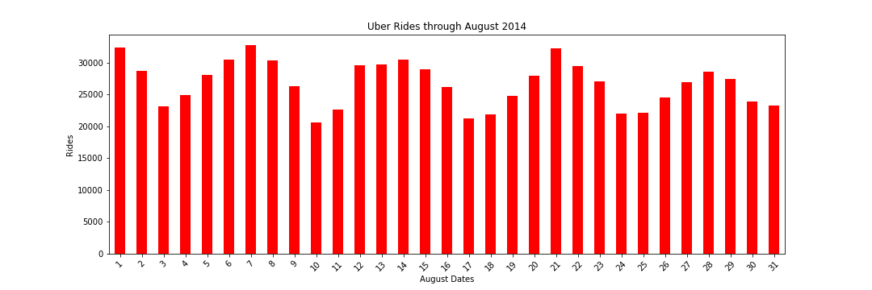
Analysis of data (August)
National friendship and girlfriend day (August 1st) was a top performer for the month.

Slide 10
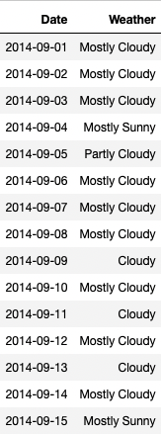
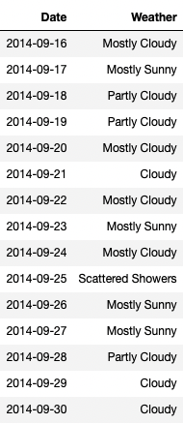
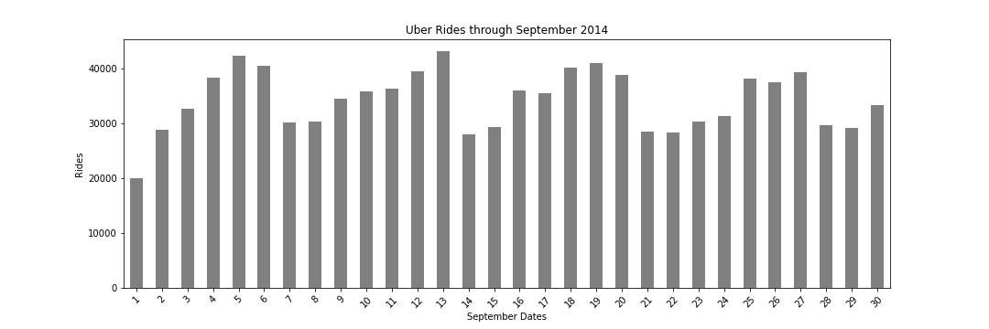
Analysis of data (September)
September 1st (Labor Day) was the lowest total number of rides for September.

Slide 11
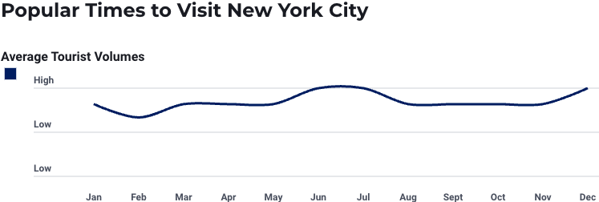
Conclusion
No real correlation between weather conditions and Uber rides purchased in New York City in 2014.
Uber rides were purchased the most during mostly cloudy and mostly sunny days.
May be because these conditions existed the most out of all listed weather conditions.
Holidays seemed to have minimal effect on the total number of Uber rides purchased.
Summer months had more total Uber rides purchased compared to the spring months.
Due to summer tourism.

