Slide 1


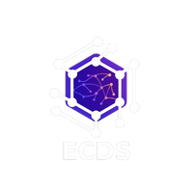


ECDS
MEDI-LEAD
UNTITLED!

Slide 2
ECDS
PROBLEM STATEMENT
Healthcare providers face a number of queries from patients through various channels such as:
• Website forms
• WhatsApp
• Social media
The major challenges faced in handling the leads are:
• Delay in responding to the queries of the patients
• Manual handling of the leads by the staff
• Poor lead qualification
• High rate of lead drop-off
A lead that is not contacted within 5 minutes is 10 times less likely to convert.
However, there is no such system that can immediately respond and convert the leads.

Slide 3
ECDS
OUR SOLUTION:
We have created an AI-powered Lead Conversion Agent that works 24/7.
The system can:
• Automate the collection of leads from Web Chat and WhatsApp
• Instantly respond to them with personalized messages
• Qualify the leads using AI-powered conversations
• Score the leads (Hot, Warm, Cold)
• Book appointments for high-intent patients

Slide 4
ECDS
Key Unique Features:
• AI Conversation Agent: Automates patient interaction
• Smart Lead Scoring System: Hot / Warm / Cold
• Automatic Appointment Booking: Based on doctor availability
• Lead Capture: Through web and WhatsApp
• Continuous Learning System: Improves conversion strategies
USP:
An AI system that automatically converts patient inquiries into confirmed appointments.

Slide 5
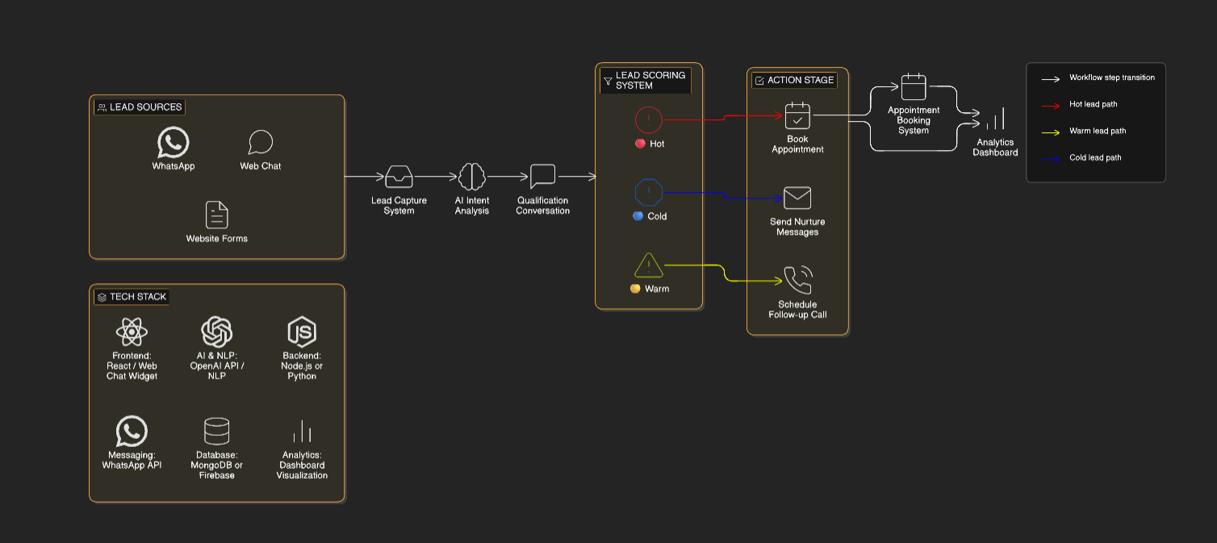
ECDS
WORKFLOW DIAGRAM WITH TECH STACK

Slide 6
ECDS
Lead Scoring System:
Lead scoring helps prioritize patients.
Hot Lead • Clear medical need • Urgent timeline • Ready to book appointment
Warm Lead • Interested but not urgent • Needs more information
Cold Lead • Only researching options
This ensures high-priority patients receive immediate attention.

Slide 7
ECDS
System Tools:
Main Functional Modules:
• capture_lead() – Extracts patient information • classify_intent() – Detects service type and urgency • ask_qualification_question() – Collects patient needs • score_lead() – Categorizes lead readiness • check_doctor_availability() – Finds available slots • book_appointment() – Confirms appointment • log_interaction() – Records lead activity

Slide 8
ECDS
Analytics Dashboard:
The system tracks lead performance through a dashboard.
Key metrics include:
• Total leads captured • Leads qualified • Appointments booked • Conversion rate • Channel performance • Service demand trends
Helps healthcare providers improve marketing and patient conversion strategies.

Slide 9
ECDS
Adaptive Learning:
The AI continuously improves using past interactions.
Process:
• Records conversation paths • Tracks converted and lost leads • Analyzes best performing question sequences • Updates qualification strategy automatically
Result:
A self-learning system that improves conversion rates over time.

Slide 10
ECDS
Team Members:
Harisivanesh P – 24MIA1074
Kameshwaran MM – 24MIA1047
Mathilesh E – 24MIA1139
Mukesh T- 24MIA1065
Santhosh S – 24MIA1049
Haswinth M – 24MIA1036

