Slide 1


Slide 2
Chemkin database Parser
Manikandarajan.M
Kameshwaran.B.N

Slide 3
Objective
Use an octave script file to read data from the Chemkin formatted database and find the thermodynamic properties of gases
Understand the behaviour of gases at various temperature – from the temperature curves

Slide 4
Motivation
Octave is a new tool for us to use
Octave being a high level language is much simple to the user
Scientific computing along with intelligence of machine makes complex problems simple
Experimenting with newer concepts and algorithms is always fun

Slide 5
Coding Framework
Locate the database
Look for the interested Gas (aka species)
Find the effective range of temperature
Get all the coefficients for that range of temperature
Calculate c_{p,} Hº , Sº
Plot a curve for all properties vs. Temperature

Slide 6
Coding Framework (contd...)
The equations are
c_{p} = cal/mol-K R=1.987 cal/mol-K
Hº = cal/mol
Sº = cal/mol-K

Slide 7
Coding Framework (contd...)
Understanding the database :
Line 1 : Species Name T_{min} T_{max} T_{mid}
Line 2 : Coefficients (a₁ to a₅ )
Line 3 : Coefficients (a₆ to a₁₀ )
Line 4 : Coefficients (a₁₁ to a₁₄ )
:: Coefficients are precise of 10 decimal points in scientific notation

Slide 8
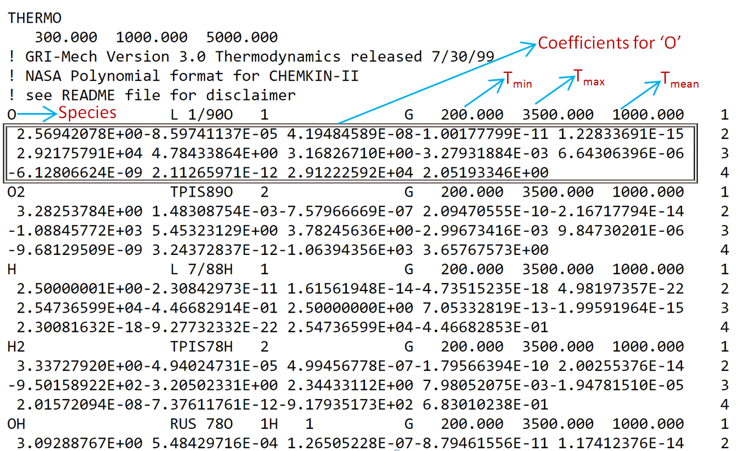

Slide 9
Script pseudocode:
LOAD database
INPUT Species, Temperature
FIND Species
IF FOUND
FIND Temperature limits for the input temperature
FIND coefficients in the successive lines
OTHERWISE
PRINT Not Found
CONVERT coefficients into numbers from string
CALCULATE c_{p} , Hº , Sº

Slide 10
Script Pseudo code (contd...)
PRINT c_{p,} Hº , Sº
FOR Temperature = lower limit : upper limit
CALCULATE properties for all temperature
PLOT properties vs. Temperature
RELEASE the database

Slide 11
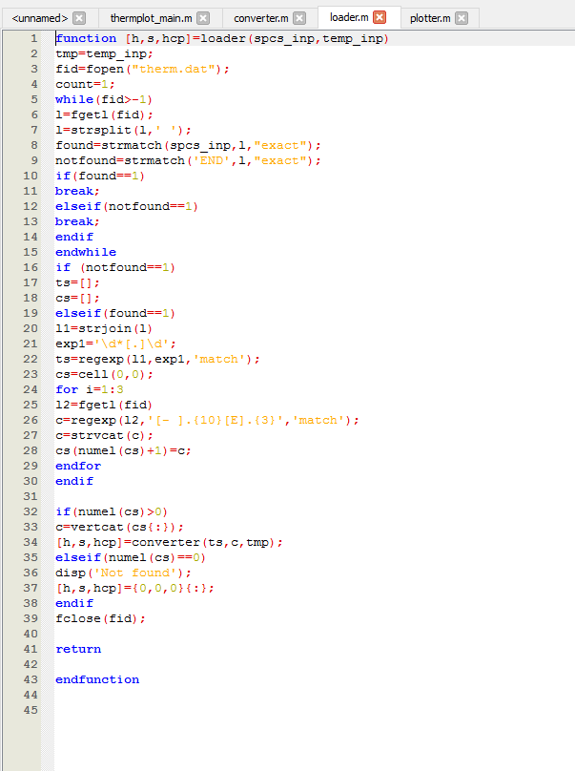
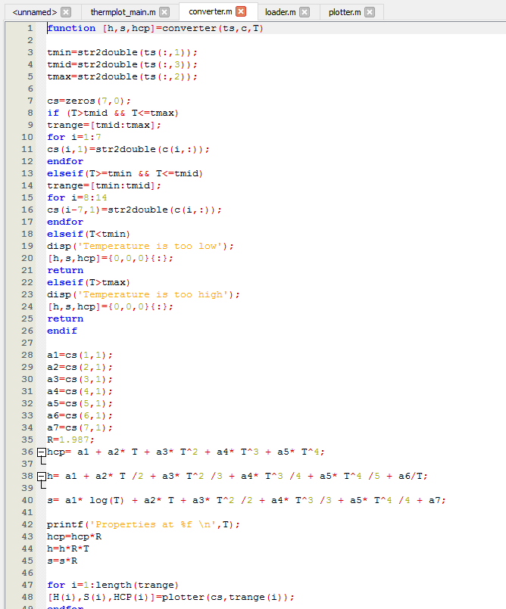
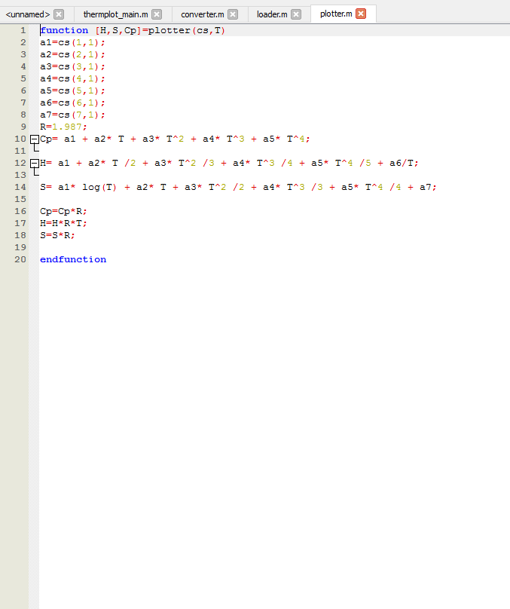
Script file (explained)

Slide 12
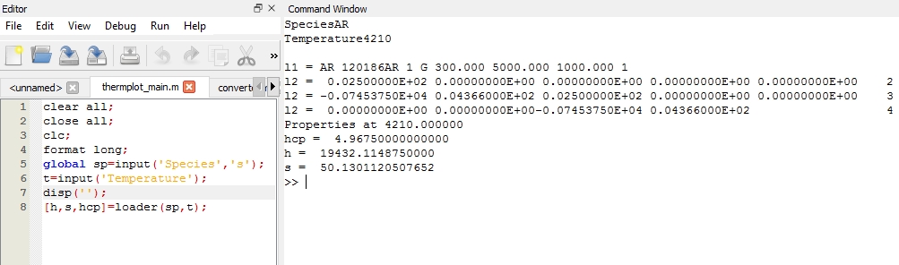
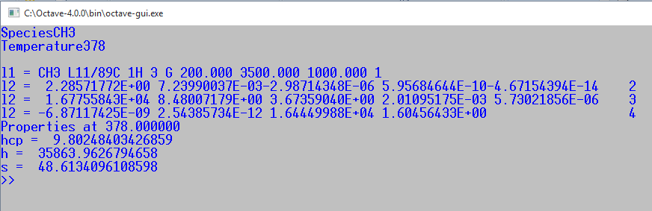
Using script
In Octave GUI :
In Octave CLI

Slide 13
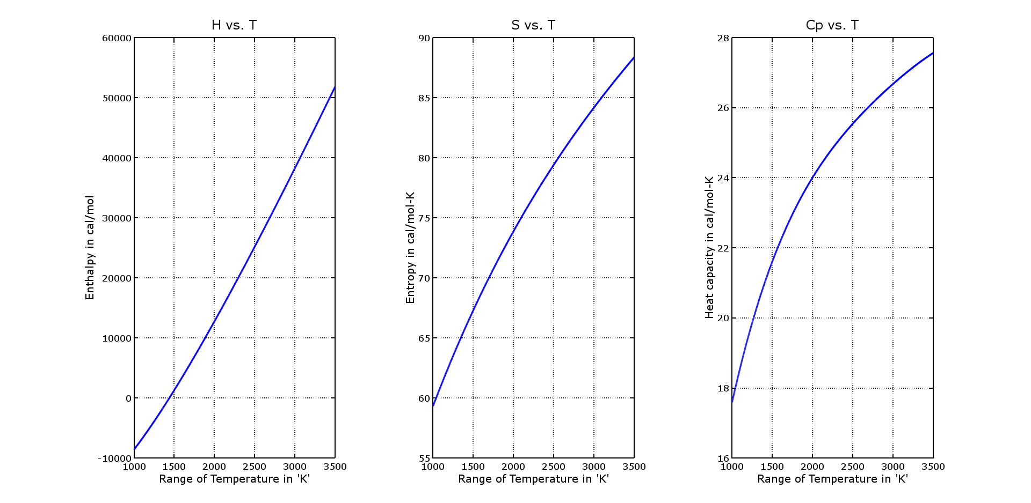
Plot Results
CH4

Slide 14
Testing
The plots can be checked by molar mixing or mass mixing
C_{p} of air = c_{p} of N₂ * 0.79 + c_{p} of O₂ * 0.21 (by molar mixing)
C_{p} of air = c_{p} of N₂ * 0.77 + c_{p} of O₂ * 0.23 (by mass mixing)
eg., @ 300 K , c_{p} of N₂ = 6.948 and O₂ = 7.023
Hence, for air = 6.948(0.79) + 7.023(0.23) = 7.104 cal/mol-k
In J/mol-k c_{p} = 29.83

Slide 15
Testing (contd...)
The air values can be referred from standard tables for different temperatures
Temperature out of bounds are input for any misbehavior of the output
Similarly, unknown species, species(case-sensitive) are also tested.

Slide 16
Inference
From the plots, the thermo chemical behaviour of the gases are studied.
For example, ammonia gas has lowered heat capacity above 5000 K
H₂ has lower enthalpy than H

Slide 17
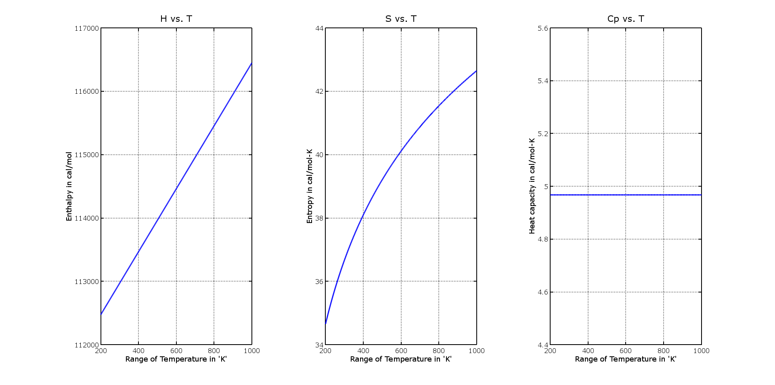
Comparison
CO₂

Slide 18
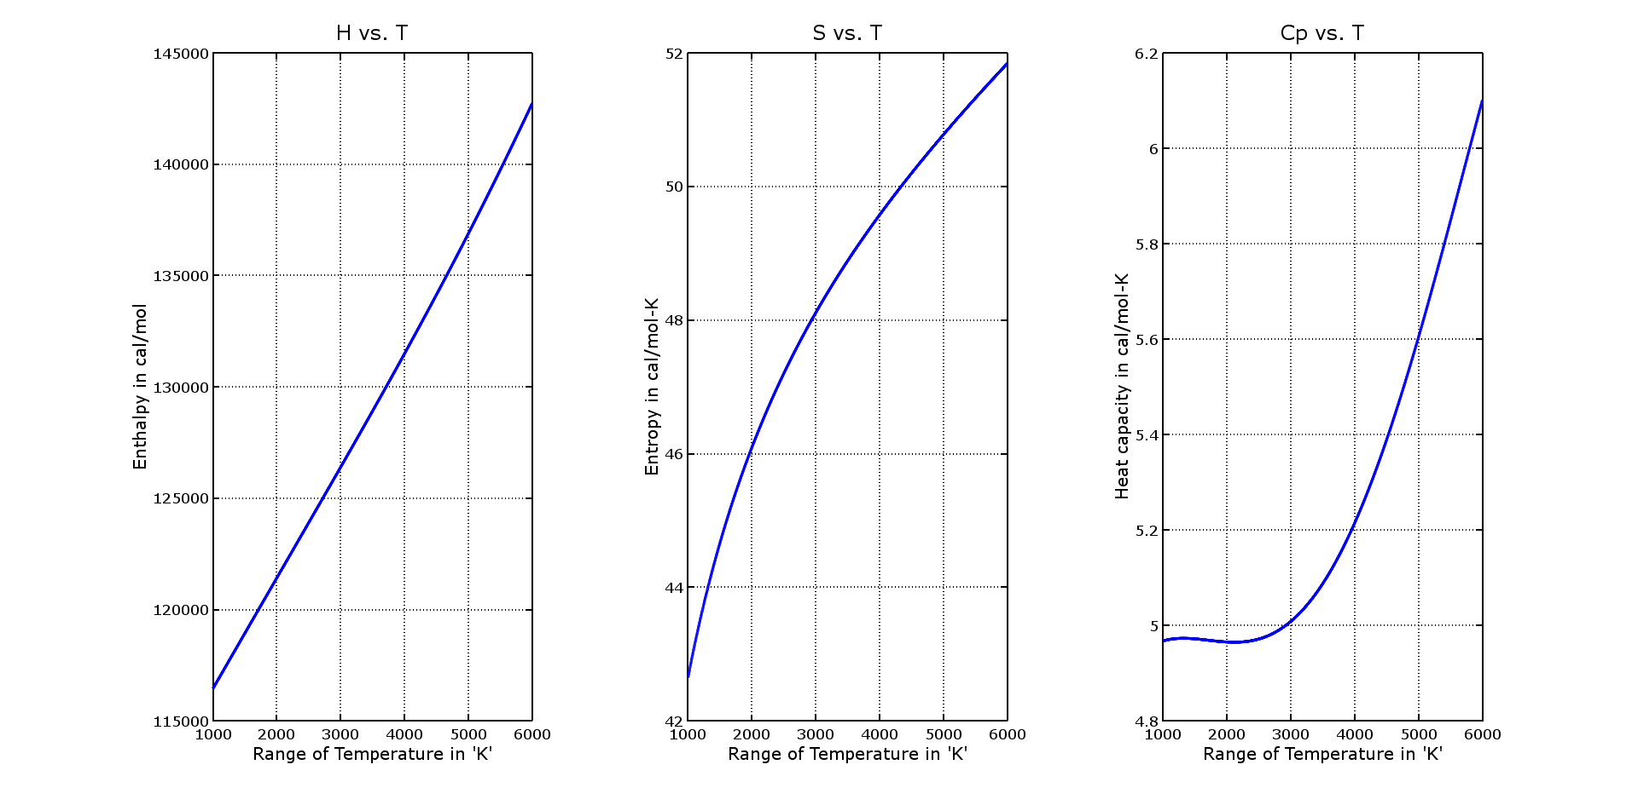
Comparison (contd...)
N

Slide 19
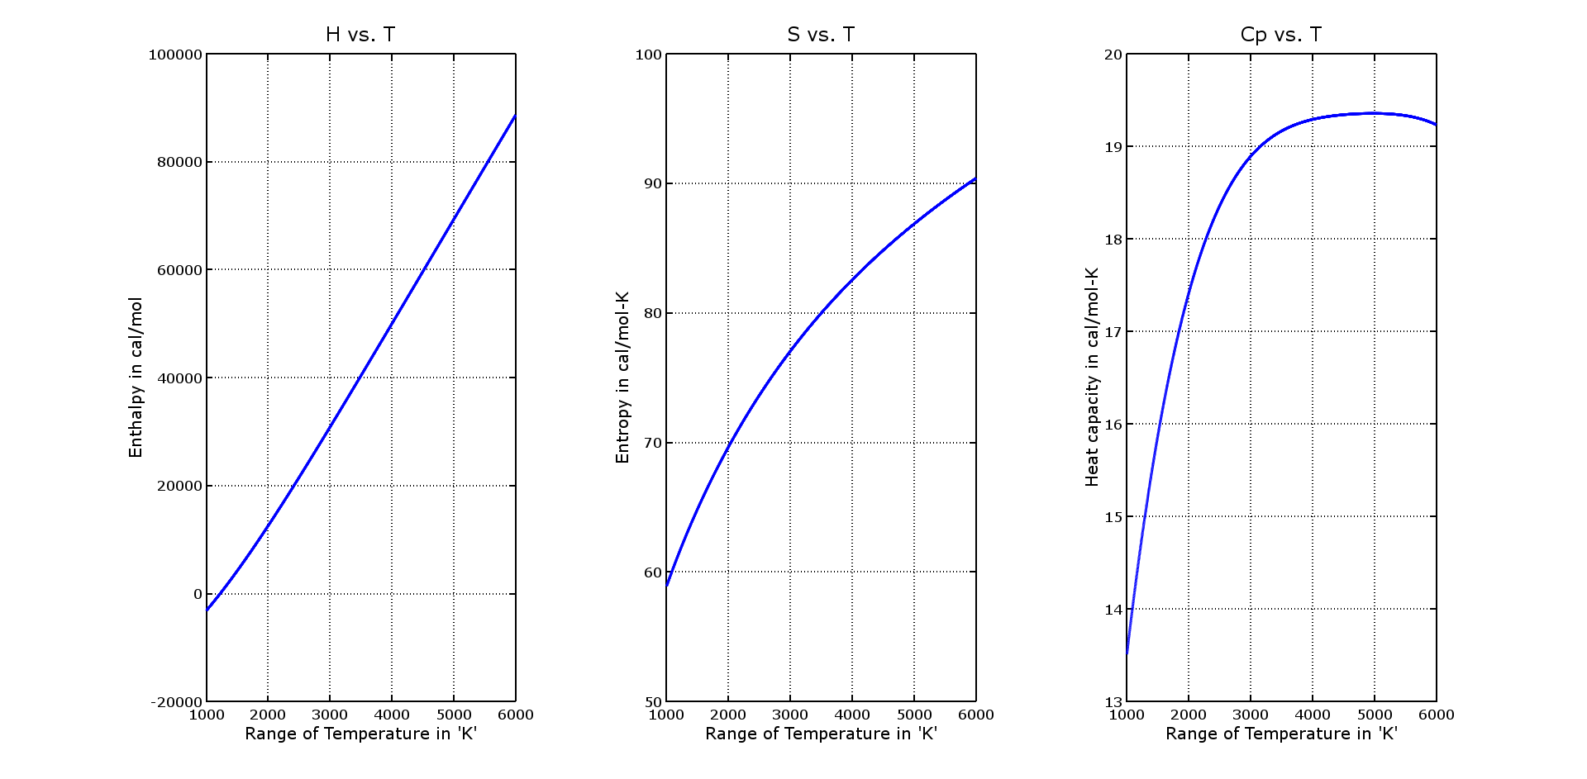
Comparison (contd...)
NH₃

Slide 20
References:
http://www.edxengine.com
http://www.gnu.org/software/octave/doc/v4.0.0/ (software help)
http://combustion.berkeley.edu/gri_mech/
http://combustion.berkeley.edu/gri_mech/version30/files30/thermo30.dat
http://combustion.berkeley.edu/gri_mech/data/nasa_plnm.html (equations)
http://www3.nd.edu/~powers/ame.60636/kee2000.pdf (manual)

