Slide 1
Marketing Campaign Optimization

Slide 2
Overview
A food company wants to produce the highest profit for the next direct marketing campaign, scheduled for the next month. A pilot campaign involving 2.240 customers was carried out, customers who bought the offer were properly labeled. The total cost of the sample campaign was 6.720MU and the revenue generated by the customers who accepted the offer was 3.674MU.Globally the campaign had a profit of -3.046MU and the success rate of the campaign was 15%.
This presentation will demonstrate the optimization developed for a large marketing campaigns. Furthermore it discusses how to reduce the complexity of large optimization problems, and how to develop a effective optimization application using Excel combined with Excel Solver to achieve our goal to maximize the Monetary, Frequency and recency for the organization.

Slide 3
Problem Statement
1
2
3
4
To decide how many catalogs to mail to each
segment in order to maximize Monetary, subject to certain
constraints that we will specify (e.g., limited marketing budget)
We have detailed info on 1.12MM customers. However, even before optimization, we know we can't
contact all of them
In interest to seeking to optimize marketing campaigns of any size while managing operational and computational complexity.
The decision to be made is to determine the percent expected to maximize Monetary that stays within our constraints.

Slide 4
Objective
2
1
3
Maximize Frequency, Recency and Monetary values
Decision Variables
Constrains
12 segments of previous campaign results, model scores, age bands x 2 response bands x 2 and sales bands
Limited number of customers to
contact, limited marketing budget.
As per data our company already
Still in its profit goals, but is falling short in its sales goals.
4
Expected Outcome
Of the possible decisions, the analysis is carried out in order to achieve the objective
and satisfy the constraints.

Slide 5
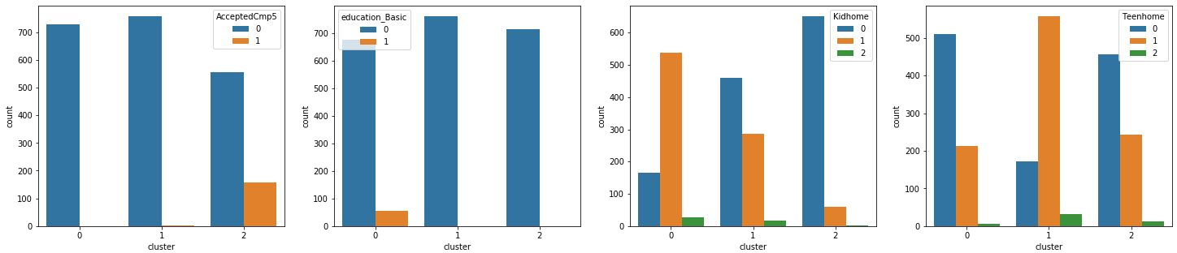
Customers Profile
Cluster 0 - Low Income Cluster 1 - Avg Income
Cluster 2 - High Income
730 customers
Represents the most part of Basic Education customers
The majority have just one Kid
761 customers
The majority has 1 Teenager at home
714 customers
Buy more, in special Wine
Accept more Campaigns, in special
Cmp 5
The majority has no kids
High Store purchases and low Web Visits

Slide 6
Recency, Frequency, Monetary
The business goals is to achieve success within budget constraints
Optimization models can identify if a RFM segment is worthy of pursuing, which create a balance between errors
Type I error: when organizations ignore customers who should have been contacted because they could have returned and repurchased
Type II error: when organizations reach customers who are not ready to purchase
The RFM approach is often used as a promotional decision-making tool in which “promotional spending is allocated on the basis of people’s amount of purchases and only to a lesser degree on the basis of their lifetime of duration.”

Slide 7
Resources
Tool
References:
Microsoft Excel:
Data Tables
Solver
Pivot Tables
Conditional Formatting
Data:https://www.kaggle.com/datasets/jackdaoud/marketing-data?select=ifood_df.csv
https://people.orie.cornell.edu/huseyin/lp_book.pdf
https://www.researchgate.net/publication/228791187_Linear_optimization_Theory_methods_and_extensions

Slide 8
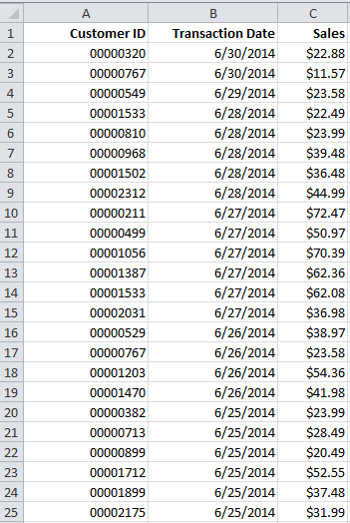
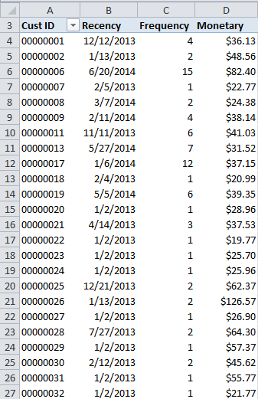
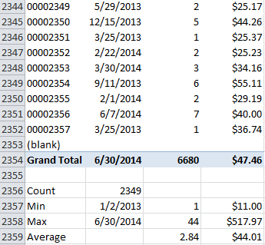
Using Pivot Table to Summarize Records
Bottom Part of the Pivot Table and Summary Statistics
Partial Top Results of the Pivot Table

Slide 9
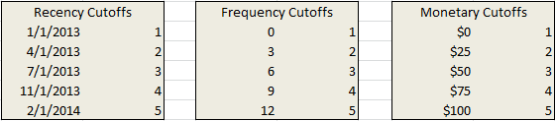
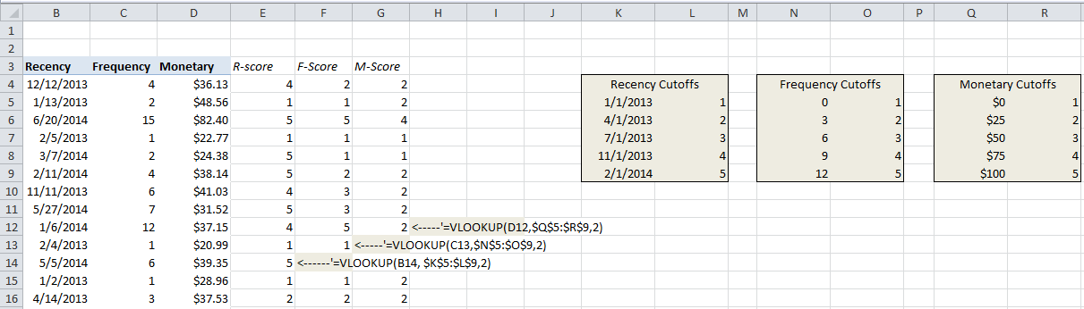
Using Vlookup to Assign RFM Score
RFM Cutoff Points
Applying Vlookup to Generate R-F-M Scores

Slide 10
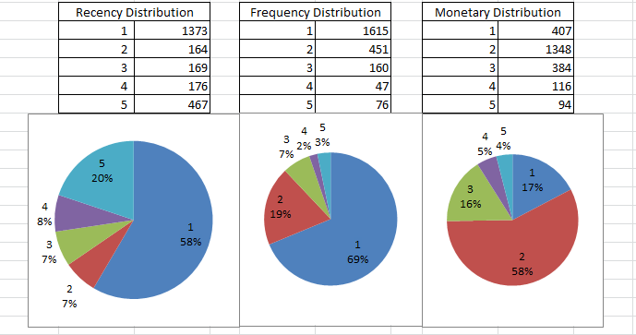
Distributions of Customers by Recency, Frequency, and Monetary Value

Slide 11
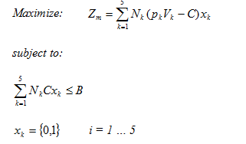
LP Model for the Monetary Value Case
Monetary Cutoffs |  | Vk | Pk | Nk
$0 | 1 | $32.57 | 0.52 | 407
$25 | 2 | $111.92 | 0.50 | 1348
$50 | 3 | $203.20 | 0.50 | 384
$75 | 4 | $293.81 | 0.51 | 116
$100 | 5 | $4333.88 | 0.49 | 94
Parameters for LP Monetary Model

Slide 12
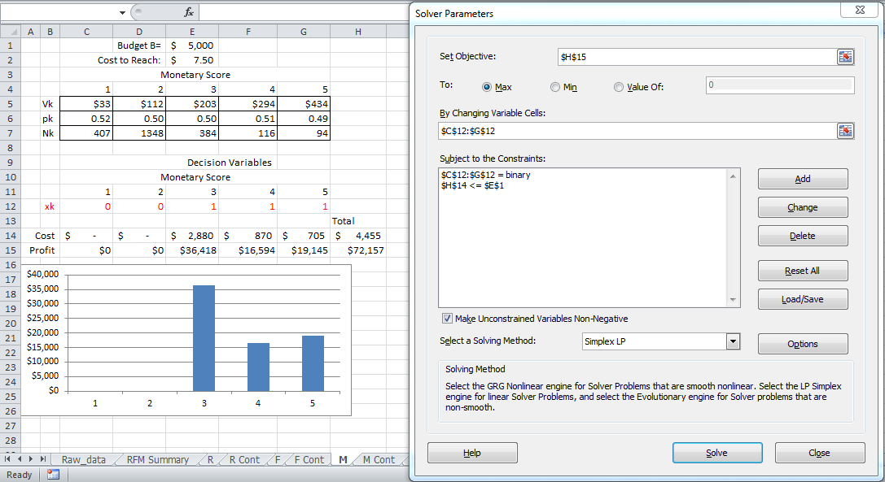
Solving the LP Model for the Monetary Value
Optimal Solution for the Monetary Model with Binary Decision Variables

Slide 13
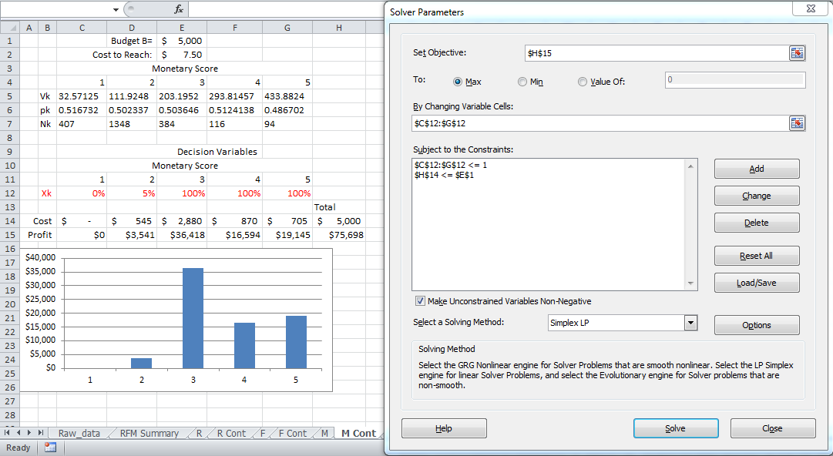
Solving the LP Model for the Monetary Value
Optimal Solution for the Monetary Model with Continuous Decision Variables

Slide 14
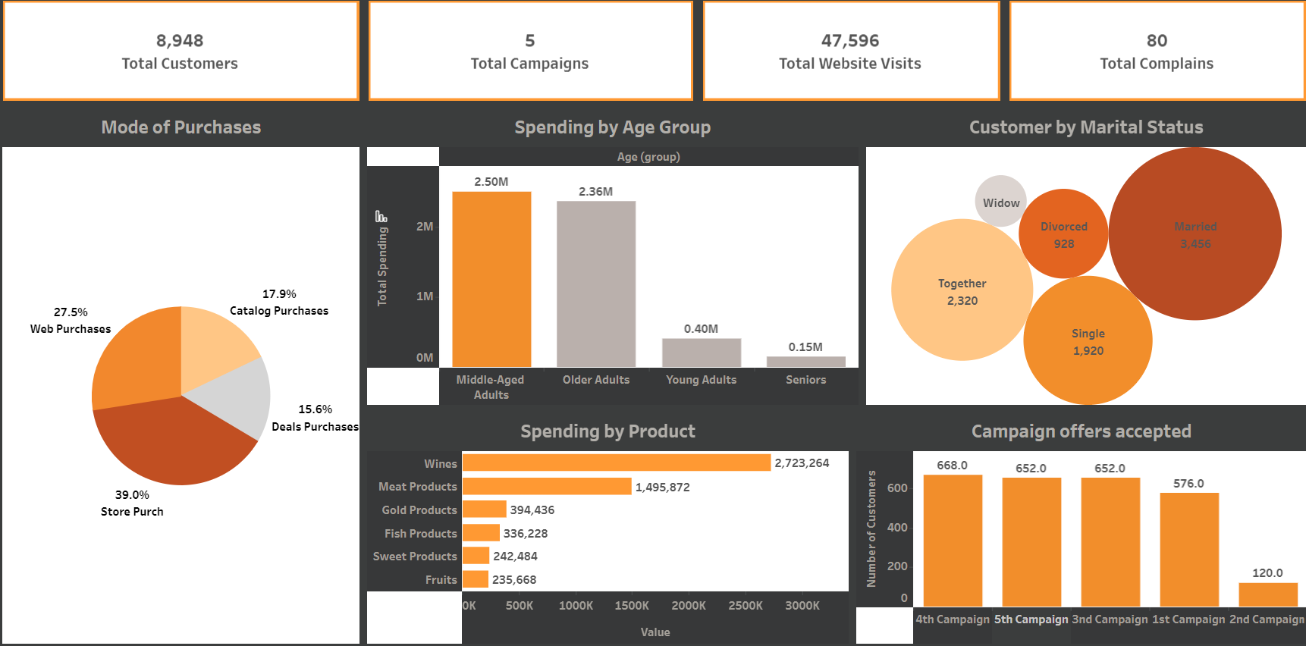
Overall optimized representation of the Campaign
Expected
acceptance

Slide 15
Conclusion
Campaign Expectation
Monetary | 8.475428
AcceptedCmpOverall | 8.151117
Customer_Days | 7.842309
Income | 5.412607
MntTotal | 5.098285
MntWines | 4.935032
MntRegularProds | 4.713860
MntMeatProducts | 4.602892
For the new campaign for which we developed a Linear model that classifies if the customer will accept the offers or not.
We can optimize as per the data and expect to conclude the acceptance rate with 87% of accuracy
With the history of past Campaigns, the Income and the customers fidelity (Age as a customer and Recency).

Slide 16
Thank you!! Questions and Suggestions Please

