Slide 1

CSC415 Operating System Principles
Processes
Professor Hao Yue
Fall 2017

Slide 2

Outline
Process Concept
Process Scheduling
Process Operation
Inter-Process Communications
Shared Memory
Message Passing

Slide 3

Process
What to call all CPU activities?
Jobs, user programs, tasks, etc.
A process is a program in execution
A program is a passive entity, such as a file containing a list of instructions stored on disk (i.e., executable file)
A process is an active entity, with a set of associated resources
A program becomes a process when the executable file is loaded into memory
Notes:
When we discuss OS, one question is how to call CPU activities.
Two processes may be associated with the same program, but they are considered two separate execution sequences. E.g., a user run many copies of Web browser program.

Slide 4
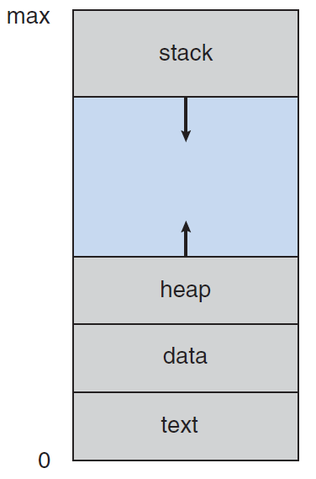
Process
A process is associated with an address space, where the process can read and write
Divide into four sections
Text section contains program code
Data section contains global variables
Heap contains the memory dynamically allocated during process run time
Process stack contains temporary data such as function parameters, local variables

Slide 5
Process Control Block
Process control block contains all the other information about the process
Process state
Program counter: the counter indicates the address of the next instruction to be executed
CPU registers
CPU scheduling information: process priority, pointers to scheduling queues, etc.
Memory-management information: page tables, segment tables, etc.
I/O status information: I/O devices allocated to the process, open files, etc.

Slide 6
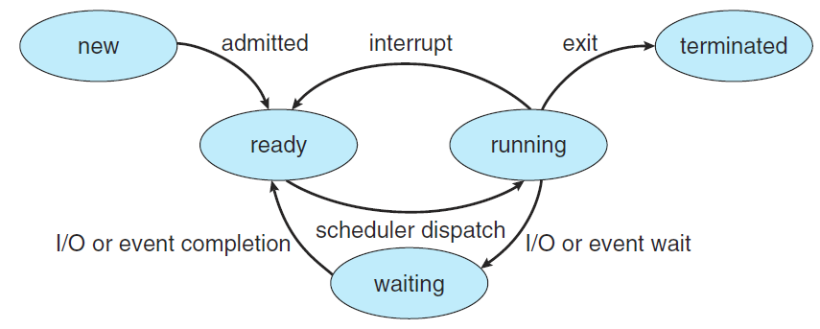
Process State
The state of a process changes as it executes
New: being created
Running: Instructions are being executed
Waiting: waiting for some event to occur (e.g., I/O completion)
Ready: waiting to be assigned to a processor
Terminated: finish execution
Notes:
One process can be running on any processor at any instant. Many processes may be ready and waiting.

Slide 7
Context Switch
Context Switch
Switching CPU to another process requires performing a state save of the current process and a state restore of a different process
Context of a process is represented in the PCB
E.g., value of CPU registers, process state, memory-management information, etc.
When a context switch occurs, kernel saves the context of the old process in its PCB and loads the saved context of the new process to run
Minimize the context-switch time to reduce the overhead
Notes:
Interrupts cause OS to change CPU from its current work to run a kernel routine. When it occurs, the system needs to save the current context of the process so that the it can restore context when it is done. The context is represented in PCB of the process. It includes the values of CPU

Slide 8
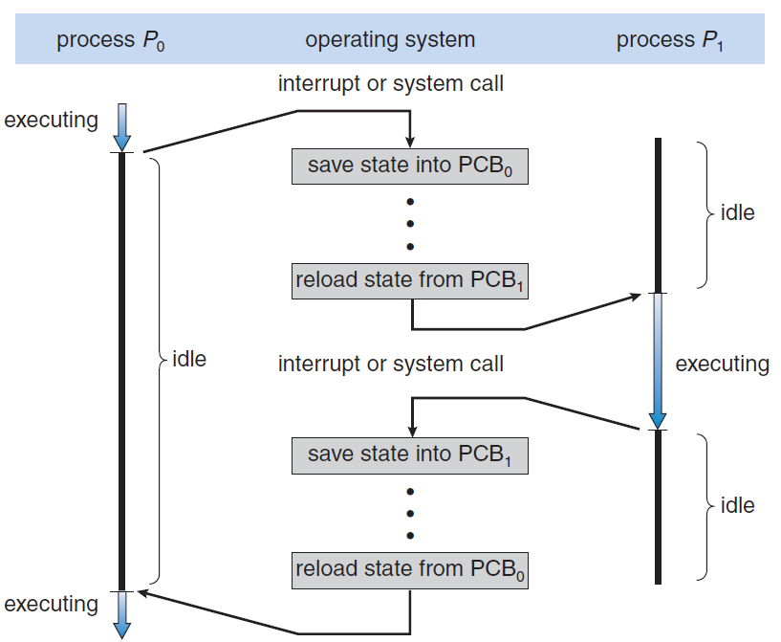
Context Switch

Slide 9
Process Operation
Process Creation
Parent process can create children process
Execution possibilities
Parent and children execute concurrently
Parent waits until some or all children terminate
Address space possibilities
Child process is a duplicate of the parent process, with the same program and data
Child process has a new program loaded into it
Notes:
OS provides mechanisms for process creation and termination.
When a process is executed, it can create new processes. Child process needs resources to accomplish its task.
Two execution possibilities.

Slide 10
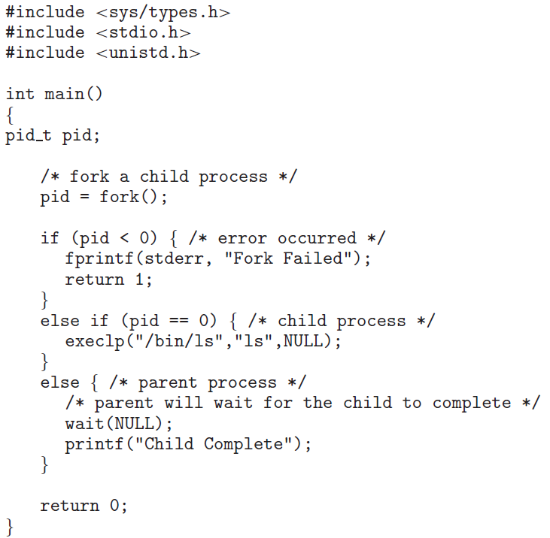
Process Operation
Process Identifier = 5000

Slide 11
Process Operation
Example: UNIX OS
Processes are identified according to a process identifier, which is a unique integer (getpid() to obtain the process identifier)
Notes:
Unix as example to show two address possibilities.
After fork(), the child process can use exec() to replace the memory space with a new program.

Slide 12
Process Operation
Process Identifier = 5000

Slide 13
Process Operation
Process Identifier = 5000

Slide 14
Process Operation
Example: UNIX OS
Processes are identified according to a process identifier, which is a unique integer (getpid() to obtain the process identifier)
fork(): create a new process
Child process has a copy of the address space of parent process
Both processes continue execution at the instruction after fork()
The return value for the fork() is zero for the child process, whereas the nonzero process identifier of the child is returned to the parent
Header file #include <unistd.h>
Notes:
Unix as example to show two address possibilities.
After fork(), the child process can use exec() to replace the memory space with a new program.

Slide 15
Process Operation
Process Identifier = 5000

Slide 16
Process Operation
Process Identifier = 5000
Process Identifier = 1234
pid = 1234
pid = 0

Slide 17
Process Operation
Process Identifier = 5000
Process Identifier = 1234
pid = 1234
pid = 0

Slide 18
Process Operation
Process Identifier = 5000
Process Identifier = 1234
pid = 1234
pid = 0
Notes:
/bin is a standard subdirectory of the root directory in Unix-like operating systems that contains the executable (i.e., ready to run) programs that must be available in order to attain minimal functionality for the purposes of booting (i.e., starting) and repairing a system.
/bin/ls specifies the pathname to the location of the new process image
Ls: the name of the executable file of the new process image

Slide 19
Process Operation
Process Identifier = 5000
Process Identifier = 1234
pid = 1234
pid = 0

Slide 20
Process Operation
Example: UNIX OS
wait(): the parent move itself off the ready queue and wait for the termination of the child
Header files
#include <sys/types.h>
#include <sys/wait.h>
Notes:
Unix as example to show two address possibilities.
After fork(), the child process can use exec() to replace the memory space with a new program.

Slide 21
Process Operation
Process Identifier = 5000
Process Identifier = 1234
pid = 1234
pid = 0

Slide 22
Process Operation
Process Identifier = 5000
Process Identifier = 1234
pid = 1234
pid = 0

Slide 23
Process Operation
Process Identifier = 5000
Process Identifier = 1234
pid = 1234
pid = 0

Slide 24
Process Operation
Example: UNIX OS
wait(): the parent move itself off the ready queue and wait for the termination of the child
exec(): replace the memory space of a process with a new program
Destroy the memory image of the program running exec() and load a new program to execute
Usually use after fork()
Header file include <unistd.h>
Notes:
Unix as example to show two address possibilities.
After fork(), the child process can use exec() to replace the memory space with a new program.

Slide 25
Process Operation
Process Identifier = 5000
Process Identifier = 1234
pid = 1234
pid = 0

Slide 26
Process Operation
Process Identifier = 5000
pid = 1234

Slide 27
Process Operation
Process Identifier = 5000
pid = 1234

Slide 28
Process Operation
Process Termination
exit(): terminate a process
Return a status value to its parent process (via wait())
Resources of the process are deallocated
Cascading termination: all its children must be terminated when a process terminates
Parent waits for the termination of a child using wait()
Pass a parameter to obtain the exit status of the child
Return the identifier of the terminated child
E.g., pid = wait(&status);
Notes:
A process terminates when it finishes the last statement and can use exit() to ask OS to delete it.
Termination can occur in other situations. E.g., the task assigned to a child is no longer required.
Usually, if a process terminates, all its children must also be terminated, called cascading termination.

Slide 29
Ex.
int main()
{
pid_t pid, pid1;
pid = fork();
if (pid == 0)
{
pid1 = getpid();
printf(“This is child process. fork() returns %d, child process ID is %d\n", pid, pid1);
}
else {
pid1 = getpid();
printf(“This is parent process fork() return %d, parent process ID is %d\n", pid, pid1);
wait(NULL);
}
return 0;
}

Slide 30
Inter-Process Communication
Processes executing concurrently in OS may be independent or cooperating
Cooperating processes can affect or be affected by other processes
Reasons to allow process cooperation
Information sharing
Computation speedup
Cooperating processes need inter-process communication (IPC) to allow them to exchange data
Two models of IPC: shared memory and message passing

Slide 31
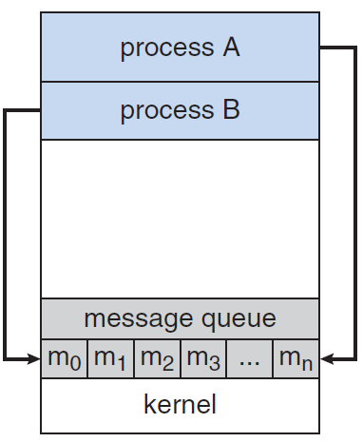
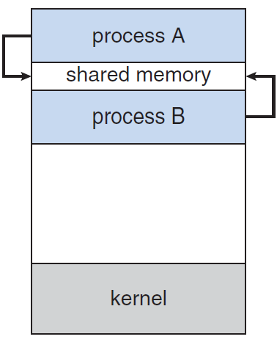
Inter-Process Communication
Message Passing
Shared Memory

Slide 32
Shared Memory
Cooperating processes establish and share a region of memory
The shared-memory region resides in the address space of the process crating the shared-memory segment
Other cooperating processes must attach it to their address space
Cooperating processes exchange information by reading and writing data to the shared region
The communication is under the control of these processes, not the OS
The processes must also ensure the synchronization of their actions when they access shared memory

Slide 33
Shared Memory
Example: Producer-Consumer Problem
Producer process produces information that is consumed by a consumer process
E.g., a compiler produces assembly code that is consumed by an assembler
Producer-Consumer problem can be solved using shared memory
Create a buffer of items that can be filled by producer and emptied by consumer
Synchronization: producer must be blocked when the buffer is full; consumer must be blocked when the buffer is empty

Slide 34
Shared Memory
Define shared variables (reside in the shared memory)
#define BUFFER_SIZE 10
typedef struct Item {
. . .
} item;
item buffer[BUFFER_SIZE];
int in = 0;
int out = 0;
Variable in points to the next free position in the buffer; out points to the first full position in the buffer
Notes:
How does the computer locate the OS and run it?

Slide 35
Shared Memory
Producer
item next_produced;
while (true) {
/* produce an item in next produced */
while (((in + 1) % BUFFER_SIZE) == out)
; /* do nothing */
buffer[in] = next_produced;
in = (in + 1) % BUFFER_SIZE;
}
Notes:
How does the computer locate the OS and run it?

Slide 36
Shared Memory
Consumer
item next_consumed;
while (true) {
while (in == out)
; /* do nothing */
next_consumed = buffer[out];
out = (out + 1) % BUFFER_SIZE;
/* consume the item in next consumed */
}
Notes:
How does the computer locate the OS and run it?

Slide 37
Example
POSIX shared memory
Shared memory is organized using memory-mapped files, which associate the region of shared memory with a file
shm_open(): create a shared-memory object
shm_fd = shm_open(name, O_CREAT | O_RDWR, 0666)
ftruncate(): configure the size of the object in bytes
ftruncate(shm_fd, 4096)
mmap(): establish a memory-mapped file containing the shared-memory object and return a pointer to the file for accessing the shared-memory object
ptr = mmap(0, SIZE, PROT_WRITE, MAP_SHARED, shm_fd, 0)

Slide 38
Message Passing
Cooperating processes use the message-passing facility provided by OS to communicate with each other
A message-passing facility provides two operations
send(message)
receive(message)
A communication link must be established between two cooperating processes in order for them to send messages to and receive messages from each other
Direct or indirect communication
Synchronous or asynchronous communication
Automatic or explicit buffering

