Slide 1

CSC415 Operating System Principles
Professor Hao Yue
Fall 2017

Slide 2

Welcome Back!

Slide 3
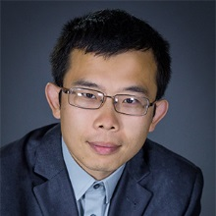
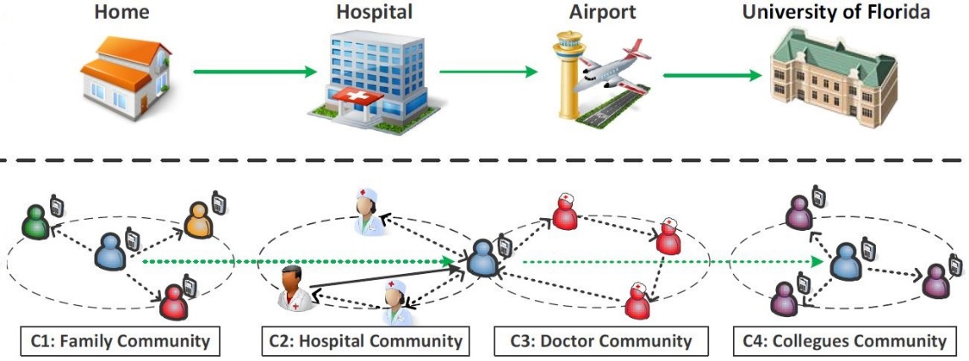
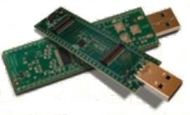
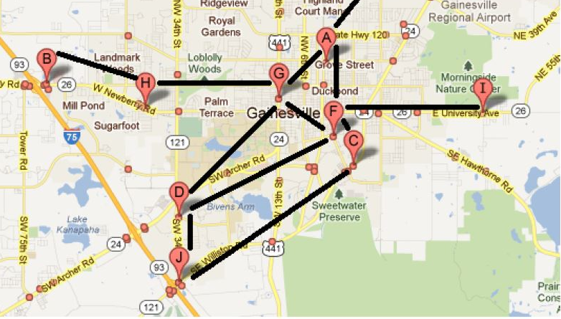
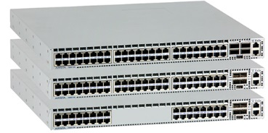
Who am I
Hao Yue
Assistant Professor
Email: haoyue@sfsu.edu
Research Interests:
Wireless Networks
Mobile Computing
Computer and Network Security
Internet of Things

Slide 4
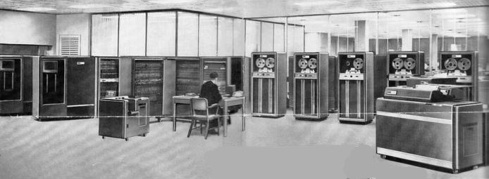
Past
IBM 704 Mainframe

Slide 5
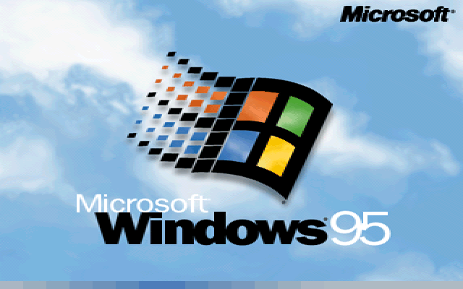


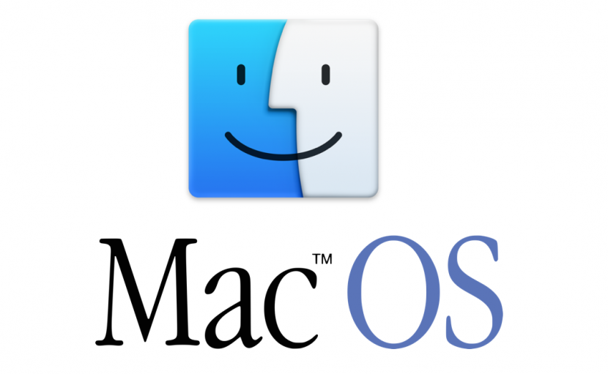
Now
Modern OS
Windows
Mac OS
Linux
…

Slide 6

Internet of Things
Internetworking of physical devices that enable them to collect and exchange data with each other
Notes:
Smallest tag like 1 cent

Slide 7



Internet of Things
Google Nest Smoke Alarm and Thermostat
Smart Coffee Maker
iWatch
…
Notes:
Smallest tag like 1 cent

Slide 8
Why we offer this course
Operating System is one of the most fundamental and important areas in CS
This course provides background knowledge for studying some other advanced courses
Computer Networks, Secure Networked Systems, Computer Organization, etc.
Essential skill for a career in CS
Google, Facebook, …

Slide 9
Course Overview
This course introduces the fundamental concepts and principles on design and implementation of operating systems
Topics will include OS Structure, System Calls, Processes, Threads, Inter-Process Communications, CPU Scheduling, Process Synchronization, Memory Allocation, Virtual Memory, Disk Management, File Systems, and other emerging topics (as time permits).

Slide 10
Learning Outcome
Students successfully completing this course will
Understand the rationale behind the design principles and implementation of modern OS’s
Gain hands-on experience in OS programming

Slide 11

General Info
Instructor: Hao Yue
Class Time/Location: Monday and Wednesday, 4:10PM-5:25PM, TH432
Office: TH930
Office Hours: Monday and Wednesday, 11:00AM-12:00PM, or by appointment
Email: haoyue@sfsu.edu
TA: Rui Feng (ruif@mail.sfsu.edu)

Slide 12
You need to know
MATH 324, CSC 256, and CSC 340
C programming language
Please contact the instructor if you have questions regarding the material or concerns about whether your background is suitable for the course.

Slide 13
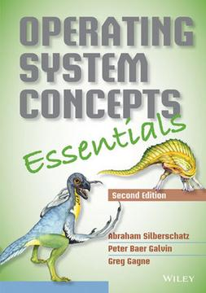
Course Materials
Textbook
Operating System Concepts Essentials, 2nd Edition
By Abraham Silberschatz, Peter B. Galvin, and Greg Gagne
Course slides, assignments, and other materials will be made available on iLearn.

Slide 14

Grading
Grading will be distributed as follows:
10% Attendance and Quizzes
10% Homework Assignments
45% Coding Assignments
35% Final Exam
Final scores will be converted to letter grades
based on a class curve
You get the grade that you earn, so be sure that
you earn a grade you like.

Slide 15
Grading
Assignments
Two homework assignments, each counts for 5% of the final grade.
Six coding assignments, counts for 45% of the final grade in total.
Exams
One final exam. Closed-book, closed-note.
Attendance and Quizzes
Five roll-calls. Each counts for 1% of the final grade.
Quizzes count for 5% of the final grade in total
Class Participation
Students actively participating in class will receive up to 5 bonus points in the final grade
Notes:
Last semester: 100-85, A; 85-70, B; 70-55, C.

Slide 16

Lateness
All assignments are due at the beginning of class
Late submission within 48 hours of the deadline is allowed, for 75% of the credits
Students with legitimate reasons should contact the instructor before the deadline to ask for an extension
Unless the problem is apocalyptic, don’t give me excuses
ALWAYS start the assignments as early
as possible

Slide 17
Academic Integrity
As scientists and engineers, we must trust each other to make progress
Academic dishonesty, whether from cheating, copying, fabricating results or through any other dishonest practice will not be tolerated
Refer to the link http://cs.sfsu.edu/plagarism.html for the department policy on plagiarism/cheating
I take this very seriously – you should too.

