Slide 1

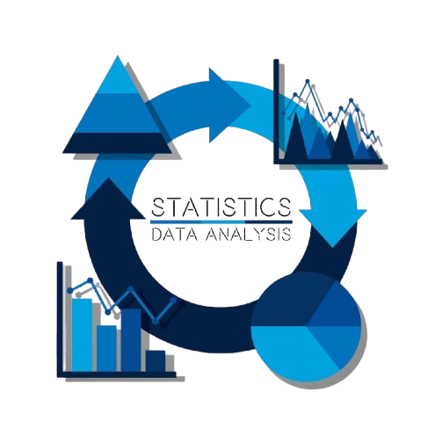
NAVTTC · Data Analytics Using Python
Statistics for
Data Analysis
Part 1 — Understanding Data Before You Analyse It
Types of Data
Central Tendency
Spread & Variability
Normal Distribution
Skewness
Instructor: Muhammad Kamil
Research Assistant DIP LAB

Slide 2

WHAT IS STATISTICS — AND WHY DO YOU NEED IT?
Statistics is the science of collecting, organising, analysing, and interpreting data to make better decisions.
📊 Describe
Summarise what happened
in your data
The Supermarket Analogy 🛒
A supermarket tracks 10,000 daily sales receipts.
No human brain can read 10,000 receipts.
Statistics compresses those 10,000 numbers into 3 facts:
→ Average spend per customer: Rs. 850
→ Most bought item: Bread
→ Biggest revenue day: Friday
That compression IS statistics.
🔍 Infer
Draw conclusions about
a large group from a sample
🎯 Predict
Use past data to forecast
future outcomes
Statistics for Data Analysis · Part 1

Slide 3
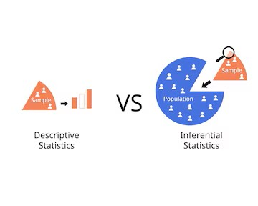
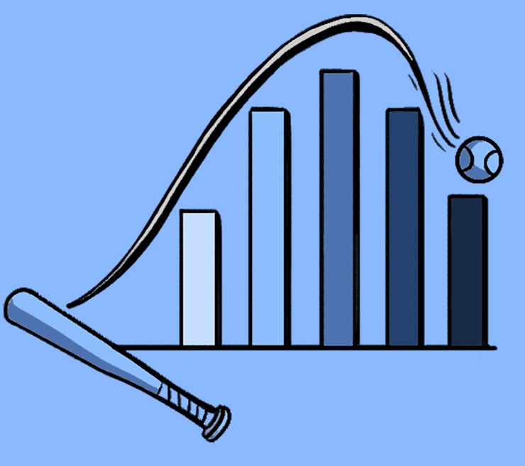
TWO BRANCHES OF STATISTICS
📋 DESCRIPTIVE STATISTICS
🔬 INFERENTIAL STATISTICS
Describes & summarises data
you already have
Draws conclusions about a
large group from a small sample
Mean, median, mode of exam scores
Is this drug effective for all patients?
Standard deviation of sales data
Will next month's sales exceed target?
A bar chart of monthly revenue
Does marketing affect purchase rate?
Percentage of customers over 30
A/B test: which ad performs better?
✅ You will use this EVERY day as an analyst
📅 Covered in coming sections — Hypothesis Testing
Statistics for Data Analysis · Part 1

Slide 4
TYPES OF DATA
Before analysis, always ask: what kind of data am I looking at?
🔢 NUMERICAL (Quantitative)
🏷️ CATEGORICAL (Qualitative)
Numbers that mean something mathematically
Labels, groups, names — no math
Age: 25, 30, 45
Salary: Rs. 45,000
Temperature: 37°C
Exam Score: 78/100
City: Karachi, Lahore, Islamabad
Gender: Male / Female
Status: Pass / Fail
Blood Group: A, B, O, AB
💡 You CAN calculate average, sum, std dev
💡 You CANNOT average categories — average of Karachi + Lahore = ???
📶 ORDINAL
📏 DISCRETE vs CONTINUOUS
Categories with a clear ORDER
Two sub-types of Numerical
Rating: 1★ 2★ 3★ 4★ 5★
Education: Matric → F.Sc → BS → MS
Size: Small → Medium → Large
Customer Satisfaction: Poor / OK / Good
Discrete: count of students (1,2,3…)
→ can't have 2.5 students
Continuous: height, weight, time
→ can be 1.75m, 68.3kg
💡 Order matters but gaps between ranks are NOT equal
💡 Different charts and tests apply to each
Statistics for Data Analysis · Part 1

Slide 5
MEASURES OF CENTRAL TENDENCY
Central Tendency answers one question: "What is the TYPICAL value in my data?"
Real Scenario: 7 Students' Exam Scores (out of 100)
45
62
68
70
72
85
95
← Median
Sum = 497 ÷ 7 = 71.0 (Mean)
MEAN
MEDIAN
MODE
Sum ÷ Count
Middle value (sorted)
Most frequent value
71.0
70
None here
(all unique)
💡 Pulled by extreme values
💡 Not affected by extremes
💡 Great for categories
Statistics for Data Analysis · Part 1

Slide 6
MEAN vs MEDIAN — When Each One Lies to You
The most important decision in descriptive statistics
⚠️ WHEN MEAN MISLEADS
✅ WHEN MEAN IS PERFECT
5 employees' monthly salaries (PKR):
7 students' exam scores:
Rs. 35,000
65
Rs. 38,000
68
Rs. 40,000
70
72
Rs. 42,000
74
Rs. 3,00,000 ← CEO
76
Mean = Rs. 91,000 → NOBODY earns near this!
Median = Rs. 40,000 → MUCH more honest
75
📌 Rule: Use MEDIAN when data has extreme outliers
(income, house prices, viral posts)
Mean = 71.4 Median = 72 → Both tell same story
No outliers → Mean is reliable ✅
Statistics for Data Analysis · Part 1

Slide 7
CHART: MEAN vs MEDIAN WITH AN OUTLIER
⚠️ The Problem
Hassan (CEO) earns Rs. 300,000 — 7× more than others.
This ONE number drags the mean to Rs. 91,000.
Mean = 91k →
✅ The Solution
Median = Rs. 40,000 — ignores the outlier.
This is what a typical employee actually earns.
Median = 40k →
Real-World Examples
where Median wins:
🏠 House prices in a city
💰 Household incomes
Statistics for Data Analysis · Part 1

Slide 8
MEASURES OF SPREAD — How Scattered Is the Data?
Two classes both have Mean = 70. Are they the same? No! You need SPREAD to know the full story.
Class A — Mean: 70 (All students similar)
Class B — Mean: 70 (Very mixed performance)
Std Dev ≈ 1.0 → Very consistent class
Std Dev ≈ 23.0 → Highly inconsistent class
Statistics for Data Analysis · Part 1

Slide 9
RANGE · VARIANCE · STANDARD DEVIATION
Three ways to measure how spread out your data is
Dataset: Zara's 6 monthly sales (units sold) → 10, 14, 20, 24, 28, 32 | Mean = 21.3
1. RANGE
2. VARIANCE
3. STD DEVIATION
Max − Min
Average of squared differences from mean
√Variance
= 32 − 10 = 22
= Σ(x − x̄)² ÷ n ≈ 52.6
= √52.6 ≈ 7.25 units
The full distance from lowest to highest
How far each point is from the mean, on average
Typical distance from the mean — same units as data
✅ Very easy to calculate
✅ Uses ALL data points
✅ Interpretable, same unit as original data
❌ Breaks with just ONE outlier
❌ Units are squared (sales² — meaningless!)
❌ Slightly complex to calculate manually
💡 If Zara sold 300 units one month (special event),
Range = 290 — misleading!
💡 Variance of 52.6 units² — hard to interpret in
business language
💡 "Sales typically vary by ±7 units from the average"
— a manager understands this!
Statistics for Data Analysis · Part 1

Slide 10
IQR — INTERQUARTILE RANGE & QUARTILES
IQR = Q3 − Q1 → The spread of the MIDDLE 50% of your data. Resistant to outliers.
Sorted data: 10, 14, 18, 22, 26, 30, 34, 38, 42, 50, 95
← IQR = Q3 − Q1 = 42 − 18 = 24 →
Min
10
Q1
18
Median
30
Q3
42
Max
95
Q0→Q1
(0%–25%)
Q1→Q2
(25%–50%)
Q2→Q3
(50%–75%)
Q3→Q4
(75%–100%)
Bottom quarter
of values
Lower-middle
quarter
Upper-middle
quarter
Top quarter
of values
Why IQR matters for Data Analysts:
1. Outlier Detection: Any value below Q1 − 1.5×IQR or above Q3 + 1.5×IQR is flagged as an outlier 2. Box Plots: The IQR is the box in a box plot — you will draw these in Seaborn
Statistics for Data Analysis · Part 1

Slide 11
THE NORMAL DISTRIBUTION
Also called the Bell Curve — the most important shape in statistics
The 68–95–99.7 Rule
(Empirical Rule)
68%
of data falls
within 1σ of mean
95%
of data falls
within 2σ of mean
99.7%
of data falls
within 3σ of mean
Real examples of Normal Distribution:
← −3σ −2σ −1σ μ (Mean) +1σ +2σ +3σ →
🎓 Exam scores in a large class
Key: In a Normal Distribution → Mean = Median = Mode | Perfectly symmetric
📏 Heights of adults
⚖️ Product weights in manufacturing
Statistics for Data Analysis · Part 1
🌡️ Body temperatures

Slide 12
THE EMPIRICAL RULE — Applied to Real Data
Scenario: NAVTTC exam scores are Normally distributed. Mean (μ) = 70 · Std Dev (σ) = 10
99.7% → Score between 40 and 100 (virtually everyone)
95% → Score between 50 and 90
68% → Score between 60 and 80
40
(μ−3σ)
50
(μ−2σ)
60
(μ−1σ)
70
(μ)
80
(μ+1σ)
90
(μ+2σ)
100
(μ+3σ)
Q1
Q2
Q3
If Ahmed scored 85 — how rare is that?
If Fatima scored 45 — is that unusual?
Most students scored between...?
→ He's in the top 16% of students.
Better than 84% of the class.
→ Yes — below μ−2σ.
Only ~2.5% score this low.
→ Between 60 and 80.
68% of all students land here.
Statistics for Data Analysis · Part 1

Slide 13
SKEWNESS — When Data Is Not Symmetric
Real-world data is almost never perfectly normal — you need to recognise the shape
NEGATIVE SKEW
(Left-Skewed)
NORMAL
(Symmetric)
POSITIVE SKEW
(Right-Skewed)
Tail on the LEFT
Mean < Median < Mode
Symmetric
Mean = Median = Mode
Tail on the RIGHT
Mode < Median < Mean
Example: Exam where most
students score very high
Example: Typical heights
in a large population
Example: Income data —
most earn low, few earn huge
💡 Mean is pulled LEFT by the few low scorers
💡 Mean and Median both describe the centre well
💡 Mean is pulled RIGHT by the very high earners
Statistics for Data Analysis · Part 1

Slide 14
PART 1 — SUMMARY
PART 2 — Coming Next
✓
What Statistics is — Descriptive vs Inferential
✓
Types of Data — Numerical, Categorical, Ordinal, Discrete, Continuous
📐 Z-scores — standard position
🧪 Sampling — population vs sample
✓
Central Tendency — Mean, Median, Mode and when each is correct
📊 Correlation — r coefficient
✓
Mean vs Median — how outliers distort the mean
🔬 Hypothesis Testing intro
✓
Measures of Spread — Range, Variance, Standard Deviation, IQR
⚖️ p-values explained simply
✓
The Normal Distribution — the bell curve and the 68–95–99.7 rule
🧮 t-test — comparing two groups
✓
Skewness — Positive, Negative, and Symmetric distributions
🔀 Chi-squared test for categories
📈 Confidence Intervals
Statistics for Data Analysis · Part 1 · NAVTTC — Data Analytics Using Python

