Slide 1

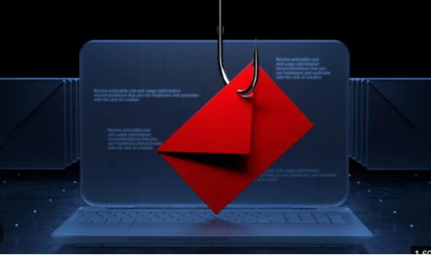
CodeAlpha CyberSecurity Internship · Task 2
Prepared by Kamil Hasanli
PHISHING AWARENESS TRAINING
Recognizing deception, defeating social engineering, and protecting your inbox

Slide 2
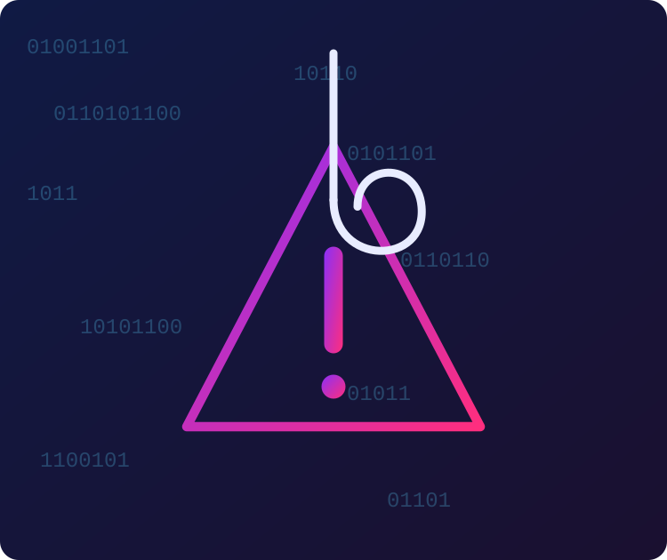
Walkthrough
1. What is phishing
2. Types of attacks
3. Spotting fake emails
4. Spotting fake websites
5. Social engineering
6. Real-world case
7. Best practices
8. Quiz & recap

Slide 3

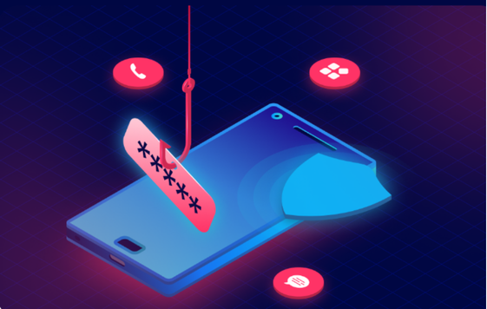

WHAT IS
PHISHING ?!
Phishing is a cyberattack that uses fraudulent messages — usually email — to trick people into revealing sensitive information, clicking malicious links, or installing malware.
91%
3.4B
$4.9M
of cyberattacks start with a phishing email
phishing emails sent worldwide every day
average cost of a phishing-related breach
Why it works?
❯
Exploits trust in familiar brands, colleagues, or authority figures
❯
Creates urgency so victims act before they think critically
❯
Looks nearly identical to legitimate communication

Slide 4








TYPES OF PHISHING ATTACKS
Attackers adapt their channel and target to maximize success
Email Phishing
Spear Phishing
Whaling
Mass, generic fraudulent emails impersonating banks, vendors, or services.
Highly targeted messages personalized using research on a specific victim.
Spear phishing aimed at executives or high-value targets like CFOs and CEOs.
Smishing
Vishing
Clone Phishing
Phishing delivered via SMS text messages with malicious links.
Voice phishing — fraudulent phone calls impersonating support or officials.
A legitimate email is copied and resent with a malicious link swapped in.

Slide 5





HOW TO RECOGNIZE PHISHING EMAILS
Five warning signs that appear in almost every phishing attempt
Generic greeting
"Dear Customer" instead of your real name.
From: Support-Team@secure-paypa1.com
False urgency
Subject: URGENT: Verify Your Account Now!
Threats of suspension pressure quick action.
Dear Valued Customer,
We detected unusual activity. Your account will be suspended in 24 hours unless you confirm your details immediately.
Click here to verify: http://paypa1-secure-login.net
Thank you,
The Security Team
Suspicious links
Misspelled domains like "paypa1" instead of "paypal".
Spoofed sender
Display name looks real, but the domain doesn’t match.
Odd requests
Asking for passwords, OTPs, or payment details.

Slide 6


HOW TO SPOT FAKE WEBSITES
Check the address bar before you type a single character
http://www.arnazon-support.com/account/verify-login
Check the domain carefully
Confirm HTTPS — but don’t stop there
Look letter-by-letter: "arnazon" vs "amazon", "rn" mimicking "m". Attackers register lookalike domains.
A padlock only means the connection is encrypted, not that the site is trustworthy. Free certificates are easy to get.
Inspect design and content
Hover before you click
Watch for low-resolution logos, broken layouts, awkward wording, and outdated copyright years.
Hover over any link to preview the real destination URL shown in the browser status bar.

Slide 7



SOCIAL ENGINEERING TACTICS
The psychology attackers exploit before the technology even matters
Urgency
Authority
Trust & Familiarity
Manufactured deadlines push victims to skip verification and act on impulse.
Impersonating executives, IT staff, or officials to demand compliance.
Mimicking a known contact, brand, or ongoing conversation thread.
Fear
Reciprocity
Curiosity
Threatening account suspension, legal trouble, or financial loss.
Offering a "free" gift or reward that requires personal info in return.
Vague, intriguing subject lines that tempt a click to "find out more".

Slide 8

REAL-WORLD EXAMPLE
Even the biggest tech companies have been fooled
1
Impersonation
The attacker set up a fake company with a name nearly identical to a real Google/Facebook hardware vendor, "Quanta Computer".
$100M+
2
Fabricated Invoices
Fraudulent invoices, contracts, and letters were sent to accounting staff at both companies, appearing entirely legitimate.
stolen from Google and Facebook between 2013–2015
3
Wire Transfers
Employees processed the payments through standard channels, unknowingly wiring tens of millions to attacker-controlled bank accounts.
Attacker: Evaldas Rimasauskas, a Lithuanian national, later sentenced to 5 years in prison.
4
The Lesson
No amount of technical sophistication was needed — the scam relied entirely on convincing paperwork and misplaced trust.

Slide 9


BEST PRACTICES & TIPS
Simple habits that stop the vast majority of phishing attempts
Verify independently
Enable MFA everywhere
Never click blindly
Contact the sender through a known number or official site — never reply to the suspicious message.
Multi-factor authentication stops most account takeovers even if a password is stolen.
Hover to preview URLs, and type known addresses directly instead of following links.
Keep software updated
Report suspicious mail
Slow down under pressure
Patches close the security holes phishing payloads are built to exploit.
Use your organization’s "report phishing" button so IT can block it for everyone.
Urgency is a tactic. Pause, verify, and never act on threats within a message.

Slide 10
QUICK QUIZ
Spot the phish — real or fake?
Q1
"Your package couldn’t be delivered. Confirm your address within 2 hours: bit.ly/track-pkg99"
Phishing
Q2
An email from your manager, sent from their known company address, about tomorrow’s meeting agenda.
Legitimate
Q3
"IT Support: your password expires today. Login here to keep access: login-secure-portal.info"
Phishing
Stay alert. Verify before you trust. Report what looks wrong.
Thank you — CodeAlpha Task 2: Phishing Awareness Training

