Slide 1
Cytotoxic
T cell
T cell
receptor
MHC class I
molecule
Peptide
fragments
Infected
cell

Slide 2
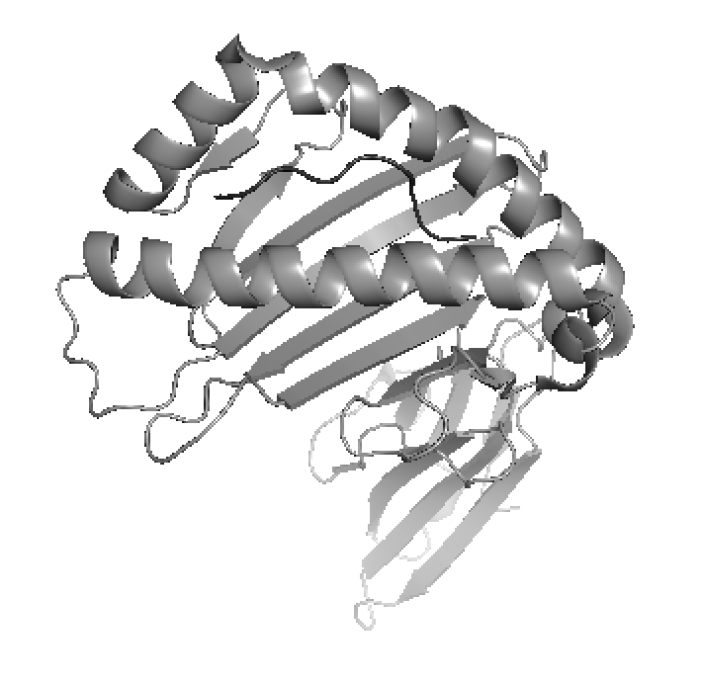
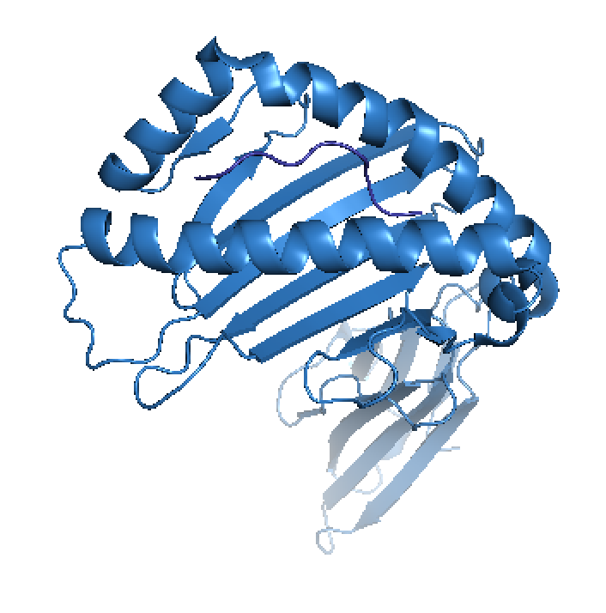
Homology modelling of pMHC complexes
TARGET
Unknown structure
Known sequence
?
Peptide CVNGSCFTV
MHC MEQEGPEYWERETQKAKG….
Select best template
in database
1
Align target and template
sequences
2
TEMPLATE
Known structure
Known sequence
Build model using the
information from the
template structure
3
Peptide CVNGSCFTV
MHC MDDEAPETWERETDKAKG….
4
Evaluate the final model
TEMPLATE MODEL
Predicted structure

Slide 3
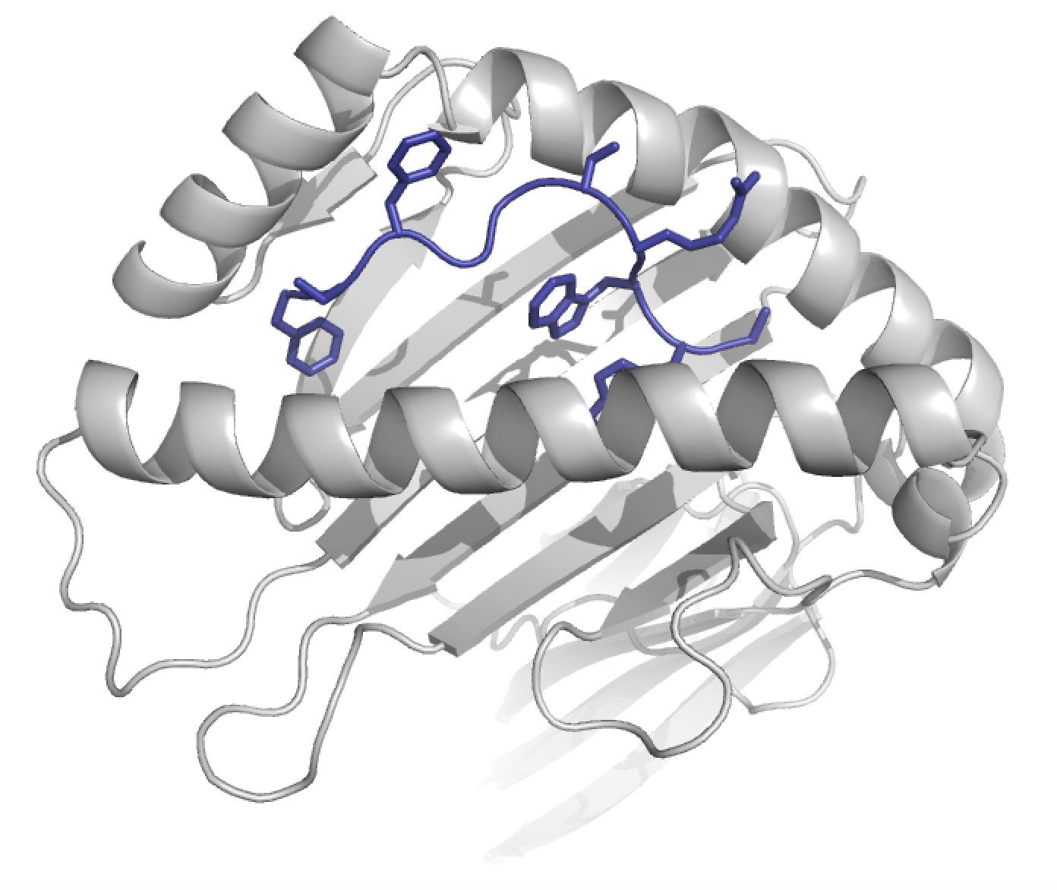
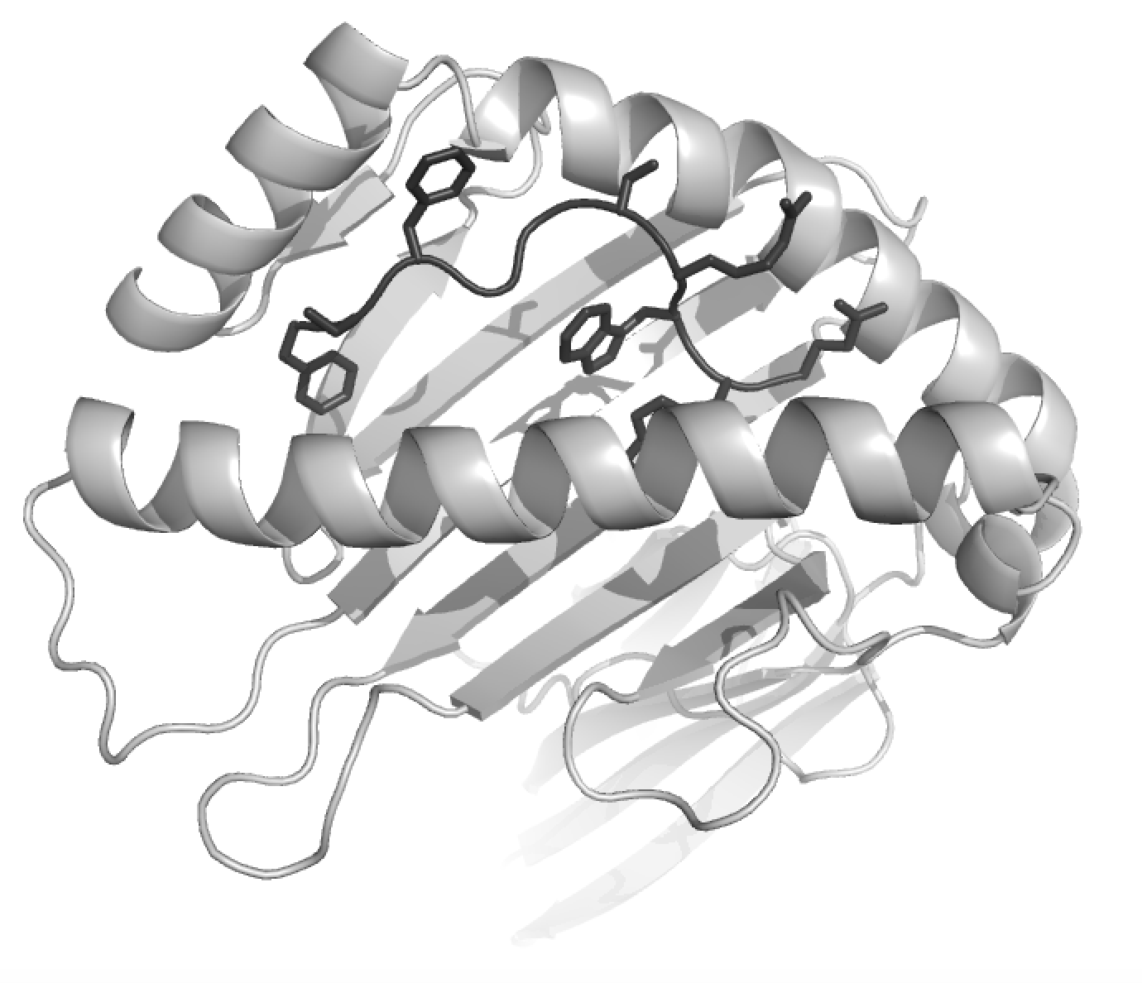
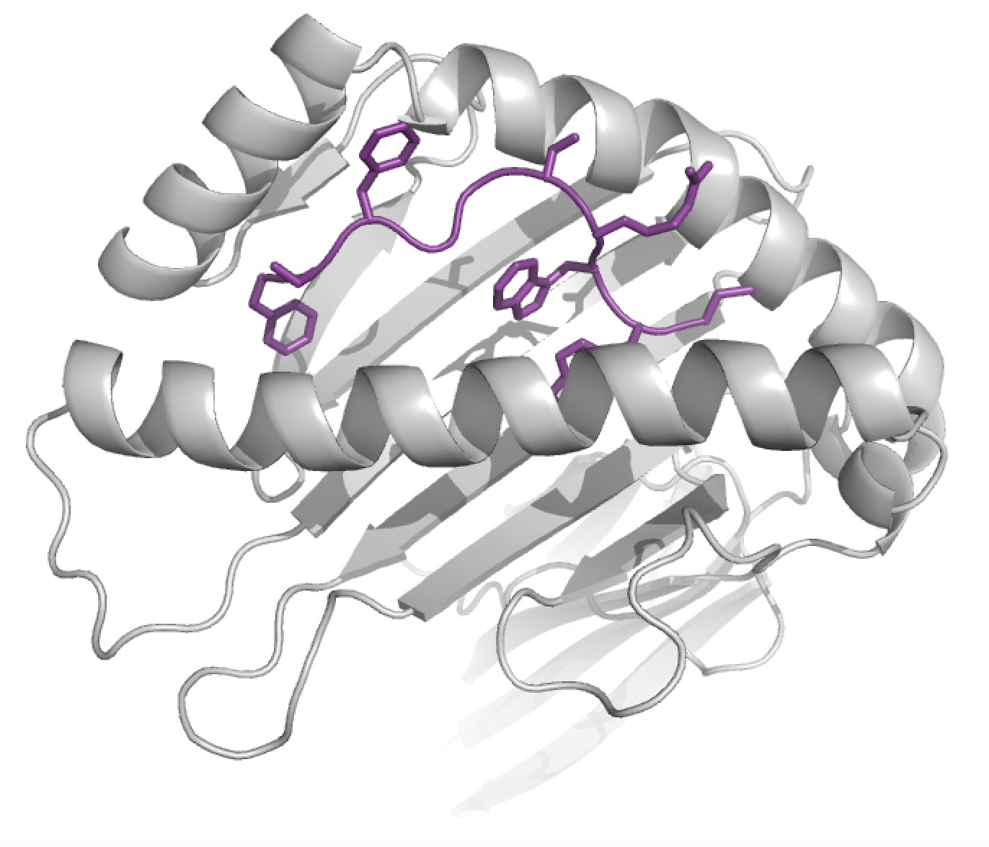
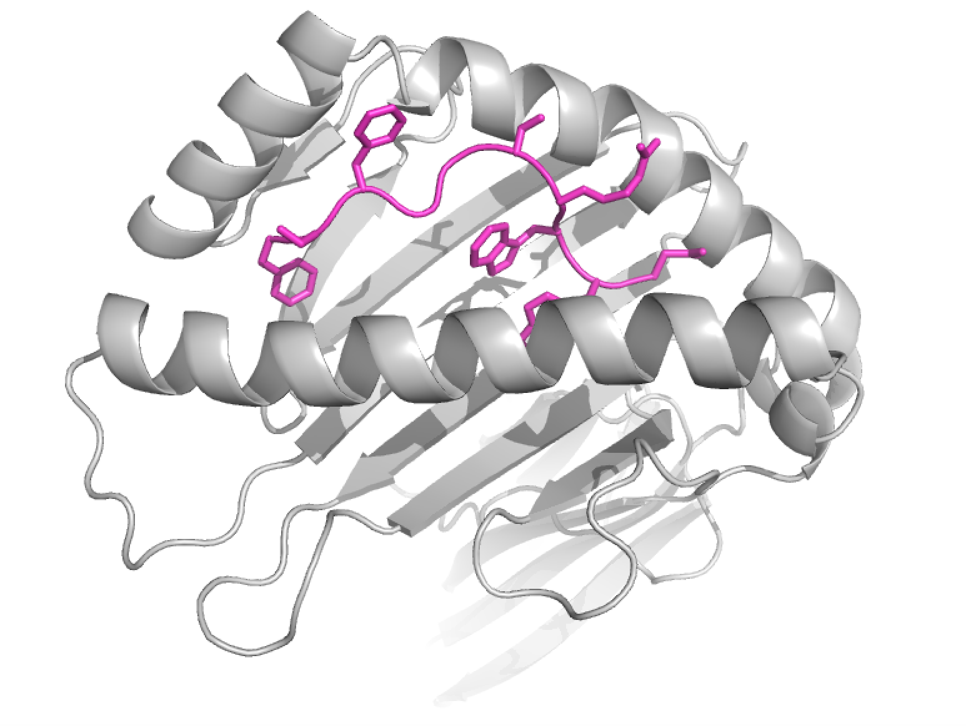
Generate mutant models with FoldX and predict energy of pMHC complex
Mutant models
WT pMHC model
1
Use WT pMHC model as input to foldX
2
Use FoldX to generate models for all peptide mutations
3
Calculate the energy between the mutated peptide and the MHC

Slide 4
Experimental TCR-pMHC binding experiment
1
pMHC
Barcode-labels
Cytotoxic
T-cell
# barcodes
after sorting
=
TCR binding
strength
T-cell
receptor
2
3
4
5
T-cell binding to
pMHC complex
1
Make DNA barcoded pMHC library
2
Mix pMHC library with T-cells
3
Sort T-cells in binders and non-binders
4
Amplify DNA barcodes and sequence them
5
Count numbers of DNA barcodes

