Slide 1

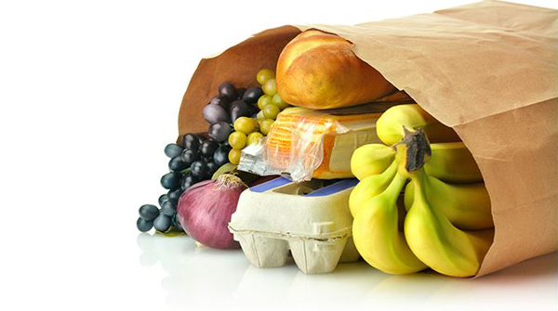








OVERVIEW: Instacart is an online grocery delivery service that operates in US & Canada. The users can order groceries via the Instacart app and have those groceries delivered directly to their home.
OBJECTIVE: To conduct an exploratory data analysis and derive insights for improved customer segmentation, I analyzed over 800,000+ customer records. The analysis involved segmenting customer behaviors based on demographic information to optimize marketing campaigns. I performed data wrangling, merged datasets, derived new variables, and designed charts to uncover key insights. One notable finding was that the top three departments accounted for 51% of sales, while the bottom 5 departments contributed only 1% of sales. Based on these findings, it is recommended to allocate advertising efforts accordingly. Additionally, scheduling ads on the least busy days, such as Tuesday and Wednesday, can be beneficial.
TOOLS:
ONLINE GROCERY BASKET

Slide 2
DATA PREPARATION
DERIVING VARIABLES
VISUALIZATION
EXCEL REPORTING
Basic descriptive exploratory analysis;
Removing duplicates, managing missing values, mixed type data checks;
Assessing data values and creating new data frames;
Merging data sets.
Used conditional logic in the form of if-statements, user-defined functions, [loc] functions, and for-loops to derive new columns.
Designed bar charts, line charts, scatterplots and 100% stacked bar chart for different variables and relationships between variables.
Summarizing analysis findings and describing what connections in the data were found;
Creating a report that describes the analysis methodology, the analysis, the results, visualizations, and recommendations.

Slide 3
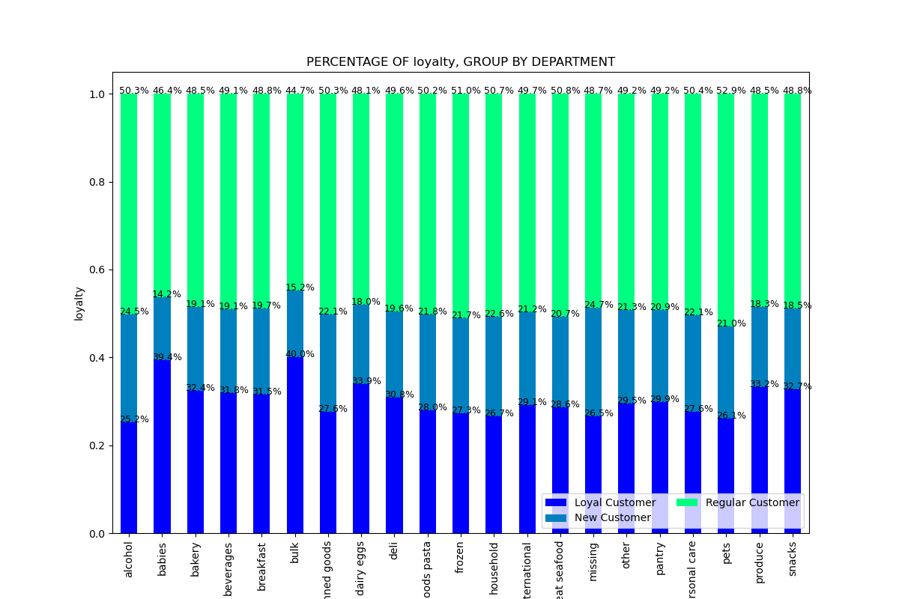
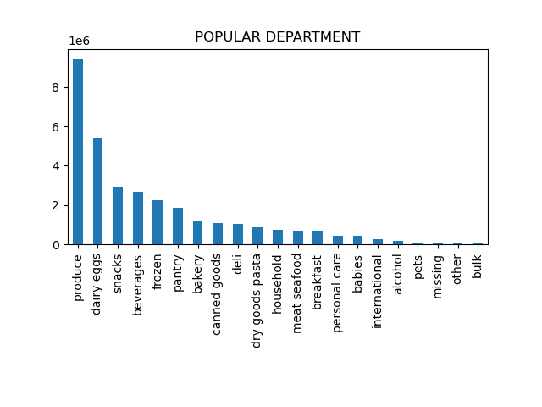
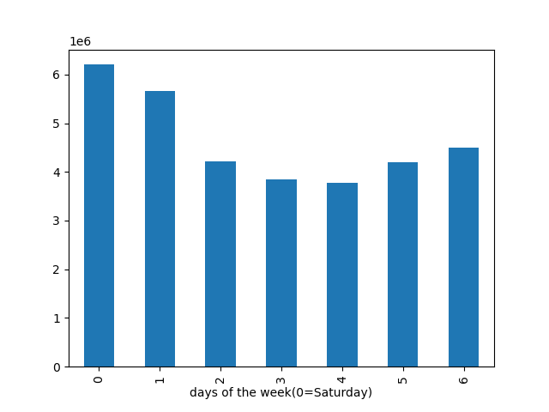
RECOMMENDATION:
To increase revenue, schedule ads on the least busy days i.e. Wednesday and Tuesday.
Instacart could either advertise the top three department(which contributes 51% to sales) or else look after the reason behind the bottom 5 departments(contributes 1% to sales) and put the advertising effort to increase the sale.
To boost customer loyalty, Instacart should introduce rewards programs with purchase discounts up to a specific limit. Additionally, they should provide incentives for existing customers to refer new users to the platform.

Slide 4
LINKS FOR FURTHER EXPLORATION:
GitHub Repository with full project
Jupyter notebook with Python code
Final report in Excel
Data set link

