Slide 1
ROCKBUSTER STEALTH
Data Analysis
Presented by: Kamini Manwal

Slide 2
Project Overview
Rockbuster Stealth LLC is a movie rental company that have stores around the world. To stay competitive, it intends to launch an online video rental service based on existing movie license.
As an analyst, helping Rockbuster’s Stealth business department with the launch strategy for the new online video service and to increase the revenue.

Slide 3
Objective
Which movies contributed the most and least to revenue gain?
Which Genre contributed the most to revenue gain?
Which countries are Rockbuster’s customer are based in?
Which countries have the highest lifetime customers of Rockbuster?
What was the average rental duration of all videos?

Slide 4
Movie Overview
Number of movies: 1000
Rental duration: 3-7 days
Rental rate: $0.99-$4.99
Replacement cost: $9.99-$29.99
Movie length: 46min-185min

Slide 5
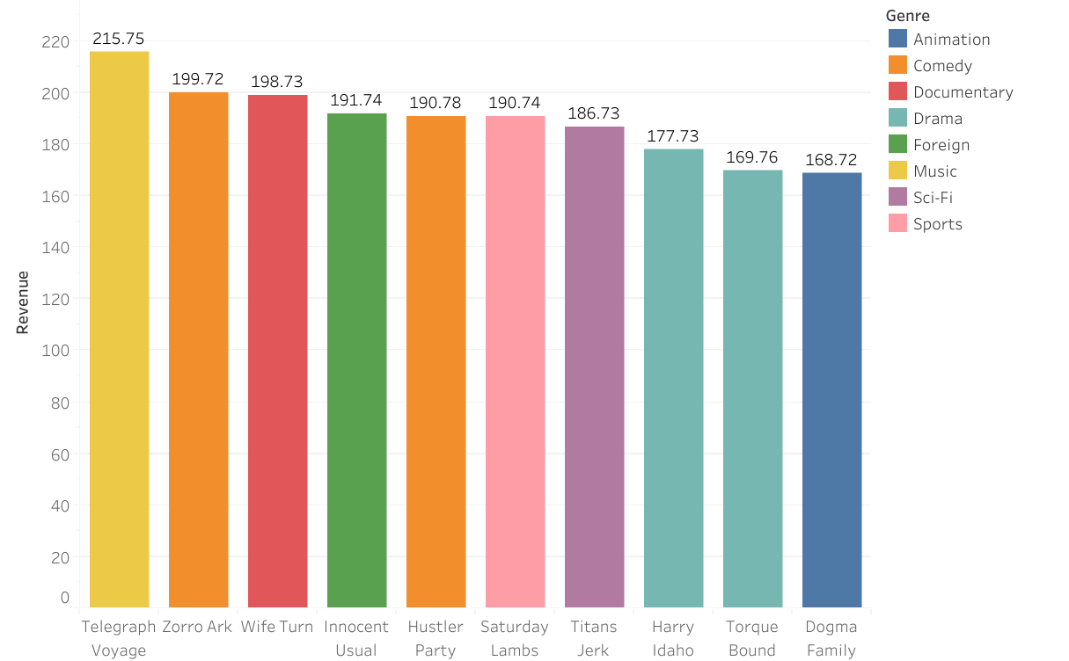
Top 10 movies with highest revenue
Total revenue gain from 1000 movies is $61,312.
3.08 % from top 10 movies are contributing to total revenue gain which I think is a positive trend in the overall revenue growth of the movie industry.

Slide 6
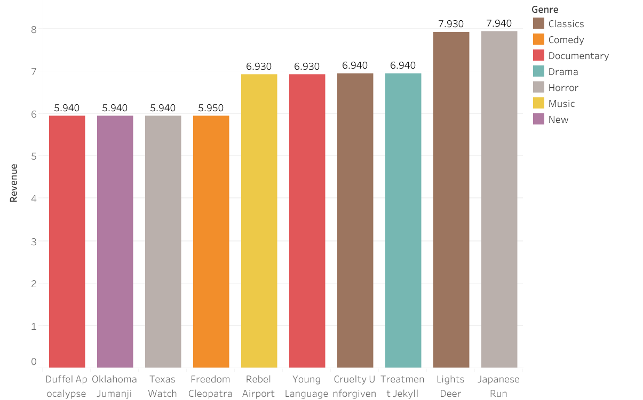
Top 10 movies with lowest revenue
Here, .10 % from bottom 10 movies are contributing to total revenue gain which I think is considerably very low. They may need to remove or re-evaluation in strategy to improve the performance.
Competitors
Strengths
Weaknesses
-for more info…List location or contact for specification (or other related documents)

Slide 7
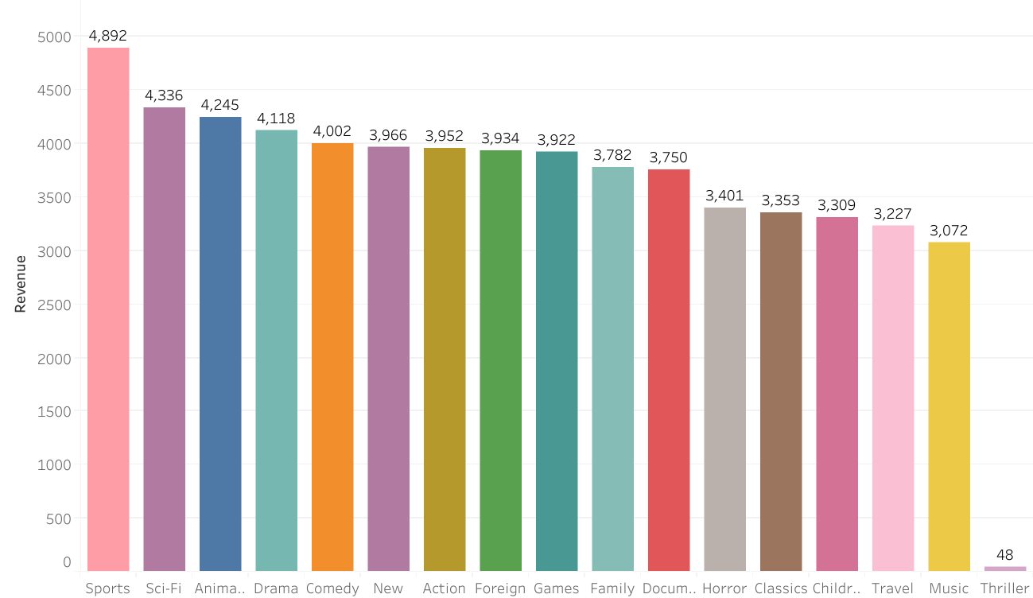
Genre by revenue
Revenue gain of all Genre lies between $4,892-$3.072 except thriller with revenue gain of only 48.

Slide 8
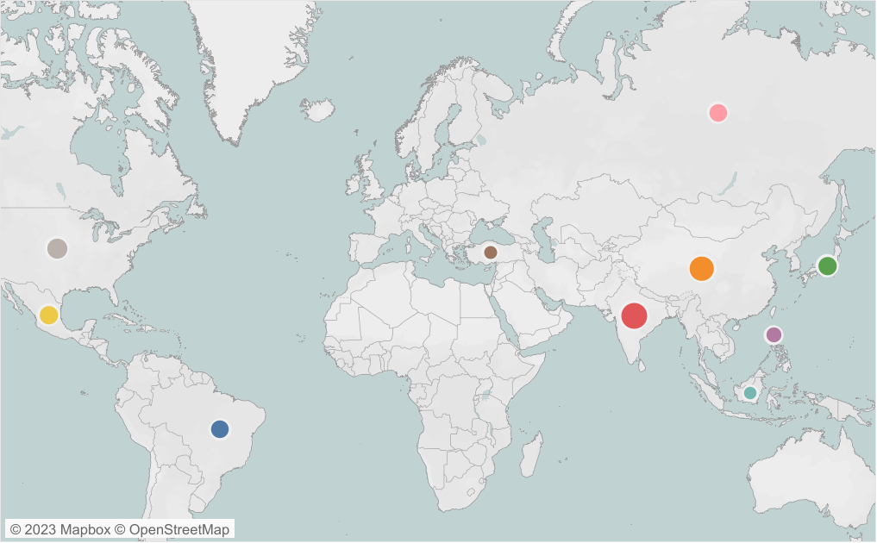
Top 10 countries with highest number of customers
Total of 599 customers are based in 108 countries. The revenue gain from top 10 nations with most customers accounts is 52% of the entire revenue gain.
Country(customer) | Total revenue($)
India(60) | 6035
China(53) | 5251
United States(36) | 3685
Japan(31) | 3123
Mexico(30) | 2985
Brazil (28) | 2919
Russian Federation(28) | 2766
Philippines (20) | 2220
Turkey (15) | 1498
Indonesia(14) | 1353

Slide 9
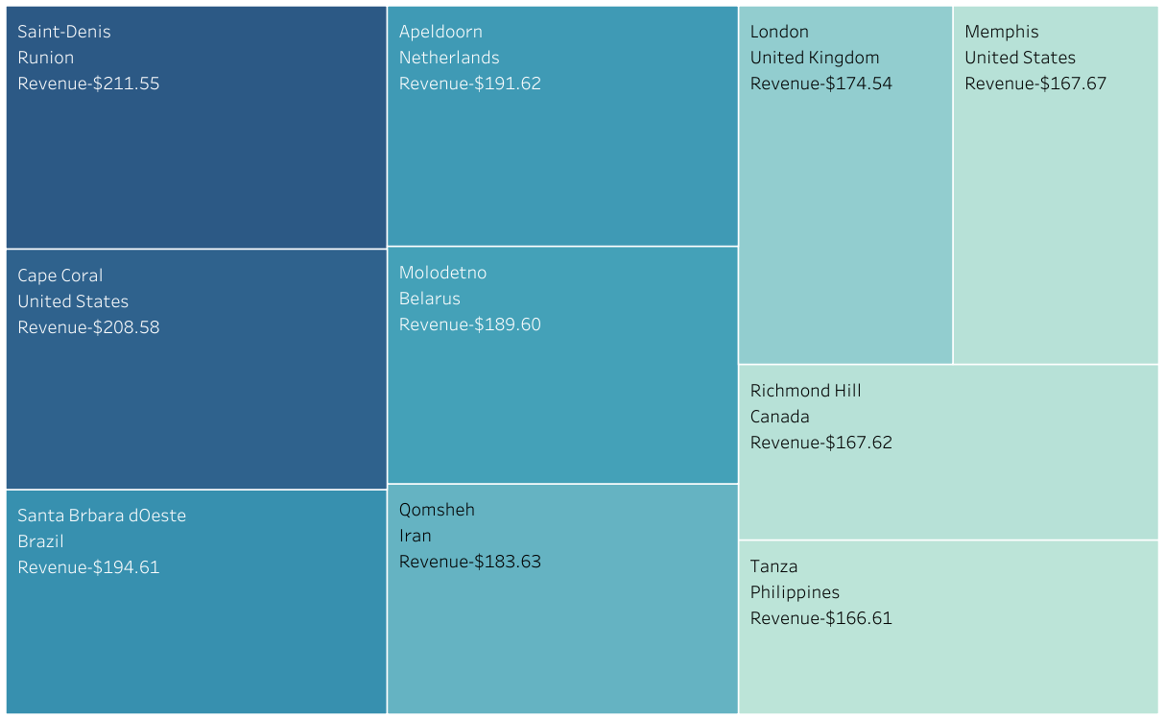
Top 10 customers with highest revenue paid
Interesting Fact: Top 5 cities with the highest revenue paid customers are not the same with the maximum customers reside.
-for more info…List location or contact for specification (or other related documents)

Slide 10
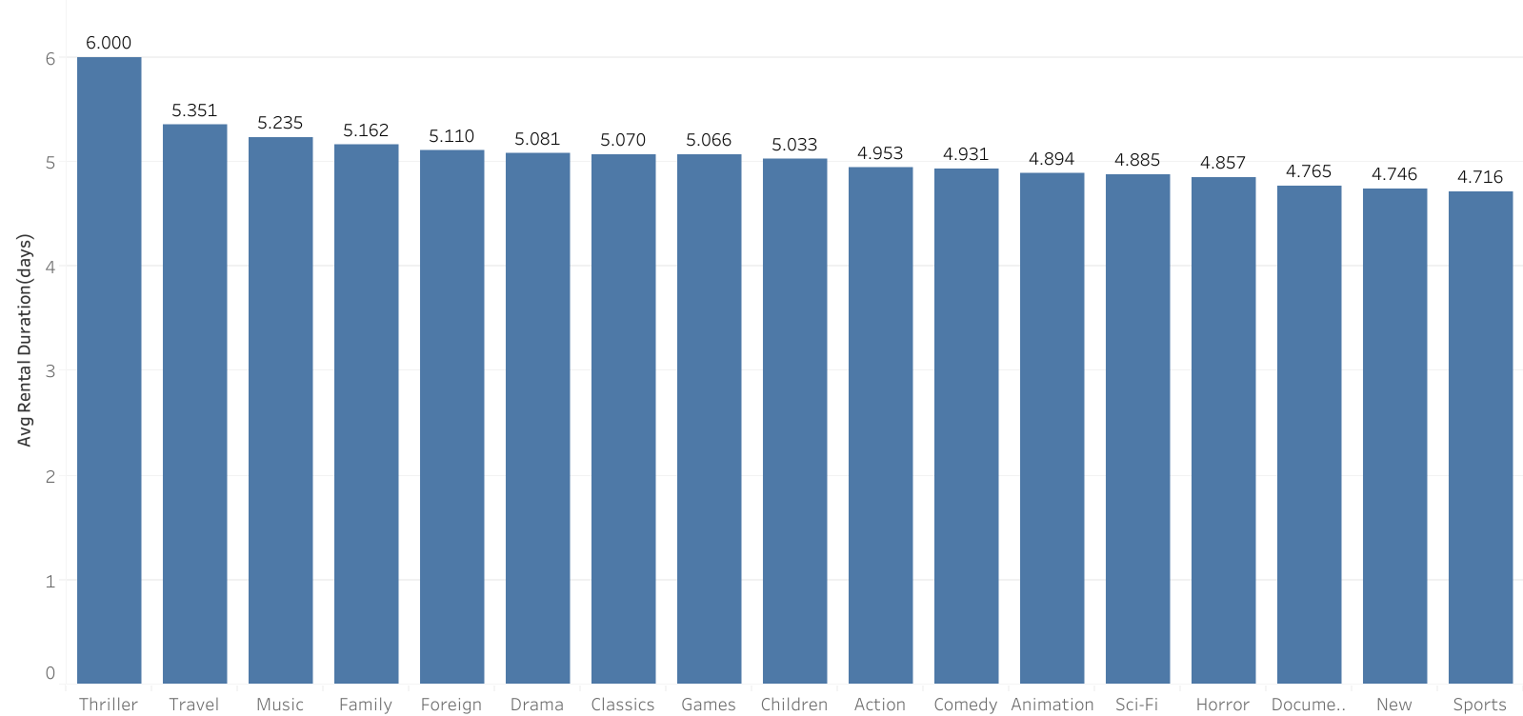
Average rental duration
The average rental duration over all genres is 4,9 days. Thriller is the genre with the highest rental duration of 6 days.

Slide 11
Conclusion
Top movies with highest revenue are Telegraph Voyage, Zorro Arc and Wife turn. These movies have different Genre and are rented at higher rental rate of $4.99. Top 10 movies contributes 3.08% to total revenue gain.
Top movies with least revenue are Duffel Apocalypse, Oklahoma Jumanji and Texas. These movies have different Genre and are rented at lower rental rate of $0.99. Top 10 movies contributes .10% to total revenue gain.
The most popular Genres are Sports, Sci-Fi and Animation. Thriller has almost negligible revenue gain(48).
There are total of 599 customers based in 108 countries. Top 3 countries with the most customers are India, China and US. The revenue gain from top 10 nations with most customers accounts is 52% of the entire revenue gain.
Customers with the highest paid revenue reside in Runion, US, Netherland. The revenue gain from top 10 customers is 3% of the entire revenue gain.
Average rental duration of all Genre is 4.9 days.

Slide 12
Recommendation
Focus on movies rather than genre(since average revenue is almost same) can lead to a better customer experience, increased engagement and ultimately, increased revenue.
Removing low revenue movies.
Focus on marketing in countries like India and China, where the majority number of customers are located and Runion and US, where the highest paid customers are located.
Offering discounts on rentals or special subscription plans to loyal customers as a reward.

Slide 13
THANK YOU!!
TABLEAU LINK

