Slide 2
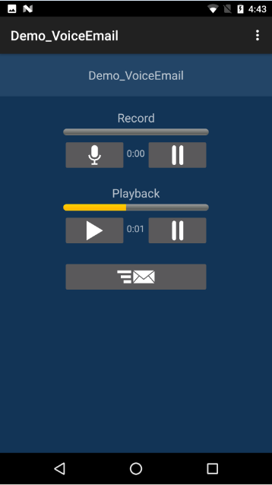
Progress Indicator
(determinate duration)

Slide 3
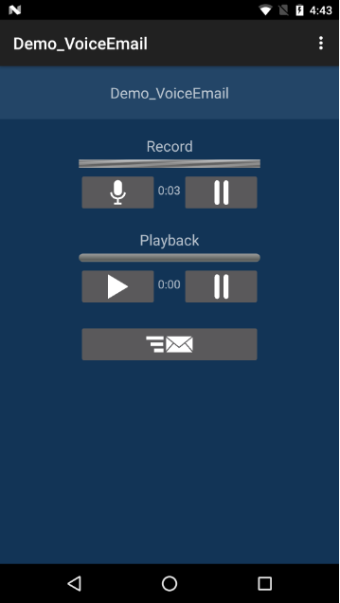
Activity Indicator
(indeterminate duration)

