Slide 1
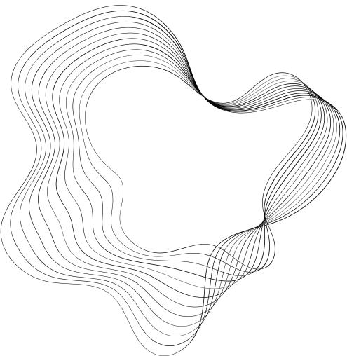

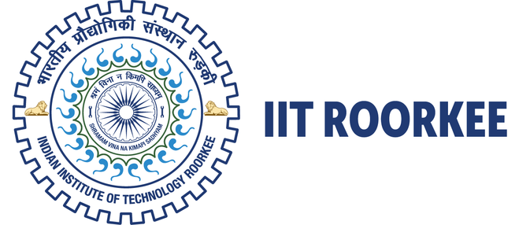
Impact of network topology in collaborative
learning dynamics
SOCIAL AND ECONOMIC NETWORK
Presenter
Kamla Singh (23617006)

Slide 2
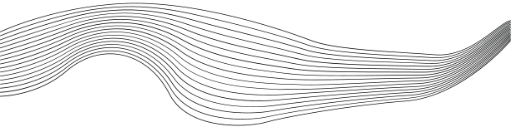
CONTENT
01
INTRODUCTION
02
THEORETICAL FRAMEWORK
03
METHODOLOGY
04
RESULTS
05
CONCLUSIONS

Slide 3




INTRODUCTION
Importance of Network Topology:
In collaborative learning, network structure significantly affects how information flows and how knowledge is collectively discovered.
Fields such as scientific research, technology, and organizational management rely on network structures for knowledge dissemination.
Objective:
This study investigates the impact of network structures—particularly efficient and inefficient configurations—on the speed and quality of learning outcomes within a networked group of agents.

Slide 4
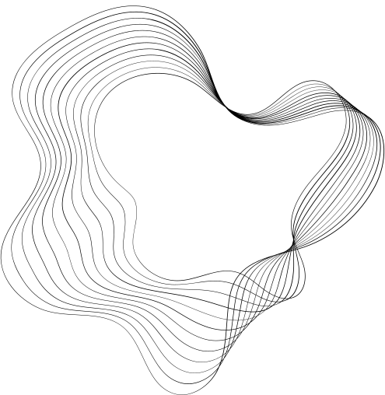
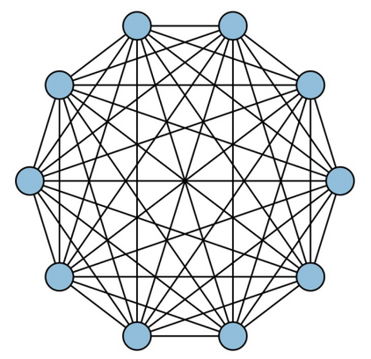
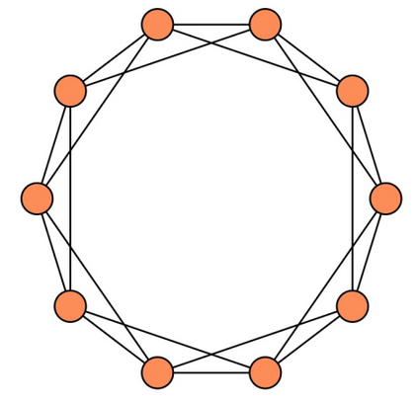
NETWORK STRUCTURES
Efficient
Fully connected network
Communication is open and unrestricted
Rapid sharing of information
Quicker convergence on solutions
1-D lattice with each node linked to four nearest neighbors
Communication is limited
Slower and more isolated flow of information
Diverse exploration of solutions.
Inefficient

Slide 5

Exploration & Exploitation
Exploration:
Defined as the process where agents seek out new information, experiment with different strategies, or test novel approaches.
Essential in complex problem landscapes, as it allows agents to explore various potential solutions.
Characterized by uncertainty and the possibility of finding innovative solutions over time.
Exploitation:
Refers to leveraging known solutions to maximize immediate gains.
Agents adopt existing, successful strategies from others rather than exploring new options.
Promotes efficiency and speed but risks overlooking better solutions that might be discovered through further exploration.
Balancing Exploration and Exploitation:
Effective learning systems need a balance—too much exploration delays convergence, while too much exploitation risks stagnation in suboptimal solutions.

Slide 6




Methodology
Simulation Setup: Two network configurations: an Efficient Network (fully connected) and an Inefficient Network (lattice structure).
Network Parameters:
N = 20 agents (nodes).
D = 4 neighbors per agent in the inefficient network.
R = 16 rounds of interaction.
Agent Behavior:
Each agent is assigned a random initial solution and must decide between exploration or exploitation each round.
Exploration: Adjust one regression coefficient to improve their own BIC score independently.
Exploitation: Adopt a neighbor’s solution if it has a lower BIC, increasing chances for better collective learning.
The probability of choosing exploitation is higher in more connected networks.
Problem solving
tasks

Slide 7
RESULTS
Initial Performance Differences:
Agents in the Efficient Network achieved lower BIC scores early due to faster solution-sharing.
This advantage reflects the efficient network’s ability to quickly spread high-quality solutions, leading to rapid improvement.
Convergence Over Time:
In the Inefficient Network, agents gradually improved their BIC scores, closing the performance gap by the final rounds.
This trend suggests that slower knowledge diffusion allows agents to develop diverse solutions, eventually approaching the quality of the more connected network.
Best and Average Solution Quality:
The Efficient Network maintained a slight advantage in achieving the lowest BIC (best solution quality) initially.
Over time, both networks reached similar average solution quality, suggesting that even sparse networks can perform well given sufficient time and iterative learning.

Slide 8
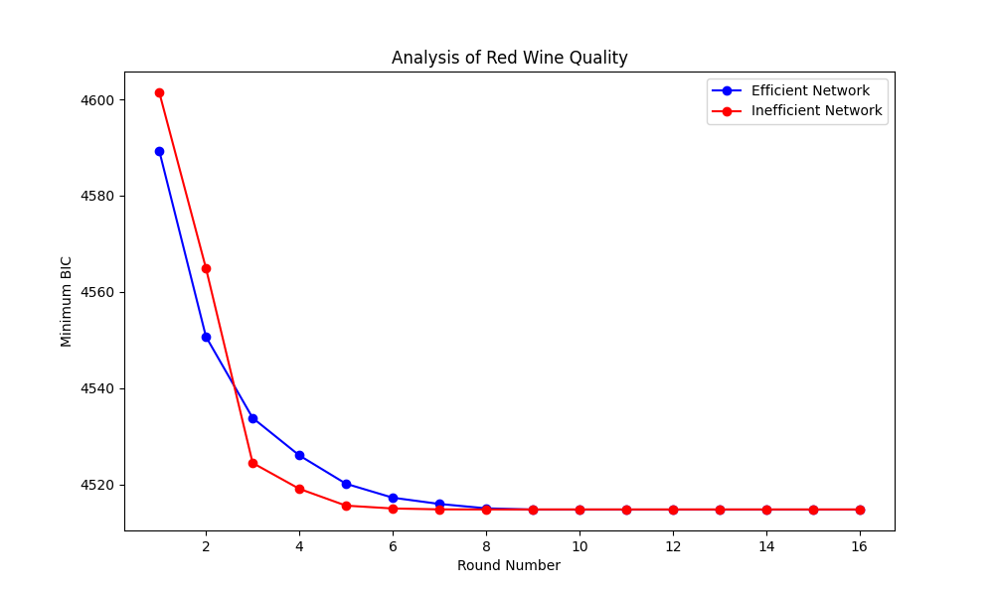
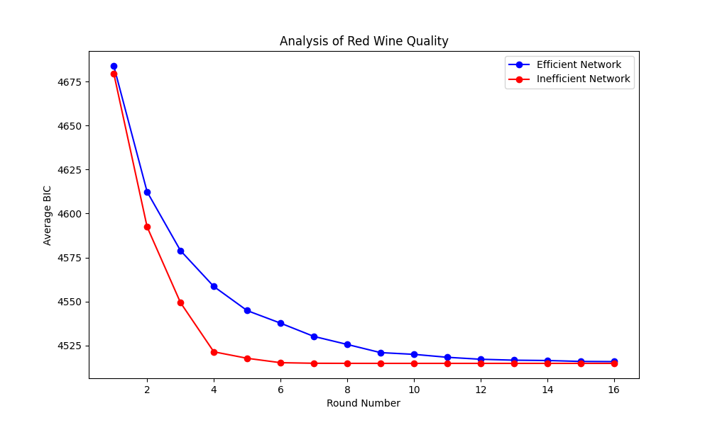
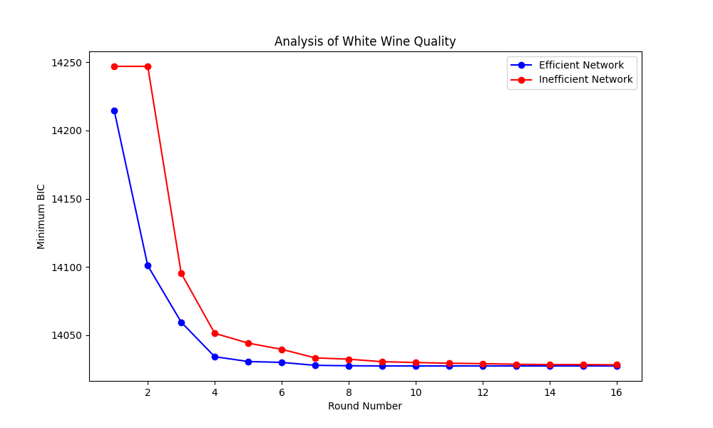
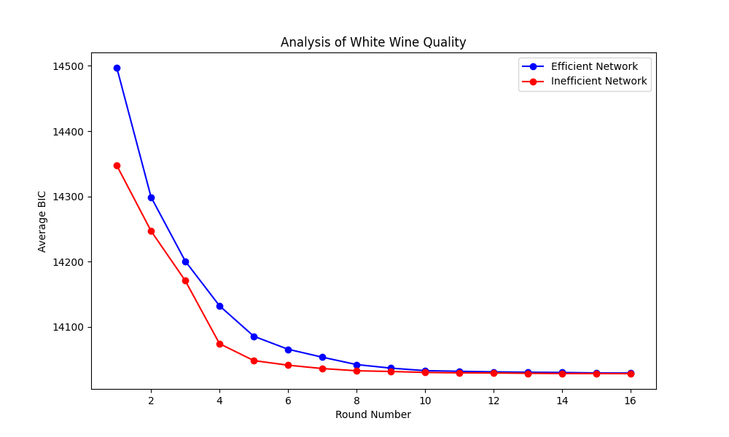
Visualisation

Slide 9
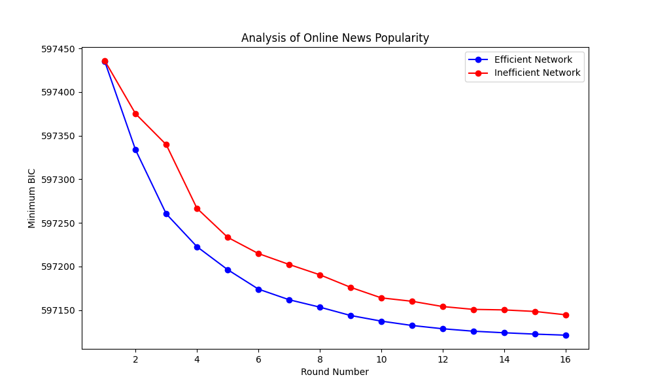
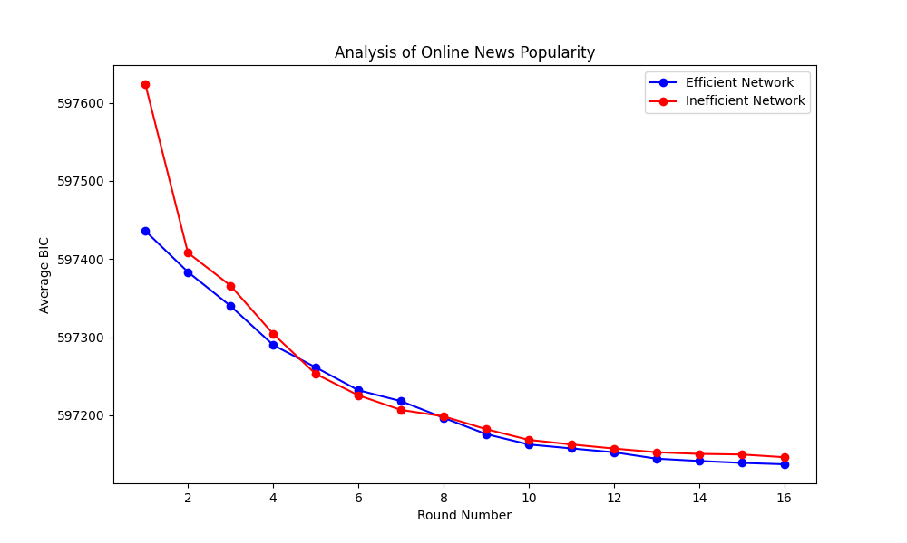
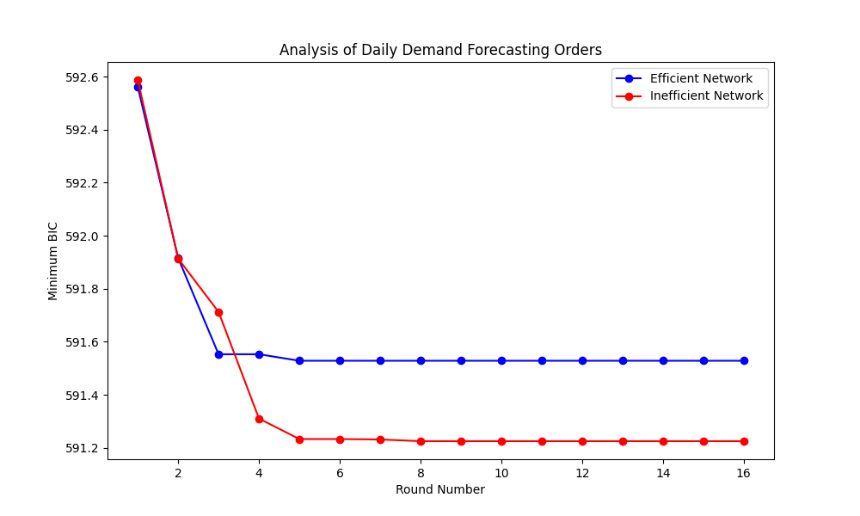
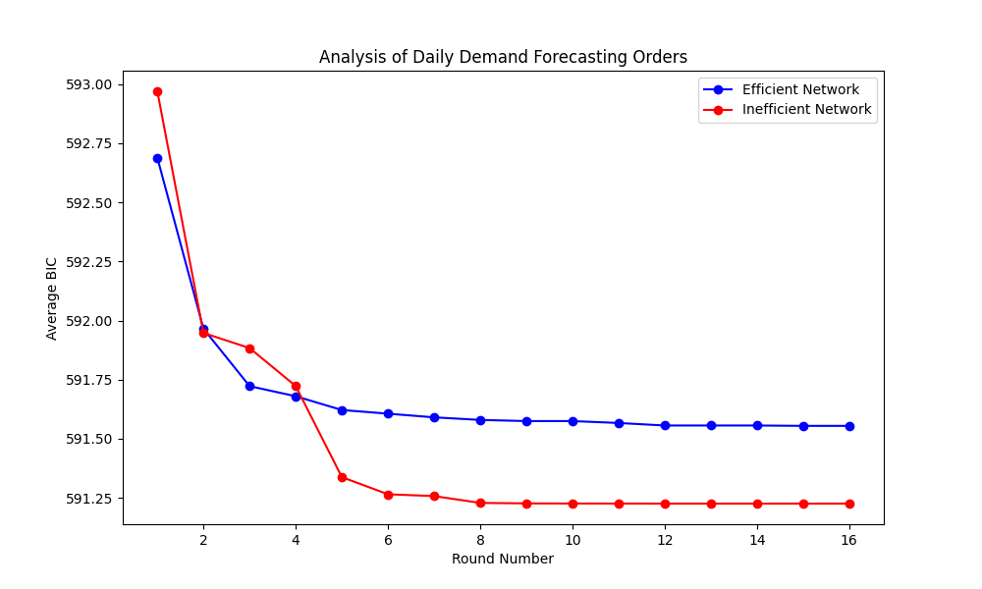
Visualisation

Slide 10
CONCLUSION
High connectivity accelerates initial solution convergence, while sparse connectivity supports more diverse exploration.
Over time, both network structures achieved comparable solution quality, highlighting the resilience of sparsely connected networks.
Implications for Network Design:
For rapid learning, highly connected networks may be ideal, but they risk limiting innovation.
In contrast, sparsely connected networks foster exploration, potentially leading to more robust solutions in the long term.
These insights can inform organizational and AI system designs that balance quick learning with innovative potential.

Slide 11

THANK YOU

