Slide 1
Project1
DSI_TDA_03
Kamlarp Satchavarodom
October 2023

Slide 2
outline
Problem statement
Context to the problem
Answer to the problem
Appendix
Data set
Data processing procedure

Slide 3
Problem statement
Rain vs Demand for public transportation
The objective of this presentation is to help audiences who operate the public transportation to be able forecast the demand on public transportation better, given by the number of rainy days and the rain volume, hence being able handling its capacity better, or even adjust for better services.
Therefore, we will address the following problems.
Does the rainy days and rain volumes have impact on demand for public transport across mode of transportation?
What are recommendation possible from the finding above?

Slide 4
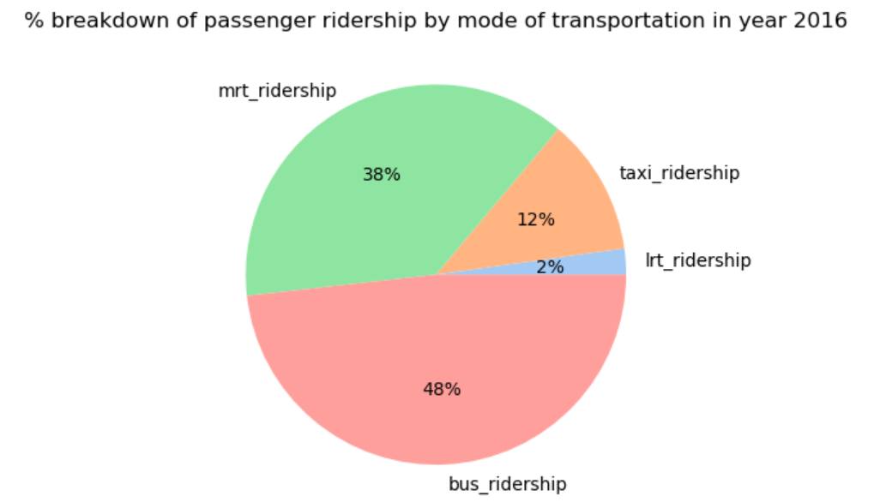
Background to the problem
Public transportation is the important thing in SG;
SG has 4 major transports led by the bus and MRT
Average number of passengers per day using public transport in Singapore is 6.39 millions passengers which are almost 100% of population.
The main transports in Singapore comprises of
The Mass Rapid Transit (MRT) 140 stations across six lines,
The Light Rail Transit (LRT) 41 stations across three lines.
The bus system operated by four companies offering different types of services such as midnight bus service and feeder bus services that connects passengers within an estate.
The six taxi operators, and the taxis can be flagged along the street, at designated taxi stands or booked online.

Slide 5
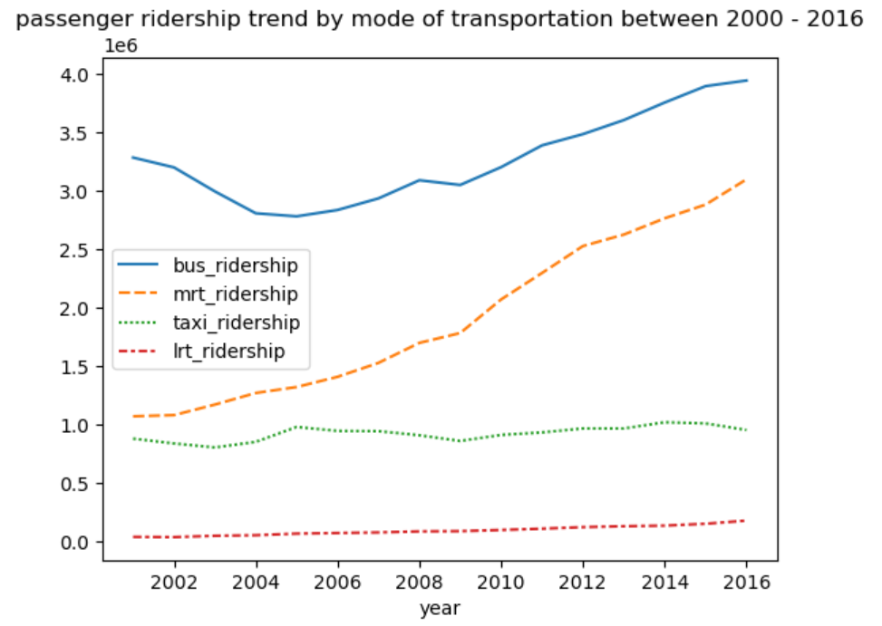
Background to the problem
Public transportation is even more important year by year ; Passenger ridership has increase annually especially MRT and Bus

Slide 6
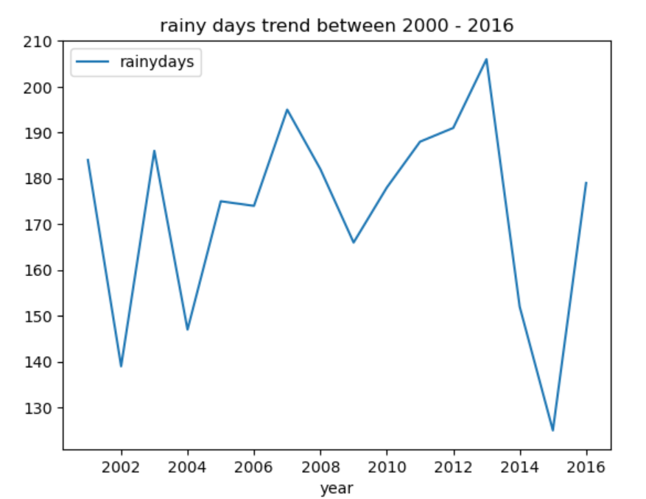
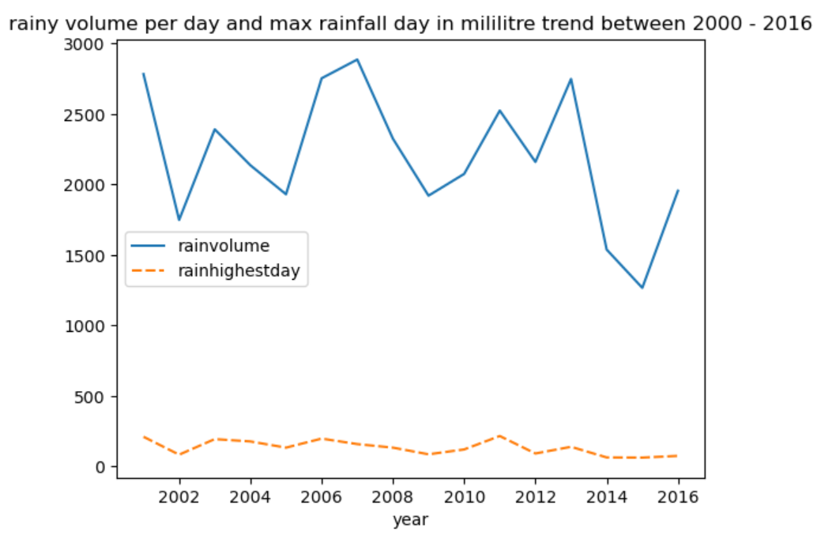
Background to the problem
Good news is that the rainy days and rain volume have flat trend or even small declines with some fluctuation over the years

Slide 7
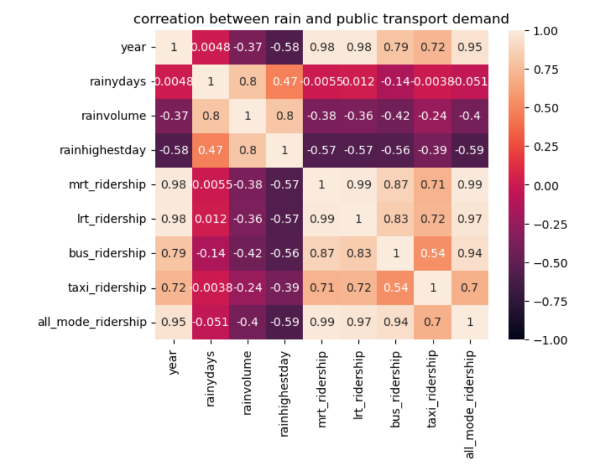
Answer to the problem
Does the rainy days and rain volumes have impact on demand for public transport across mode of transportation?
Rainy days and rain volumes has negative impact on demand for public transport across MRT, LRT, bus, and taxi, with heavy impact on MRT, LRT, and bus, and moderate impact on taxi.
These difference in impact between mode of transportation may because taxi does not require walking distance compared to MRT, LRT, and bus.

Slide 8
Answer to the problem
What are recommendation possible from the finding above?
operators of MRT, LRT, bus, and taxi should include rain forecast as part of features in transportation demand prediction.
to perform better forecast, daily level data of rain and usage of public transportation are required.
for operators to increase the demand for public transportation, the infrastructure to help prevent the rainfall along the walking distance to train stations or bus stops are required. we can start this project by looking at the train station and bus stop with high demand during rainy season. or the operators can provide the sales of umbrella or raincoat during rainy season at the bus stops or train station.

Slide 9
Appendix

Slide 10
Data Set
we use total 4 data sources …
we use total 4 data sources. all of them are from https://beta.data.gov.sg/
# provided data
1 rainyday_mth = pd.read_csv("../data/rainfall-monthly-number-of-rain-days.csv")
2 rainvolume_mth = pd.read_csv("../data/rainfall-monthly-total.csv")
3 rainhighestday_mth = pd.read_csv("../data/RainfallMonthlyHighestDailyTotal.csv")
# additional data
4 trans_ridership_yr = pd.read_csv("../data/PublicTransportUtilisationAveragePublicTransportRidership.csv")

Slide 11
Data processing procedure
based on our problem statement, we first checked the data issues, then merge 4 datasets into 1 datasets with year summary for each row
There are 5 steps in this data processing
step 1) check data set
step 2) transform these following 3 datasets from month summary datasets into year summary datasets
# rainyday_mth --> rainyday_year
# rainvolume_mth --> rainvolume_yr
# rainhighestday_mth --> rainvolume_yr
step 3) combine these 3 datasets above into one dataset with year as key # rain_yr_join
step 4) transform "trans_ridership_yr" data set by pivoting values into attributes and summarizing into year summary per row
# trans_ridership_yr --> trans_ridership_yr_join
step 5) combine "rain_yr_join" data set with "trans_ridership_yr_join" dataset, and then filter year before 2000 to handle missing values
# rain_vs_publictransport
# rain_vs_publictransport_start2001

