Slide 1

Reg no: 11611575
Role: Web Developer
Work assigned: Grocery Store Web App

Slide 2
Company Overview
Clients choose InfoStride as their workforce partner to complete quick-fill demands.
We work on a global basis, managing PC refreshes, Operating system upgrades, help desk/desk-side support outsourcing, and Quality Assurance testing.
We can quickly deploy a team of IT experts for program management, coordination and implementation of small to large-scale projects.

Slide 3
Project assigned: Grocery Store App
In this app we have builded a portal from where a user can buy the grocery items.
Also there is an admin panel, to which the data of various stores registered on the app is available.
Worked upon the dashboard part along with the teammates ( managed the CRUD functionality) i.e. to delete the store, add new store or editing the info of the store.

Slide 4
Technologies Used
This app is based upon MERN stack
React Js has been used for the front end part
Node Js for the backend of the app, mongo as a database
Express.js used to simply development and making the code easier to write and securing it

Slide 5
Why MERN stack has been selected?
MERN stack is perfect for building all kinds of applications, from dynamic single-page applications to complex enterprise and social media apps so this stack has been used
As our project has dynamic requirements, adding the new stores and managing their data properly, so MERN stack is suitable for it

Slide 6
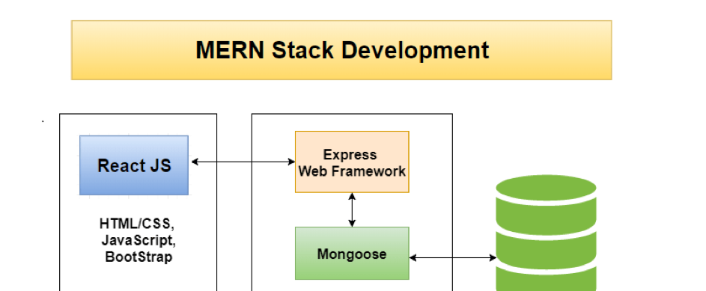
How It Works
Working model of MERN stack

Slide 7
Packages Used
Node Mailer
Html Pdf
Bcrypt
JWT Token

Slide 8
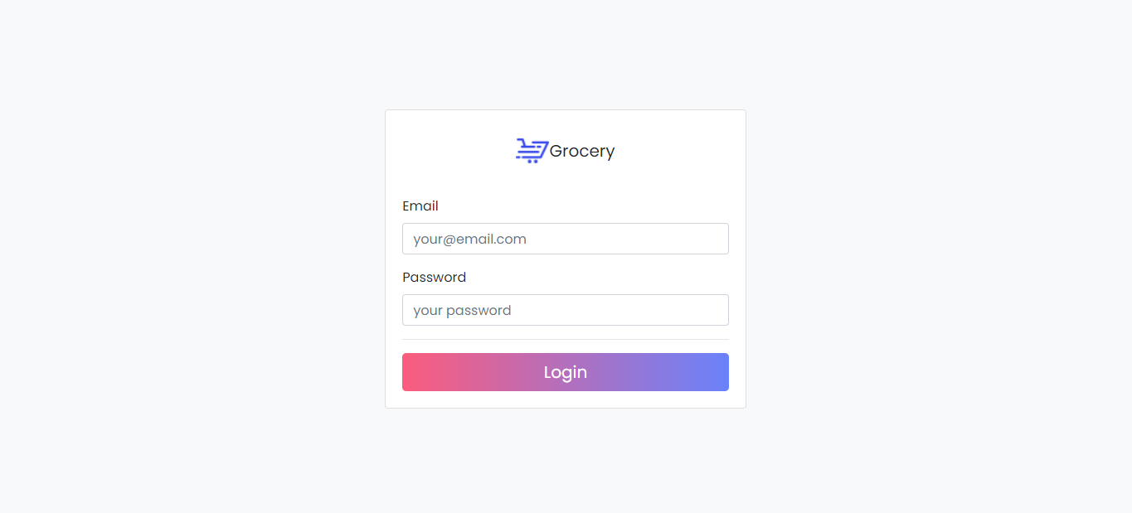
Screenshots of the project
Login page of the project

Slide 9
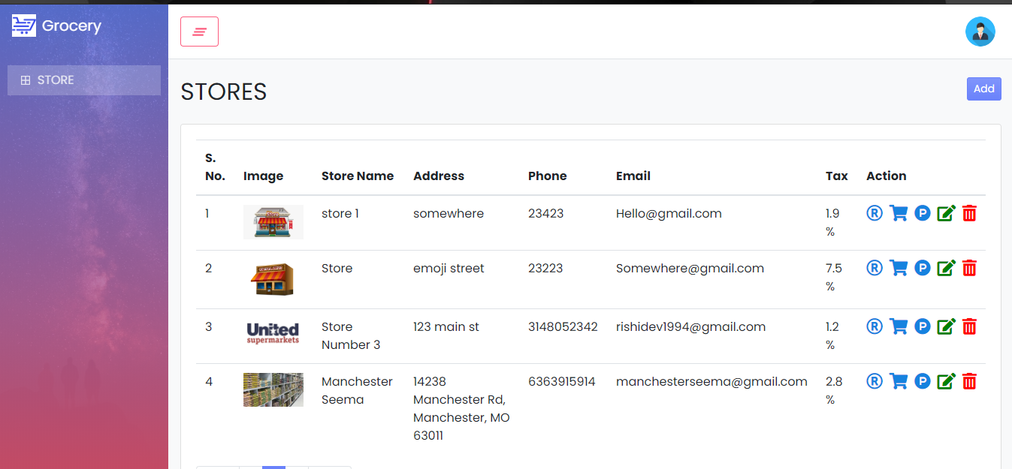
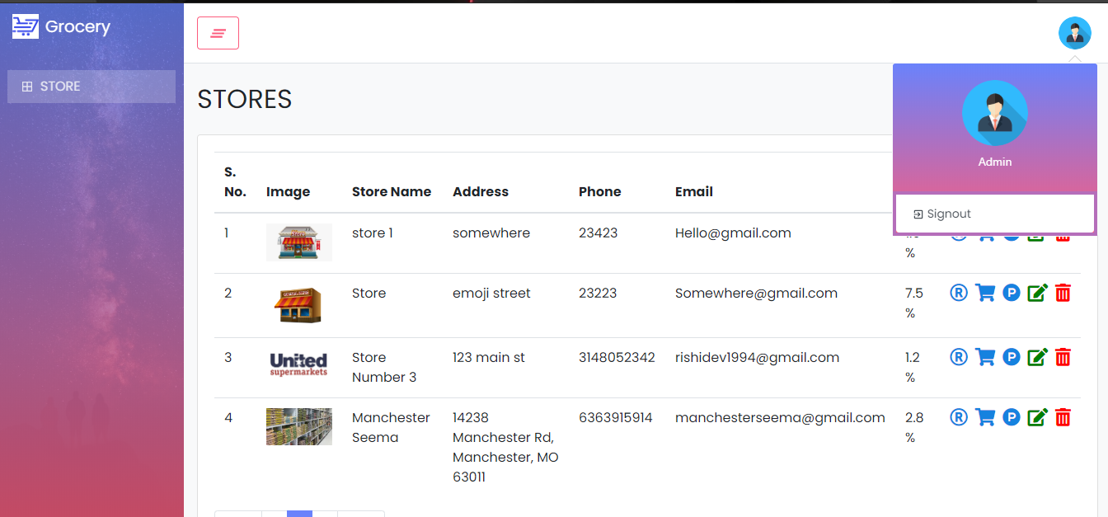
Landing page for Admin
Dashboard

Slide 10
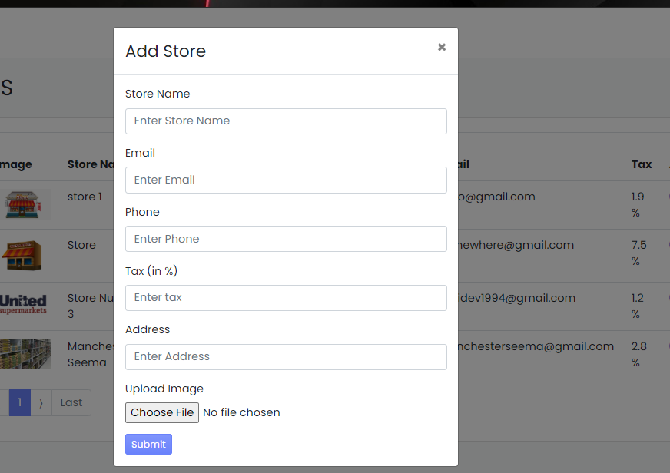
Adding a new store
Adding the information of the new store

Slide 11

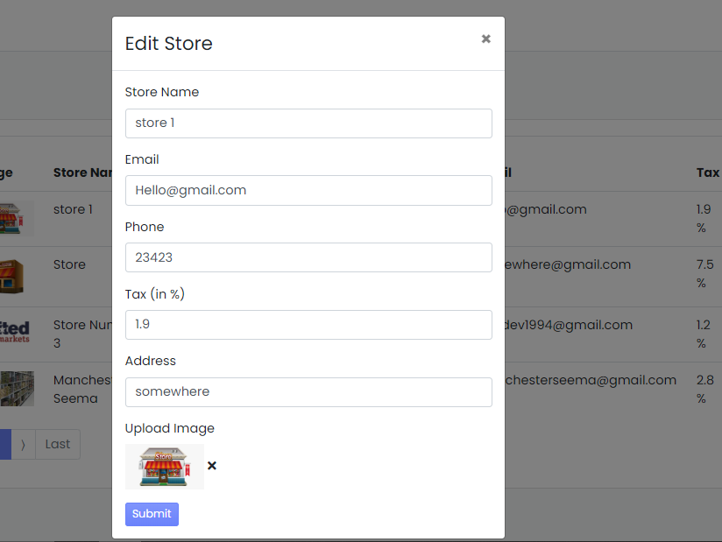
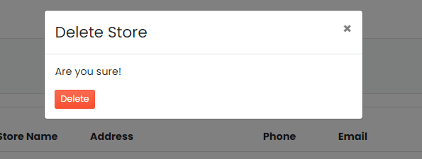
Deleting/ Editing a store’s information

Slide 12
Thank you

