Slide 1
Padding
A technique used in image processing to add extra pixels around the edges of an image
Often done to maintain the spatial dimensions of an image when applying convolutional filters or other image transformations
Done to avoid losing information at the borders of the image during filtering operations
Types of Image Padding:
Constant padding
Nearest Value padding
Periodic padding
Mirror padding

Slide 2
Padding
Zero Padding
Zero padding adds pixels with a zero intensity (black pixels) around the edges of the image.
Commonly used in convolutional neural networks (CNNs) to keep the output size the same as the input size after applying a convolutional filter.
Original image: Zero padded image(Margin 2):
0 0 0 0 0 0 0 0 0
0 0 0 0 0 0 0 0 0
1 1 1 1 1 0 0 1 1 1 1 1 0 0
1 1 1 1 1 0 0 1 1 1 1 1 0 0
1 1 1 1 1 ===> 0 0 1 1 1 1 1 0 0
1 1 1 1 1 0 0 1 1 1 1 1 0 0
1 1 1 1 1 0 0 1 1 1 1 1 0 0
0 0 0 0 0 0 0 0 0
0 0 0 0 0 0 0 0 0

Slide 3
Padding
Nearest Value Padding
Also known as replicate padding, extends the border pixels outward by replicating the value of the edge pixels
Maintains the intensity values at the edges and is useful in certain filtering operations to prevent abrupt changes at the borders
Original image: Nearest Value padded image(Margin 2):
1 1 1 2 3 3 3
1 1 1 2 3 3 3
1 2 3 1 1 1 2 3 3 3
4 5 6 4 4 4 5 6 6 6
7 8 9 7 7 7 8 9 9 9
7 7 7 8 9 9 9
7 7 7 8 9 9 9

Slide 4
Padding
Periodic Padding
Periodic padding, also known as circular padding, wraps the image around itself. The pixels from the opposite edge of the image are used as the padding.
Useful in certain signal processing applications where the image is considered to be periodic.
Original image: Periodic padded image(Margin 1):
9 7 8 9 7
1 2 3 3 1 2 3 1
4 5 6 6 4 5 6 4
7 8 9 9 7 8 9 7
3 1 2 3 1

Slide 5
Padding
Mirror Padding
Mirror padding, also known as symmetric padding, mirrors the image content at the borders.
For example, if the border pixels have values [1, 2, 3], symmetric padding would add [2, 1] outside the border.
Useful for reducing boundary artifacts in image processing and preserving edge information.
Original image: Zero padded image(Margin 2):
5 4 5 6 5
1 2 3 2 1 2 3 2
4 5 6 5 4 5 6 5
7 8 9 8 7 8 9 8
5 4 5 6 5

Slide 6
Filtering
Image filtering refers to the process of applying various image processing techniques
NIfTI images, commonly used in medical imaging and neuroimaging, is a file format designed to store neuroimaging data, typically derived from :
MRI (Magnetic Resonance Imaging)
CT (Computed Tomography)
PET (Positron Emission Tomography) scans
Filtering these images involves applying algorithms that enhance, modify, or analyze the image data for various purposes.

Slide 7
Filtering
Types:
Mean Filter
LoG filter
Laws filter
Gabor filter
Wavelet filter
Daubechies
Coiflet
Haar
Simoncelli

Slide 8
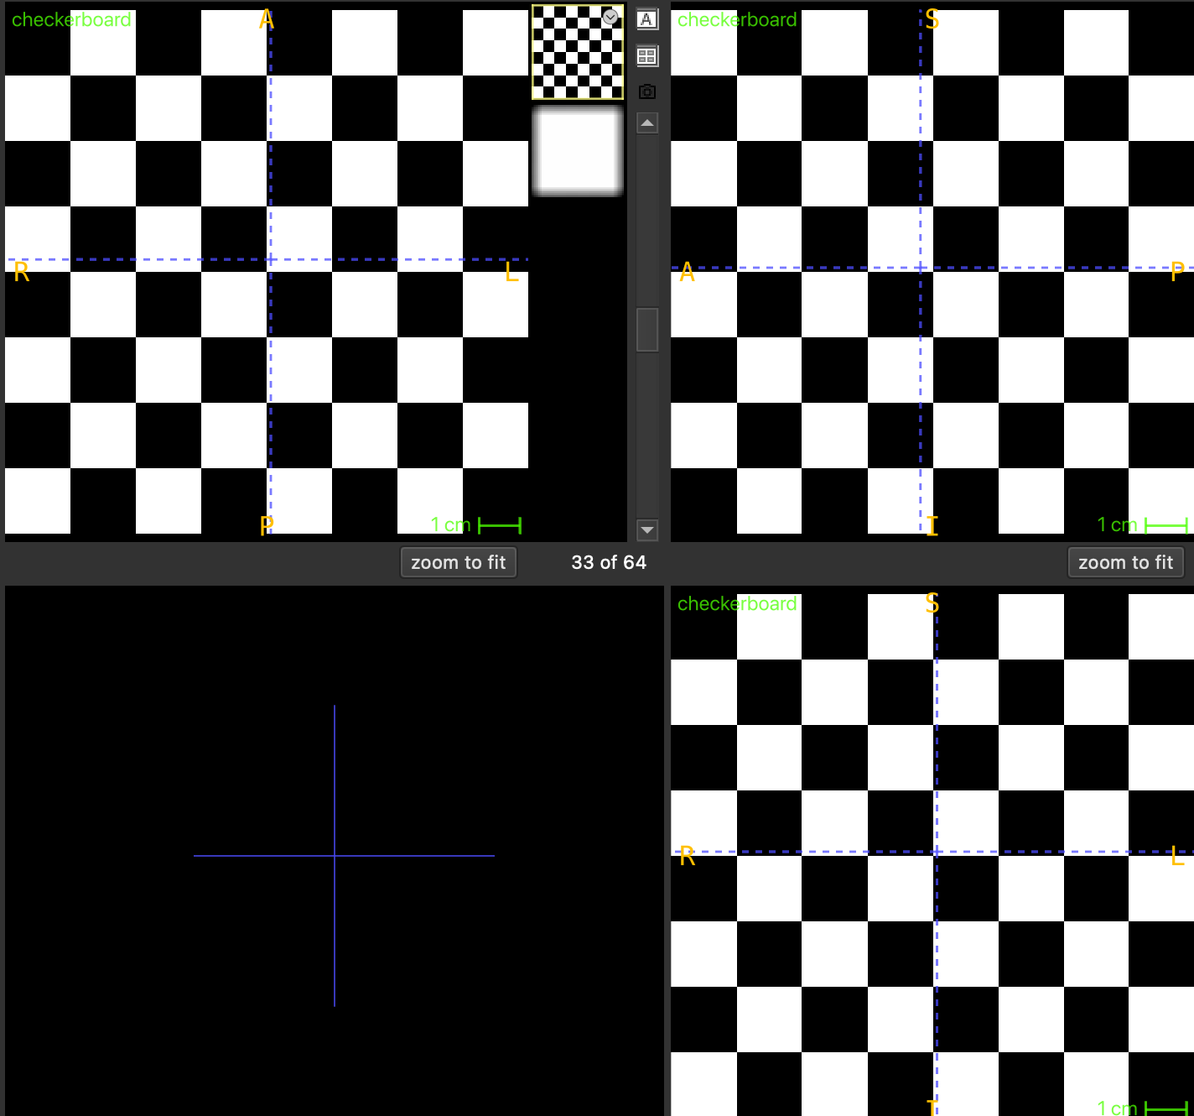
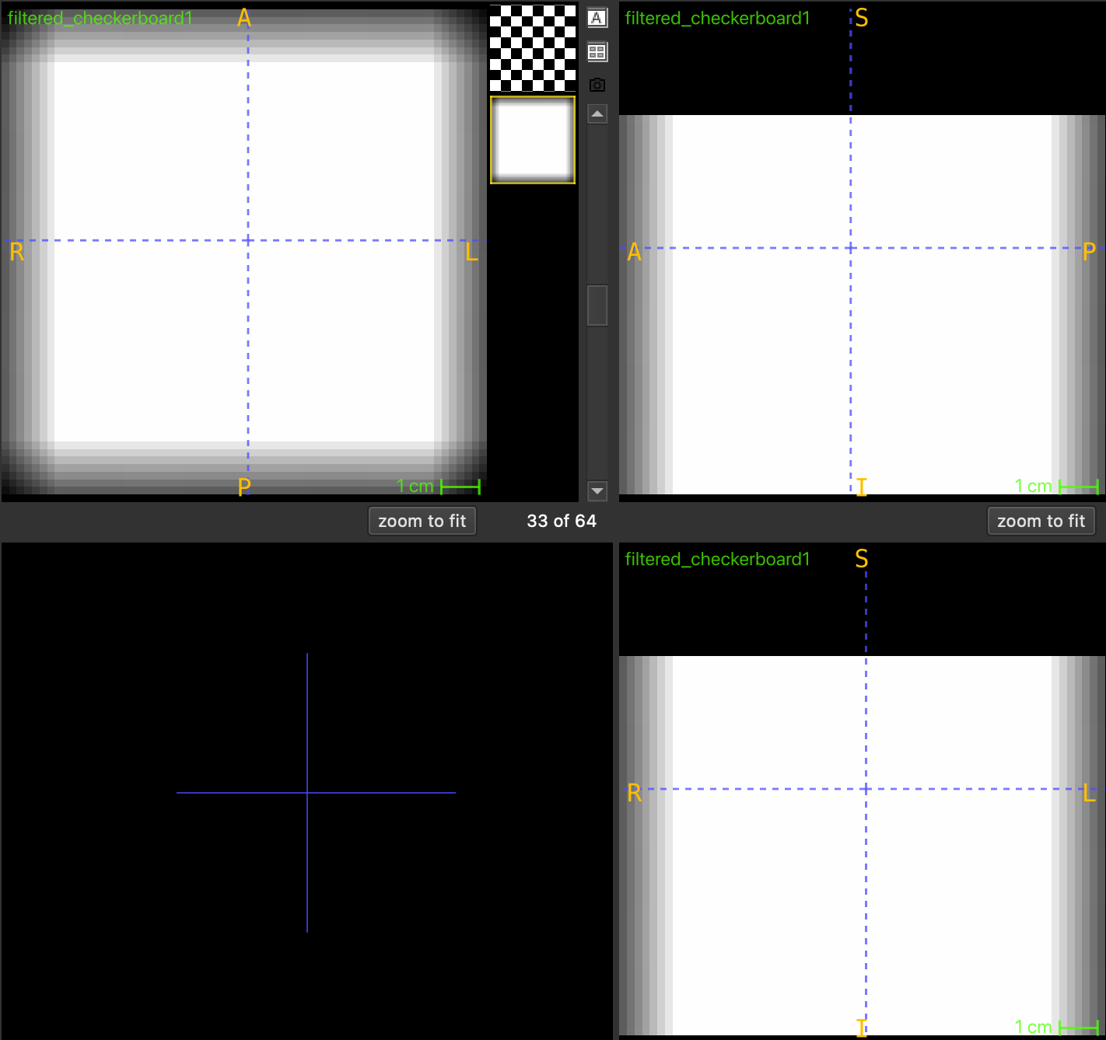
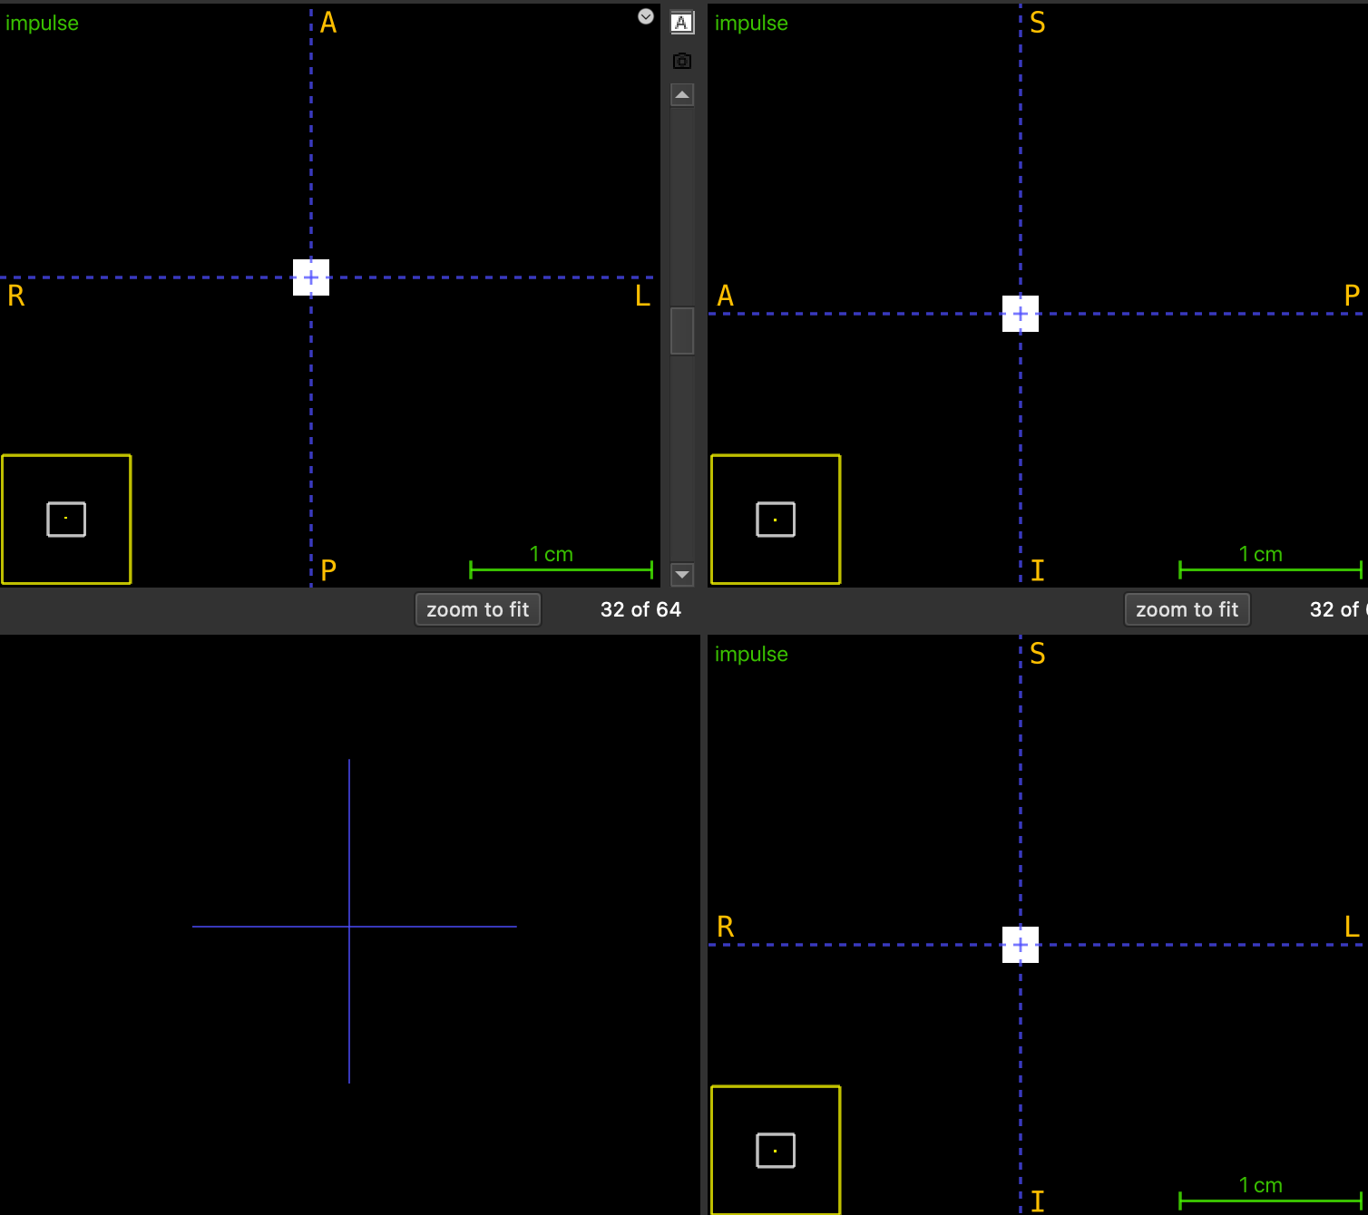
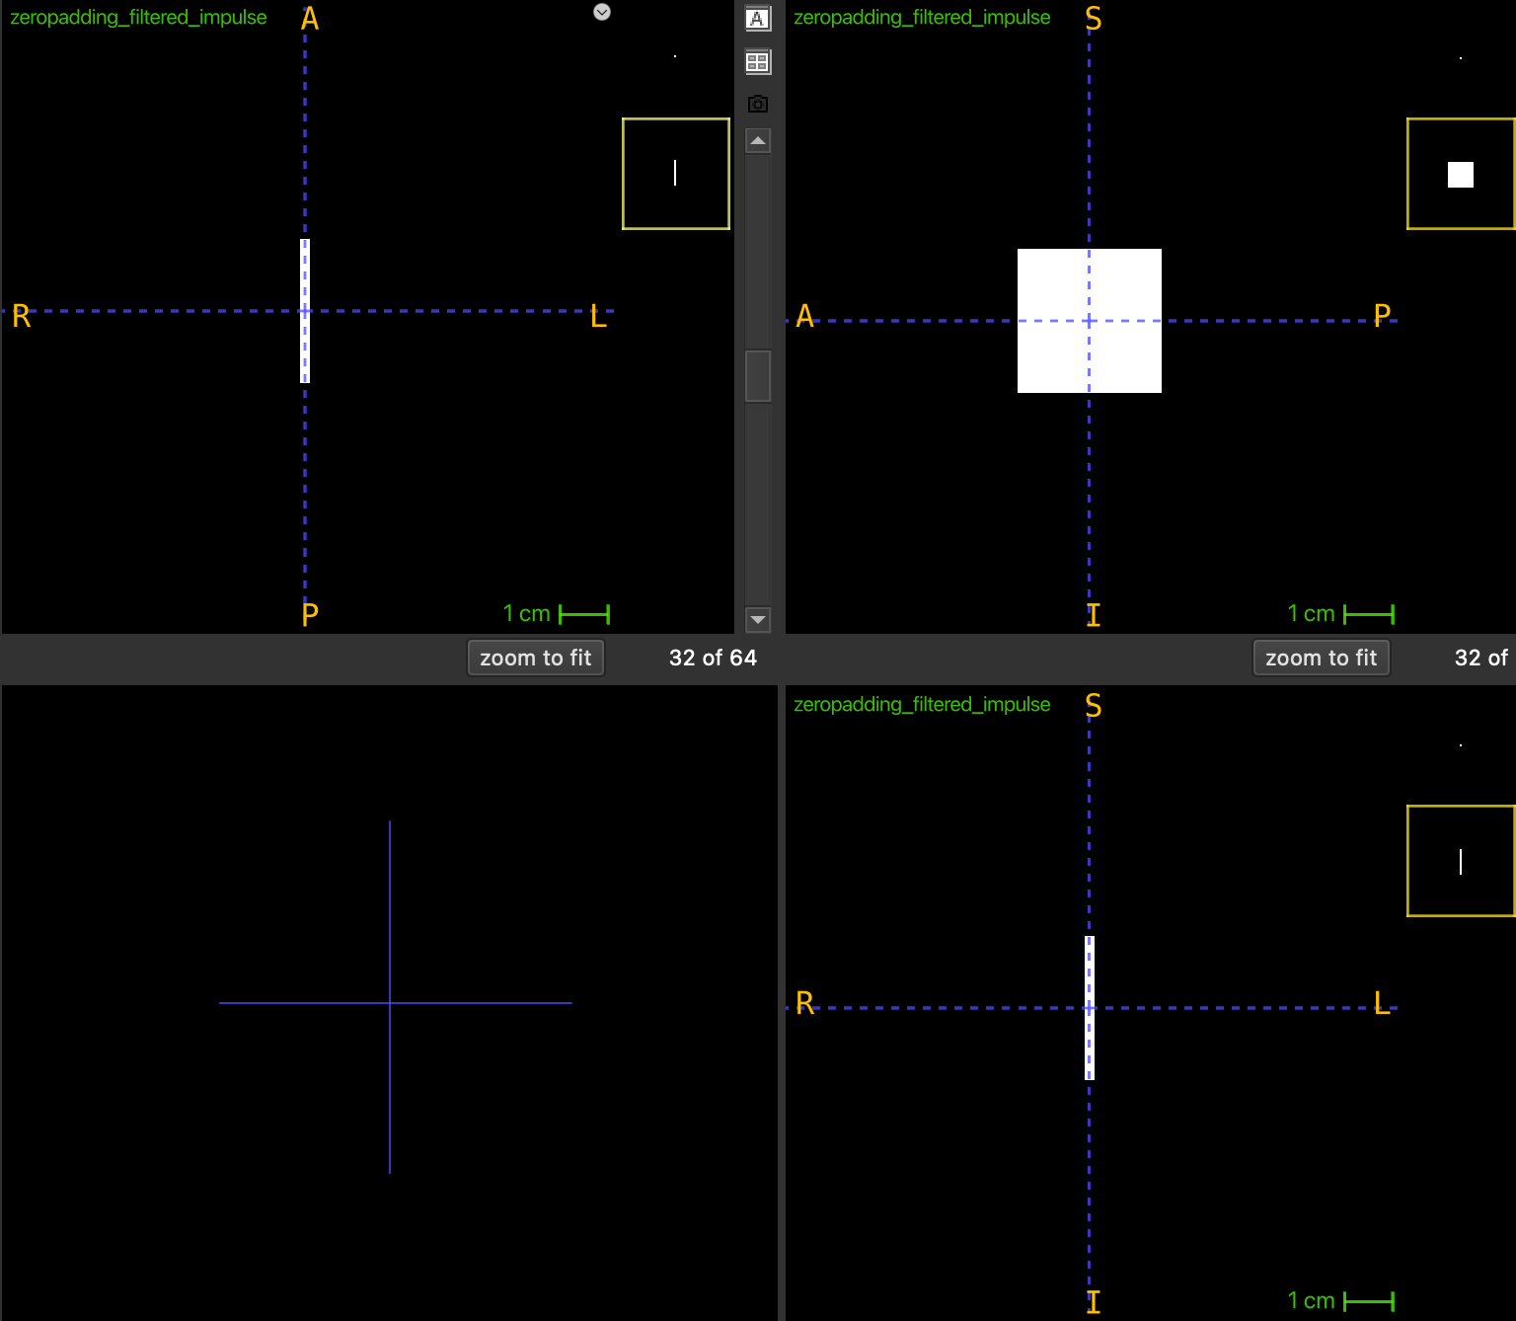
Filtering
Mean Filtering

Slide 9
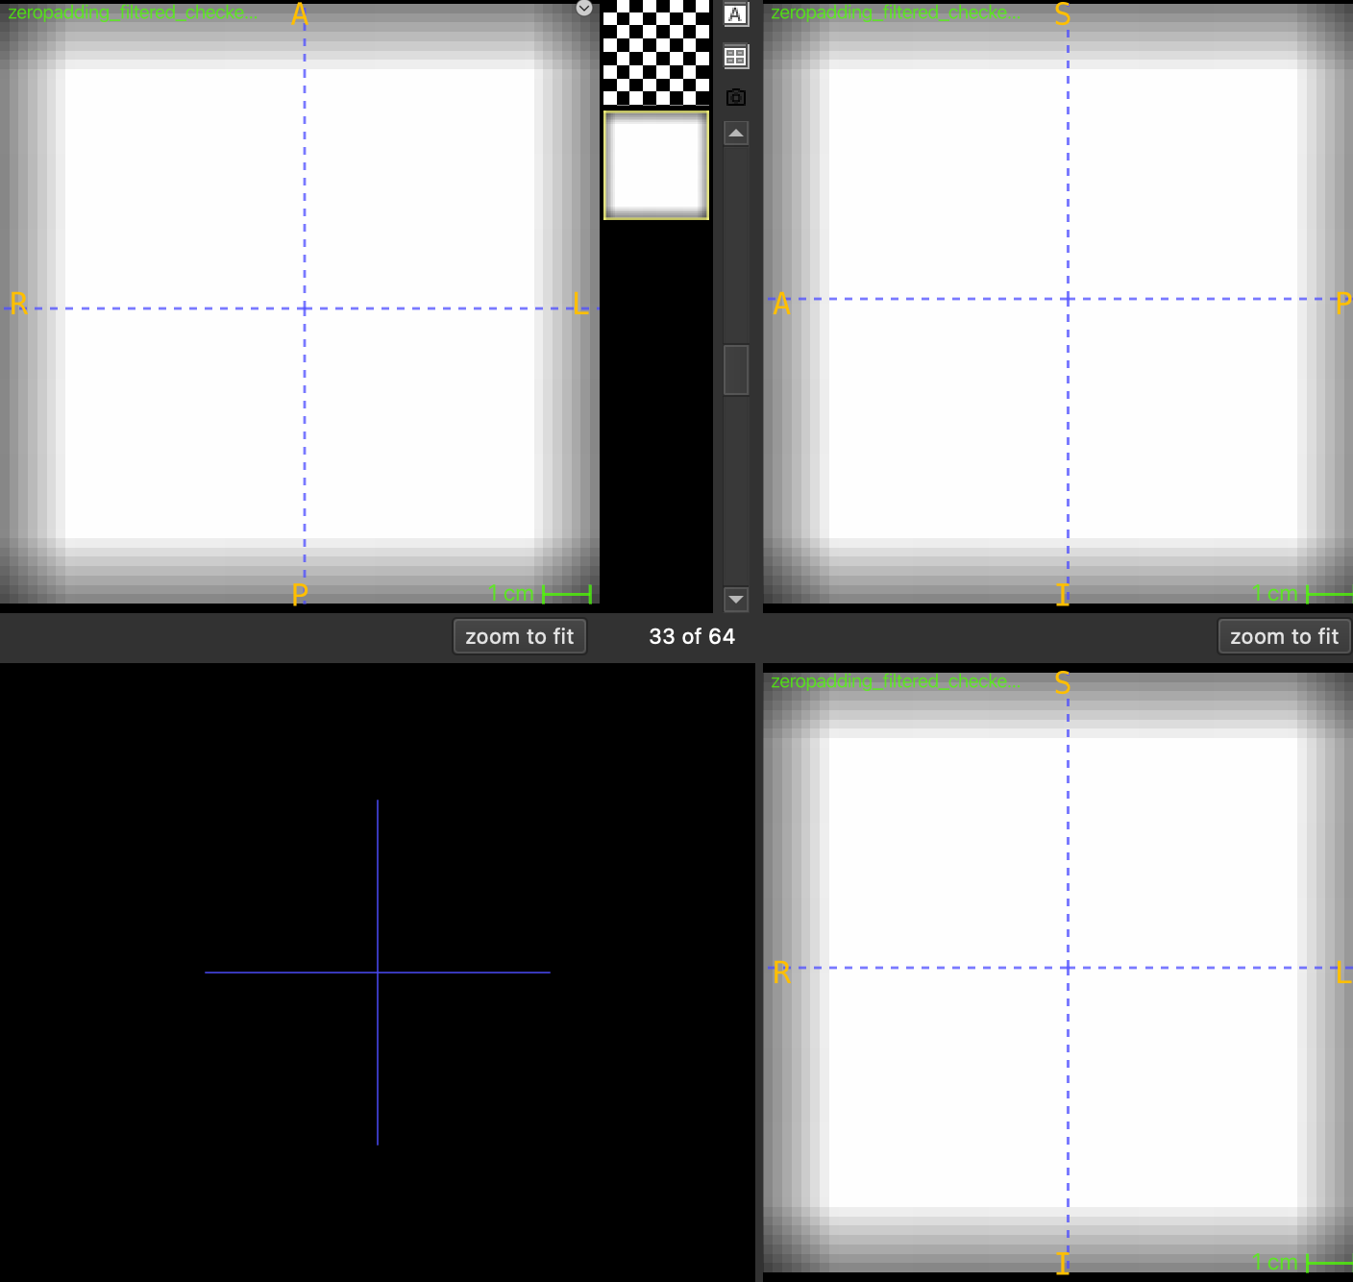
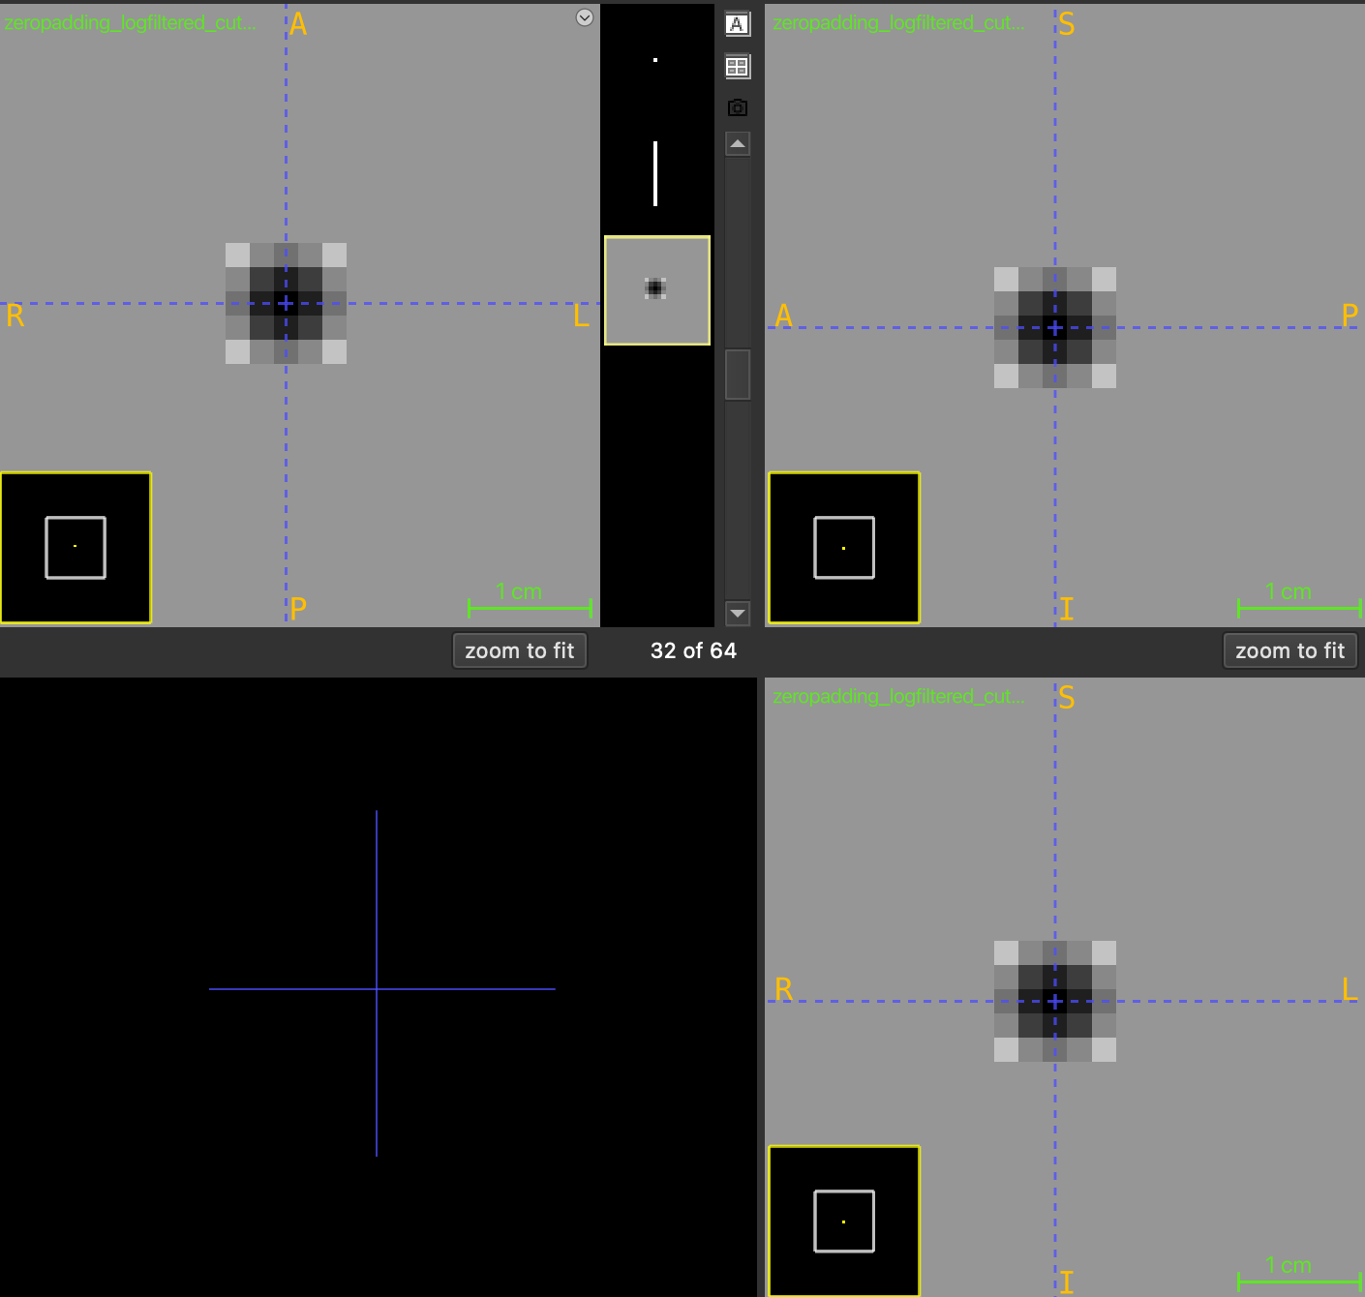
Padding
LoG filtering

Slide 10
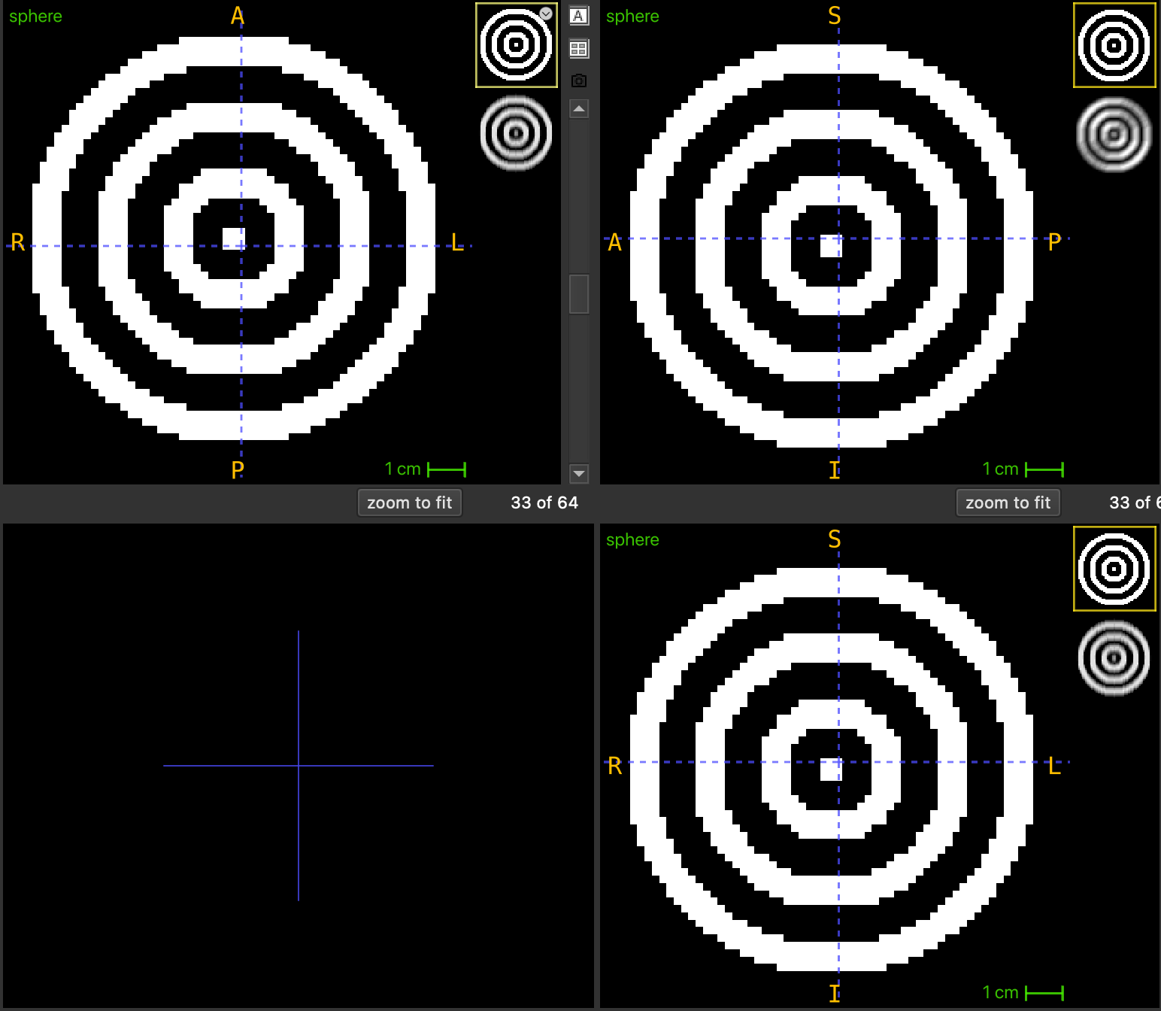
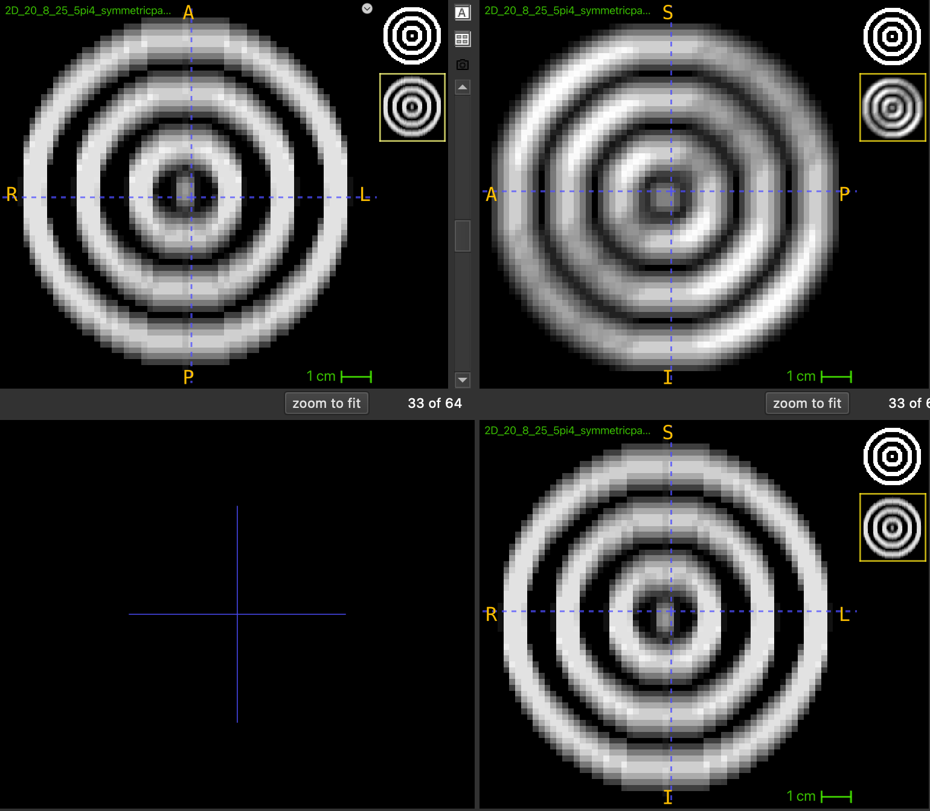
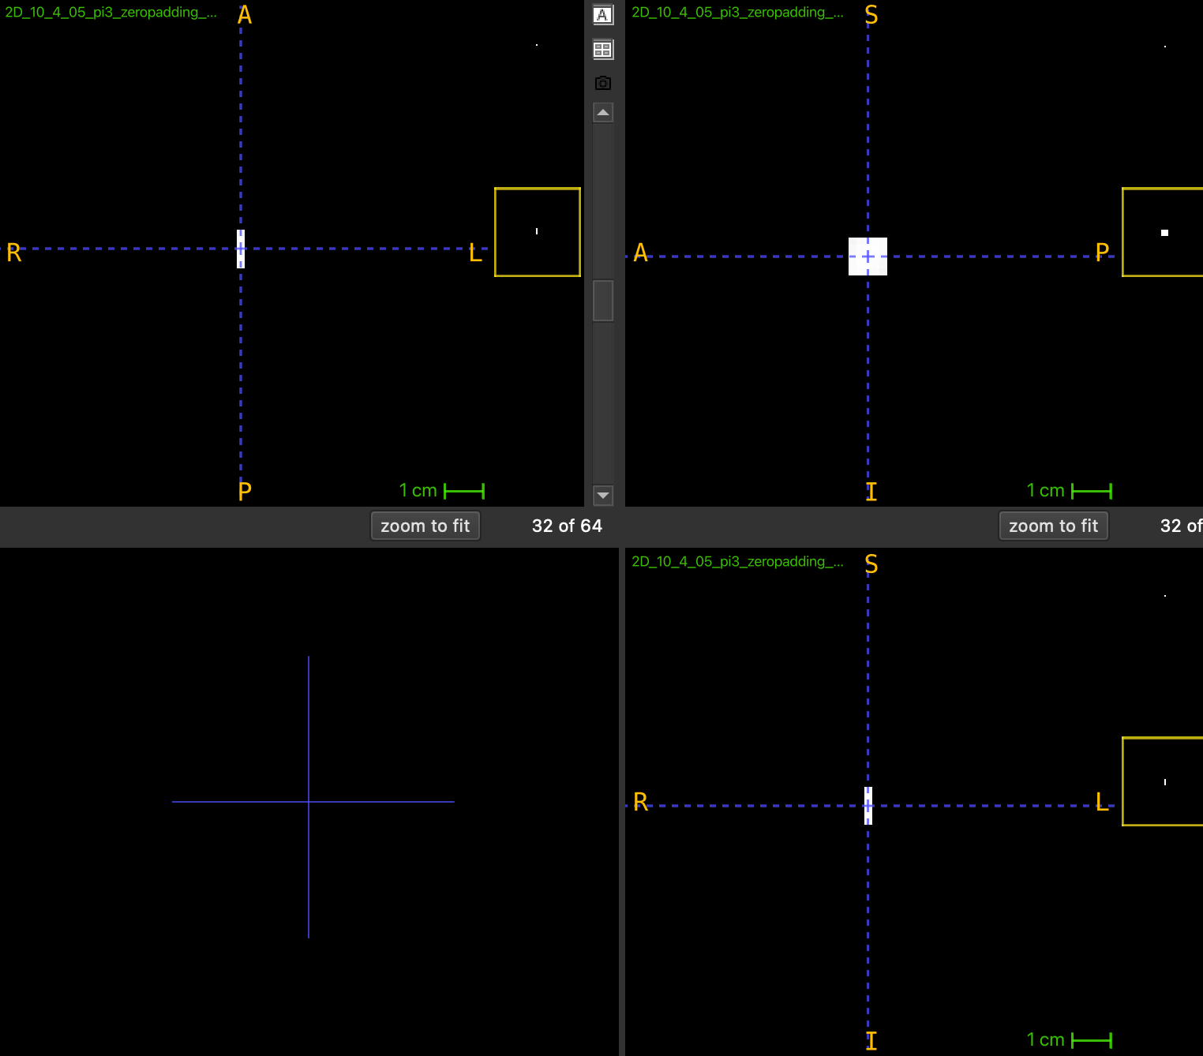
Filtering
Gabor Filter

Slide 11
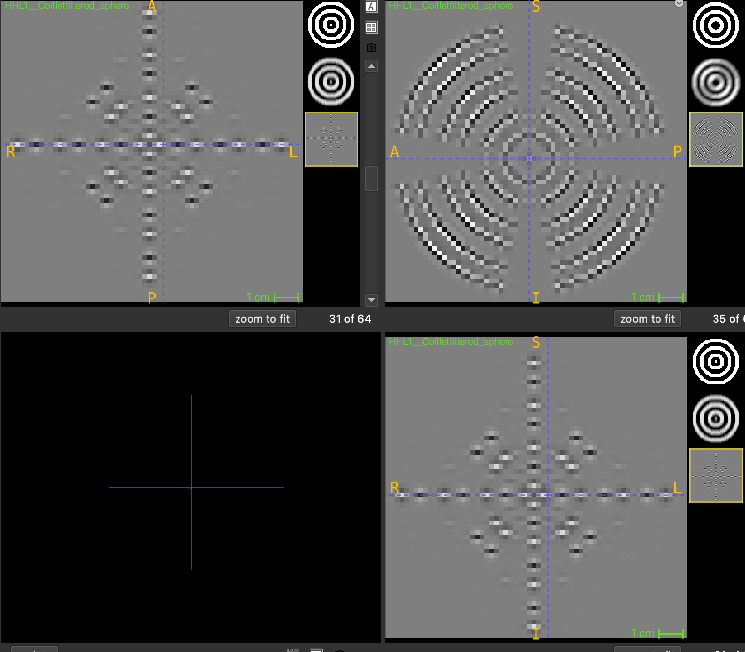
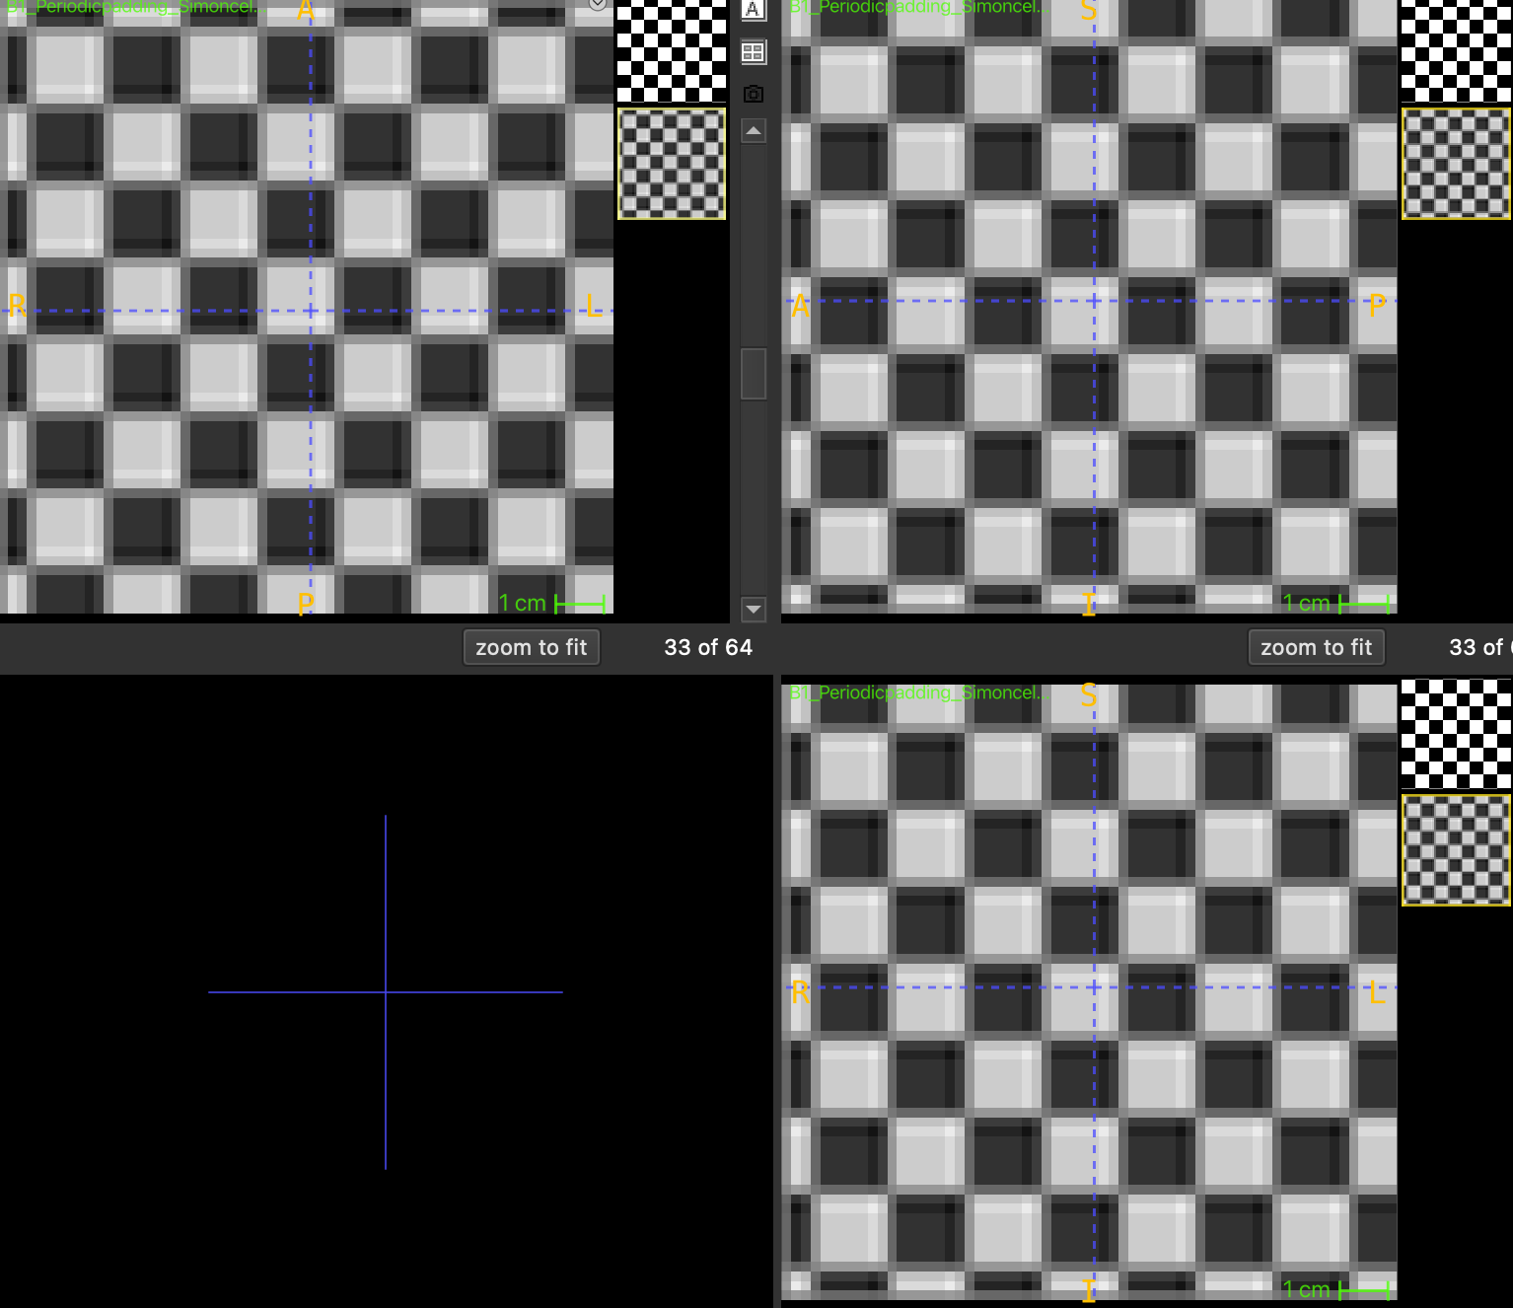
Filtering
Wavelet Filter

