Slide 1
CASE PROFILE FOR THE HEART FAILURE MODULES
MedTrix team

Slide 2
Presentation -April 2016
A 56 year old female presented at the emergency room with palpitations and dyspnoea on exertion

Slide 3
Due to the progressive nature of HF, patients cannot be perceived as ‘stable’
Frequency of decompensation and risk of mortality increase,^{1–5} with acute events and sudden death occurring at any time
Chronic decline¹
Cardiac function and Quality of life
Mortality
Decompensation/
hospitalization
Disease progression

Slide 4
Worsening heart failure symptoms increase the risk of morbidity and mortality
Worsening of heart failure symptoms and signs that results in hospital admission increases the risk of readmission and death¹
6X
greater risk of all-cause mortality for patients whose symptoms require a heart failure hospitalization¹
5X
greater risk of all-cause mortality in patients with worsening heart failure symptoms¹

Slide 5
Laboratory findings
Normal electrolytes
Normal creatinine
GFR: 93 ml/minute/1,73 m2
Echocardiograph: EF 25%
Heart failure stage: NYHA 3
Tachycardia –HR: 110 bpm
Stable BP 110/75 mmHg

Slide 6
Management: 13th February 2016 (Day 35)
Furosemide 40 mg twice daily
Bisoprolol 2.5 mg twice daily
Ramipril 5 mg OD
Eplerenone 25 mg orally once daily

Slide 7
Presentation –June 2016
Patient was in the same status with no improvement

Slide 8
Laboratory findings June 2016
Serum chemistry: Normal electrolytes and creatinine
GFR 88 ml/minute/1,73 m2

Slide 9
Management–June 2016
Defibrillator without CRT (narrow QRS < 110 minutes) was implanted
Bisoprolol5 mg twice daily,
Eplerenone25 mg orally once daily,
Furosemide 40 mg twice daily
Ramipril was stopped and 36 hours later entresto50 mg orally twice daily was started

Slide 10

ENTRESTO, the first-in-class angiotensin receptor-neprilysin inhibitor¹
An innovative multipathway approach restores balance to the CV system in HF
Vardeny O, Miller R, Solomon SD. Combined neprilysin and renin-angiotensin system inhibition for the treatment of heart failure.
JACC Heart Fail. 2014;2(6):663-670
ENHANCES
The beneficial effects of natriuretic peptides (NPs)
by suppressing their breakdown by neprilysin*
INHIBITS
The renin-angiotensin-aldosterone system
(RAAS) through AT₁ receptor blockade
Vasodilation
The benefits of restoring the natural balance between the NP system and the RAAS include:
Natriuretic and diuretic effects
Antiproliferative and antihypertrophic effects
Inhibition of aldosterone secretion
*Other vasoactive peptides
are concomitantly affected.
Vardeny O, Miller R, Solomon SD. Combined neprilysin and renin-angiotensin system inhibition for the treatment of heart failure. JACC Heart Fail. 2014;2(6):663-670
Notes:
Slide Name: GLB_Entresto_EN_moa_overview_8_1_GLCM LCZ 0036
Description: MOA Overview
Category: Mode of Action
Slide order: 39
Add-on file names (video/PDF):N/A

Slide 11
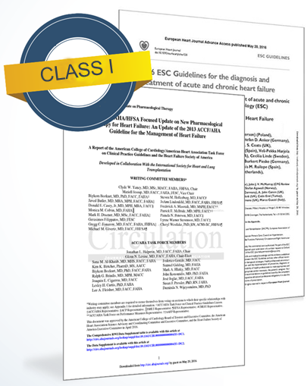
2016 ACC/AHA/HFSA and ESC guidelines recommend ARNI for the treatment of HFrEF^{1,2}
2016 ACC/AHA/HFSA Guideline Update
Recommend sacubitril/valsartan OR ACE inhibitors OR ARBs for patients with HFrEF²
Recommend sacubitril/valsartan in conjunction with evidence-based beta-blockers and MRAs in patients with chronic symptomatic HFrEF NYHA class II or III who tolerate an ACE inhibitor or ARB²
2016 ESC HF Guidelines
Recommend replacing an ACE inhibitor (or ARB) with sacubitril/valsartan in ambulatory patients with HFrEF who are symptomatic despite optimal treatment with an ACE inhibitor, a beta-blocker, and an MRA¹⁰

Slide 12
Entresto significantly reduced death from CV causes or first hospitalization for HF*
Composite primary endpoint
NNT
21
0.4
Enalapril‡ (N=4,212)
Entresto (N=4,187)
§
0.3
20%
0.2
Cumulative probability
0.1
p<0.0001
HR: 0.80
(95 % CI: 0.73–0.87)
ARR: 4.7 %
RELATIVE RISK REDUCTION
OF PRIMARY ENDPOINT
0
6
12
18
24
30
36
42
No. at risk
Entresto
Enalapril
Months since randomization
4,187 3,922 3,663 3,018 2,257 1,544 896 249
4,212 3,883 3,579 2,922 2,123 1,488 853 236
*Compared with enalapril, as assessed via time until cardiovascular death or first hospitalization for HF.¹ ‡Enalapril 10 mg 2x daily as comparator vs sacubitril/valsartan 200 mg 2x daily in the PARADIGM-HF study (in addition of standard therapy). §27 months since randomization (median)
ACE=angiotensin-converting enzyme; ARR=absolute risk reduction; CI=confidence interval; HF=heart failure; HFrEF=heart failure with reduced ejection fraction; HR=hazard ratio; NNT=number needed to treat
McMurray et al. N Engl J Med 2014;371:993–1004

Slide 13
Entresto significantly reduced CV mortality*
Primary endpoint
NNT
32
NNT
XX
0.3
Enalapril‡ (N=4,212)
Entresto (N=4,187)
§
***
0.2
20%
Cumulative probability
0.1
p<0.001
HR: 0.80
(95 % CI: 0.71–0.89)
ARR: 3.2 %
RELATIVE RISK REDUCTION OF
CARDIOVASCULAR MORTALITY
0
6
12
18
24
30
36
42
No. at risk
Entresto
Enalapril
Months since randomization
4,187 4,056 3,891 3,282 2,478 1,716 1,005 280
4,212 4,051 3,860 3,231 2,410 1,726 994 279
*Time to cardiovascular death. ‡Enalapril 10 mg 2x daily as comparator vs sacubitril/valsartan 200 mg 2x daily in the PARADIGM-HF study (in addition of standard therapy). §27 months since randomization (median)
ACE=angiotensin-converting enzyme; ARR=absolute risk reduction; CI=confidence interval; CV=cardiovascular; HR=hazard ratio
McMurray et al. N Engl J Med 2014;371:993–1004

Slide 14
Entresto significantly reduces the risk of first HF hospitalization, keeping HFrEF patients out of the hospital*
Primary endpoint
NNT
36
0.3
Enalapril‡ (N=4,212)
Entresto (N=4,187)
§
0.2
21%
Cumulative probability
0.1
p<0.001
HR: 0.79
(95 % CI: 0.71–0.89)
ARR: 2.8 %
RELATIVE RISK REDUCTION OF
FIRST HOSPITALIZATION FOR HF
0
6
12
18
24
30
36
42
No. at risk
Entresto
Enalapril
Months since randomization
4,187 3,922 3,663 3,018 2,257 1,544 896 249
4,212 3,883 3,579 2,922 2,123 1,488 853 236
*Compared with enalapril, as assessed via time to first hospitalization for HF (single component of primary endpoint). ‡Enalapril 10 mg 2x daily as comparator vs sacubitril/valsartan 200 mg 2x daily in the PARADIGM-HF study (in addition of standard therapy). §27 months since randomization (median)
ACE=angiotensin-converting enzyme; ARR=absolute risk reduction; CI=confidence interval; HF=heart failure; HFrEF=heart failure with reduced ejection fraction; HR=hazard ratio; NNT=number needed to treat
McMurray et al. N Engl J Med 2014;371:993–1004

Slide 15
Entresto significantly reduced the risk of first hospitalization for HF within the first 30 days after randomization*
1.2
Enalapril‡ (N=4,212)
Entresto (N=4,187)
1.0
0.8
Cumulative probability
0.4
0.2
p=0.027
HR: 0.60
(95 % CI: 0.3–0.94)
0
10
20
30
No. at risk
Entresto
Enalapril
Days since randomization
4,187 4,174 4,153 4,140
4,212 4,192 4,166 4,143
*Time to first hospitalization for HF; ‡Enalapril 10 mg 2x daily as comparator vs sacubitril/valsartan 200 mg 2x daily in the PARADIGM-HF study (in addition of standard therapy)
CI=confidence interval; HF=heart failure; HR=hazard ratio
1. Packer et al. Circulation 2015;131:54–61

Slide 16



Entresto reduced the frequency and severity of hospitalizations compared to enalapril*
30%
18%
12%
FEWER VISITS
TO THE EMERGENCY UNIT
FOR HEART FAILURE
p=0.017
FEWER STAYS
IN INTENSIVE CARE UNITS
p=0.005
LOWER RISK
OF ALL-CAUSE HOSPITALIZATION
p<0.001
*Enalapril 10 mg 2x daily as comparator vs sacubitril/valsartan 200 mg 2x daily in the PARADIGM-HF study (in addition of standard therapy).
Packer et al. Circulation 2015;131:54–61

Slide 17
Lower cumulative number of HF hospitalizations per 100 HFrEF patients with Entresto, compared with enalapril
60
50
Enalapril* (N=4,212)
Entresto (N=4,187)
40
Cumulative number of HF hospitalizations per 100 patients
Hazard ratio=0.77
(95% CI: 0.67–0.89)
p<0.001
30
20
10
0
0
6
12
18
24
30
36
42
48
Number of patients at risk
Entresto 4,187 4,054 3,885 3,276 2,472 1,710 1,001 279 12
Enalapril 4,212 4,049 3,857 3,228 2,408 1,724 993 278 17
Months after randomization
*Enalapril 10 mg 2x daily as comparator vs sacubitril/valsartan 200 mg 2x daily in the PARADIGM-HF study (in addition of standard therapy). Shown is cumulative number of hospitalizations for HF in the two study groups per 100 patients, ignoring death as an informative dropout, with the rate ratio calculated using the negative binomial regression model. CI=confidence interval; HF=heart failure; HFrEF=heart failure with reduced ejection fraction
Packer et al. Circulation 2015;131:54–61

Slide 18
Treatment with Entresto resulted in a lower likelihood of multiple hospitalizations for HF
HR 0.79
(95% CI: 0.71–0.89) p<0.001
Entresto (N=4,187)
Enalapril (N=4,212)
29% fewer HFrEF patients were hospitalized more than once for HF with sacubitril/valsartan than with enalapril (n=170 and n=240 respectively; p=0.001)
p<0.001
Proportion of patients (%)
p<0.001
p<0.001
p<0.001
n=537
n=658
n=367
n=418
n=110
n=143
n=33
n=53
n=27
n=44
Total number of patients hospitalized for HF once and multiple times
1
2
3
≥4
Number of admissions for HF
CI=confidence interval; HF=heart failure; HFrEF=heart failure with reduced ejection fraction; HR=hazard ratio
Packer et al. Circulation 2015;131:54–61

Slide 19
Duration of hospital stay per admission was similar for Entresto and enalapril Entresto group had 18% fewer stays in intensive care
Event | Entresto‡ | Enalapril§ | Rate ratio (95% CI) | p value | Relative risk reduction¶
Number of days in hospital per admission per patient | 10.8 ± 17.5 | 9.7 ± 9.5 | n/a | 0.86 | n/a
Total number of stays in intensive care | 768 | 879 | 0.82 (0.72–0.94)* | 0.005 | ↓18%
*With sacubitril/valsartan, compared with enalapril; ‡N=4,187; §N=4,212; CI=confidence interval
Packer et al. Circulation 2015;131:54–61

Slide 20
Lower proportion of Entresto-treated patients required intravenous positive inotropic support during hospitalization, compared with enalapril
Event | Entresto§ n (%) | Enalapril¶ n (%) | Rate ratio (95% CI) | p value | Relative risk reduction¶
Patients receiving i.v. positive inotropic drugs | 161 (3.9) | 229 (5.4) | 0.69 (0.57–0.85) | <0.001 | ↓31%
Patients requiring cardiac resynchronization, ventricular assist device implantation or cardiac transplantation* | 94 (2.3) | 119 (2.8) | 0.78 (0.60–1.02) | 0.07 | ↓22% (non-significant)
*Number of patients who received a left ventricular assist device or underwent cardiac transplantation was 23 in the enalapril group and 13 in the sacubitril/valsartan group; ‡With sacubitril/valsartan, compared with enalapril; §N=4,187; ¶N=4,212.
CI=confidence interval; HFrEF=heart failure with reduced ejection fraction; HR=hazard ratio; i.v.=intravenous
Packer et al. Circulation 2015;131:54–61

Slide 21
Entresto treatment effect for sudden cardiac death was not influenced by the presence of ICD
 | Sudden cardiac death n (%) | Hazard ratio, Entresto vs enalapril (95% CI) | p-value for interaction
−ICD | 525 (93.6%) | 0.82 (0.69–0.98) | 0.17
+ICD | 36 (6.4%) | 0.49 (0.25–0.98)
CI=confidence interval; ICD=implantable cardioverter defibrillator; vs=versus
Desai et al. Eur Heart J 2015;36:1990–7

Slide 22
Presentation –July 2016
The patient presented with significant clinical improvement

Slide 23
Laboratory and physical examination: july 2016
The patient was clinically better (NYHA 2)
HR 106 bpm, BP 105/71 mmHg, mild basal crackles
Normal electrolytes
Normal creatinine
GFR: 89 ml/minute/1.73 m2
BNP level 566 pg/ml
Echocardiograph: EF 30-35 %

Slide 24
Management: July 2016
We decide to increase Entresto to 100 mg twice daily
Next visit is scheduled in 3 weeks

Slide 25
Presentation -August 2016
The patient was totally free of symptoms
HR 88 bpm
BP: 96/69 mmHg
Lungs clear
ECG: Sinus rhythm
Biology: Normal electrolytes, normal GFR
Echocardiograph: EF 35-40%

Slide 26
Treatment with Entresto provides sustainable improvement of patients’ Quality of Life*
PARADIGM-HF study
Treatment with Entresto improves patients’ Quality of Life*, including HF symptoms and physical limitations (as measured based on the KCCQ)
The effect of Entresto on Quality of Life is sustained for up to 36 months; over the same treatment period, patients treated with enalapril experience a Quality of Life decline
Entresto had similar improvements as were seen with cardiac resynchronization therapy
Change in KCCQ-Overall Summary Scores vs. baseline
KCCQ-OS
Time from randomization
* In surviving patients
Source: Lewis E. F. et al, Health-Related Quality of Life Outcomes in PARADIGM-HF, Circ Heart Fail. 2017;10:e003430. DOI: 10.1161/CIRCHEARTFAILURE.116.003430

Slide 27
The benefit of Entresto is significantly superior vs. enalapril on Quality of Life, in all KCCQ domains* PARADIGM-HF study
Entresto Quality of Life improvement vs. enalapril
Change vs. baseline for each KCCQ domain at 8 months
KCCQ Score
P value
Physical Limitation
0.05
Symptom Stability
0.005
Symptom Frequency
0.001
Symptom Burden
0.02
Total Symptom Score
0.003
Quality of Life
<0.001
Self Efficacy
0.05
Social Limitation
<0.001
Enalapril superior
Entresto superior
* In surviving patients
Source: Lewis E. F. et al, Health-Related Quality of Life Outcomes in PARADIGM-HF, Circ Heart Fail. 2017;10:e003430. DOI: 10.1161/CIRCHEARTFAILURE.116.003430

Slide 28
Entresto is consistently superior vs. enalapril on Quality of Life – across physician-assessed NYHA classes PARADIGM-HF study
Entresto improves patients’ Quality of Life vs. enalapril irrespective of NYHA class
Patients on Entresto are less likely to have functional class deterioration vs. enalapril
The Entresto benefit on Quality of Life vs. enalapril is statistically significant for patients with moderate / severe symptoms at baseline (NYHA III/IV classes), as well as for patients with mild symptoms (NYHA I/II classes) – as measured by the EQ-5D index score
Source: Trueman D. et al, Better health-related quality of life in patients treated with sacubitril/valsartan compared with enalapril, irrespective of baseline NYHA class: Analysis of EQ-5D in PARADIGM-HF. Abstract accepted at ESC Congress 2017.
.
Patients* treated with Entresto were less likely to have functional deterioration (by at least 1 NYHA class) vs. patients treated with enalapril after 8 and 12 months of treatment (statistically significant difference)
* In surviving patients
Source: Packer M. et al, Angiotensin Receptor Neprilysin Inhibition compared with enalapril on the risk of clinical progression in surviving patients with heart failure. Circulation. 2015 Jan 6;131(1):54-61

Slide 29
Management: August 2016
To continue entresto100 mg twice daily until the following visit scheduled in three months

Slide 30
The majority of patients achieved and maintained the target dose of Entresto throughout PARADIGM-HF¹
76%
OF PATIENTS REMAINED AT THE TARGET DOSE OF Entresto 200 MG* TWICE DAILY AT THE END OF THE STUDY¹
There were fewer discontinuations due to adverse events with Entresto vs enalapril (mean daily dose of 375 mg and 18.9 mg, respectively)²
*In PARADIGM-HF, sacubitril/valsartan 24 mg/26 mg, 49 mg/51 mg, and 97 mg/103 mg were referred to as 50 mg, 100 mg, and 200 mg, respectively.
1. Sacubitril/valsartan Core Data Sheet, version 1.1. Novartis Pharmaceuticals, August 2015;
2. McMurray et al. N Engl J Med 2014;371:993–1004

Slide 31
The treatment benefit with Entresto relative to enalapril was maintained at lower than target doses – 1 of 2
Patients taking Entreston had fewer events relative to enalapril both prior and after dose reduction (HR 0.79, 95% CI 0.71–0.88, p<0.001 vs. HR 0.80, 95% CI 0.70–0.93, p<0.001; respectively)
CV death or HF hospitalization by dose reduction status
Events prior to dose reduction
Events after dose reduction
0.40
0.30
0.20
0.10
0.00
0.40
0.30
0.20
0.10
0.00
0
1
2
3
0
1
2
3
Years from randomization
Years from randomization
Number at risk
Enalapril | 4210 | 2868 | 1451 | 514
Entresto | 4186 | 2891 | 1514 | 511
Number at risk
Enalapril | 1452 | 795 | 325 | 89
Entresto | 1496 | 854 | 383 | 88
Enalapril
Entresto
CI=confidence interval; CV=cardiovascular; HF=heart failure; HR=hazard ratio
Vardeny et al. Eur J Heart Fail 2016;18:1228–34

Slide 32
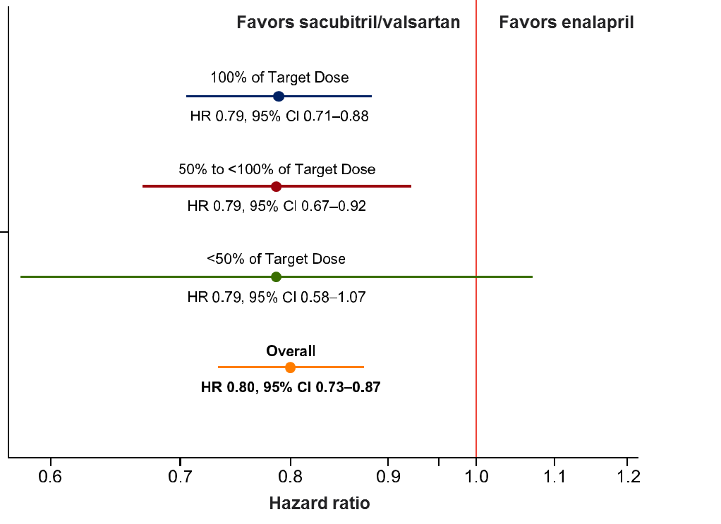
The treatment benefit with Entresto relative to enalapril was maintained at lower than target doses – 2 of 2
Risk of the primary outcome measure by time‐updated mean dose post‐randomization
CI= confidence interval; HR=hazard ratio
Vardeny et al. Eur J Heart Fail 2016;18:1228–34

Slide 33
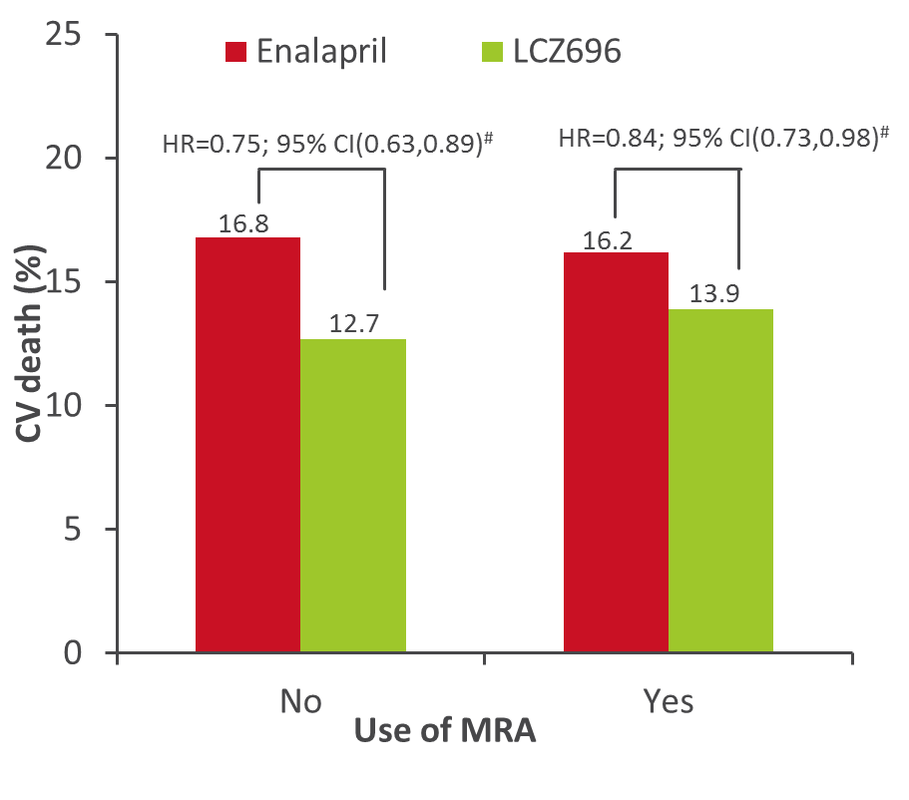
What about MRA use?
The benefit of Entresto (reduction of CV mortality) was similar in subgroups of patients receiving MRA at baseline, versus those who were not (p = 0.32 for interaction)¹
CV death: baseline MRA use
Entresto
#Interaction p = 0.32
CI, confidence interval; CV, cardiovascular; HR, hazard ratio; MRA, mineralocorticoid receptor antagonist;
1. McMurray et al. N Engl J Med 2014;371:993-1004.

Slide 34
No significant difference in progression of renal dysfunction with Entresto, compared with enalapril
Change from baseline in eGFR
Change in eGFR –6.1 mL/min/1.73 m² over 44 months (sacubitril/valsartan –5.4 ± 1.0 vs enalapril –6.8 ± 1.0 mL/min/1.73 m²)
Slope eGFR: sacubitril/valsartan –1.14 vs enalapril –1.53 mL/min/1.73 m²/year (p=0.0047)
eGFR=estimated glomerular filtration rate
Damman et al. Oral presentation at the ESC congress 2015, London, UK, 29 August – 2 September 2015

Slide 35
Entresto has a safety and tolerability profile comparable to that of enalapril
Four most frequently reported adverse reactions and incidence of angioedema in PARADIGM-HF
Entresto (N=4,187)
Enalapril* (N=4,212)
20
p=0.15
17.3
p<0.001
16.1
p<0.001
14.3
14.0
15
11.3
Proportion of adverse events (%)
9.2
10
p=0.07
4.5
5
3.3
p=0.19
0.2
0.1
0
Cough
Renal impairment‡
Hyperkalemia§
Symptomatic hypotension
Angioedema¶
*Enalapril 10 mg 2x daily as comparator vs sacubitril/valsartan 200 mg 2x daily in the PARADIGM-HF study (in addition of standard therapy); ‡Elevated serum creatinine ≥2,5 mg/dL; §Elevated serum potassium >5,5 mmol/l; ¶Angioedema with no treatment or use of antihistamines only McMurray et al. N Engl J Med 2014;371:993–1004

