Slide 1
UCF 439 Heart Disease Prediction System using Machine Learning and Deep Learning Group No. 54
Under the guidance of
Miss Shreya Deoli shreya.deoli@dituniversity.edu.in
Team Members :
Ankit Nainwal 1000014497
1000014497@dit.edu.in
Kamlesh Singh 1000014214
1000014214@dit.edu.in
Abhimat Kala 1000014969
1000014969@dit.edu.in

Slide 2
Table of Contents
Introduction
Feasibility Study Overview
Project Description
Work Done
Screenshots
Project Timeline
Conclusion

Slide 3
Introduction
Heart disease is the leading cause of death globally, and early detection is crucial for effective treatment and prevention.
Machine learning offers a powerful approach to analyze vast amounts of medical data and identify patterns that can help predict the risk of heart disease.
Our project is driven by the recognition that early detection plays a pivotal role in mitigating the impact of heart disease. By harnessing the power of data analytics and predictive modeling, we have developed a system that analyzes relevant health indicators and risk factors to assess an individual's likelihood of developing heart disease

Slide 4
Feasibility Study Overview
Objective & Scope
To develop a machine learning-based system for predicting heart disease risk.
Data Availability
One of the primary aspects evaluated was the availability and accessibility of relevant datasets containing clinical and demographic information of patients.
Multiple datasets were explored to ensure an adequate amount of data for training and testing the predictive models.
Algorithm Exploration
Explored various machine learning algorithms, including logistic regression, XGB Classifier, Bagging Classifier, Extra Trees, K-Nearest Neighbor, Gradient Boosting, AdaBoost, Decision Tree, Multinomial NB, random forests, and neural networks.

Slide 5
Feasibility Study Overview
Evaluation Metrics:
Evaluation metrics were established to assess the performance of the algorithms.
Metrics such as accuracy, precision, recall, and F1-score were utilized to measure the predictive capability and robustness of the models.
Benefit Analysis:
Improved accuracy in heart disease prediction
Early detection leading to better patient outcomes
Reduced healthcare costs through preventive measures

Slide 6
Project Description
Project Aim:
To develop a robust heart disease prediction system integrating diverse machine learning algorithms for accurate risk assessment.
Innovation:
Employed both machine learning and deep learning algorithms to enhance accuracy levels significantly.
Key Features:
Simple User interface for users.
Easy to use.
Precise Prediction of disease

Slide 7
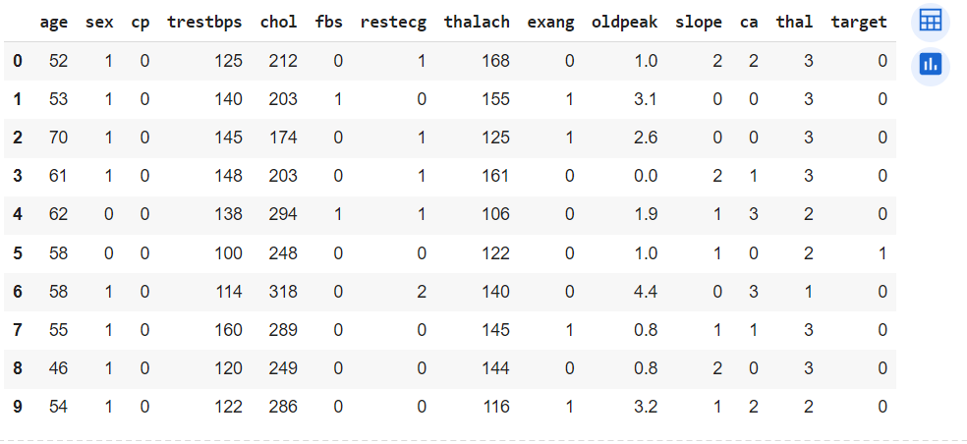
Project Description
Dataset Used : heart_dataset_RafaelGranza_1026

Slide 8
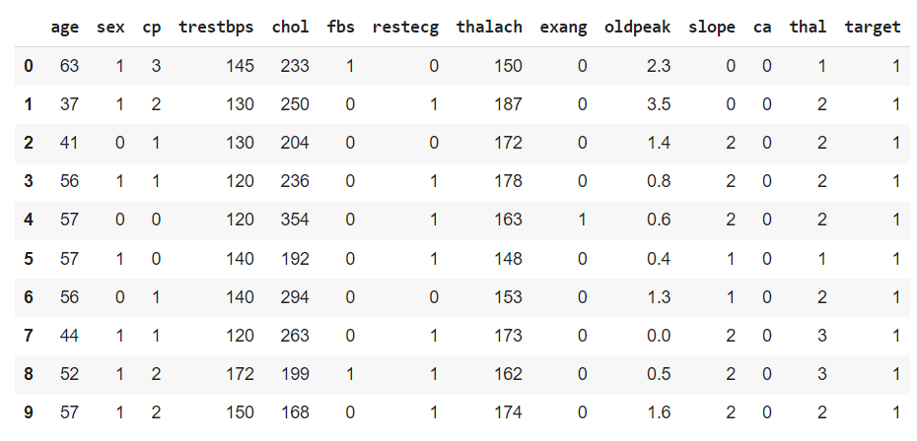
Project Description
Dataset Used : heart_dataset_bharath0609_304

Slide 9
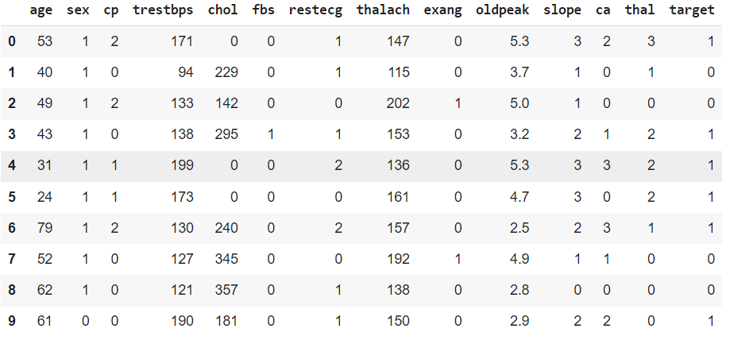
Project Description
Dataset Used : heart_dataset_jocelyndumlao_1000

Slide 10
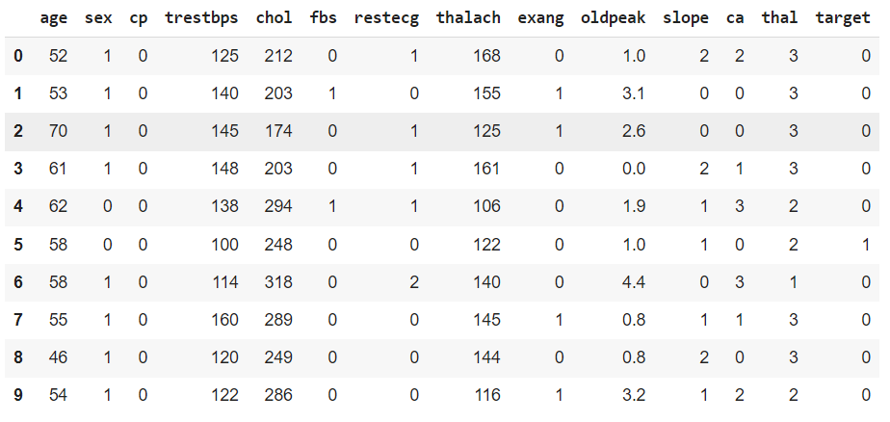
Project Description
Dataset Used : heart_dataset_rishidamarla_271

Slide 11
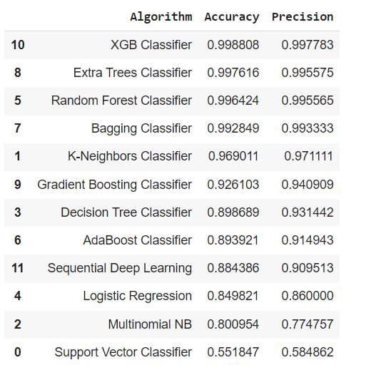
Project Description
Accuracy Achieved :

Slide 12
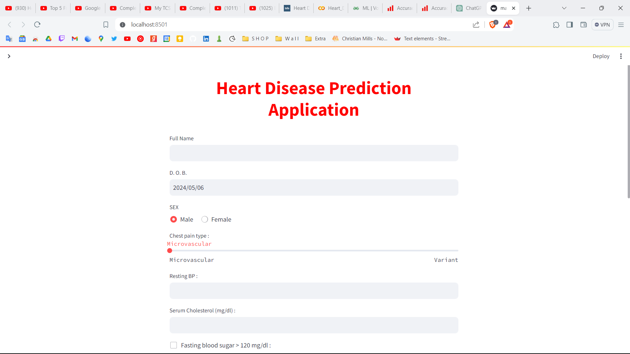
Work Done
User Interface Design:
Finalized design for the platform, ensuring easy navigation and interaction for all users.

Slide 13
Work Done
Exploratory data analysis (EDA) :
Utilized Exploratory Data Analysis (EDA) to gain insights into the dataset’s characteristics, identify patterns, and understand relationships among variables, thereby informing the feature selection process and improving model performance
Machine Learning algorithm Implementation :
Implemented various machine learning algorithms, including logistic regression, XGB Classifier, Bagging Classifier, Extra Trees, K-Nearest Neighbor, Gradient Boosting, AdaBoost, Decision Tree, Multinomial NB, random forests, and neural networks.
Model Development and Evaluation :
Model development evaluation is integral to ensuring the effectiveness and reliability of your predictive system.

Slide 14
Work Done
Ensemble Learning:
Ensemble learning involves combining multiple machine learning models to improve overall predictive performance.
Model Evaluation:
Model evaluation is essential for assessing the effectiveness of individual models within the ensemble and the ensemble itself.
Incorporating ensemble learning techniques into heart disease prediction project allows harness the collective power of multiple models, improving predictive accuracy and reliability. Effective model evaluation ensures that the ensemble model performs optimally and can be trusted for real-world applications in healthcare settings.
Utilizing multiple models like XGBClassifier, BaggingClassifier, RandomForestClassifier, and ExtraTreesClassifier can enhance the predictive accuracy and robustness of your heart disease prediction system.

Slide 15
Work Done
Deep Learning Implementation:
We have used a sequential deep learning model to predict heart disease. This model, tailored for sequential data analysis, enabled the examination of temporal dependencies within the dataset, enhancing the accuracy of heart disease predictions.

Slide 16
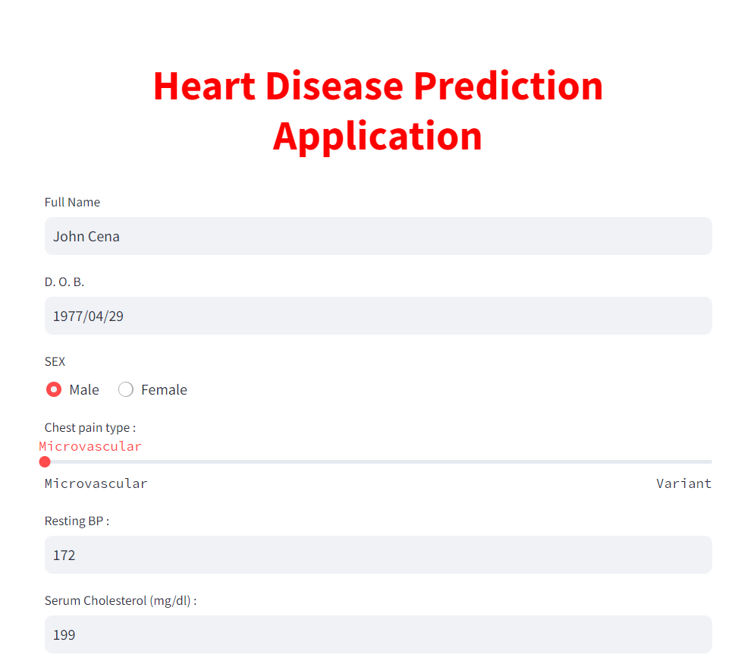
Screenshots

Slide 17
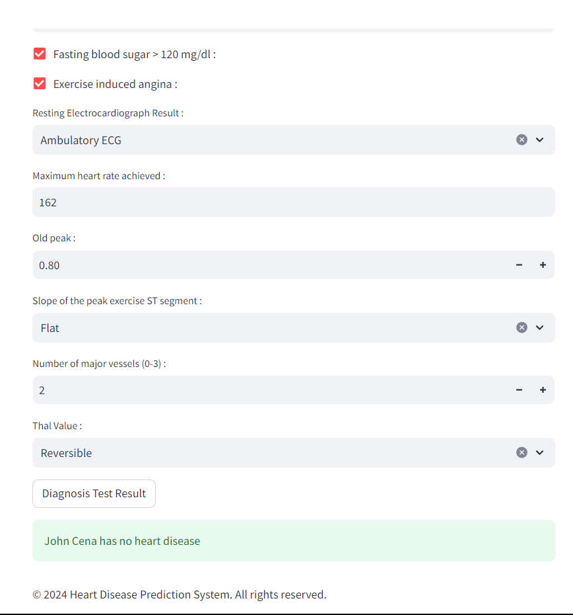

Slide 18
Improvement Done
Project Enhancement and addition of new features:
Deep Learning : Implemented Deep Learning
Frontend: We made a User interface where users can enter his/ her health data and our model will predict whether users have heart disease or not and generate output.

Slide 19
Project Timeline
Week 1 (05/02/2024 - 11/02/2024): Week 2 (12/02/2024 - 18/02/2024):
Design and Planning Data collection
Week 3 (19/02/2024 - 25/02/2024): Week 4 (25/02/2024 - 3/03/2024):
Model training Model evaluation and improvement
Week 5 (4/03/2024 - 10/03/2024): Week 6 (11/03/2024 - 17/03/2024):
User Interface PPT for Mid-Term
Week 7 (18/03/2024 - 24/03/2024): Week 8 (25/03/2024 - 31/03/2024):
Submission of PPT Mid-Term Preparation
Week 9 (1/04/2024 - 7/04/2024): Week 10 (8/04/2024 - 14/04/2024):
Mid-Term Exam Guide, Contact Us and About Us Pages
Week 11 (15/04/2024 - 21/04/2024): Week 12 (22/04/2024 - 28/04/2024):
Adding Deep Learning Techniques Improving model
Week 13 (29/04/2024 - 5/05/2024): Week 14 (6/05/2024 - 12/05/2024):
Better User Interface Submission of PPT for End-term

Slide 20
Conclusion
In conclusion, the XGB Classifier has proven to be the most effective among all the machine learning models and deep learning techniques we employed. It provides an accurate and efficient means of predicting heart disease risk in patients. By analyzing patient data using machine learning and deep learning algorithms, the system aims to assist both users and healthcare professionals in making timely and precise diagnoses. This could lead to early disease detection, better patient outcomes, and improved healthcare delivery. Additionally, the system's user-friendly interface, accessible from anywhere via the internet, further enhances its potential impact on healthcare accessibility and efficiency.

Slide 21
Thank You!
End of Presentation

