Slide 1
Parent Patent – Architecture 🔍 EXTRACTION → ⚖️ IDENTIFICATION → 🔧 RESOLUTION → 🔄 FEEDBACK Intelligent Healing (Cross-cutting capability)
IDENTIFICATION PATENT
🚨 CRITICAL ERRORS:
OOD Claim Detector → Complete Fabrication
Contextual Discontinuity Detector → Config/Security Errors
⚠️ ACCURACY ERRORS:
Temporal-Context Detector → Temporal Errors
Statistical Outlier Detector → Numerical Errors
KG Lookup Validator → Partial Truth/Inaccuracy
📚 REFERENCE ERRORS:
Citation Verifier → Source Citation Errors
Semantic Logic Analyzer → Logical Errors
RESOLUTION PATENT
🛠️ SPECIALIZED RESOLVERS (Error-specific):
Full Claim Replacement ← Complete Fabrication
Geospatial Resolver ← Config/Security Errors
Temporal Resolver ← Temporal Errors
Numerical Resolver ← Numerical Errors
Precision Correction ← Partial Truth/Inaccuracy
Provenance Resolver ← Source Citation Errors
Logical Resolver ← Logical Errors
🔧INTELLIGENT HEALING (Cross-cutting):
-> Context-aware Correction
-> Multi-alternative Generation
-> Confidence-based Selection
-> Explainable Outputs

Slide 2

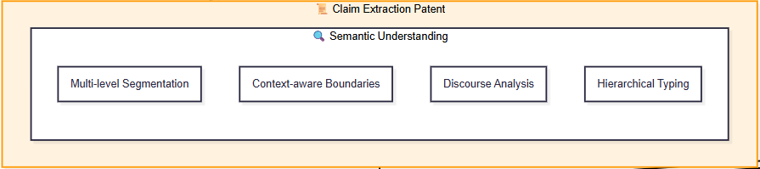
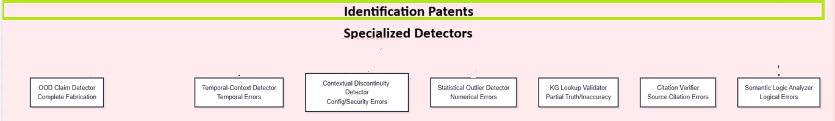

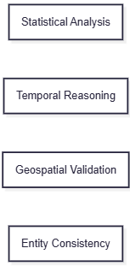
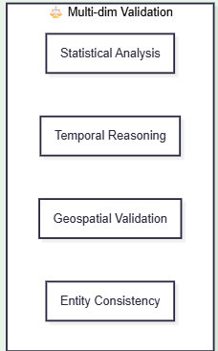
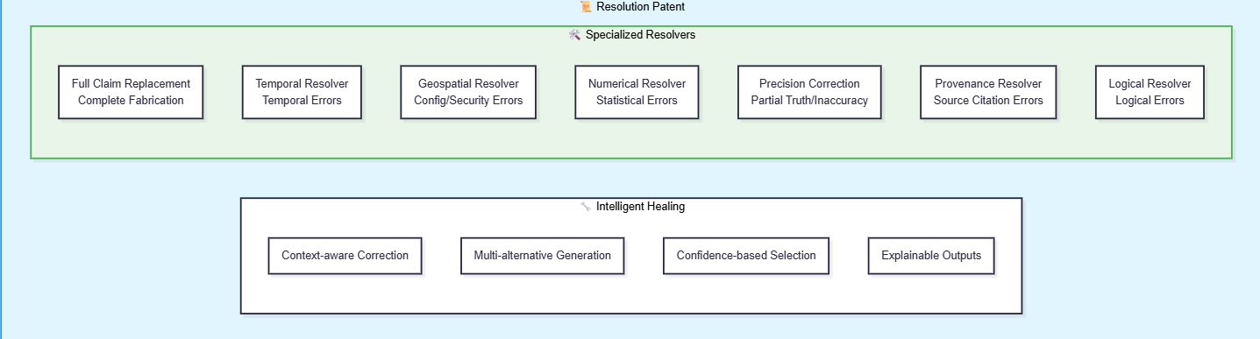

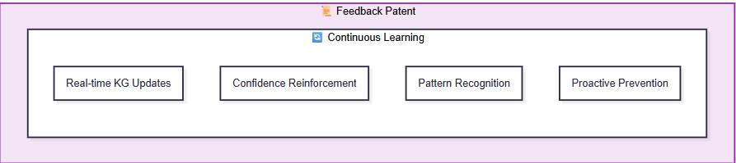

Slide 3
Extraction | Identification | Resolution | Intelligent Healing | Example (DevOps/DevSecOps)
Multi-level Segmentation Isolates "aws s3 encrypt my-bucket" from context | OOD Claim Detector Flags non-existent AWS CLI subcommand | Full Claim Replacement Replaces with valid s3api command | Context-aware Correction Maintains encryption intent while fixing syntax | Complete Fabrication: Hallucinated: aws s3 encrypt my-bucket --algorithm AES-256 Corrected: aws s3api put-bucket-encryption --bucket my-bucket --server-side-encryption-configuration '{"Rules": [{"ApplyServerSideEncryptionByDefault": {"SSEAlgorithm": "AES256"}}]}'
Context-aware Boundaries Detects package manager command boundaries | Temporal-Context Detector Identifies deprecated package manager usage | Temporal Resolver Updates to current package manager | Multi-alternative Generation Provides multiple installation methods | Temporal Error: Hallucinated: sudo yum install docker (Amazon Linux 2023) Corrected: sudo dnf install docker-ce docker-ce-cli containerd.io + Docker Desktop alternative
Discourse Analysis Identifies security context in configuration | Contextual Discontinuity Detector Flags security policy violations | Geospatial Resolver Applies least privilege principles | Confidence-based Selection Chooses most secure proven approach | Config/Security Error: Hallucinated: securityContext: {privileged: true, runAsUser: 0} Corrected: securityContext: {allowPrivilegeEscalation: false, runAsUser: 1000, runAsNonRoot: true, privileged: false}
Hierarchical Typing Classifies as numerical service limit claim | Statistical Outlier Detector Detects unrealistic memory allocation | Numerical Resolver Provides statistically appropriate values | Explainable Outputs Shows reasoning for correction | Statistical Error: Hallucinated: resources: requests: memory: "64Mi" (Java app) Corrected: resources: requests: memory: "512Mi" // Typical JVM baseline
Semantic Understanding Parses exact command syntax | KG Lookup Validator Validates flag names against knowledge base | Precision Correction Fixes specific parameter inaccuracies | Context-aware Correction Maintains tool functionality intent | Partial Truth/Inaccuracy: Hallucinated: trivy image --severity CRITICAL my-image Corrected: trivy image --severity CRITICAL --ignore-unfixed my-image
Claim Context Isolation Extracts citation reference separately | Citation Verifier Validates against official standards | Provenance Resolver Provides accurate qualification | Explainable Outputs Clarifies requirement vs recommendation | Source Citation Error: Hallucinated: "CIS AWS Benchmark requires MFA delete for S3" Corrected: "CIS AWS Benchmark recommends MFA delete (optional, non-scored)"
Logical Flow Analysis Maps conditional dependencies | Semantic Logic Analyzer Detects unreliable variable usage | Logical Resolver Implements robust conditional logic | Multi-alternative Generation Provides fallback options | Logical Error: Hallucinated: rules: - if: $CI_COMMIT_TAG $CI_COMMIT_BRANCH == "main"` Corrected: `rules: - if: $CI_COMMIT_TAG =~ /^v\d+.\d+.\d+/

Slide 4
🔄 Feedback Patent - Continuous Learning Examples:
Learning Component | DevOps/DevSecOps Example | Improvement Impact
Real-time KG Updates | New AWS CLI command patterns added after verification | Future detections of aws s3 encrypt become instant
Confidence Reinforcement | High success rate with security context corrections | Security policy violations detected with 99%+ confidence
Pattern Recognition | Identifies trend of deprecated yum recommendations | Proactively suggests dnf for Amazon Linux 2023 contexts
Proactive Prevention | Learns common Java memory patterns | Prevents 64MB recommendations

Slide 5
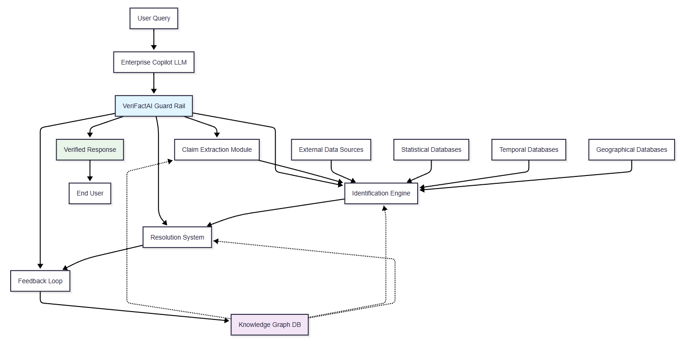

Slide 6
