Slide 1




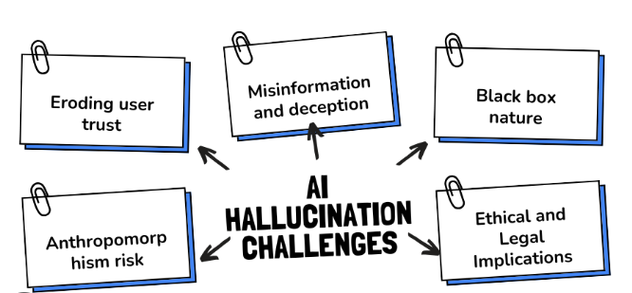
LLM hallucinations
Even when a warning appears, if users ignore it and use the output blindly — hallucinations can propagate downstream.
Hallucination = AI confidently asserts falsehoods. For Example:
Nonexistent API endpoints (“GET /api/v2/users/listAll” when none exists).
Invented citations, functions, or parameters.
Fabricated factual claims (“In 2021, Bitbucket merged with GitHub”).
Overgeneralized logic (“Python decorators always take two arguments”).
Warnings:-
This response is AI-generated, for reference only.
ChatGPT can make mistakes.,
This output may be inaccurate or incomplete.,
Use at your own discretion.,
Does not substitute professional judgment.

Slide 2
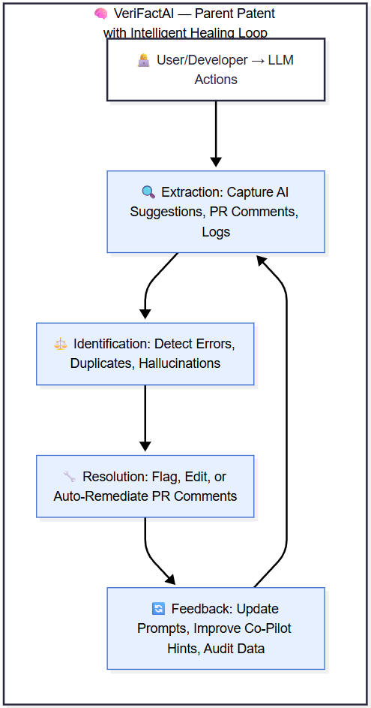
Patent – Architecture 🔍 EXTRACTION → ⚖️ IDENTIFICATION → 🔧 RESOLUTION → 🔄 FEEDBACK Intelligent Healing (Cross-cutting capability)
IDENTIFICATION PATENT
🚨 CRITICAL ERRORS:
OOD Claim Detector → Complete Fabrication
Contextual Discontinuity Detector → Config/Security Errors
⚠️ ACCURACY ERRORS:
Temporal-Context Detector → Temporal Errors
Statistical Outlier Detector → Numerical Errors
KG Lookup Validator → Partial Truth/Inaccuracy
📚 REFERENCE ERRORS:
Citation Verifier → Source Citation Errors
Semantic Logic Analyzer → Logical Errors
RESOLUTION PATENT
🛠️ SPECIALIZED RESOLVERS (Error-specific):
Full Claim Replacement ← Complete Fabrication
Geospatial Resolver ← Config/Security Errors
Temporal Resolver ← Temporal Errors
Numerical Resolver ← Numerical Errors
Precision Correction ← Partial Truth/Inaccuracy
Provenance Resolver ← Source Citation Errors
Logical Resolver ← Logical Errors
🔧 INTELLIGENT HEALING (Cross-cutting):
-> Context-aware Correction
-> Multi-alternative Generation
-> Confidence-based Selection
-> Explainable Outputs
Specialized Resolver → Context-aware Correction → Multi-alternative Generation →
Confidence-based Selection → Explainable Outputs->Verified Response → Learning Feedback → Resolver Improvement

Slide 3

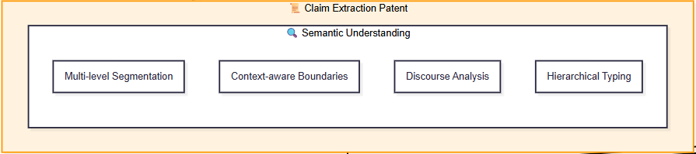
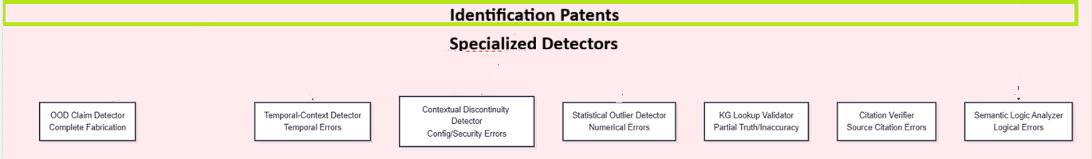

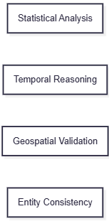
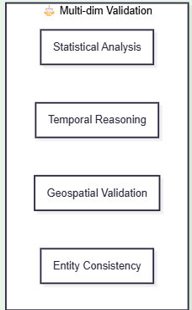
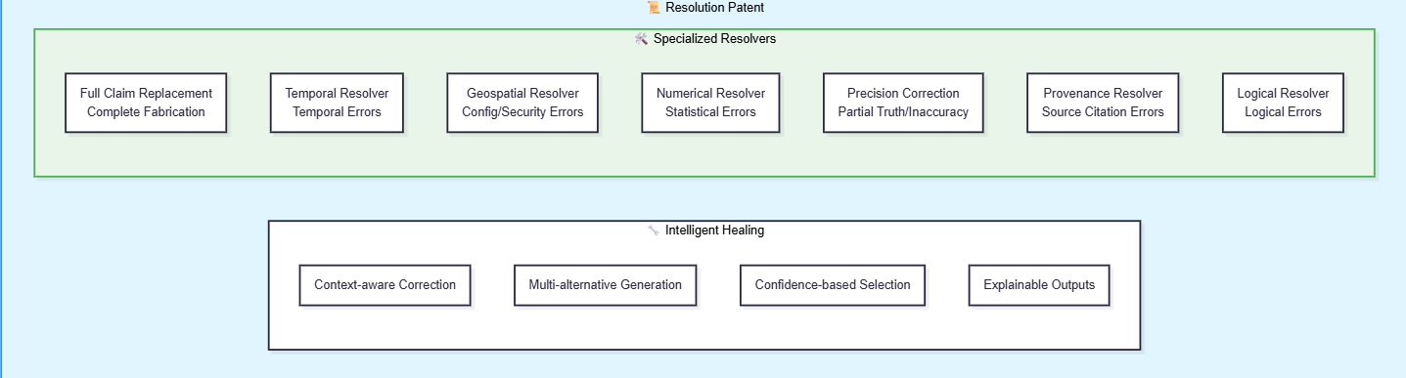

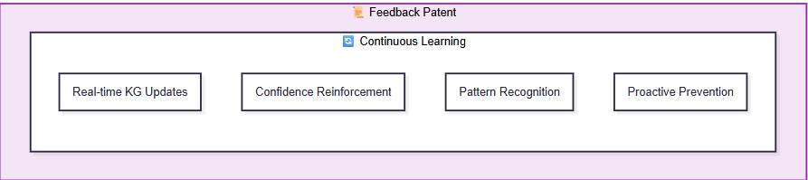

Slide 4
Extraction | Identification | Resolution | Intelligent Healing | Example (DevOps/DevSecOps)
Multi-level Segmentation Isolates "aws s3 encrypt my-bucket" from context | OOD Claim Detector Flags non-existent AWS CLI subcommand | Full Claim Replacement Replaces with valid s3api command | Context-aware Correction Maintains encryption intent while fixing syntax | Complete Fabrication: Hallucinated: aws s3 encrypt my-bucket --algorithm AES-256 Corrected: aws s3api put-bucket-encryption --bucket my-bucket --server-side-encryption-configuration '{"Rules": [{"ApplyServerSideEncryptionByDefault": {"SSEAlgorithm": "AES256"}}]}’ Example: aws s3 encrypt → aws s3api put-bucket-encryption
Context-aware Boundaries Detects package manager command boundaries | Temporal-Context Detector Identifies deprecated package manager usage | Temporal Resolver Updates to current package manager | Multi-alternative Generation Provides multiple installation methods | Temporal Error: Hallucinated: sudo yum install docker (Amazon Linux 2023) Corrected: sudo dnf install docker-ce docker-ce-cli containerd.io + Docker Desktop alternative Example: yum → dnf for Amazon Linux 2023
Discourse Analysis Identifies security context in configuration | Contextual Discontinuity Detector Flags security policy violations | Geospatial Resolver Applies least privilege principles | Confidence-based Selection Chooses most secure proven approach | Config/Security Error: Hallucinated: securityContext: {privileged: true, runAsUser: 0} Corrected: securityContext: {allowPrivilegeEscalation: false, runAsUser: 1000, runAsNonRoot: true, privileged: false} Example: Removes privileged: true, adds security Context constraints
Hierarchical Typing Classifies as numerical service limit claim | Statistical Outlier Detector Detects unrealistic memory allocation | Numerical Resolver Provides statistically appropriate values | Explainable Outputs Shows reasoning for correction | Statistical Error: Hallucinated: resources: requests: memory: "64Mi" (Java app) Corrected: resources: requests: memory: "512Mi" // Typical JVM baseline Example: 64MB → 512MB for Java memory request
Semantic Understanding Parses exact command syntax | KG Lookup Validator Validates flag names against knowledge base | Precision Correction Fixes specific parameter inaccuracies | Context-aware Correction Maintains tool functionality intent | Partial Truth/Inaccuracy: Hallucinated: trivy image --severity CRITICAL my-image Corrected: trivy image --severity CRITICAL --ignore-unfixed my-image Example: --severity CRITICAL → --severity CRITICAL (verified correct)
Claim Context Isolation Extracts citation reference separately | Citation Verifier Validates against official standards | Provenance Resolver Provides accurate qualification | Explainable Outputs Clarifies requirement vs recommendation | Source Citation Error: Hallucinated: "CIS AWS Benchmark requires MFA delete for S3" Corrected: "CIS AWS Benchmark recommends MFA delete (optional, non-scored)“ Example: Explains PCI DSS recommendation vs requirement status
Logical Flow Analysis Maps conditional dependencies | Semantic Logic Analyzer Detects unreliable variable usage | Logical Resolver Implements robust conditional logic | Multi-alternative Generation Provides fallback options | Logical Error: Hallucinated: rules: - if: $CI_COMMIT_TAG $CI_COMMIT_BRANCH == "main"` Corrected: `rules: - if: $CI_COMMIT_TAG =~ /^v\d+.\d+.\d+/ Example: Enhanced GitLab CI rules for tag detection

Slide 5
1. Multi-level Segmentation
RAW CLAIM → EXTRACTION (understand) → IDENTIFICATION (verify) → RESOLUTION (fix)
↓ ↓ ↓ ↓
"aws s3 encrypt & privileged true" → "Separate commands" → "Fake command + security risk" → "s3api + secure context“
Example: aws s3 encrypt → aws s3api put-bucket-encryption
2. Context-aware Boundaries
RAW CLAIM → EXTRACTION (understand) → IDENTIFICATION (verify) → RESOLUTION (fix)
↓ ↓ ↓ ↓
"yum but use dnf on AL2023" → "Split at contrast" → "Deprecated package manager" → "dnf with docker-ce“
Example: aws s3 encrypt → aws s3api put-bucket-encryption
3. Discourse Analysis
RAW CLAIM → EXTRACTION (understand) → IDENTIFICATION (verify) → RESOLUTION (fix)
↓ ↓ ↓ ↓
"MFA delete because CIS requires" → "Action + justification" → "Citation misrepresentation" → "CIS recommends“
Example: Removes privileged: true, adds security Context constraints
4. Hierarchical Typing
RAW CLAIM → EXTRACTION (understand) → IDENTIFICATION (verify) → RESOLUTION (fix)
↓ ↓ ↓ ↓
"64Mi for Java app" → "JVM memory config" → "Statistical outlier" → "512Mi baseline“
Example: 64MB → 512MB for Java memory request
5. Semantic Understanding
RAW CLAIM → EXTRACTION (understand) → IDENTIFICATION (verify) → RESOLUTION (fix)
↓ ↓ ↓ ↓
"trivy severity CRITICAL" → "Security scan syntax" → "Missing ignore-unfixed" → "Add flag for production“
Example: --severity CRITICAL → --severity CRITICAL (verified correct)
6. Claim Context Isolation
RAW CLAIM → EXTRACTION (understand) → IDENTIFICATION (verify) → RESOLUTION (fix)
↓ ↓ ↓ ↓
"CIS requires MFA delete" → "Separate fact from citation" → "Source language error" → "CIS recommends“
Example: Explains PCI DSS recommendation vs requirement status
7. Logical Flow Analysis
RAW CLAIM → EXTRACTION (understand) → IDENTIFICATION (verify) → RESOLUTION (fix)
↓ ↓ ↓ ↓
"if $CI_COMMIT_TAG" → "Conditional logic" → "Unreliable variable" → "Pattern matching“
Example: Enhanced GitLab CI rules for tag detection

Slide 6
🎯 Summary: What Each Extraction Specializes In
Extraction Method | Specializes In | Simple Test | Pipeline Impact
Multi-level Segmentation | Breaking complex text into claims | "Multiple actions in one sentence?" | Prevents missing critical claims
Context-aware Boundaries | Finding where to split/merge | "But/however/then in text?" | Ensures proper claim isolation
Discourse Analysis | Understanding relationships | "Because/therefore in text?" | Catches misleading justifications
Hierarchical Typing | Categorizing claim types | "Security/command/reference?" | Routes to right verification engine
Semantic Understanding | Deep command parsing | "Technical command syntax?" | Catches incomplete/partial commands
Claim Context Isolation | Separating facts from references | "Cites standards/docs?" | Prevents citation misrepresentations
Logical Flow Analysis | Analyzing conditions/dependencies | "If/then logic?" | Prevents runtime logic failures

Slide 7
1. Segmentation: Multiple commands → Separate claims → Verify individually → Fix each
"aws s3 encrypt & privileged true" → "Separate security commands" → "Fake command + security violation" → "s3api encryption + secure context"
2. Boundaries: Contrasting contexts → Split correctly → Temporal errors → Update to current
"yum on AL2023 but use dnf" → "Split legacy vs current" → "Deprecated package manager" → "dnf with docker-ce packages"
3. Discourse: Claim + justification → Map relationships → Citation errors → Accurate references
"MFA delete because CIS requires" → "Action with justification" → "Citation error: recommends not requires" → "MFA delete with accurate citation"
4. Typing: Generic claim → Specific category → Statistical errors → Realistic values
"64Mi for Java app" → "JVM memory configuration" → "Statistical outlier - too low" → "512Mi typical JVM baseline"
5. Semantic: Command syntax → Deep parsing → Partial truths → Complete commands
"trivy severity CRITICAL" → "Security scan command" → "Missing --ignore-unfixed flag" → "Add flag for actionable results"
6. Isolation: Mixed statement → Separate facts/citations → Source errors → Accurate attributions
"CIS requires MFA delete" → "Separate technical from reference" → "Citation misrepresentation" → "CIS recommends (optional)“
7. Logical: Conditional logic → Analyze reliability → Logic errors → Robust patterns
"if $CI_COMMIT_TAG" → "Conditional deployment logic" → "Unreliable variable usage" → "Pattern matching for reliability"

Slide 8
🔄 Feedback Patent - Continuous Learning Examples:
Learning Component | DevOps/DevSecOps Example | Improvement Impact
Real-time KG Updates | New AWS CLI command patterns added after verification | Future detections of aws s3 encrypt become instant
Confidence Reinforcement | High success rate with security context corrections | Security policy violations detected with 99%+ confidence
Pattern Recognition | Identifies trend of deprecated yum recommendations | Proactively suggests dnf for Amazon Linux 2023 contexts
Proactive Prevention | Learns common Java memory patterns | Prevents 64MB recommendations

Slide 10
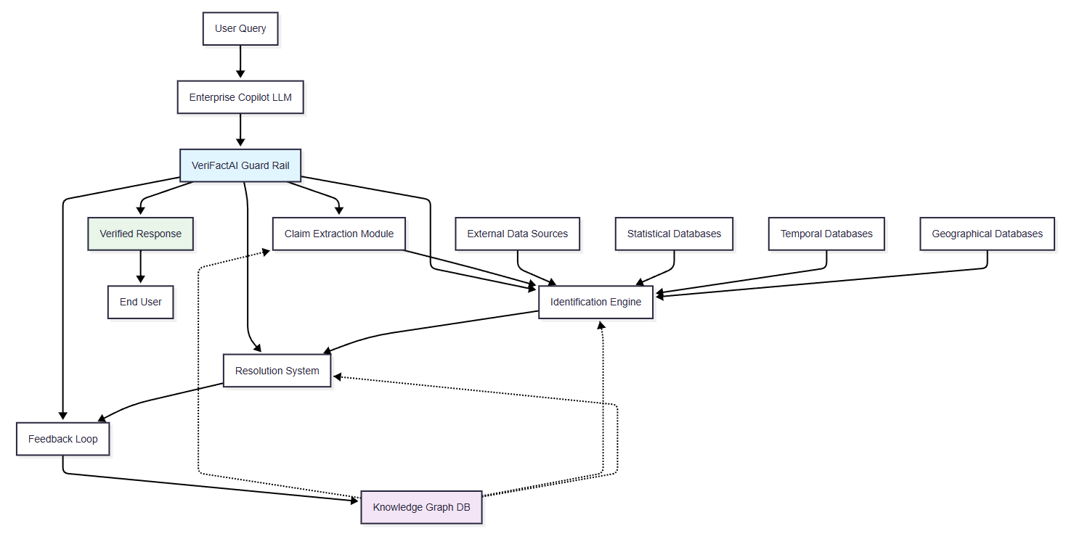

Slide 11
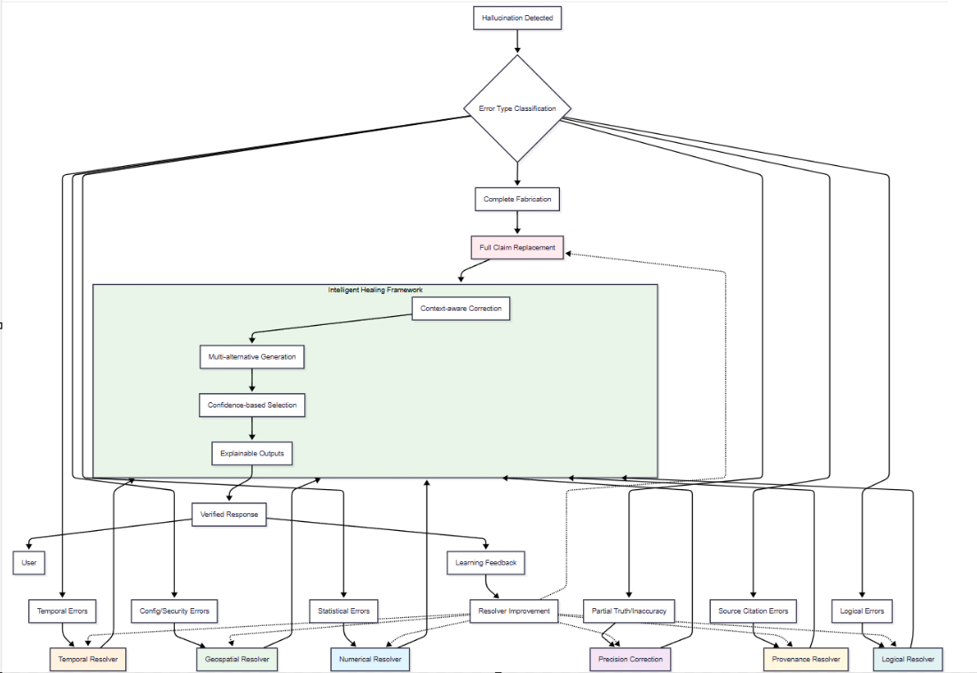

Slide 12
Key Insight:
The Multi-dim Validation layer provides the analytical foundation that enables the specialized detectors to be so precise. Instead of each detector working in isolation, they all leverage these four verification dimensions, making the identification system:
More robust (multiple validation angles)
More accurate (cross-dimensional consistency checking)
More scalable (reusable validation patterns)
More explainable (clear which dimension detected the issue)
Multi-dim Validation Applied:
Statistical Analysis: Checks if command structure matches AWS CLI patterns
Temporal Reasoning: Validates command syntax against current AWS CLI version
Geospatial Validation: Confirms this is valid AWS syntax (not Azure/GCP)
Entity Consistency: Ensures encrypt subcommand exists for aws s3 entity

Slide 13
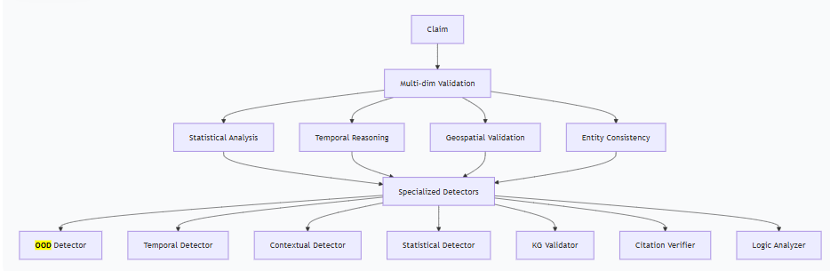

Slide 14
Patent | Core Innovation | Traditional Approach | VeriFactAI Novelty
📜 Claim Extraction | Semantic claim isolation | Simple sentence splitting | Multi-level contextual understanding
📜 Identification | Multi-dimensional validation | Single-source fact checking | Cross-source consensus scoring
📜 Resolution | Intelligent hallucination healing | Basic text replacement | Context-aware correction generation
📜 Feedback | Continuous self-learning | Manual knowledge updates | Real-time adaptive improvement
🎯 Integration Architecture Options
Option A: API Gateway Pattern (Recommended)
User → API Gateway → Enterprise LLM → VeriFactAI → Verified Response
Option B: Sidecar Pattern (Cloud Native)
Kubernetes Pod: [LLM Container + VeriFactAI Sidecar]
Option C: Plugin Architecture (High Performance)
Enhanced LLM with built-in VeriFactAI verification plugin

Slide 15
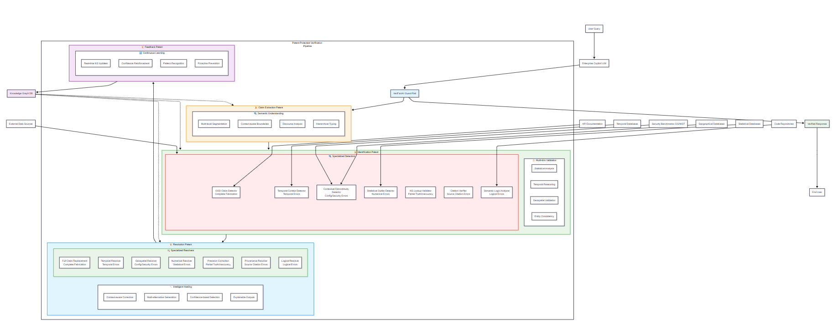

Slide 16
