Slide 1
Search Engine
Group Members
Duaa Omer
Kamlesh Kumar
Abdullah Fazeel
Mastora Alizada

Slide 2
Implementation
Implemented in Python.
Search engine program can be used to index and then search a dataset of json files for relevant documents.
Performs two major functions: indexing and searching.
Creates lexicon, forward index, inverted index (divided into barrels), and some other reference documents.
Lexicon and inverted index stored in json files, forward index just used in the program

Slide 3
Data Sets Used
We have choosen Nela-gt dataset for searching
Reason : Because it contains the relevant data about real world. Which is more interesting to work with.

Slide 4
Lexicon and Indices
Lexicon stores each unique word with assigned word ID. (For new file is added then the same lexicon is appended )
Forward index stores word IDs and lists of positions of words against document ID of each document the word occurs in. (For new file the same code is used as for others)
Inverted index stores document IDs and hitlists (lists of positions of words) against each word ID. (For new file the same code is used as for others but some new condition are added.)

Slide 5
Emphasis on useability of code
We have used the same code for the new file.
By using only one Emphasis on useability of codelobal variable to switch between multiple cases for single and all files at a time.
This was our major emphasis.
Two major functions use
These two function are called by button on GUI every time :
Searching() → to search words.
Data_fun() → to process all the data

Slide 6
Trade off between Scalability and Speed
Inverted index is stored in the form of barrels.
But when there are more then 200 K articles then there is always lack of memory within any system.
But Now Our program is capable of working even with 1M Articles (More scalable).
Although It was running quite faster with 100K articles.

Slide 7
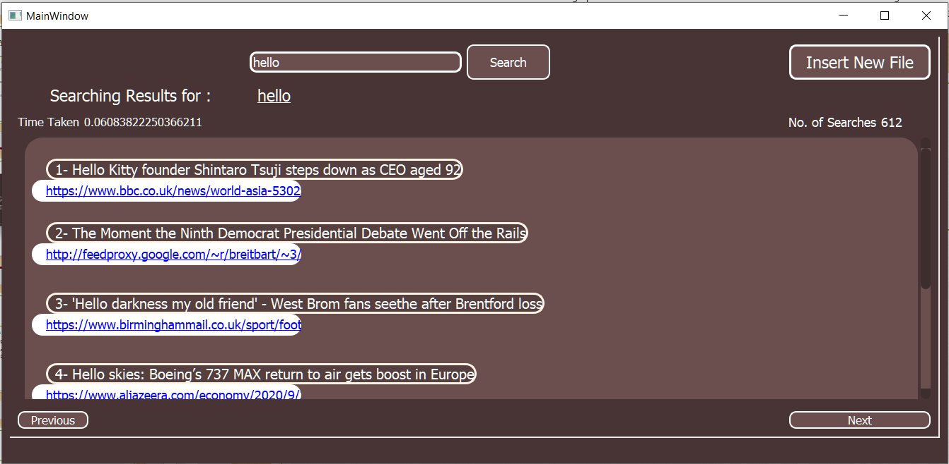
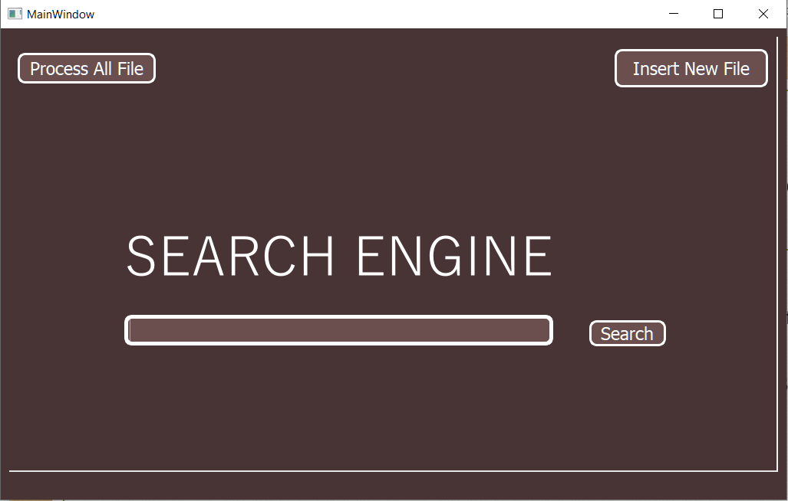
Searching

Slide 8
Searching
For each word in query, first find its ID in the lexicon.
Then find corresponding entry in the correct barrel of inverted index
Rank of each document calculated according to the number of times word comes in article, positions of the words and how close they are to each other.

Slide 9
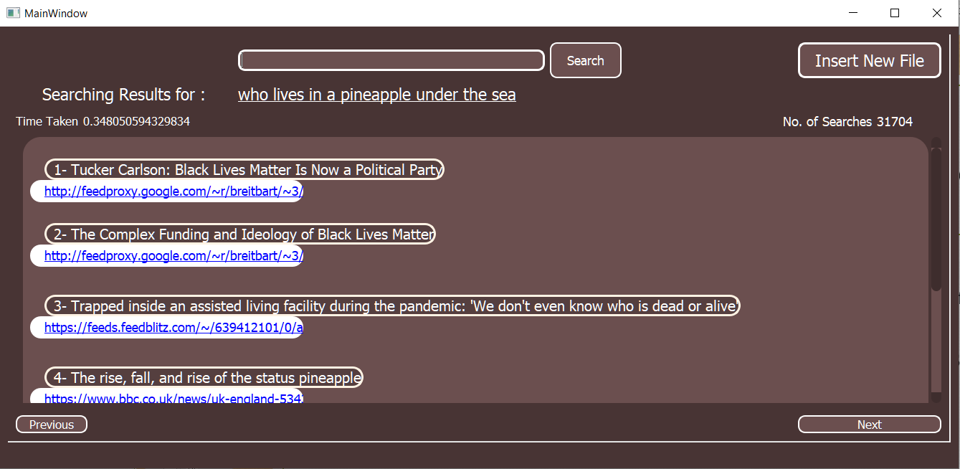
Multi-Word Search
For more than one word, intersection of all the document lists is taken
If there are more than 20 results containing all terms, only those results displayed
Otherwise results containing only some of the terms also ranked and displayed

Slide 10
GUI
Simple, intuitive GUI made using PyQt5 library
Search bar to enter query
Results displayed in pages of 6 results each
Option to upload new json file by browsing through computer memory and selecting any json file.

Slide 11
Questions

