Slide 1

Project Presentation
Snake Game in Assembly Language

Slide 2
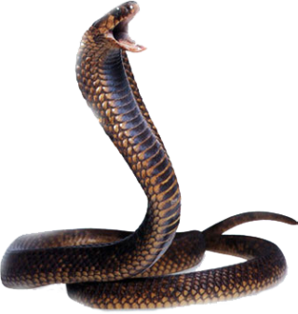
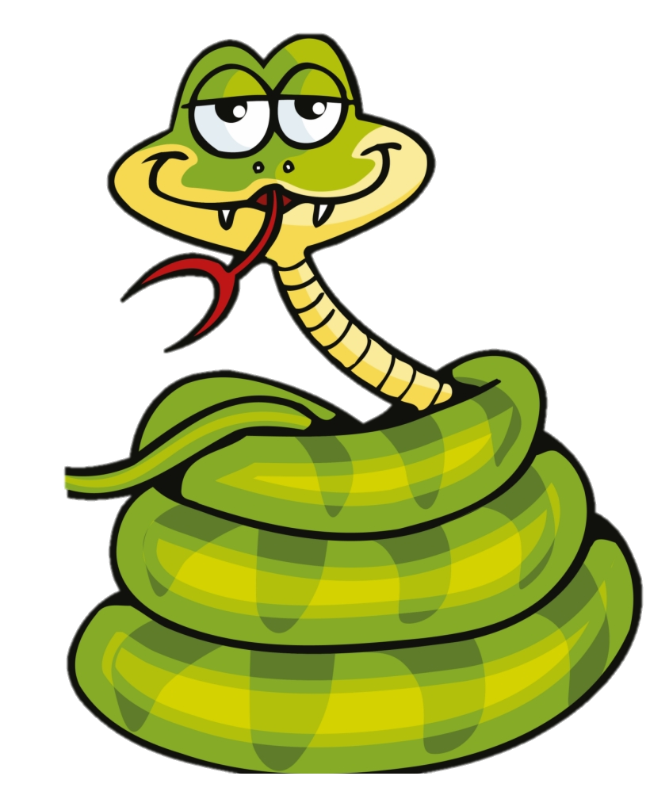
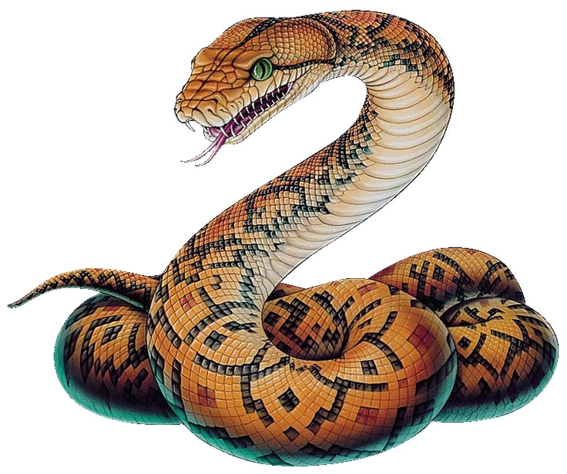
Team Members
Usama Qureshi
(338954)
Kamlesh Kumar (348395)
Muhammad Talha (338796)

Slide 3

Our Approach
We have designed our game in modular, i.e. different procedure for each task to make it easier to understand and implement. So to explain the working we proceed with all the procedures…

Slide 4
—Some famous snake
“hissssssssssssss”

Slide 5
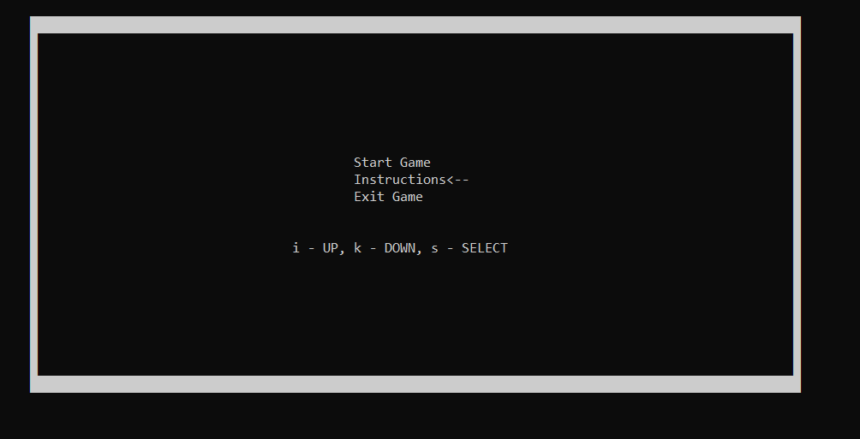
MENU
Displays three options i.e. Start Game, Instructions, Exit Game
And an arrow represents which option is currently selected
Menu can be traversed using I and K buttons
And S button is used to select the option

Slide 6
MENU
The entire screen is redisplayed each time the user presses I or k to move in the menu
There are 3 labels i.e. case1, case2, case3 each representing the three options
Conditional jumps to jump to the specific label

Slide 7
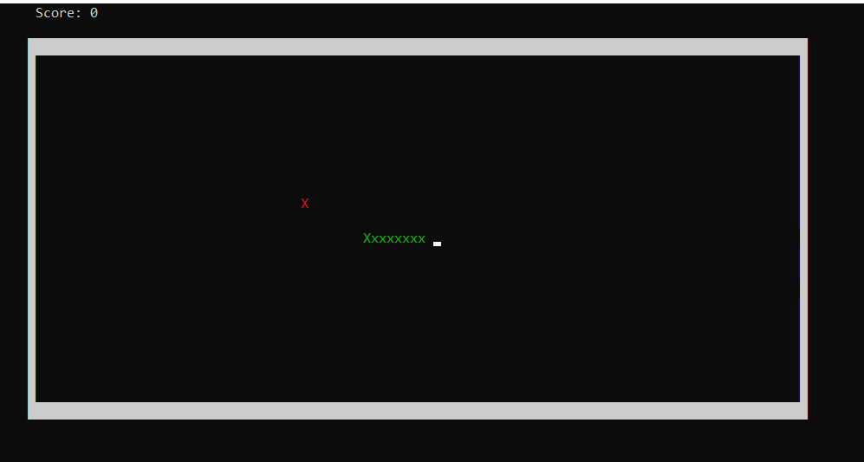
DRAW_BOUNDARY
We use character at Ascii code (219) as wall element.
This procedure first moves cursor to upper left corner of boundary i.e. (8,2).
Then use a loop to generate with 100 count to print the horizontal upper boundary.
Another loop runs for 20 times to draw left and right boundary. In this loop move cursor to (8,2) keep increasing y coordinate print a single wall element, increase x by 99 print the element. Repeat the loop.
After completing above loop move 8 to dl. Now we are at left-lower corner print the element 100 times.

Slide 8
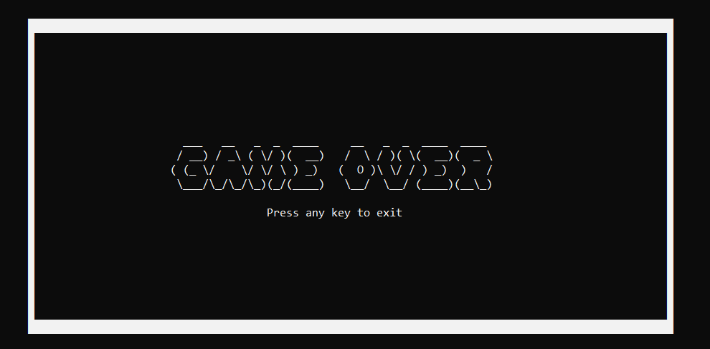
GAMEOVER_DISPLAY
ASCII ART stored in BYTE sized arrays
Uses writeString to display that ASCII ART once the game is over

Slide 9
START_SNAKE
This procedure calls the generate_food procedure to randomly generate the food within the boundaries of game.
then uses Readkey if there is any input then compares with I, J ,K , L. then changes the coordinates of snake position accordingly.
But If there is no input then use the previous input again to change the coordinates.
According to the change of coordinates the snake is repositioned using draw_snake and update_snake function.
After every input the snake is being checked for any collision with itself and with the boundary walls and actions are taken in respective functions.

Slide 10
CHECK_BOUNDARY_COLLISION:
moves the x and y coordinates of snake in al, ah
the coordinates of boundaries all four boundaries one by one in ‘bl’.
compares bl with al, if both are same.
Wrap around the respective boundary : i.e. for wrapping from right it changes the x coordinates of snake with the coordinates of right wall (defined in .code segment).

Slide 11
CHECK_SNAKE_COLLISION:
moves the coordinates of snake’s head in al and ah.
Loop is used which runs for the length of snack, and coordinates of other segments of snack are saved in dl and dh one by one.
Then coordinates of snake’s head and other segments in dl and dh are compared. If there is any match then game is over.

Slide 12
CLEAR_SCREEN
Using this instead of clsr, because clsr clears only some portion of screen. Where as we need whole screen to be wiped.
We defined an array of 110 (total x coordinates used in program), and initialized it with “ ”.
Then printed it 24(total y coordinate used in program) times using a new line every time.
SCORE_DISPLAY
moves the cursor to the ( 16 , 0), where 16 = (left_wall + 8 [other characters of “score : ” string]),
And simply print the score.

Slide 13
GENERATE_FOOD
In y coordinate we need food in y coordinate from 4 to 19.
Using randomize function : generate value between 4 and 19, using EAX = 15 and then adding 4
In x coordinate we need food in x coordinate from 9 to 107.
Using randomize function : generate value between 9 and 107 using EAX = and then adding 14
At the end move cursor at that (x , y) and print ‘X’ for food.
OH
NONONONO
YUMMY!

Slide 14
CHECK_FOOD
Store the coordinates of food in temporary variables.
compare the coordinates of snack with the coordinates of food stored in temp variable.
if both the coordinates are same then food is eaten.
If food is eaten again call generate_function.

Slide 15
START_SNAKE
This procedure calls the generate_food procedure to randomly generate the food within the boundaries of game.
then uses Readkey if there is any input then compares with I, J ,K , L. then changes the coordinates of snake position accordingly.
But If there is no input then use the previous input again to change the coordinates.
According to the change of coordinates the snake is repositioned using draw_snake and update_snake function.
After every input the snake is being checked for any collision with itself and with the boundary walls and actions are taken in respective functions.

Slide 16
The End
Assembly Language Supremacy, SIUUUU

