Slide 1
The Scouter (A document management system)
Database Systems End Semester Project

Slide 2
Group Members
Name | CMS
Usama Qureshi | 338954
Saad Subhani | 338803
Muneeb Muhammad | 340174
Kamlesh Kumar | 348395

Slide 3
What is Scouter?
Scouter is a basic document management system in which a user uploads his/her own specific files and can view or search his/her files through various parameters.
Liked (favourite) files option is also available for the user if he has additional subscription as well.

Slide 4
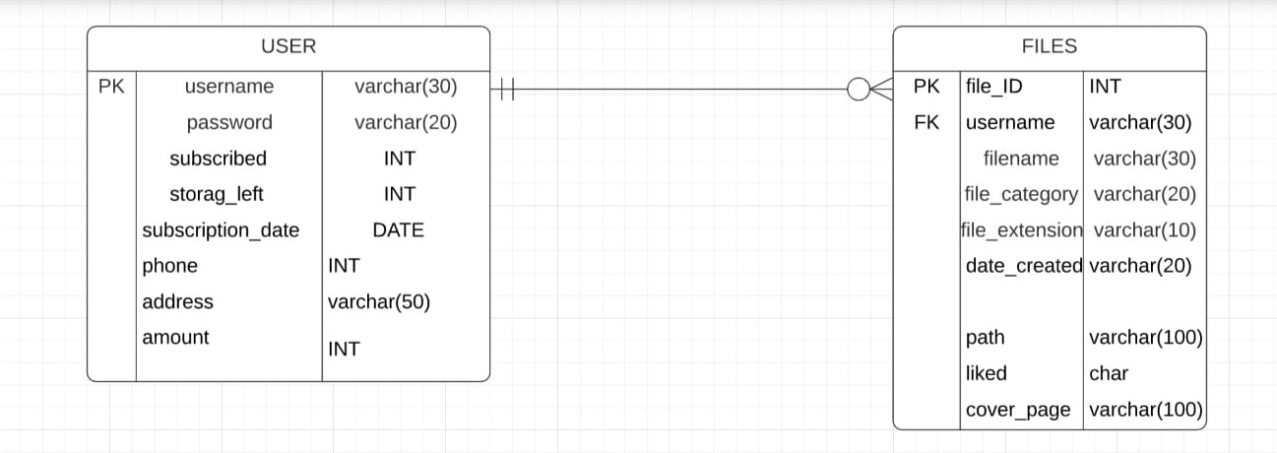
Entity-Relationship Diagram of the project

Slide 5
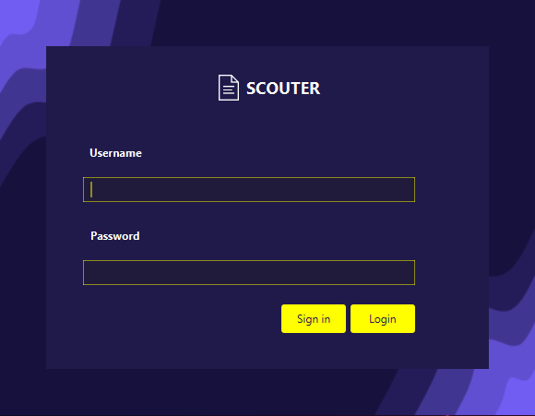
The Login Screen (for existing users)

Slide 6
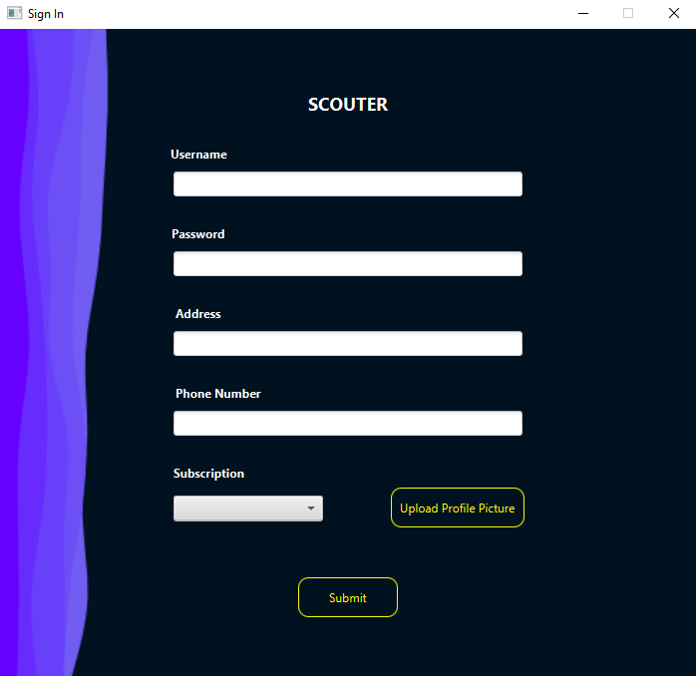
The Sign in Screen (for new users)

Slide 7
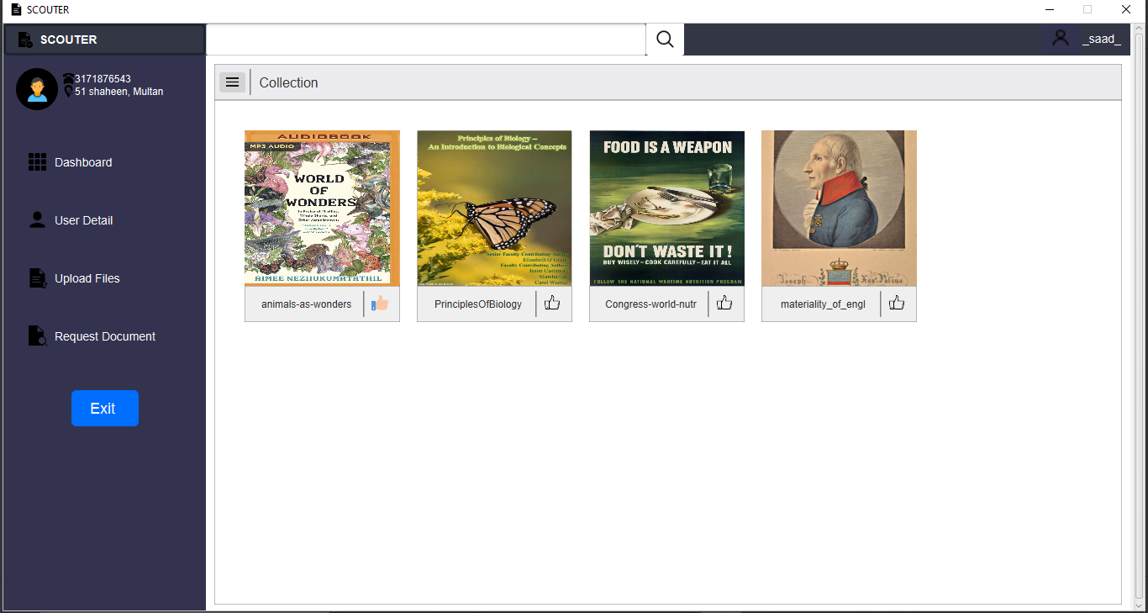
The Dashboard

Slide 8
The Dashboard
This Pane contains the collection of all user files.
The upper pane contains a search bar from which user can find some files from his own data.
The lower pane contains the collections which contains a thumbnails and like button. The thumbnails is consist of file name and file poster
File can directly be opened by clicking the cover of the file.
User uploads the file and the cover. A default cover has been set for files if the user doesn’t upload any file.

Slide 9
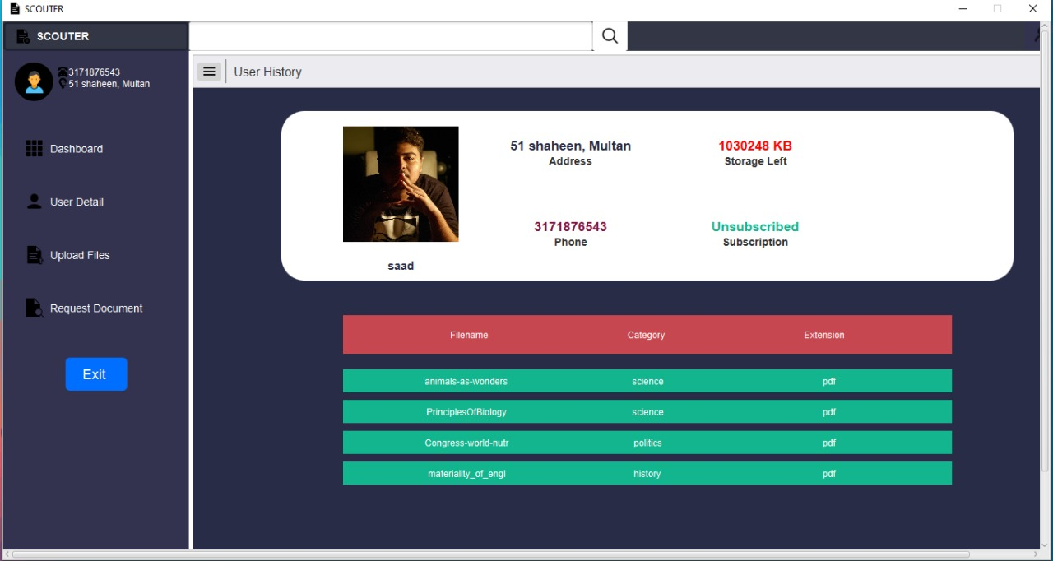
User Details Pane

Slide 10
User Details Pane
This is quite simple pane which shows the simple user details and user history.
Upper pane contains the User data like User Name, Subscription details, Storage left, User profile picture and address
While the lower pane shows the history of the person who is logged in at that time including all the files he/she recently uploaded.

Slide 11
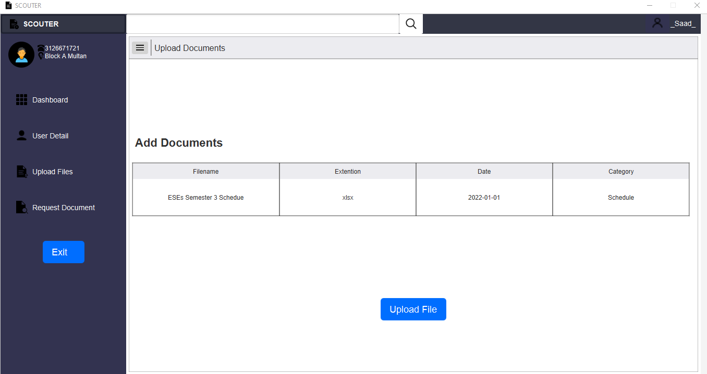
Upload Files Pane

Slide 12
Upload Files Pane
This is the pane where the user uploads his/her files in the scouter.
After selecting a certain file, the scouter asks for the category of the file which is written by the user itself.
After category it asks the user to enter insert a cover photo for the file for ease of access of the files.

Slide 13
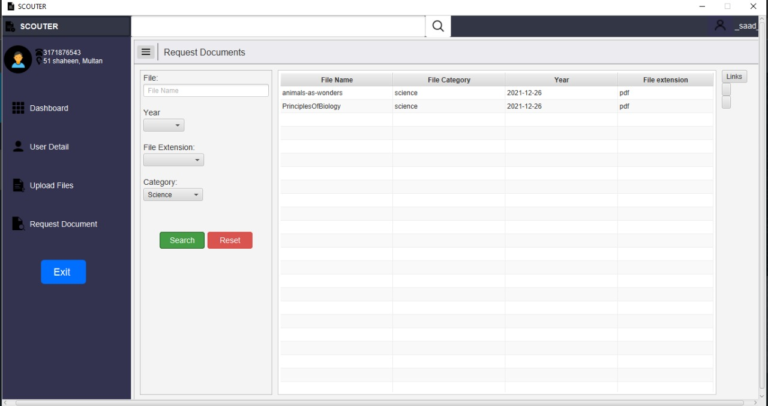
Request Document

Slide 14
Request Document
This is where the scouter’s true functionality lies.
The user can use various parameters (name of file, category, date modified and extension) to search for a specific file from his/her dataset.
It runs a query on the backend on mySQL, based on the parameters entered and returns the required files requested by the user.

Slide 15
The End

