Slide 1
IBM University Engagement Project Submission
“Exploring the Power of Agentic AI with IBM Granite and LangFlow”

Slide 2

Project Tile – Street Vendor Digitalization Agent
Domain of Project – Conversational AI & Retrieval-Augmented Generation(RAG)
Student Name | Recent Passport Photo | Email ID | Mobile number [WhatsApp]
Kammari Sushma |  | sushmaprinceton525@gmail.com | 9182679945

Slide 3
Problem Statement - 29
Problem Statement : Street Vendor Digitalization Agent
The Challenge
A Street Vendor Digitalization Agent, powered by RAG (Retrieval-Augmented Generation), helps local hawkers and micro-entrepreneurs become digitally visible by generating business profiles, UPI setup guides, local SEO strategies, and customer engagement tips.
The Objective
Build a Street Vendor Digitalization Agent that delivers conversational, step-by-step guidance and technical empowerment for informal merchants, hawkers, and local micro-entrepreneurs. The solution should:
Government Scheme Accessibility – Simplify complex eligibility criteria and application pathways for micro-credit initiatives like the PM SVANidhi scheme.
Fintech Onboarding Guidance – Provide clear, jargon-free walk-throughs for establishing merchant UPI accounts, navigating e-KYC verification, and deploying QR codes.
Hyperlocal SEO Integration – Instruct non-technical vendors on precise geolocation techniques to pin their physical stalls on digital mapping services and drive discovery.
Empathetic Tone Guardrails – Enforce a highly accessible, supportive peer-to-peer conversational style that eliminates confusing corporate or technological terminology.
Multi-Agent Architecture Module –
Scheme Navigator Agent (extracts government micro-loan policy frameworks and requirements)
Digital Payment Onboarder Agent (manages fintech registration rules and standee configuration steps)
Hyperlocal Geolocation Agent (guides map-pinning strategies and regional search optimizations)
Dialogue Controller Agent (reformats dense outputs into simplified, mobile-friendly checklists)
Web Integration Window – Provide an open, unauthenticated web chat interface optimized for low-friction access directly via smartphone viewports.

Slide 4
Technology Used
Tech Stack
I used the following:
IBM Orchestrate + IBM watsonx.ai + Granite Models
IBM Cloud Agentic Lab with IBM Granite Models

Slide 5
Proposed Solution -
Proposed Solution: Street Vendor Digitalization Agent
The proposed solution is a multi-agent AI-powered digital assistant built using IBM watsonx Orchestrate, IBM watsonx.ai, and Granite Models to provide personalized, real-time guidance for informal merchants. The system addresses challenges in accessing micro-loans, setting up digital payments, and improving local search visibility through an intelligent, modular architecture.
At its core, the solution uses a Retrieval-Augmented Generation (RAG) pipeline to fetch accurate policy data from trusted sources such as PM SVANidhi guidelines and fintech documentation. This data is embedded and stored in a vector database, enabling the system to retrieve and summarize complex bureaucratic and financial details (eligibility criteria, KYC steps, loan tranches) using Granite models.
The system consists of four key agents:
Scheme Navigator Agent retrieves and summarizes government micro-loan policy frameworks and application requirements.
Digital Payment Onboarder Agent provides jargon-free walkthroughs for establishing merchant UPI accounts, QR code standees, and e-KYC verification.
Hyperlocal Geolocation Agent guides map-pinning strategies and regional search optimizations to increase physical foot traffic to the vendor's stall.
Dialogue Controller Agent reformats dense outputs into simplified, mobile-friendly checklists tailored for non-technical users.
The solution includes a user-friendly web interface (built with an embedded HTML/JS chat widget) that provides zero-friction access directly on smartphone browsers, requiring no app downloads or secure logins.
IBM watsonx Orchestrate is used to build and manage the agent workflows, while watsonx.ai ensures scalable model deployment, embeddings, and AI governance. Granite models power the reasoning, summarization, and empathetic peer-to-peer personalization.
Overall, this solution delivers an end-to-end intelligent digital consultant that promotes financial inclusion and economic growth for street vendors through localized insights, step-by-step technical guidance, and accessible technology.

Slide 6
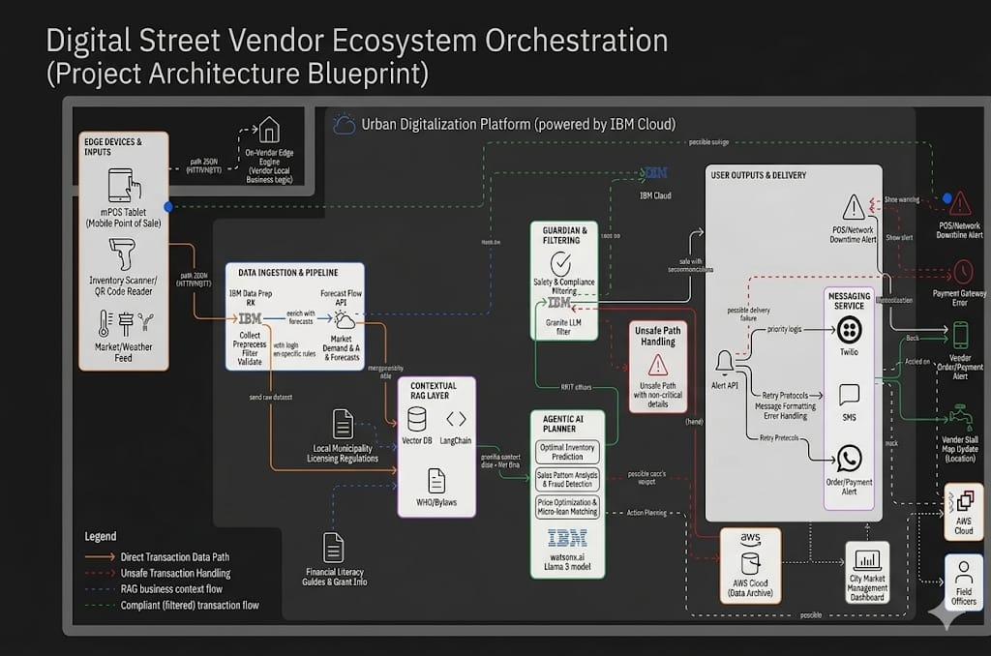
Architecture blueprint

Slide 7

Role of Agentic AI in the solution
Role of Agentic AI in Street Vendor Digitalization Agent
Agentic AI enables the Street Vendor Digitalization Agent to function as an intelligent, autonomous system rather than a simple chatbot. Using IBM watsonx Orchestrate and IBM Granite models, it coordinates multiple specialized agents to deliver personalized business and financial guidance. Each agent performs a specific role—such as retrieving government scheme data, generating step-by-step payment setups, providing map optimization advice, and formatting accessible lists—while working collaboratively. This multi-agent approach ensures efficient task execution and accurate results.
Agentic AI also brings context awareness, understanding user details like vendor location, business category, and financial requirements to generate tailored recommendations. It supports real-time adaptation, continuously updating suggestions based on user inputs like document availability or mapping status. Additionally, agents communicate with each other, enabling better decision-making and improved outcomes.
Overall, Agentic AI makes the system proactive, personalized, and goal-driven, acting like a smart digital consultant that helps micro-entrepreneurs thrive in the modern digital economy.

Slide 8
Technology Used
IBM watsonx Orchestrate – For designing and orchestrating multi-agent workflows visually without complex coding.
IBM Granite models – For natural language understanding, reasoning, and providing accessible, personalized guidance for vendors.
IBM Cloud – It provides the infrastructure to build, deploy, and scale the Digitalization Agent efficiently. IBM Cloud enables a reliable, secure, and scalable environment for deploying the agent to the public.
RAG – RAG to fetch real policy data first, then generate intelligent answers, making the Digitalization Agent more trustworthy and factually accurate regarding government schemes and financial procedures.
IBM watsonx.ai – For model deployment, embeddings, and AI governance.
Vector Database – For RAG-based retrieval of unstructured financial guidelines, KYC requirements, and municipal policy documents.

Slide 9
Novelty and Uniqueness
The proposed Street Vendor Digitalization Agent stands out by combining Agentic AI, RAG, and hyperlocal personalization into a single intelligent system.
Multi-Agent Intelligence – Instead of a single chatbot, multiple specialized agents collaborate to deliver accurate and context-aware financial and digital onboarding guidance.
RAG-Based Accuracy – Integrates real-time policy retrieval with AI generation, reducing misinformation and ensuring trustworthy recommendations for schemes like PM SVANidhi.
Hyper-Personalization – Tailors business strategies and step-by-step guidance based on the vendor's specific location, trade type, and financial needs.
Real-Time Feedback Loop – Continuously adapts recommendations based on user responses, document availability, and onboarding progress.
Zero-Friction Accessibility – Optimized for simple smartphone browsers, requiring no app downloads, making it highly usable for non-technical users.
Economic Empowerment Focus – Goes beyond simple queries to actively drive digital payment adoption, e-KYC compliance, and mapping visibility.
Scalable & Enterprise-Ready – Built on IBM watsonx Orchestrate and watsonx.ai with IBM Granite models, ensuring reliability and governance.

Slide 10
Future Scope
1. Integration with Payment Soundboxes & mPOS Devices –
The system can be integrated with digital payment soundboxes (e.g., Paytm, PhonePe) and mobile Point-of-Sale (mPOS) applications to collect real-time transaction data. This will enable the Digitalization Agent to provide dynamic credit-building advice and accurately assess vendor eligibility for advanced PM SVANidhi loan tranches based on actual daily sales metrics.
2. AI-Powered Voice Assistant & Multilingual Support –
Enhancing the system with a voice-enabled assistant and support for multiple regional languages will significantly improve accessibility. Vendors can interact naturally using spoken audio in their preferred language, making the solution highly inclusive and suitable for informal business owners who may face barriers with typing or digital literacy.
·
·
·

Slide 11


