Slide 1

SENTIMENT ANALYSIS ON TEXT
USING BERT NEURAL NETWORK
PRESENTED BY
20Q91A05J5 (J ESHWAR)
20Q91A05I6 (P DIVYASRI)
20Q91A05I1 (S PRASAD)
20Q91A05J8 (K ANAND)
UNDER THE GUIDENCE OF
MR.Y.SHIVA RAO
(Assistant Professor)

Slide 2
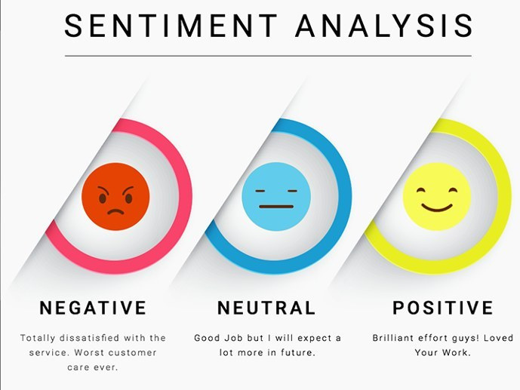
CONTENTS
ABSTRACT
OBJECTIVE
INTRODUCTION
LITERATURE SURVEY
EXISTING SYSTEMS
DRAWBACKS
PROPOSE SYSYTEMS
ADVANTAGES
APPLICATIONS
SYSTEM ARCHITECTURE
MODULES
SYSTEM REQUIREMENTS

Slide 3
ABSTRACT
The Bidirectional Encoder Representations from Transformers (BERT) neural network is a powerful natural language processing model designed to understand the context of words in a sentence. Instead of processing words sequentially, BERT takes into account both left and right context simultaneously, which significantly enhances its understanding of context. BERT is based on the Transformer architecture, which involves self-attention mechanisms to capture relationships between words.

Slide 4
This project involves creating a system design automatically discernthe the sentiment expressed within a given text and classify into one of the three categories :
Positive
Negative
Neutral
By analising the choice of words and the overall tone employed in the text, the system will determine the text conveys positive enthusiasm, negative displeasure or neutral stance.

Slide 5
OBJECTIVE
The main objective of this project is to analyze and understand the sentiment expressed in text data, Automate sentiment analysis for efficient processing of large volume of text, Provide decision support and insights to individuals and businesses. Elevating the accuracy of sentiment classification, ensuring the system cam distinguish between subtle emotional nuances and providing valuable insights.

Slide 6
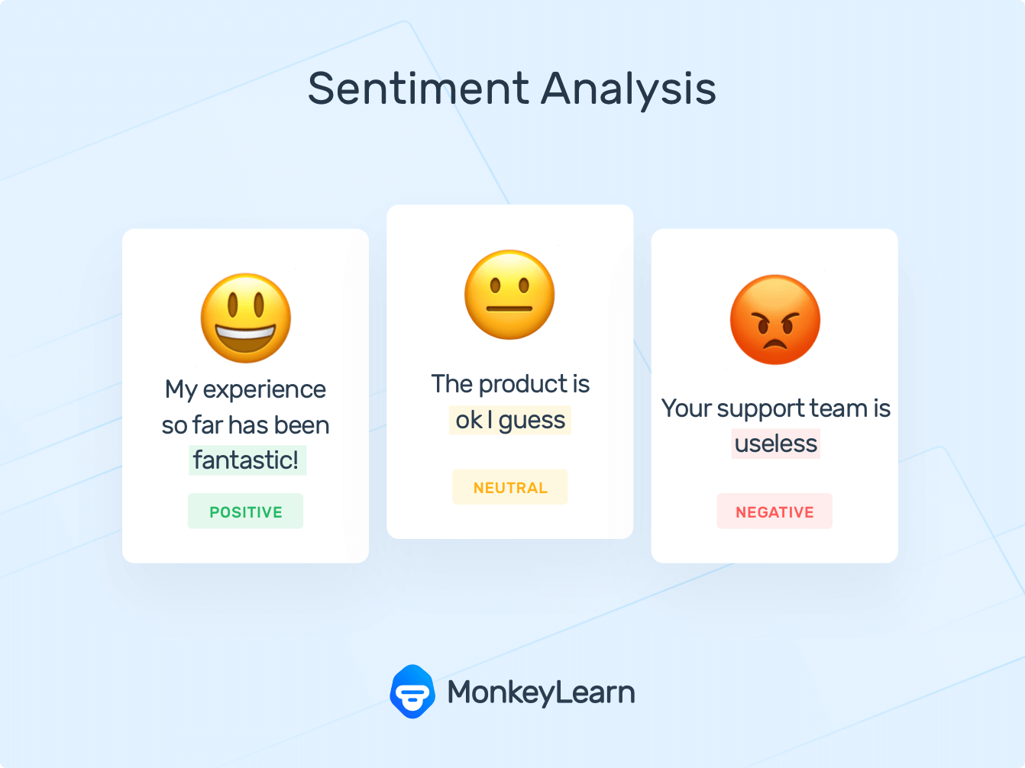



Introduction
Welcome to the presentation on unveiling the power of BERT :
A comprehensive approach to the sentiment analysis on text. In this presentation we will explore the state of the art techniques for sentiment analysis using BERT neural network

Slide 7
EXISTING SYSTEMS
Sentiment analysis is carried out using NLP (Natural Language Processing) and NLTK(Natural Language Tool Kit) to determine the polarity of individual classes. It is a simple model with low accuracy.
Algorithms used: Naive Bayes, SVM, Decision trees

Slide 8
CONTEXTUAL UNDERSTANDING
FEATURE ENGINEERING
DRAW BACKS
AMBIGUITY HANDLING
TRANSFER OF LEARNING

Slide 9
PROPOSE SYSTEM
We are using latest deep learning BERT( Bidirectional Encoder Representations from Transformers) model and This uses Transfer Learning to build Sentiment Classifier using
the Transformers library by BERT transformer.

Slide 10
CONTEXTUAL UNDERSTANDING
MULTILINGUAL SUPPORT
ADVANTAGES
STATE OF THE ART PERFORMANCE
TRANSFER LEARNING
HANDLING AMBIGUITY

Slide 11
APPLICATIONS
HEALTH CARE
E-COMMERCE
FINANCIAL SERVICES
To analyze patient reviews and feedback, helping hospitals and healthcare.
To analyze customers reviews and feedback on product.
To analyze customer sentiment towards financial products and services.

Slide 12
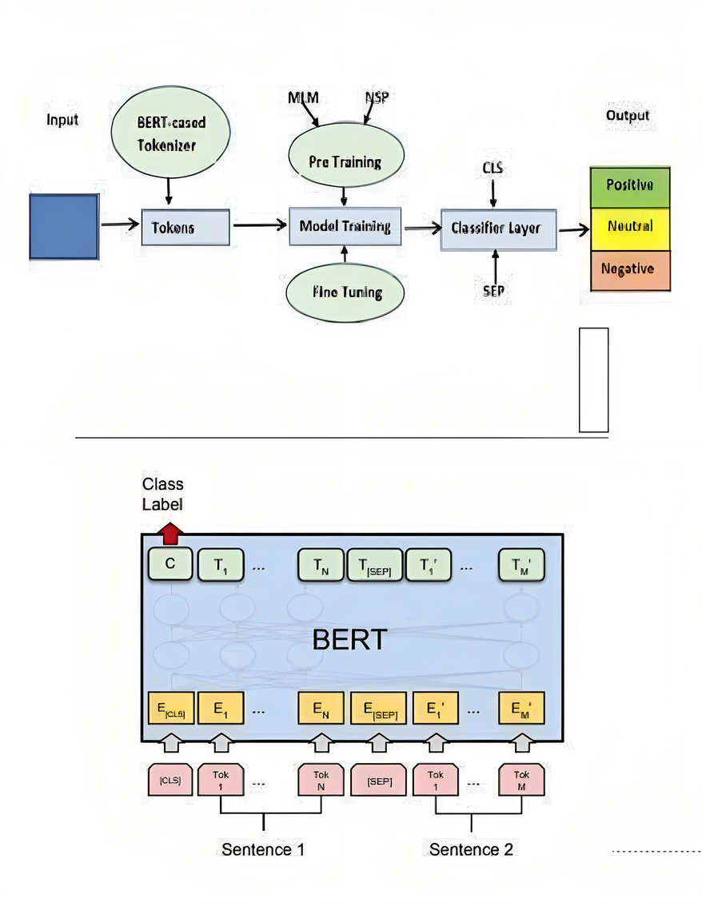
ARCHITECTURE

Slide 13
MODULES
Product Review: It refers to the input text for the sentiment analysis,The reviews can be from various sources
Sentiment Identification: This step involves in identifying and extracting the sentiment from the text. Sentiment identification can be thought of as the preliminary analysis, Where you determine whether the sentiment is positive,negative, neutral.as mention earlier BERT plays a crucial role in this step

Slide 14
Feature Selection: Feature selection is choosing relevant aspects or attributes from the text that contribute to the sentiment analysis project. It involves identifying keywords that are indicative of sentiment analysis.
Sentiment Classification: This is where the sentiment labels are assigned to each text based on the extracted features, in this case, it would be classifying the reviews as positive, negative, or neutral words
Sentiment Polarity: Sentiment polarity refers to the degree or strength of sentiment within review, it can be positive, negative, or neutral, but it can also have different levels of intensity. For example, a review might express a strong positive sentiment a weak positive sentiment, a strong negative sentiment, or a weak negative sentiment. Understanding polarity provides more detailed insights into the sentiment expressed in the reviews.

Slide 15
SYSTEM REQUIREMENTS
SOFTWARE:
IDE : Google Colab
LANGUAGE : Python
LIBRARIES : BERT, Sci-kit learn,Transformers,Pandas
HARDWARE:
RAM : 16GB Minimum
CPU : I5 Processor
SSD : 256 GB
GPU

Slide 16
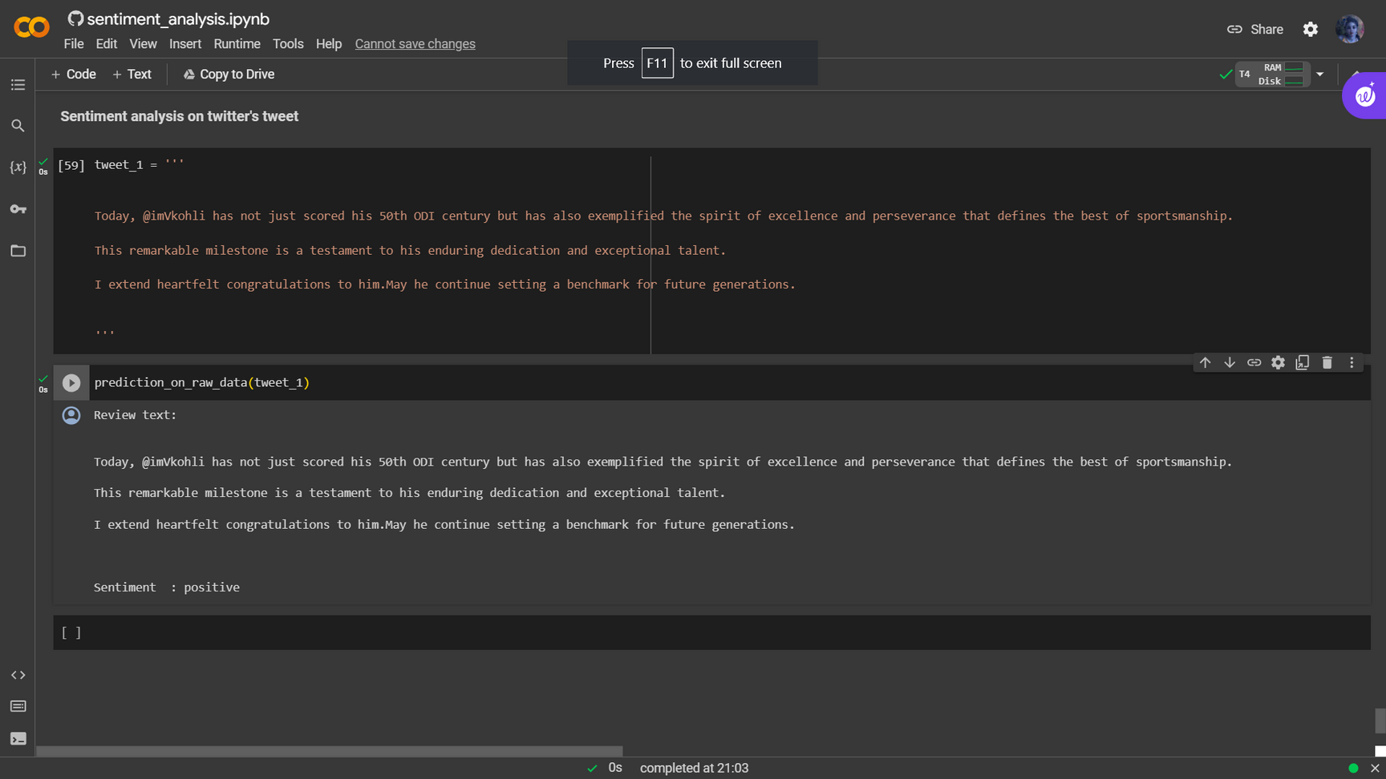
IMPLEMENTATION
A prediction for positive text

Slide 17
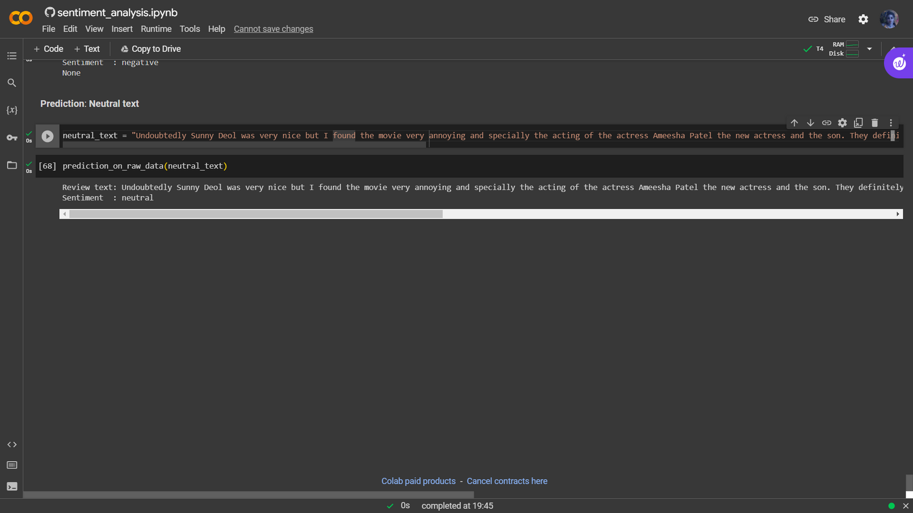
A Prediction on neutral text

Slide 18
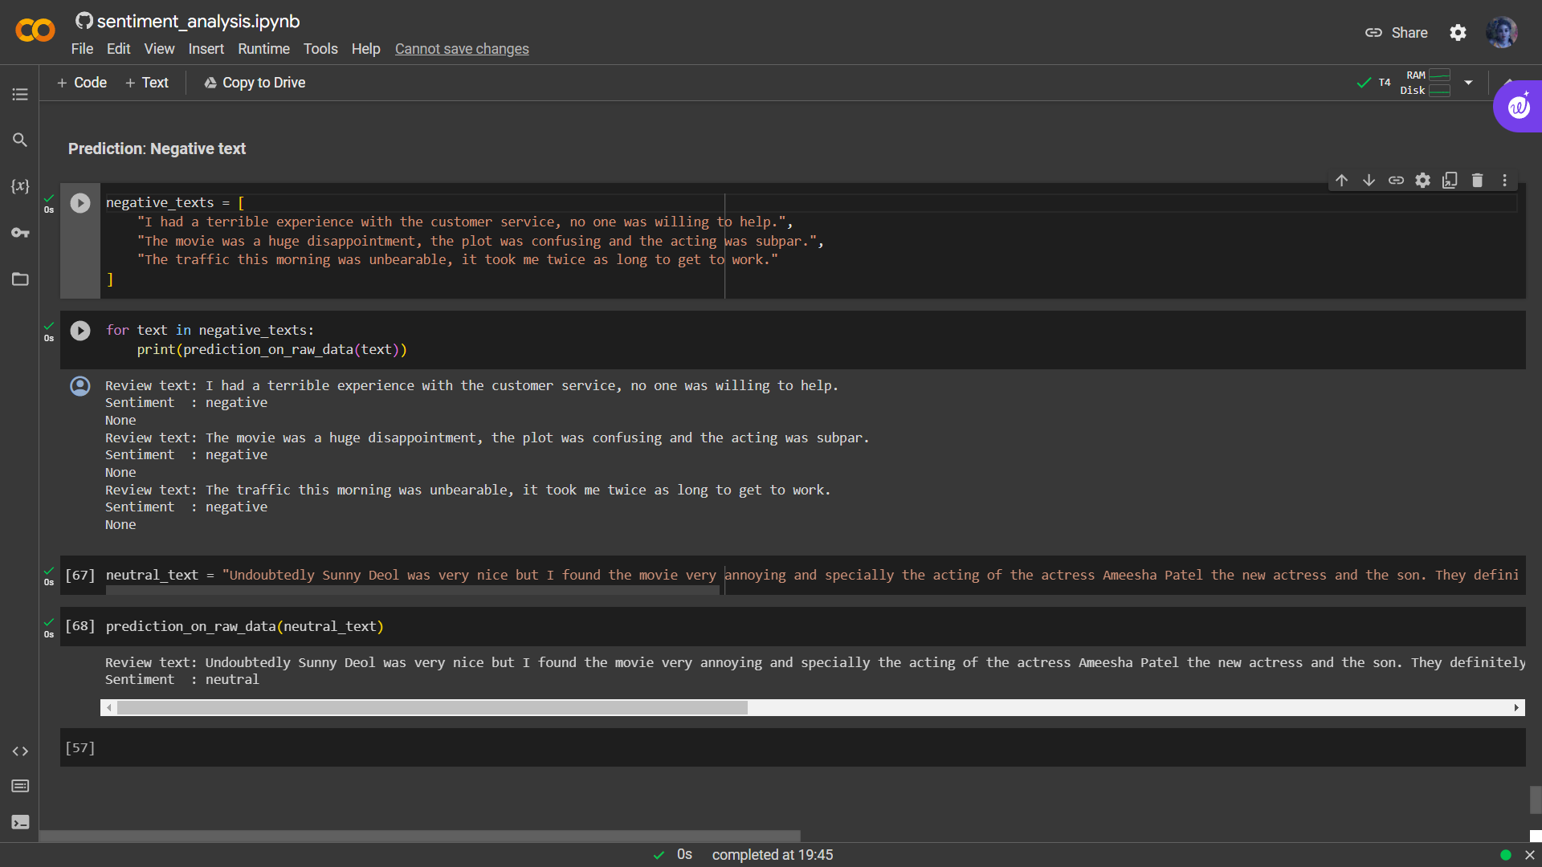
A prediction on negative text

Slide 19
REFERENCES
Rishi Meridian, “Analysis of Google Play Store Data set and predict the popularity of an app on Google Play Store”, Texas a & M University College Station, Texas, June-2020. Jong, J. (2011). Predicting rating with sentiment analysis
ZHENGJIE GAO , AO FENG , XINYU SONG, AND XI WU Department of Computer Science, Chengdu University of Information Technology on Target-dependent sentiment classification using BERT.
Https://developer.mozilla.org/enUS/docs/Learn/Serverside/Django/Introduction

Slide 20
Thank
you!

