Slide 1
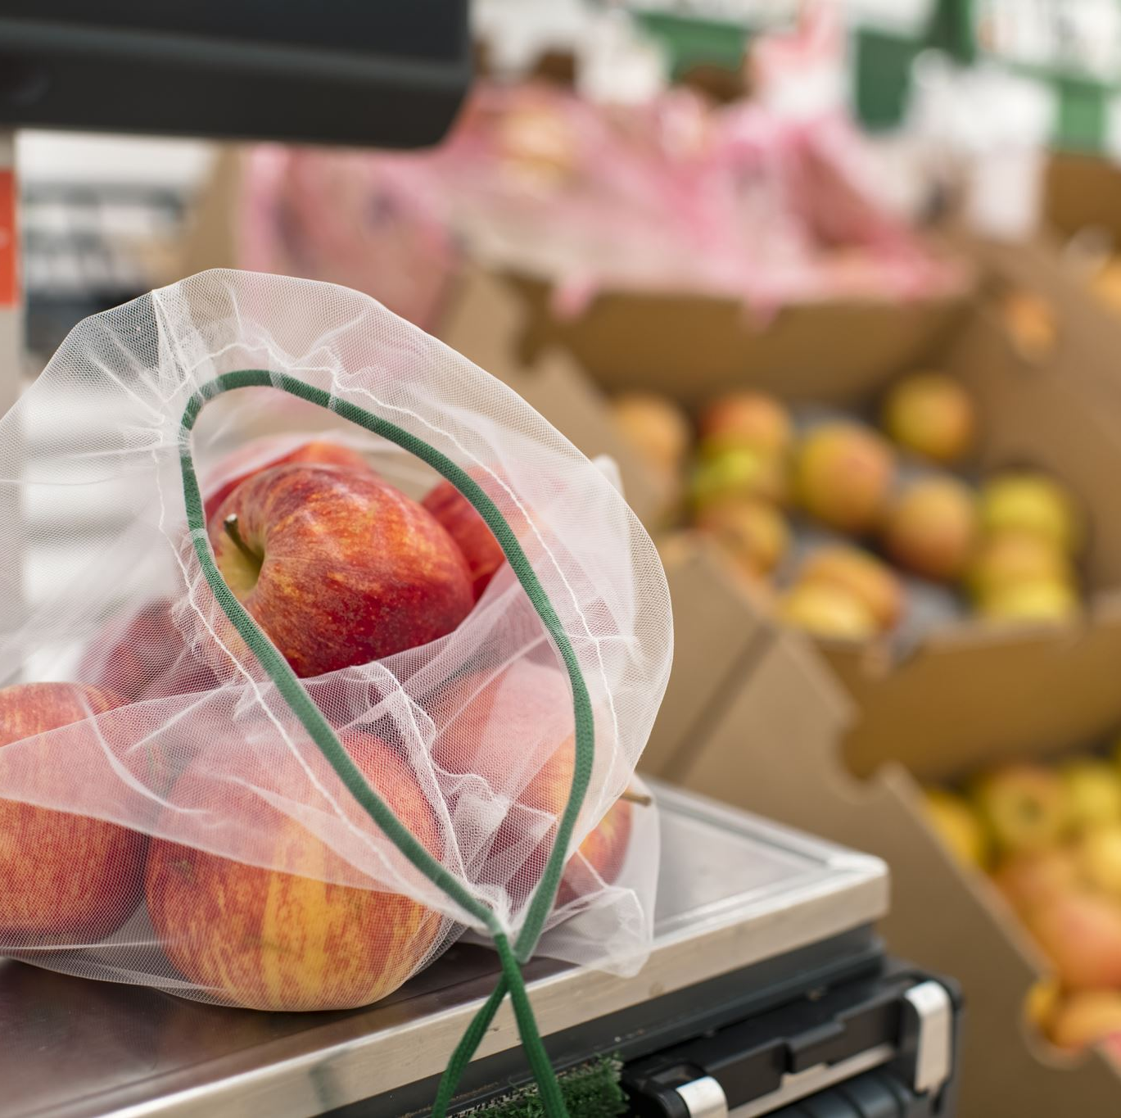
FOOD ORDERING SYSTEM
PRESENTED by
B.THANSINGH
G..SANDEEP-41 K.VAMSHI-49 MD.SAMEER-71

Slide 2

Mobile app development
To enhance the user experience and provide grater accessibility, a mobile app version of the online food ordering system will be developed

Slide 3
Designs
The mobile app will feature a simple and intuitive interface to enable users to quickly and easily place their order
The design will be consistent with the existing online ordering system to maintain brand identity and recognition.

Slide 4

Technical implementation
The mobile app will be developed using React native to ensure compatibility with both ios and Android devices.
API integration will be used to connect the mobile app to the existing online food ordering system

Slide 5

Time line
8-12 weeks for design exploration, technical implementation, and user testing.

Slide 6

Feast from the screen :Revolutionizing Food ordering system
The feature of the food ordering is online
The benefits of online food ordering
Hoe online food works
The importance of user experience
Online food ordering trends
The future of online food ordering

Slide 7
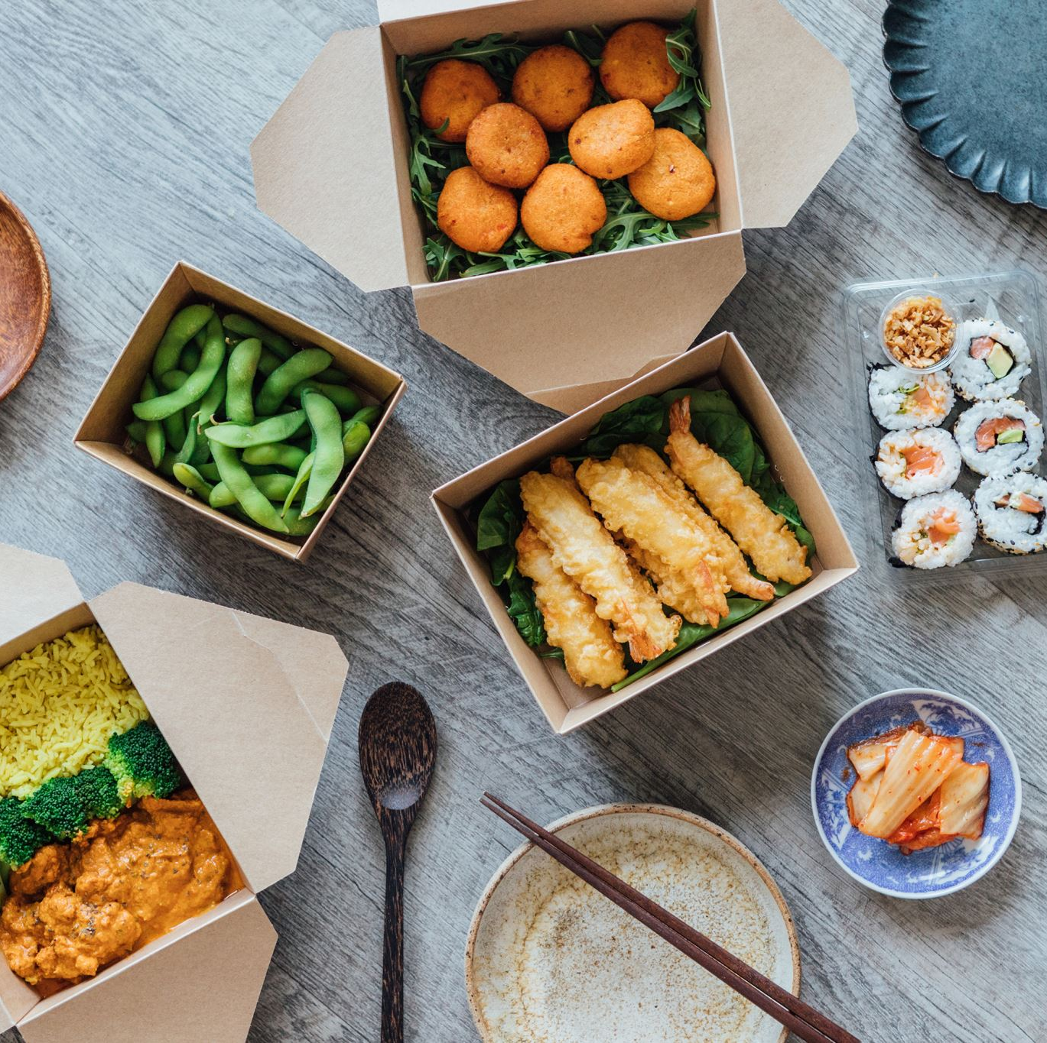
The feature of food ordering is online
The world is changing, and so are our eating habits. With the advent of technology, online food ordering has become a popular choice for many people. In fact, it’s not just a trend anymore;it’s the feature of food ordering.
Online food ordering is convenient, fast and easy. It eliminates the need to wait in long lines or make phone calls to order food. With just few clicks on your computer or mobile devices, you can have your favorite meals delivered right to your doorstep, and with the current pandemic situation, online food ordering has become even more important as people try to maintain social distanceing

Slide 8
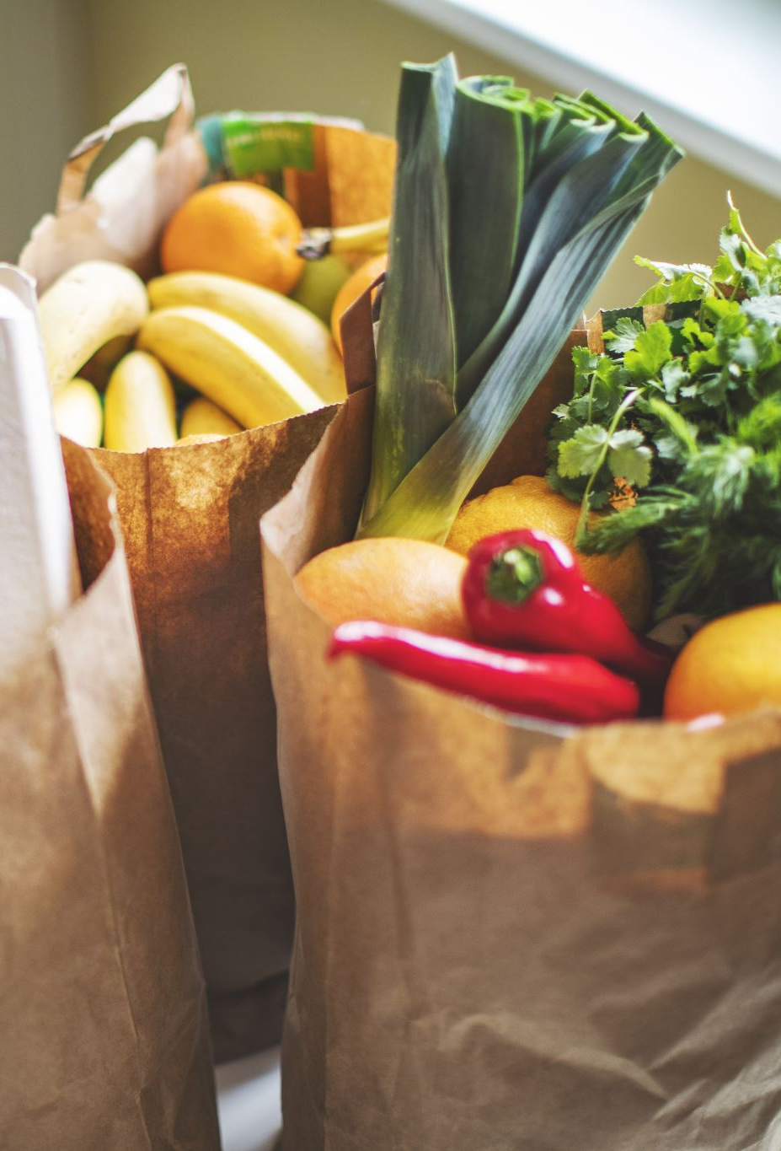
How online food ordering works
Online food ordering is simple and conveninent way to get your favorite meals delivered right to your doorstep. It all starts with selecting a restaurant and browsing their menu online. Most online food ordering platforms, and other factors to help you find the prefect meal.

Slide 9

The importance of user experience
User experience is a critical component of online food ordering. It’s not just about the conference of ordering from your couch;it’s about creating a seamless and enjoyable experience for the customer.

Slide 10

Software requirement
Operating system :-windows XP or higher
Server:-XAMPP
Front end:-HTML, CSS
Scrioting:JAVASCRIPT
Database connectivitity:phomy Admin
Prigramming language:PHP

Slide 11

Hardware requirements:
Operating system :windows 7 or higher
Procrssor :Intel Core processor or above
RAM :4GB or above
Hard Disk : 40GB or above

Slide 12
System Design:user case diagram admin
Admi-Dashboard
Manager regeneration users
Manage food categories add/update
Manage food menu add/update
Order management
Report Generation
Update profile change password

Slide 13
User ER diagram
Sign up
Sing in
Place order
Order training
Change password
Update profile

Slide 14
Conclusion
After a decade, the advancement and innovation of technology help people to manage their tasks easily and efficiently.
In many other industry area have been used management system to assist their business grow long time ago, therefore it is also a trend that causes F&B industry to make use of a management system for their business

Slide 15

THANK YOU

