Slide 1

K.Lakshmi
- Final Project
3/21/2024 Annual Review
<number>

Slide 2
KEYLOGGER
A keylogger is a type of software or hardware that records the keystrokes on a computer or device. It can capture everything you type, including passwords, messages, and other sensitive information.
Keyloggers are sometimes used for legitimate purposes like monitoring children’s online activities or employee productivity.
3/21/2024 Annual Review
<number>

Slide 3


AGENDA
An introduction highlighting the importance of keyloggers, followed by a detailed exploration of project objectives, technical intricacies of key press capture, and the functionality of logging keystrokes to both text and JSON files.
The agenda includes a demonstration of the GUI interface, a discussion on ethical considerations surrounding keyloggers, and a live showcase of the keylogger in operation.
3/21/2024 Annual Review
<number>

Slide 4

PROBLEM STATEMENT
Develop a sophisticated keylogger using Python, integrating the `pynput` library for key press monitoring and a user-friendly GUI designed with `tkinter`. The key objective is to create a secure and efficient keylogging tool that can accurately record and store keystrokes in various file formats. This endeavor seeks to address the need for a reliable keylogging solution that balances technical complexity with user accessibility, ensuring data integrity and ethical usage in the realm of cybersecurity and software development.
3/21/2024 Annual Review
<number>

Slide 5

PROJECT OVERVIEW
Imagine delving into the realm of cybersecurity by crafting a cutting-edge Python keylogger enriched with a sleek graphical interface using `tkinter`. This project embarks on a journey to blend the art of key press monitoring with the science of user-friendly design, culminating in a dynamic tool that captures keystrokes with precision and presents them in a visually engaging format.
By harmonizing technical prowess with aesthetic appeal, this endeavor not only enhances data logging efficiency but also elevates the user experience, offering a novel perspective on the intersection of functionality and style in software development.
3/21/2024 Annual Review
<number>

Slide 6

WHO ARE THE END USERS?
The end users of this project could include cybersecurity professionals, software developers, ethical hackers, and individuals seeking to monitor and log keystrokes for security or productivity purposes.
Additionally, students or researchers interested in cybersecurity concepts and Python programming may also find this project beneficial for learning and experimentation. The user-friendly GUI aspect could attract individuals who prefer a visually appealing and intuitive interface for interacting with the keylogging tool.
3/21/2024 Annual Review
<number>

Slide 7

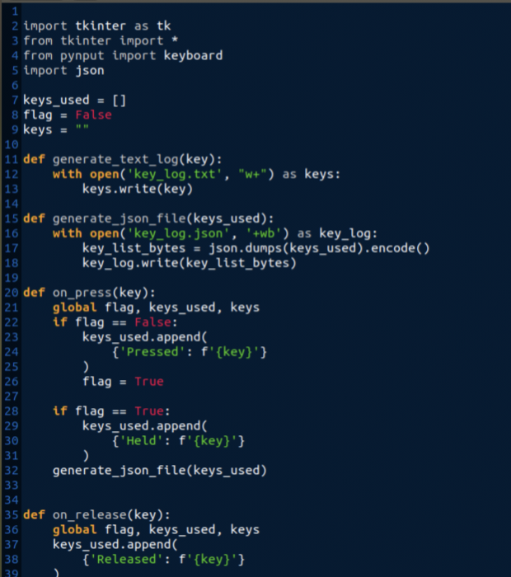
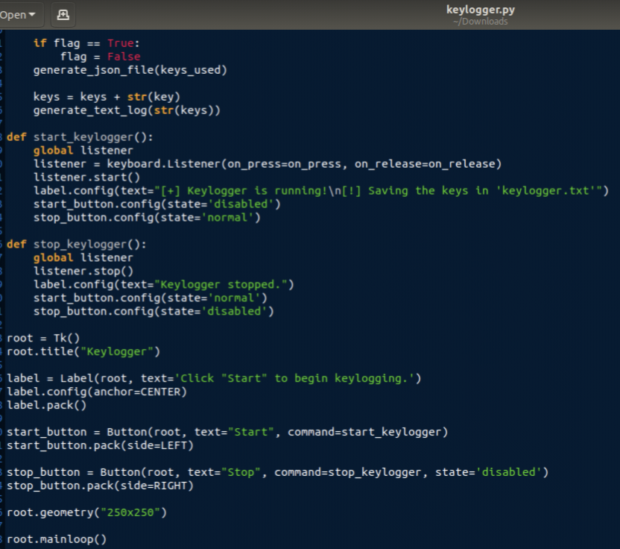
YOUR SOLUTION AND ITS VALUE PROPOSITION
Developing a slotion for keylogger using pyinput and jsonlib
3/21/2024 Annual Review
<number>

Slide 8

THE WOW IN MY SOLUTION
The wow factor in Python keylogger project solution lies in the seamless integration of advanced keylogging functionality with a visually appealing GUI interface. By combining the technical sophistication of key press monitoring with the user-friendly design of `tkinter`, not only excels in data capture accuracy but also enhances the overall user experience.
This harmonious blend of powerful functionality and elegant presentation sets your keylogger solution apart, offering a compelling and innovative approach to keystroke logging in the realm of cybersecurity and software development.
3/21/2024 Annual Review
<number>

Slide 9
MODULES
Keylogger Module : This module will handle the keylogging functionality using the `pynput` library to monitor and record keystrokes.
GUI Module : The GUI module will be responsible for creating the graphical user interface using `tkinter` to provide a visually appealing way for users to interact with the keylogger.
Pynput : `pynput` is a Python library that enables you to control and monitor input devices such as the mouse and keyboard.
jsonlib : The standard library for working with JSON data in Python is called `json`. It provides functions for encoding Python objects into JSON strings and decoding JSON strings into Python objects.
3/21/2024 Annual Review
<number>

Slide 10
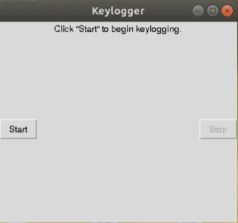
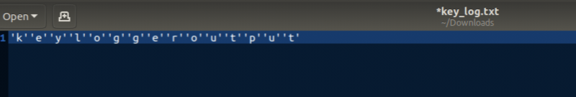
RESULTS
Coupled with a sophisticated GUI, harmonizes advanced keylogging functionalities with an appealing user interface. This integration seamlessly captures keystrokes while presenting a visually engaging user experience.
The provided solution gives the following output :
After executing key_log.txt text fikr is created.It consists the following
3/21/2024 Annual Review
<number>

Slide 11

CONCLUSION
Keylogger , enriched with a sleek GUI, epitomizes the synergy of cutting-edge keystroke capture and visually captivating user interaction. This fusion of advanced functionality and elegant design culminates in a distinctive and compelling tool for keystroke monitoring and recording.
The seamless integration of powerful features and aesthetic appeal sets your keylogger project apart, offering a sophisticated and innovative solution for user engagement and data monitoring.

Slide 12
PROJECT LINK
Here is my project Link.
https://github.com/KammatiLakshmi/Lakshmi_project.git

Slide 13

THANK YOU

