Slide 1

CSE 573: Semantic Web Mining

Slide 2
Group 6
Project 21: Personality Classification with Social Media
Group Members:
Kampally Sreshta Chowdary, 1224031900
Kunj Patel, 1213184152
Phani Rohitha Kaza, 1219915970
Prakruti Singh Thakur, 1222301340
Sai Ajitesh Krovvidi, 1219320388
Ankit Sharma, 1219472813

Slide 3
Problem Definition
With the increasing usage of social media in recent times, it has been possible to get hold of a large amount of data. People interact on social media in many ways. Some of the most popular ways are through liking someone’s posts or commenting on them.
In the Q4 of 2021, the number of daily active users on Facebook reached 1.93 billion. With such a high volume of data availability, it is becoming more and more critical to classify an individual’s personality traits to better serve their demands.
At the same time, it could also translate to more revenue for the company by running targeted ads and marketing campaigns. This is also important because some personality types are more likely to engage in certain types of activities.

Slide 4
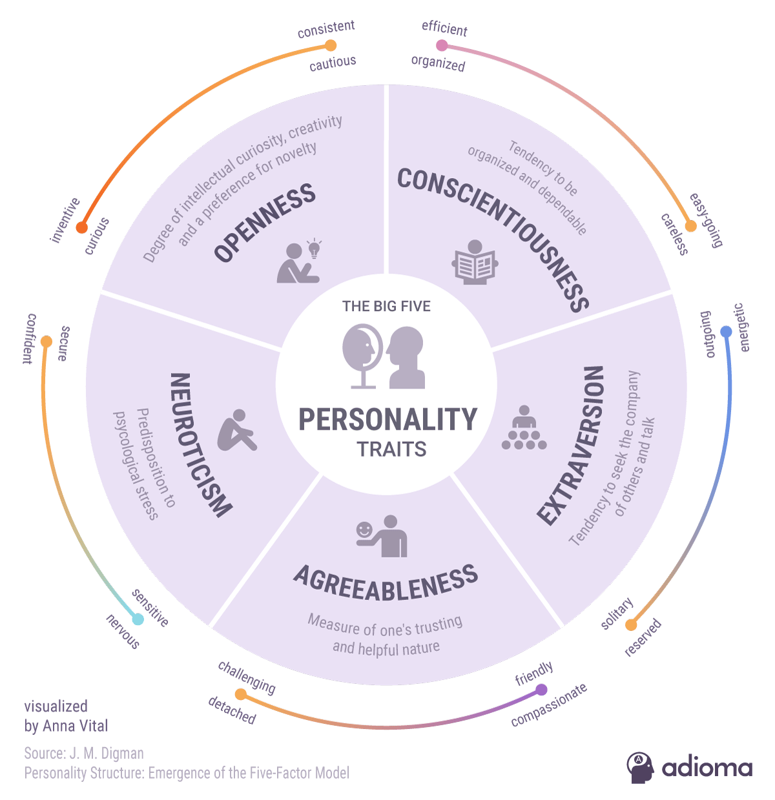

Slide 5
Datasets
The dataset we are using has been obtained from the website- https://www.michalkosinski.com/dataminingtutorial
user.csv: This file contains the data of 110,729 Facebook users. It includes the userids and their respective gender, age, political inclination, and 5 personality traits.
likes.csv: This file contains 1,580,284 likeids and the name of the post that is liked.
users-likes.csv : This file contains 10,612,326 lines of data. This data comprises two columns which are userid and the likeids of the posts they liked.

Slide 6
State-of-Art Methods & Algorithms
Dimensionality reduction
Principal Component Analysis (PCA)
Latent Dirichlet Allocation (LDA)
Singular Value Decomposition (SVD)
Clustering techniques
DBSCAN
K-Means
Fuzzy K-Means
Clustering techniques comparison
Silhouette score
Davies-Bouldin Index
Calinski-Harabaz Index

Slide 7
Research & Development Plan
Preprocessing & Visualization:
Match the entries
Use the user footprint matrix
Remove less frequent occurrences
Dimensionality Reduction:
Critical step as it provides numerous advantages
PCA, LDA, SVD analyzed for applicability
Results are the basis for evaluation
Clustering:
Visualize preprocessed data, use relevant clustering techniques
Analyze the accuracy using multiple metrics to arrive at sound conclusions
Assigns users to groups, forestep to prediction models
Prediction Models:
Linear and Logistic Regression methods to build models
SVM and Decision Trees are potential considerations
Final step is to analyze prediction models for accuracy

Slide 8
Evaluation Plan
We plan on implementing various dimensionality reduction techniques with a combination of distinct clustering algorithms.
Next, we’ll be performing predictive analysis to predict the personality type from the OCEAN parameters.
Upon comparing and analyzing the results for the mentioned models, we will use the model with the highest score for the chosen performance metrics.
If time permits, we also plan to acquire the dataset for the other social media platforms like Twitter and work on it.

Slide 9
Project Plan: Tasks, Deadlines, Division of Work
Task | Deadline | Assignee
Data Collection & Pre-processing | 02-25-2022 | Sai Ajitesh Krovvidi, Kunj Patel, Prakruti Singh Thakur
Data Analysis & Visualization | 03-09-2022 | Phani Rohitha Kaza, Kunj Patel, Prakruti Singh Thakur
Research on Dimensionality Reduction & Clustering Algorithms | 03-17-2022 | Sai Ajitesh Krovvidi, Sreshta Chowdary Kampally, Ankit Sharma
Perform the Dimensionality Reduction & Clustering Algorithms | 03-25-2022 | Sai Ajitesh Krovvidi, Sreshta Chowdary Kampally, Kunj Patel
Building the model for predictive Analysis | 04-07-2022 | Phani Rohitha Kaza, Sreshta Chowdary Kampally, Ankit Sharma
Compare the results of the various Classification models and Choose the appropriate model | 04-11-2022 | Phani Rohitha Kaza, Sreshta Chowdary Kampally, Prakruti Singh Thakur

Slide 10
References
[1] Michal Kosinski, Yilun Wang, Himabindu Lakkaraju, and Jure Leskovec, ”Mining Big Data to Extract Patterns and Predict Real-Life Outcomes”, 2016.
[2] Michal Kosinski, https://www.michalkosinski.com/data-mining-tutorial, R code
[3] Dimensionality reduction techniques, 11-dimensionality-reduction-techniques-you-shouldknow-in-2021
[4] Clustering Algorithms, 17 Clustering Algorithms Used In Data Science and Mining
[5] Golbeck, Jennifer, et al. ”Predicting personality from twitter.” Privacy, Security, Risk and Trust (PASSAT) and 2011 IEEE Third Inernational Conference on Social Computing (SocialCom), 2011 IEEE Third International Conference on. IEEE, 2011.
[6] Quercia, Daniele, et al. ”Our Twitter profiles, our selves: Predicting personality with Twitter.”Privacy, Security, Risk and Trust (PASSAT) and 2011 IEEE Third InernationalConference on Social Computing (SocialCom), 2011 IEEE Third International Conference on. IEEE, 2011.
[7] OCEAN traits the-big-five-personality-dimensions
[8] Statista Facebook DAU statistic
[9]https://blog.adioma.com/5-personality-traits-infographic/

Slide 11
THE END

