Slide 1
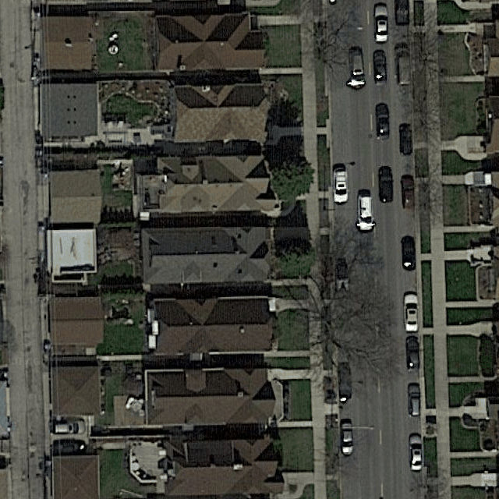
Building 1
Building 8
Building 2
Building 9
Building 3
Building 10
Building 4
Building 11
Road 1
Building 5
Building 12
Building 6
Building 13
Building 7
Building 14

Slide 2
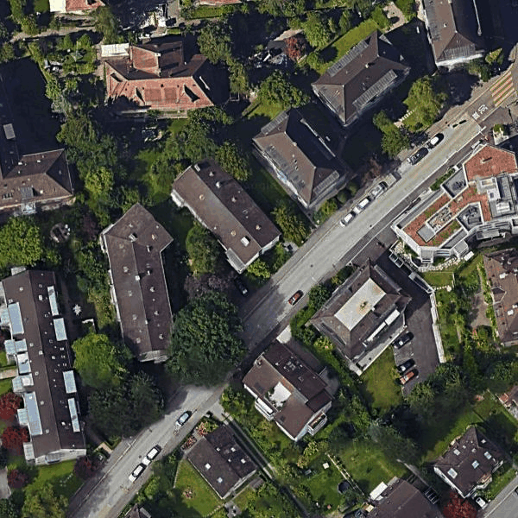

Slide 3
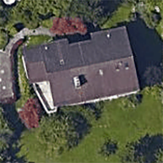
CNN
RNN
Image
Features
Polygon

Slide 4
conv1_1
conv1_2
conv2_1
conv2_2
pool1
conv3_1
conv3_2
conv3_3
pool2
conv4_1
conv4_2
conv4_3
pool3
conv5_1
conv5_2
conv5_3
pool4
pool5
Original Image
28×28
28×28
28×28
28×28
14×14
14×14
14×14
14×14
224×224
224×224
224×224
112×112
112×112
112×112
56×56
56×56
56×56
56×56
Fully Connected Layers
7×7
512
512
512
512
512
256
512
512
512
128
256
256
256
64
128
128
3×3 Convolution + ReLU
2×2 Max Pooling
3
64
64

Slide 5
conv1_1
conv1_2
28×28
28×28
28×28
28×28
28×28
14×14
28×28
conv2_1
conv2_2
128
pool1
128
128
128
128
128
512
conv3_1
conv3_2
conv3_3
pool2
conv4_1
conv4_2
conv4_3
Feature
pool3
conv5_1
conv5_2
conv5_3
pool4
Original Image
28×28
28×28
28×28
28×28
14×14
14×14
14×14
14×14
224×224
224×224
224×224
112×112
112×112
112×112
56×56
56×56
56×56
56×56
Mask Prediction and RNN
28×28
512
512
512
512
256
512
512
512
128
128
256
256
256
64
128
128
Concatenate
3×3 Convolution + ReLU
2×2 Max Pooling
3
64
64
2×2 Upsampling

Slide 6



Modified
VGG-16
3×3 Conv
Sigmoid
3×3 Conv
Sigmoid
Original Image
224×224×3
Features
28×28×128
Mask of Boundary
28×28×1
Mask of Vertices
28×28×1
RNN
Loss
CNN

Slide 7
h_{t}
c_{t−1}
৹
+
c_{t}
৹
tanh
৹
b
sigmoid
sigmoid
tanh
sigmoid
f_{t}
i_{t}
g_{t}
o_{t}
h_{t−1}
W_{h}
+
W_{x}
h_{t}
x_{t}

Slide 8
v_{t−2}
28×28×1
v_{t−1}
28×28×1
v_{t}
28×28×1
v_{t+1}
28×28×1
···
One-hot
One-hot
One-hot
One-hot
···
y_{t}
28×28+1=785
···
FC & Softmax
FC & Softmax
FC & Softmax
FC & Softmax
···
h_{t}⁽²⁾
28×28×16
···
ConvLSTM⁽²⁾
ConvLSTM⁽²⁾
ConvLSTM⁽²⁾
ConvLSTM⁽²⁾
···
h_{t}⁽¹⁾
28×28×16
···
ConvLSTM⁽¹⁾
ConvLSTM⁽¹⁾
ConvLSTM⁽¹⁾
ConvLSTM⁽¹⁾
···
x_{t}
28×28×133
x_{t+1}
28×28×133
Features
28×28×128
Mask of Boundary
28×28×1
Mask of Vertices
28×28×1
v₀
28×28×1
Fixed at each time step

Slide 9
8
9
5
7
4
6
3
2
10
11
1
12

Slide 10
CNN
FC
x
y
Image
Features
Output
BBox
w
h

Slide 13
FPN
l_{p}⁽¹⁾
l_{p}⁽²⁾
l_{p}^{(i)}
l_{n}⁽¹⁾
l_{n}⁽²⁾
l_{n}^{(i)}
Image
Output
x_{r}⁽¹⁾
x_{r}⁽²⁾
x_{r}^{(i)}
Recover
···
···
y_{r}⁽¹⁾
y_{r}⁽²⁾
y_{r}^{(i)}
Suppression
w_{r}⁽¹⁾
w_{r}⁽²⁾
w_{r}^{(i)}
h_{r}⁽¹⁾
h_{r}⁽²⁾
h_{r}^{(i)}

Slide 14
1/4 resolution
Feature Map
Entry of Feature Map
Original Image
Anchor
1/2 resolution

Slide 15
Feature Pyramid
256
256
256
256
56×56
28×28
14×14
7×7
conv1_1
conv1_2
+
+
256
256
256
256
256
conv2_1
conv2_2
56×56
56×56
28×28
28×28
14×14
pool1
conv3_1
conv3_2
conv3_3
pool2
conv4_1
conv4_2
conv4_3
pool3
conv5_1
conv5_2
conv5_3
pool4
Original Image
28×28
28×28
28×28
28×28
14×14
14×14
14×14
14×14
224×224
224×224
224×224
112×112
112×112
112×112
56×56
56×56
56×56
56×56
512
512
512
512
256
512
512
512
128
256
256
256
64
128
128
1×1 Convolution + ReLU
3×3 Convolution + ReLU
2×2 Max Pooling
3
64
64
2×2 Upsampling

Slide 17
FPN
CNN
VGG-16
FC
Classification
Regression
Aerial
Feature
RoIs
Image
CNN
VGG-16
RNN
ConvLSTM
Building
Feature
Polygon
Image
PolygonRNN

Slide 18
FPN
CNN
VGG-16
FC
Classification
Regression
Aerial
Feature
RoIs
Image
RNN
ConvLSTM
Building
Feature
Polygon
Image
PolygonRNN

Slide 19
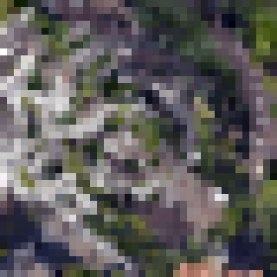

FPN
CNN
VGG-16
FC
Classification
Regression
Aerial
Feature
RoIs
Image
RoIAlign
RNN
ConvLSTM
Polygon
RNN part of PolygonRNN

Slide 20
Proposal 1
v₄⁽¹⁾
New Proposal 1
v₀
v₁
v₂
v₃
v₄⁽²⁾
v₀
v₁
v₂
v₃
v₄⁽⁴⁾
v₄⁽³⁾
Proposal 2
v₄⁽⁴⁾
New Proposal 2
v₀
v₁
v₂
v₃
v₄⁽⁵⁾
v₀
v₁
v₂
v₃
v₄⁽¹⁾
v₄⁽⁶⁾
Proposal 3
v₄⁽⁷⁾
New Proposal 3
v₀
v₁
v₂
v₃
v₄⁽⁸⁾
v₀
v₁
v₂
v₃
v₄⁽⁵⁾
v₄⁽⁹⁾
Probability (Log)

Slide 21
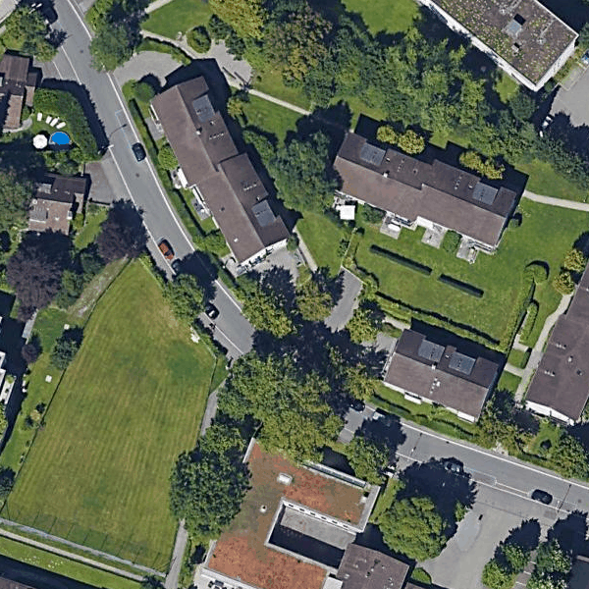
0
1
6
7
8
2
9
3
4
5
10

Slide 22
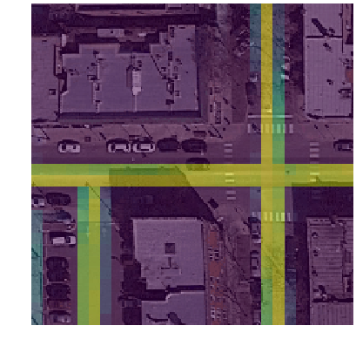
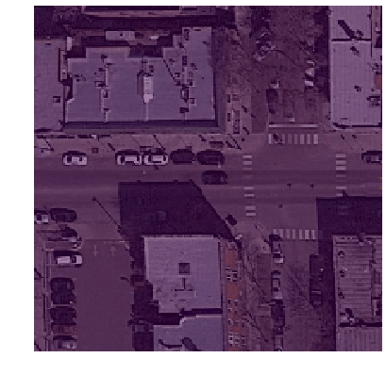
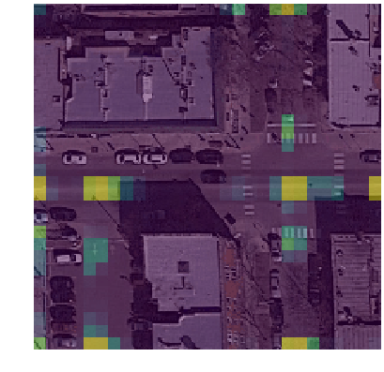
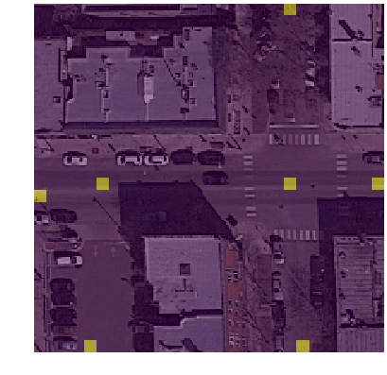
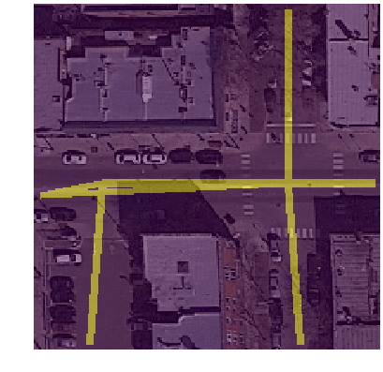
Mask of Boundary
Image
Is road or not
CNN
FC
Fixed
True
Final Output
Mask of Vertices
Edge of 2 Different Peaks
False
Mask of Peaks

Slide 23
0
4
3
1
5
2
3
7
2
5
6
0
1
8
4

