Slide 1

Text Matching as Image Recognition
Liang Pang, Yanyan Lan, Jiafeng Guo, Jun Xu, Shengxian Wan, Xueqi Cheng Institute of Computing Technology, Chinese Academy of Sciences Published in AAAI 2016
Presented by Zuoyue Li
Notes:
Good afternoon everyone! So, I’m going to give a presentation about the paper, Text Matching as Image Recognition, which was published in triple AI, two thousand and sixteen.

Slide 2
Contents
Introduction
Motivation
Model: MatchPyramid
Experiments
Conclusion
Notes:
This is thi outline of my presentation.
(*) First I’ll introduce some basic ideas of Text Matching and Image Recognition,
(*) and the motivation part will show you how these two totally different topics can be related.
(*) The third part is about the model, namely match pyramid, I will explain in detail about thi architecture.
(*) Then I’ll illustrate its performance in the two experiments, comparing with other recent models,
(*) and finally the conclusion will be given.
OK, let’s start the first section.

Slide 3
Contents
Introduction
Text Matching
Image Recognition
Motivation
Model: MatchPyramid
Experiments
Conclusion
Notes:
(*)

Slide 4
Introduction Text Matching: Applications
Machine
Translation
[Brown et al. 1993]
Document
Retrieval
[Li and Xu 2014]
Question
Answering
[Xue, Jeon, and
Croft 2008]
Text Matching
Dialogue
[Lu and Li 2013]
Paraphrase
Identification
[Socher et al. 2011]
Notes:
Matching two texts is a fundamental problem in many natural language processing tasks.
(*) It is also central to many natural language applications, such as machine translation, question answering, paraphrase identification and document retrieval.

Slide 5
Introduction Text Matching: Measurement
Example: Paraphrase Identification
T₁: Down the ages noodles and dumplings were famous Chinese food.
T₂: Down the ages dumplings and noodles were popular in China.
Representation
Notes:
(*) Let’s take the task of paraphrase identification for example,
given these two texts about Chinese food,
we can see that these two texts have very similar meanings,
thus they should have a high matching score.
But why we think their meanings are similar?
Actually, these two texts show many matching patterns,
such as the same time adverbial
and same sentence subjects in different orders,
and the similar predicative /prɪˈdɪkətɪv/ expressions.
So, a successful matching algorithm needs to capture the rich interaction structures like these in the matching process.
(*) This is a mathematical definition.
The matching score is produced by a function (+) f, on the representation of each text,
and the (+) phi here, is a function, to map each text to a vector, such as word embeddings.

Slide 6
Introduction Text Matching: Related Work
Traditional Models: Design Features
TF-IDF | BM25 | LDA | Learning to Rank
Deep Models: Learn Features
Siamese Framework: DSSM | CDSSM | ARC-I
Complex Matching Patterns: uRAE | DeepMatch | ARC-II MatchPyramid
Notes:
(*) There are some traditional models to tackle the text matching problems.
(*) TF-IDF is typical model which is widely used in text mining. In this method, each text is represented as a vector with TF-IDF score of each word, and the final matching score is produced by thi inner product of the two vectors. Thus, this method only captures the unigram matching information.
(*) Most previous /ˈpriviəs/ works on text matching are mainly focusing on deep models.
(*) (+) The main character of this kind of model is learning features automatically, instead of designing features manually in the traditional models.
(*) Deep models can be roughly divided into two different frameworks. The first one, Siamese /sai e mis/ framework, tries to find good representations for a single text, and use a simple scoring function to obtain the matching results. Examples include DSSM, CDSSM and ARC one.
(*) And recently, a brand new approach focusing on modeling thi interaction between two sentences has been proposed and gained much attention. They can extract complex matching patterns. Examples include uRAE, deep match, and ARC two.
And the model of this paper, namely match pyramid, also falls into this category.

Slide 7
Introduction Image Recognition
Convolutional Neural Network (CNN) [LeCun et al. 1998]
Layer-by-layer Composition [Girshick et al. 2014]
Notes:
Next let’s talk about image recognition。
(*) This figure shows the pipeline of thi image recognition process (*) by using convolutional neural network. It has been widely observed that CNN can successfully abstract visual patterns from raw pixels with (*) layer-by-layer composition.
In an image, like this (+) cat, raw pixels provide basic units of thi image,
and each patch may contain some elementary visual features,
such as edges and corners.
Using (+) different kernels, we can capture many kinds of these features.
(+) Local combinations of these features form motifs, motifs assemble into parts, and parts form objects.
Thus, the success of CNN inspire thi authors to solve text matching problem, in the frameworks of image recognition. However, the representations of text and image are so different that it remains a challenging problem to perform such transformation.

Slide 8
Contents
Introduction
Motivation
Matching Signals
Compare with Image Recognition
Model: MatchPyramid
Experiments
Conclusion
Notes:
OK. Let’s move to the next section, motivation.

Slide 9
Motivation Matching Signals
Word Level Matching Signals (identical, similar)
Phrase Level Matching Signals (N-gram, N-term)
Sentence Level Matching Signals
Example
T₁: Down the ages noodles and dumplings were famous Chinese food.
T₂: Down the ages dumplings and noodles were popular in China.
Notes:
(*) As I mentioned in the previous /ˈpriviəs/ slides, making a good matching decision, requires to take the rich interaction structures and matching patterns into account, from words, to phrases and the whole sentences.
Taking these two sentences as an example,
(*) First, let’s see the word level matching signals. It includes not only thi identical word matching, such as (***) down, the, ages, noodles, and, dumplings, were, but also similar word matching, such as, famous–popular and Chinese–China.
(*) The second one is the phrase level matching signals, including N-gram and N-term.
N-gram matching occurs with exactly N (!) successive matched words, for example, (*) down thi ages.
N-term matching allows for order or semantic alternatives, for example (*) noodles and dumplings, versus dumplings and noodles, (*) were famous Chinese food, versus were popular in china.
(*) The last one is the sentence level matching signals,
which are composed of lower level matching signals, for example,
the three successive phrase level matching signals.
Thus, we can conclude that, such interaction structures are compositional hierarchies (降调), in which higher level signals, are obtained by composing lower level ones.

Slide 10
Motivation Compare with Image Recognition
Notes:
(*) This is very similar to image recognition, higher level patterns are formed by many lower level features.
(*) We can compare the raw image pixels with the word level matching signals,
and regard (*) captured edges, corners, motifs and parts as phrase level matching signals,
(*) and thi objects can be compared with the sentence level matching signals.
These can be the relationship between text matching and image recognition.

Slide 11
Contents
Introduction
Motivation
Model: MatchPyramid
Matching Matrix
Hierarchical Convolution
Matching Score and Training
Experiments
Conclusion
Notes:
In the next section, model, I will introduce the deep architecture, match pyramid, in detail.

Slide 12
Model: MatchPyramid Matching Matrix: Representation
Bridging the gap between text matching and image recognition
Notes:
I think the most important structure in this model is the matching matrix.
(*) Thi authors describe the matching matrix as a bridge between text matching and image recognition.
As discussed before, one challenging problem by modeling text matching as image recognition,
lies in the different representations of text and image:
the formers are two, single dimensional word sequences while the latter is a two dimensional pixel grid.
(*) To address this issue, thi authors represent thi input of text matching, as a matching matrix, and take this matrix as an image.
Actually, the matching matrix is exactly a word level similarity matrix.
Each element M i j, is standing for the basic interaction, or the similarity between word w i in T one, and word v j in T two.
(+) and this sign here stands for a general operator to obtain the similarity.

Slide 13
Model: MatchPyramid Matching Matrix: Similarity Functions
Indicator Function
Cosine
Dot Product
Notes:
We can adopt different kinds of similarity function to model thi interactions between two words, leading to different kinds of raw images.
(*) The first one is thi indicator function, it produces either one or zero to indicate whether two words are identical.
One limitation of this function is that, it cannot capture the semantic matching between similar words.
(*) To tackle this problem, we can define the similarity function based on word embeddings, which will make the matrix more flexible to capture semantic interactions.
(*) Based on this, thi authors introduce thi other two operators: cosine (降调) and dot product.
Cosine views angles between word vectors as the similarity, while dot product further considers the norm of word vectors.

Slide 14
Model: MatchPyramid Matching Matrix: Images
Indicator Function
Cosine
Dot Product
Notes:
Based on these three different functions, the matching matrices of the given example are shown in these figures.
The matching matrix can be viewed as a (+) binary image if we define the similarity to be an indicator function.
It can be also viewed as a gray image if we define the similarity to be (+) real valued produced by cosine (降调) or dot product of word embeddings.

Slide 15
Model: MatchPyramid Hierarchical Convolution: Example
A way to capture rich matching patterns
Notes:
(*) Then, a convolutional neural network is applied on this matching matrix to extract different levels of matching patterns.
(*) Now let’s see how to convolve the kernel and the matrix.
(+) You can just regard the kernel as a sliding window over the matching matrix,
(+) and for each sub-matrix with the same size as the kernel, compute the product just like two vectors,
(+) so we get one here, and then (+) move to the next position, and do the same thing, so we get zero here.
This example can also show, how thi important phrase level interactions, are extracted and make further compositions.
With the given two kernels, the first convolutional layer can capture both (+) n-gram matching signal, down thi ages and (+) n-term matching signal, noodles and dumplings, versus dumplings and noodles.
These matching patterns are like (!) edges in image recognition.
The higher convolutional layers make compositions and form higher level of matching patterns. From the second layer, (+) given the three dimensional kernel, (+) more complicated T type pattern is captured. It looks like some motifs or parts in image recognition.

Slide 16
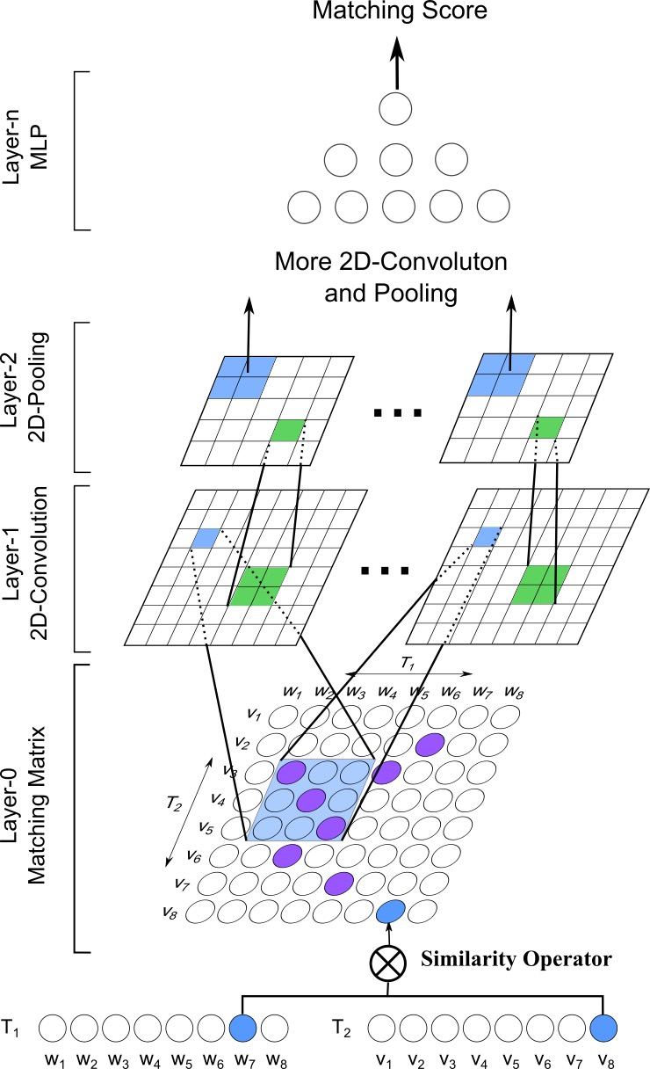
Model: MatchPyramid Hierarchical Convolution: Structure
Convolution
Dynamic Max Pooling
Notes:
This is the whole architecture of the model, match pyramid.
(+) The layer zero is the matching matrix mentioned before,
(+) and the layers with odd index, form the hierarchical convolution, which is very similar to CNN in image recognition.
(*) These formulas mathematically define the convolution process that I mentioned in the previous /ˈpriviəs/ slide.
(*) (+) The layers with even index, form the dynamic max pooling, which is used to deal with the different text lengths. By applying dynamic max pooling, we can get fixed-size feature maps.
You can simply think this process is just a function that divide the matrix into many blocks, and each block takes the maximum.
(+) With more two dimensional convolution and max pooling, this layer-by-layer architecture can obtain higher abstraction of interaction patterns between words, phrases and sentences.

Slide 17
Model: MatchPyramid Matching Score and Training
Multilayer Perceptron
Matching Score
Objective Function
Training
AdaGrad [Duchi, Hazan, and Singer 2011]
Notes:
After hierarchical convolution and max pooling,
(*) match pyramid uses a multilayer perceptron to produce the final matching score.
This is an example for the binary classification and two layer perceptron.
Thi output is a two dimensional matching score vector [s zero and s one], which are the matching scores of the corresponding class, z here is thi output of the hierarchical convolution.
(*) Soft max function is used to output the probability of belonging to each class.
(*) As for training, the logistic loss, or the cross entropy is used as thi objective function.
And, thi optimization is straightforward with the standard back (!) propagation.
(*) And, thi authors apply stochastic /stəˈkastik/ gradient descent method, AdaGrad for thi optimization.

Slide 18
Contents
Introduction
Motivation
Model: MatchPyramid
Experiments
Competitor Methods
Experimental Settings
Experiment 1: Paraphrase Identification
Experiment 2: Paper Citation Matching
Conclusion
Notes:
OK, let’s move to thi experiments section.
In this section, thi authors conduct experiments on two tasks, paraphrase identification and paper citation matching,
to demonstrate the superiority /suːˌpɪərɪˈɒrɪti/ of match pyramid against the baselines.

Slide 19
Experiments Competitor Methods
All Positive
TF-IDF [Salton, Fox, and Wu 1983]
DSSM [Huang et al. 2013]
CDSSM [Gao et al. 2014; Shen et al. 2014]
ARC-I and ARC-II [Hu et al. 2014]
uRAE [Socher et al. 2011]
MatchPyramid
MP-IND
MP-COS
MP-DOT
Notes:
These models are the competitor methods.
All positive here means the matching algorithm always predict positive for each pair of texts.
As for DSSM and CDSSM, thi authors use their released models.
And there are three versions of match pyramid, depending on different functions used for constructing the matching matrix,
denoted as MP-IND, MP-COS, and MP-DOT.

Slide 20
Experiments Experimental Settings
Number of Layers
Convolution: 2
Max Pooling: 2 (with 1 Dynamic Pooling)
Full Connected MLP: 2
Feature Maps
First Convolutional Layer: 8, size 5×5
Second Convolutional Layer: 16, size 3×3
Initiate the word vectors randomly from a unit ball in the first experiment
Notes:
(*) All these models use two convolutional layers, two max pooling layers and two full connection MLP layers.
(*) The number of feature maps is eight and sixteen for the first and second convolutional layer
And the kernel size is set to be five times five and three times three, respectively.
(*) Unlike ARC two which initiates /ɪˈnɪʃɪeɪt/ with word embeddings, thi authors initiate the word vectors in MP-COS and MP-DOT randomly from a unit (降调) ball in the first experiment.

Slide 21
Experiments Experiment 1: Paraphrase Identification
Aims to determine whether two sentences have the same meaning
Data Set: MSRP [Dolan and Brockett 2005]
Training Set: 4076 Instances
Test Set: 1725 Instances
Heavily relies on pre-training
Notes:
(*) First experiment is the paraphrase identification, which aims to determine whether two sentences have the same meaning.
(*) Let’s look at the results.
(+) We can see that traditional simple model such as TF-IDF, although it only uses the unigram matching signals, it has still achieved a high accuracy and F one score.
The three match pyramid models all performs much better than TF-IDF, which indicates that the complicated matching patterns, captured by hierarchical convolution, are important to text matching.
(+) For the comparison with recent deep models, we can see that DSSM performs better than thi others except uRAE, though thi improvement is quite limited.
(+) Thi interesting thing is that MP-DOT is still slightly worse than uRAE, however, (*) uRAE relies heavily on pre-training with an external large dataset with syntactic /sɪnˈtaktɪk/ tree information.

Slide 22
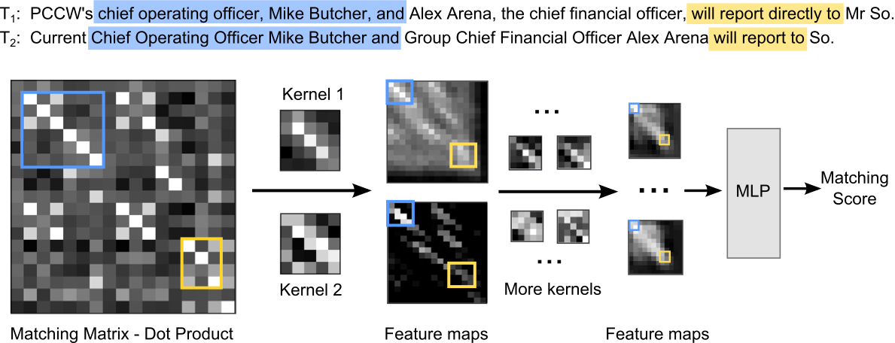
Experiments Experiment 1: Paraphrase Identification
Visualization of the Trained Network
Notes:
(*) Thi authors also visualize what the match pyramid model have learned, and we can gain some insights from this process.
(*) Here is an example from the data set, we can see that n-gram and n-term matching, which are in the blue and yellow color in original texts.
They are represented as a diagonal sub-matrix with the blue and yellow rectangles.
(+) Kernel one and kernel two are learned in the first convolutional layer. They can well captures thi important n-gram and n-term matching signals.
In the second convolutional layer, (+) the model make compositions, and keep the useful matching signals and pass it to the MLP classifier. This explains clearly why match pyramid model works well.

Slide 23
Experiments Experiment 2: Paper Citation Matching
A paper and its citations’ abstracts, defined as a type of matching
Example
T₁: this article describes pulsed thermal time of flight ttof flow sensor system as two subsystems pulsed wire system and heat flow system the entire flow sensor is regarded system theoretically as linear
T₂: the authors report on novel linear time invariant lti modeling of flow sensor system based on thermal time of flight tof principle by using pulsed hot wire anemometry thermal he at pulses
Notes:
(*) As for another text matching task, paper citation matching, semantic matching becomes very important.
Basically, in this case, we are given a set of papers, along with their abstracts.
A paper and its citations’ abstracts then becomes a pair of texts, and defined as a type of matching.
(*) This is a representative example. We can see that the matching here should take both lexical and semantic information into consideration.

Slide 24
Experiments Experiment 2: Paper Citation Matching
A Large Academic Data Set:
838,908 text pairs, with 279,636 match and 559,272 mismatch
Training Set: 599,196 Instances
Cross Validation: 119,829 Instances
Test Set: 119,883 Instances
Notes:
The dataset is collected from a commercial academic website.
The negative instances are randomly sampled from papers which have no citation relations.
(*) (+) The results in this figure show that TF-IDF is also a strong baseline on this dataset,
even better than some deep models such as DSSM and CDSSM.
This may be caused by the large difference between the test data and training data used in DSSM and CDSSM.
Since thi authors directly use their released models.
(+) ARC-I and ARC-II gain a significant improvement over these models, when compared with thi experiment one.
(+) As for our models, the best performance is still achieved by MP-DOT, also better than ARC two.
(+) However, we can see the poor performance of MP-IND on this task, the reason may lie in that thi indicator function only captures thi exact matching between words, but omits /əˈmɪt/ the semantic similarity.

Slide 25
Experiments Experiment 2: Paper Citation Matching
MP-COS vs. MP-DOT
Length of word vector counts
the, with, for, be, are: around 0.4 to 0.5
robotics, java, snake, musical, rfid: around 1.6 to 1.8
More lexical and semantic information from MP-DOT
Notes:
(*) Thi authors further show the reason, why (+) MP-DOT performs better than MP-COS, by analyzing the word embeddings.
If we pick some words for example, we can see that most words with small norm, such as the, with, for, are useless for matching,
while most words with large norm, such as robotics, java, play an important role in paper citation matching.
(*) By further considering thi importance of words, MP-DOT can capture more semantic information than MP-COS and thus achieve better performance.

Slide 26
Contents
Introduction
Motivation
Model: MatchPyramid
Experiments
Conclusion
Contributions
Discussion
Notes:
The final section, conclusion.

Slide 27
Conclusion Contributions
View text matching as image recognition
Deep Architecture: MatchPyramid
Matching Matrix
Hierarchical Convolution & Dynamic Max Pooling
Capture matching patterns at different levels
Outperform baselines, including recently proposed deep matching algorithms
Notes:
The contributions of this paper include:
(*) a novel view of text matching as image recognition
(*) the new deep architecture, match pyramid
(*) based on the matching matrix.
(*) By using hierarchical convolution and dynamic max pooling
(*) the model can capture the rich matching patterns such as n-gram and n-term at different levels, from words, phrases, to sentences
(*) experimental analysis on different tasks also demonstrate the superior /suːˈpɪərɪə/ power of the match pyramid against competitor matching algorithms

Slide 28
Conclusion Discussion
Word Vector Initialization
Random
Word Embeddings
Accuracy vs. F₁
Order of Patterns
T₁: ABCDXXX
T₂: DXBXCXA
Multiple Outputs
[3, 4] vs. [4, 5]
Soft Max: Probability

Slide 29
Conclusion Discussion
Model Parameters
Number of Layers: L
Number of Neurons per layer: N (average)
Size of Kernels: K (average)
Text Length: T
Convolution Time Complexity: O(LNK²T²)
L, N, K typically grow as T grows
Can use FFT for fast convolution computation

Slide 30
Thank you!
Q&A
zuli@student.ethz.ch
Notes:
That’s all, and thanks for the listening!

