Slide 1

JASP
A Quora-Styled Website for Balochi Literature
Kamiran Umer
Sulaman Imdad
Qambar Arz
Supervised by: Mr. Balach Khan
Department of Computer Science, University of Turbat

Slide 2

Why JASP?
The Problem
The Solution
•
Unstructured: Valuable literary discussions get lost in chat history on platforms like WhatsApp & Facebook.
•
Dedicated Platform: A Q&A space specifically tailored for Balochi literature.
•
Structured Knowledge: Organizes content clearly into Questions, Answers, and Articles.
•
Hard to Search: You cannot Google search a WhatsApp message or effectively filter old posts.
•
Digital Library: Creates a permanent, searchable archive accessible to everyone.
•
No Archiving: Knowledge is fleeting and not preserved for future generations of students.

Slide 3









What We Achieved
Structured Q&A
Rich Publishing
Bilingual
Curation
A professional space to ask and answer linguistic queries effectively.
Tools specifically for writing Poetry and Prose (Bold, Italic, Stanzas).
A custom engine to toggle instantly between English and Balochi.
Voting system to ensure quality content rises to the top.

Slide 4
Tools & Technologies
Frontend
•
Next.js 14 (React): For a fast, interactive User Interface and server-side rendering.
•
Tailwind CSS: For responsive and modern utility-first styling.
Backend & Hosting
•
Supabase: Provides robust Authentication and a real-time PostgreSQL database.
•
Vercel: Ensures global speed via Edge Networks.

Slide 5
How It Works
Client-Server Model
•
User interacts with the Next.js Frontend.
•
Frontend sends requests (API calls) to Supabase.
•
Supabase checks security rules (RLS) and updates the Database.
•
Real-time updates are sent back to all connected users (e.g., for live votes/likes).

Slide 6

Core Database Tables
Table Name | Description
Profiles | Stores User data (Avatar, Bio, Language Preference).
Posts | Stores Rich Text articles and poetry content.
Questions | Stores user queries linked with Topic Tags.
Votes | Tracks Upvotes/Downvotes (logic to prevent duplicates).
Notifications | Alert system for user actions like Follows and Likes.

Slide 7
Bilingual & RTL Support
The Challenge: Balochi is written Right-to-Left (RTL), while English is Left-to-Right (LTR).
Our Solution
•
Custom Language Switcher: A seamless toggle for users.
•
Instant Translation: Translates UI elements immediately.
•
Layout Flipping: Automatically flips the entire layout (e.g., Sidebar moves from Left to Right) to support the script correctly.

Slide 8


Two Ways to Share
Ask a Question
Create a Post
Simple text format focused on getting clear, direct answers from the community.
Rich Text Editor included. Allows formatting essential for Literature and Poetry (Line breaks, Bold titles, Stanzas).

Slide 9






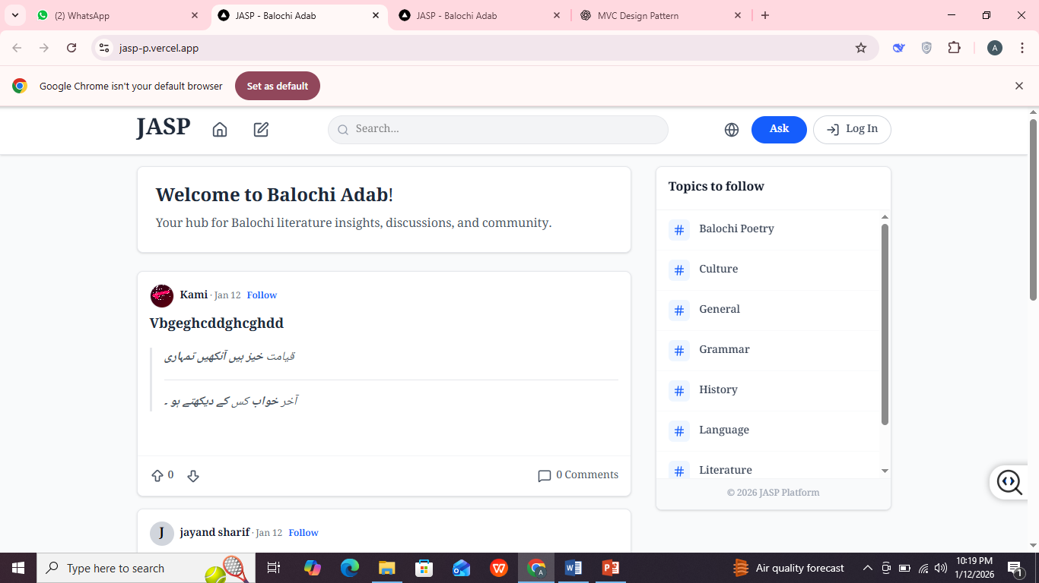
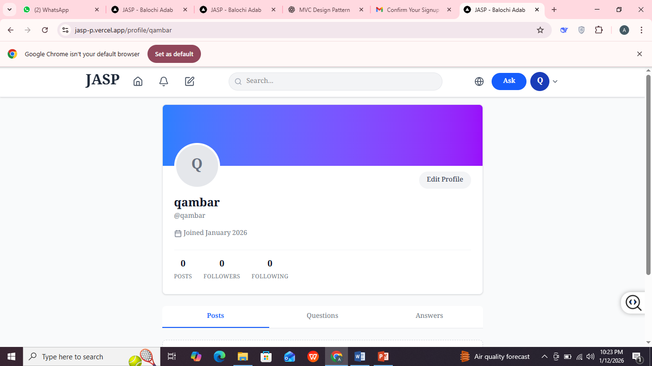

User Interface
Home Feed
Profile Page
Notifications
Filter by Topics (#History)
User stats & history
Real-time alerts

Slide 10
Summary & Future
Conclusion
•
JASP bridges the gap between social media chaos and academic archiving.
•
It provides a permanent, respectful home for the Balochi literary community.
Future Work
•
Mobile App: React Native version for Android/iOS.
•
Audio Posts: Allow poets to upload voice recitations.
•
Direct Messaging: Private chat between scholars.

Slide 11

Thank You!
Any Questions?

