Slide 1
Project on
Customer Retention

Slide 2
Import library
I have import pandas, NumPy, matplotlib etc.
Load data.
Check first five rows in dataset.
Check information about dataset.
Check describes the dataset.
Check null values in dataset.
Splitting the data two parts male data & female data.

Slide 3
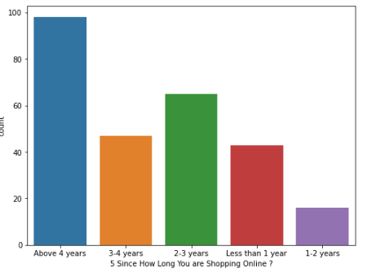
Above 4 years-: 98
2-3 years -:65
3-4 years -:47
Less than 1 year -:43
1-2 years-: 16
Maximum customers are doing online transactions for more than 4 years.

Slide 4
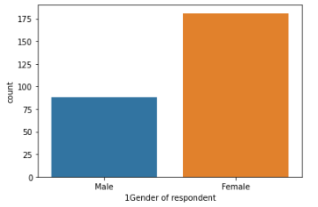
Female-:181
Male-: 88
No. of female customers are greater than male customers

Slide 5
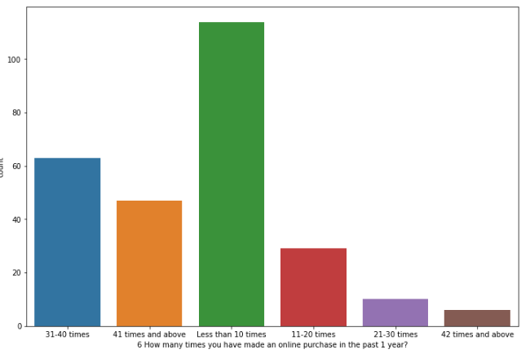
Less than 10 times-: 114
31-40 times-: 63
41 times and above-: 47
11-20 times -:29
21-30 times-: 10
42 times and above-: 6
Maximum users made online transactions less than 10 times

Slide 6
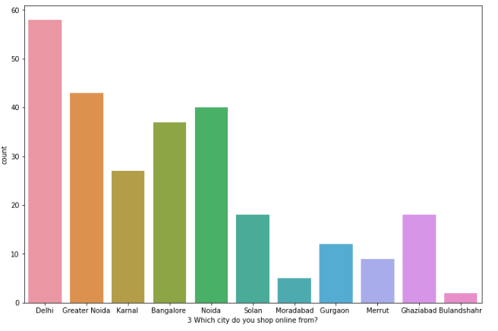
Delhi-: 58
Greater Noida -:43
Noida -:40
Bangalore -:37
Karnal -:27
Solan-: 18
Ghaziabad -:18
Gurgaon-: 12
Meerut -:9
Moradabad -:5
Bulandshahr: 2
There are total 11 cities from which customers are doing online shopping.
Delhi is having maximum no. of customers.

Slide 7
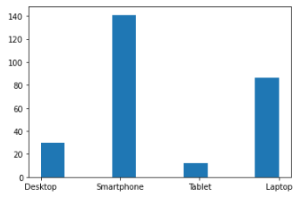
Smartphone-: 141
Laptop -:86
Desktop -:30
Tablet-: 1
Users do most of the transactions through smartphones

Slide 8
Analysing male and female age in dataset
Female user is more then male user in this dataset.
21 – 30 years female user are greater than 50 – 60 year & 31-14 years male people is only 30 .
Analysing how many male and female people in city
In Delhi we have more male compare to other city & In Greater Noida we have more female compare to other city.

Slide 9
Analyse since how long you are shopping online male and female people
More than 25 male people since online shopping above four years.
More than 70 female people since online shopping above four years.
Analyse how many times you have male online purchase in the past one
year
40 plus males online purchase less then ten times in the past one year.
70 plus females online purchase less then ten years in the past one year.

Slide 10
Which device you use to do the online shopping
More than 40 male use smartphones to perform the online shopping
More than 100 female use smartphones to do the online shopping & females does not use tablets to do the online shopping.
What is the operating system of your devices
More than 35 male people use windows and mobiles .
More than 80 females use windows and mobiles.

Slide 11
How much time do you explore the e-retail store before making
purchase decision
40 plus males 6-10 minutes explore e-retail store before making purchase decision.
80 plus female more the 15 minutes explore e-retails store before making purchase decision.
The contents on the website must be easy to read and understand
40 plus male agree with this decision or 30 plus strong agree and 120 plus
females strongly agree for this decision .

Slide 12
Easy to navigate in website
40 plus male agree with this decision or 30 plus strongly agree and 100 plus females
strongly agree for this decision.
Being able to guarantee the privacy of the customer
50 plus males strongly and 120 plus females strongly agree for this decision.
Online shopping give benefits and discount
25 plus males strongly and 75 plus females strongly agree for this decision.

Slide 13
What is your preferred payment option
50 plus males use debit or credit card and 80 plus female use debit or credit card for payment method.
Longer delivery period in city
Myntra , amazon , Flipkart , Snapdeal , Paytm long delivery period of this website in
Noida.
Speedy order delivery
Myntra, Amazon, Flipkart, Snapdeal , Paytm speedy delivery period of this website in Greater Noida.

Slide 14
Fast loading website speed of website and application
Amazon and Flipkart are fast loading website and application.
Easy to use website and application
Amazon and Flipkart are fast loading website and application.

Slide 15
Conclusion
After analyzing the data females mostly use online shopping compare to males
The best application is Amazon and Flipkart .
Speedy delivery in greater Noida of all website.

