Slide 1

Natural Language Processing
Making the world a better place through Artificial Intelligence!

Slide 2
Transformer

Slide 3
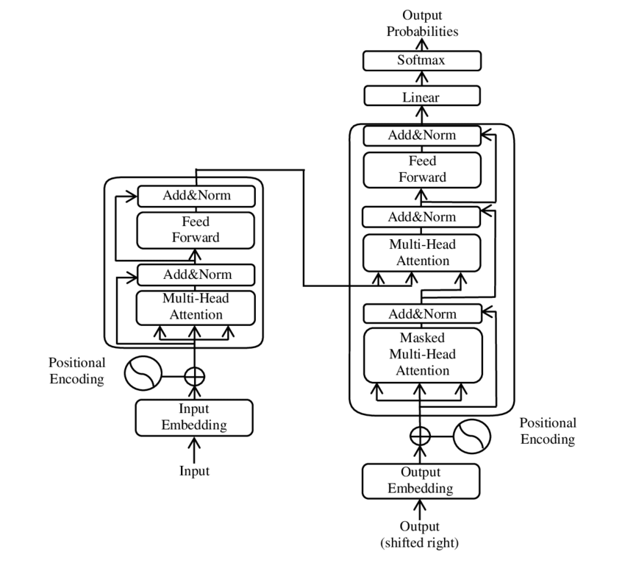
Architecture
Encoder
Decoder

Slide 4
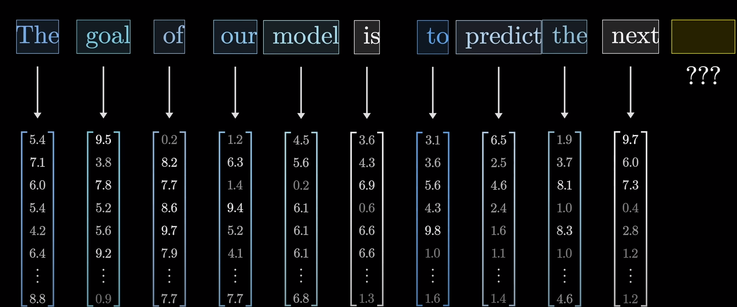
Input text (chunks) to Tokenization → Vector

Slide 5
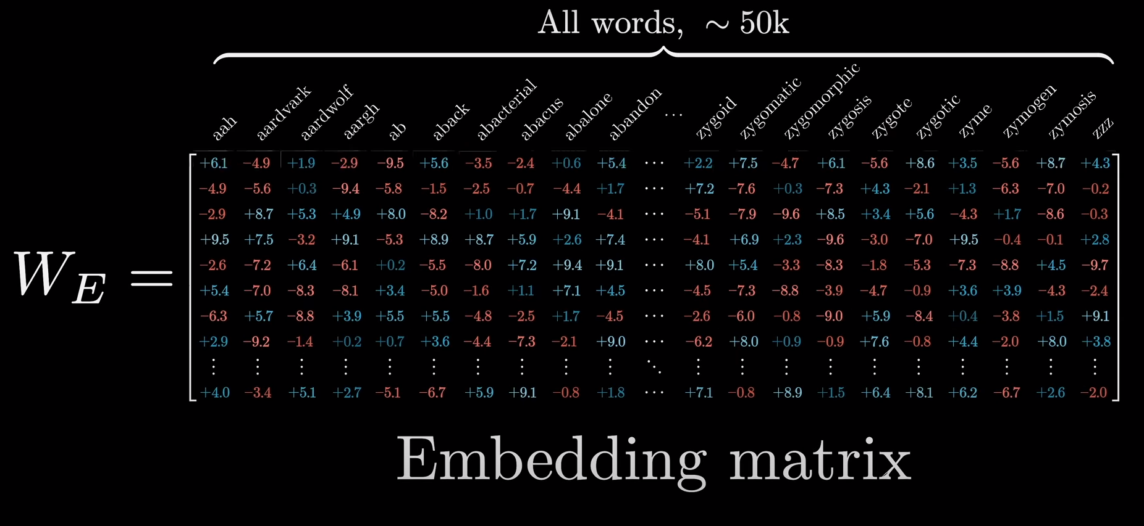
Embedding Matrix

Slide 6
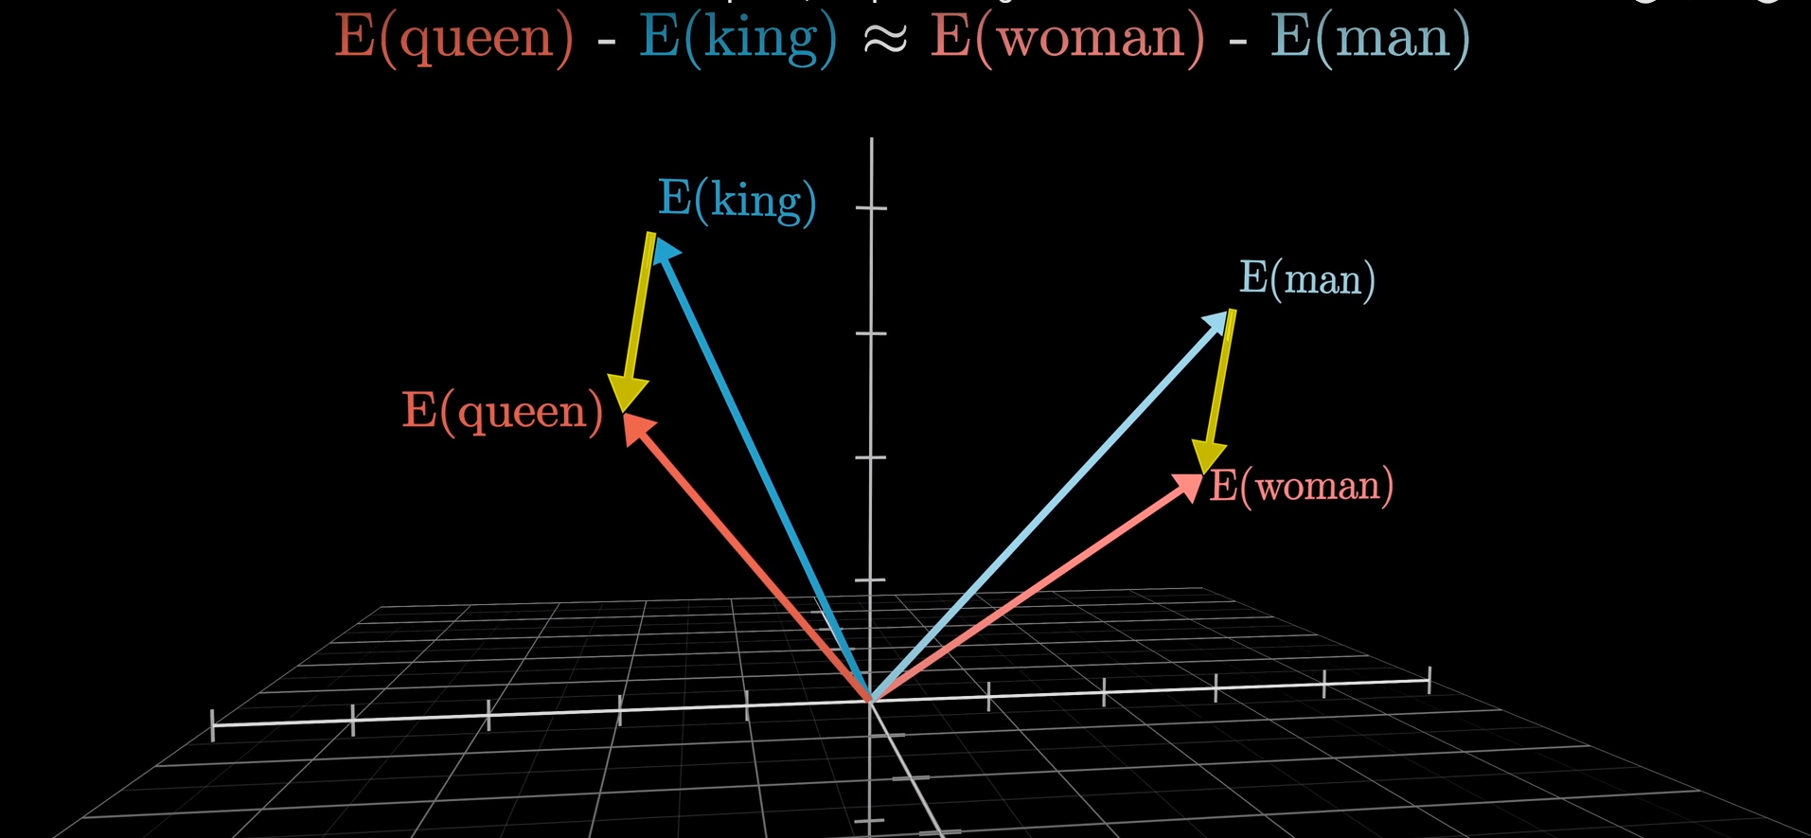
Embedding Matrix

Slide 7
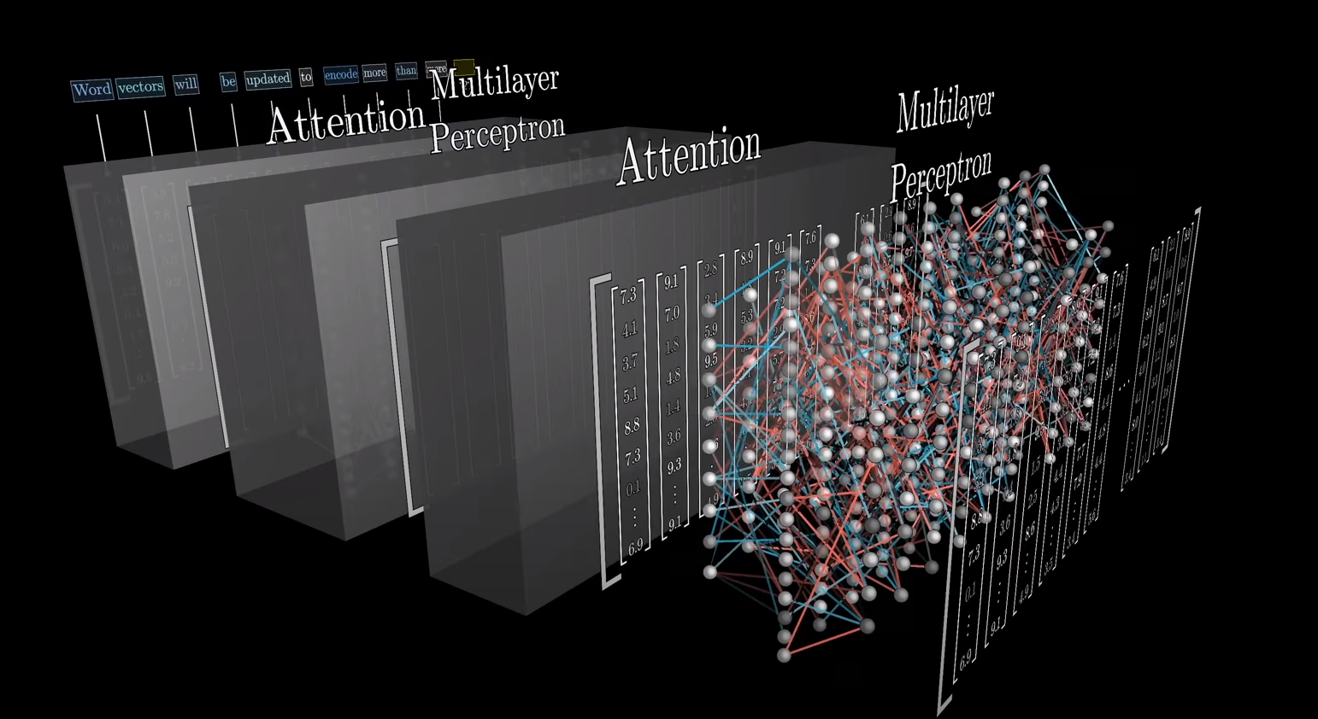
Embedding Matrix

Slide 8
Prompt Message!

Slide 9
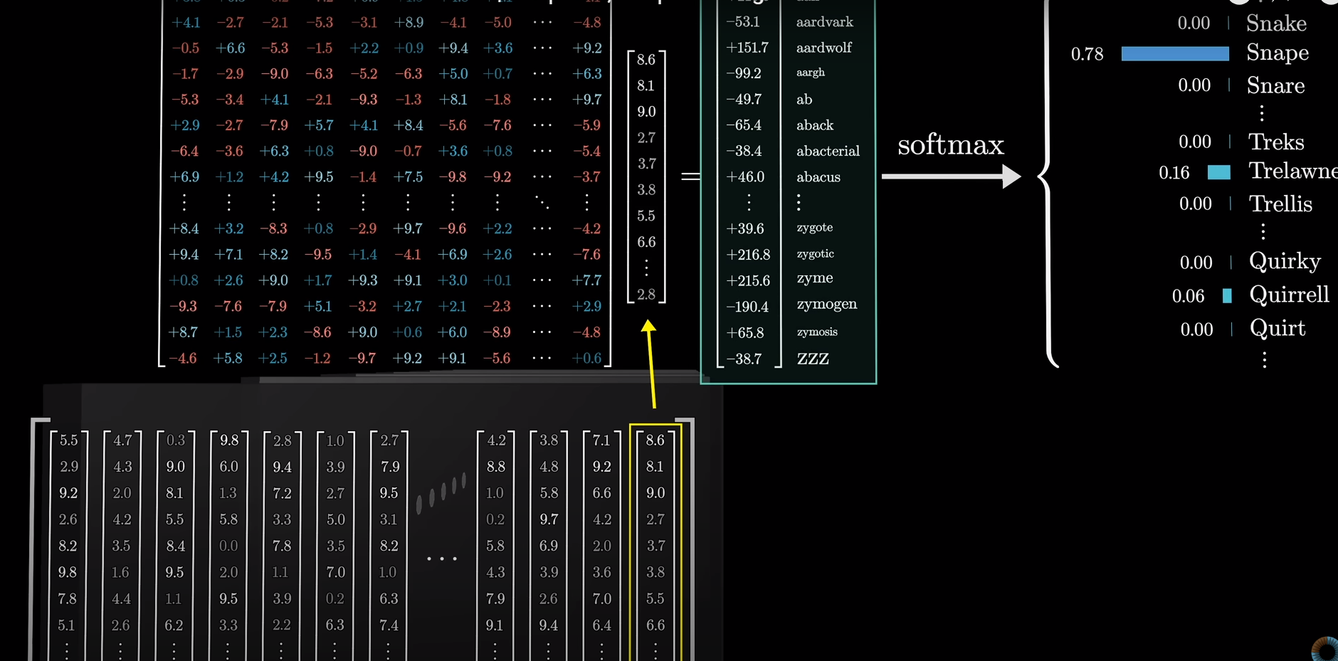
Conclusion Matrix

Slide 10
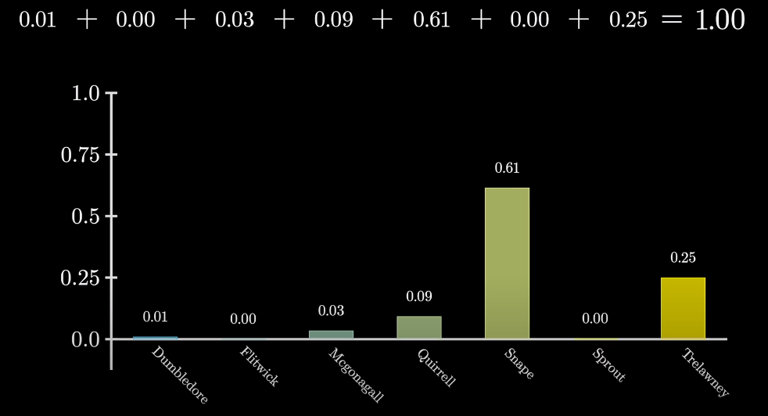
Softmax → Probability Distribution

Slide 11
Components
Input Embedding
Positional Encoding
Self Attention Mechanism
Multi head Attention Mechanism
Feed Forward Neural Network
Residual Connection and Layer Normalization
Output Embedding
Softmax

Slide 12

Applications #1
Text Generation: ChatGPT

Slide 13

Applications #2
Text to Image: DALL E, Midjourney

Slide 14
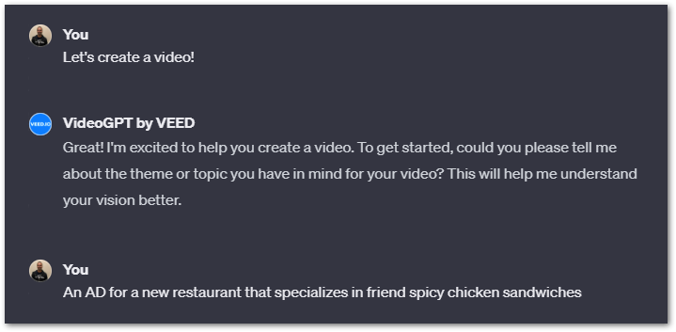
Applications #3
Text to Video: Video GPT

Slide 15
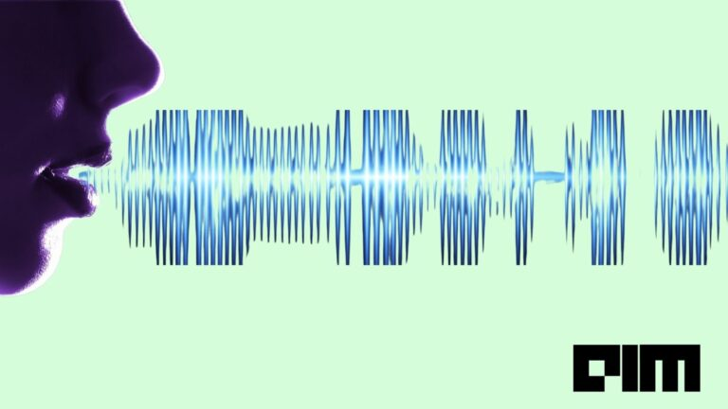
Applications #4
Text to Speech: Tacotron

Slide 16
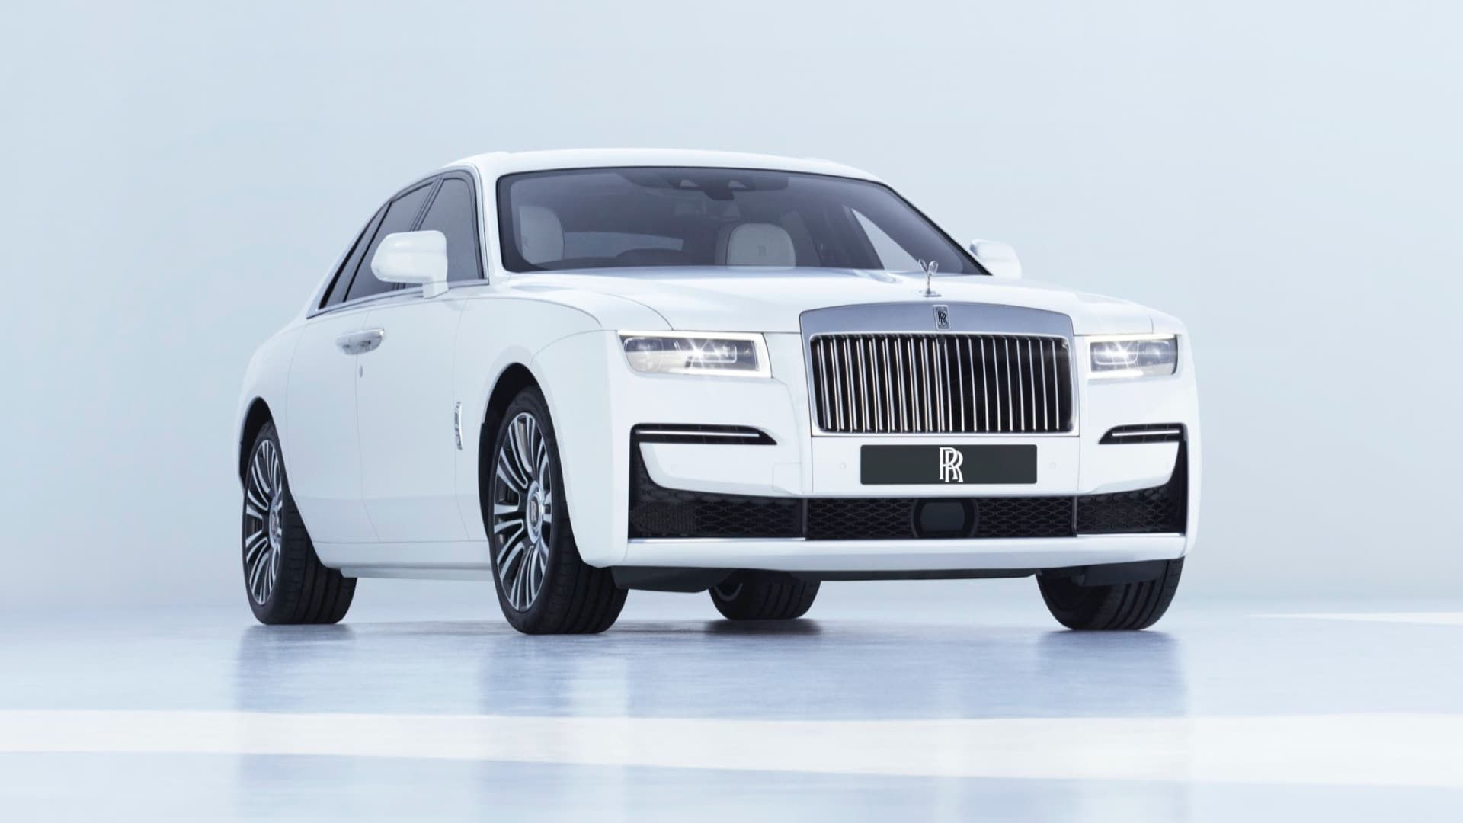
Applications #5
Image Captioning: Image Transformer
Rolls-Royce Car

