Slide 1

This Photo by Unknown Author is licensed under CC BY-NC-ND
Analysis of reviews given by boarding passengers and their feedback
by : Syed Kamran Ali

Slide 2
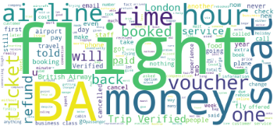
Customer Reviews
The Dissatisfied Customers on Board are 68.5 % which is a Serious Concern
Value for Money :
Avg Rating for Value for money section is 1.6 out of 5
The Vouchers have no Credibility and the staff force to use them
Passengers experience a longer delay time
Meals and Drinks :
Avg Rating for Meals and refreshments onboard is 2 out of 5
Minimum items are listed on the menu
Takes longer to deliver the food
Food taste like it’s undercooked.

