Slide 1

This Photo by Unknown Author is licensed under CC BY-NC-ND
Predicational Analysis of Customer buying behaviour
by : Syed Kamran Ali

Slide 2
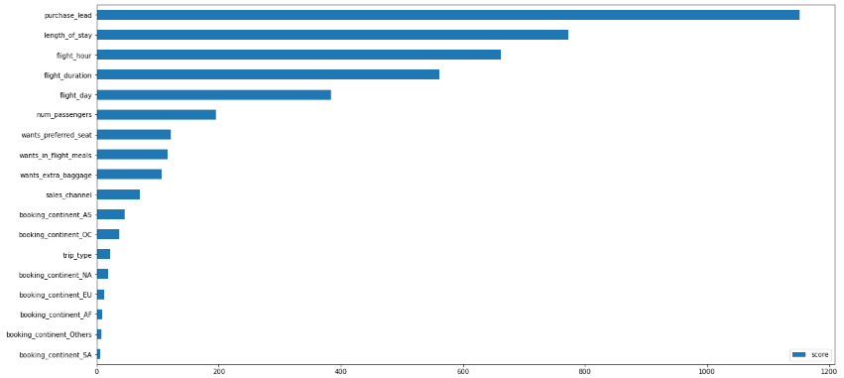
ML model
Based on the feature importance from our model, we found that key factors influencing whether customers complete their bookings include the purchase lead (i.e., the time gap between the booking and the flight) and the length of stay (how long the customer plans to stay at the destination).
In contrast, the customer's location when placing the order does not significantly impact the likelihood of completing the booking.

