Slide 1
Simple AI Workflow
AI integration to make your life easier
by Kamran Azeem
Link: https://github.com/KamranAzeem/Simple-AI-Workflow
License: MIT

Slide 2


Simple AI Workflow
Advanced / Cool / Slick / Smart

Slide 3



AI in a nutshell
Memory
Brain
Tools
ai/
|-- README.md
|-- ai-policy-override.md
|-- context.md
|-- daily-checkpoints
| |-- 2026-02-26.md
| |-- . . .
| |-- 2026-04-08.md
| `-- 2026-04-09.md
|-- next-steps.md
`-- progress.md
AI Chatbots / Assitants / Agents:
Chat GPT
Claude
DeepSeek
Gemini
GitHub Copilot
. . .
All tools available in your OS
Perl, python, sed, grep, cut, diff, git, jq, az, gcloud, kubectl, docker, . . . . .
LLMs:
GPT-5.4
GPT-5.4-mini
GPT-5.4-nano
GPT-5.3-codex

Slide 4
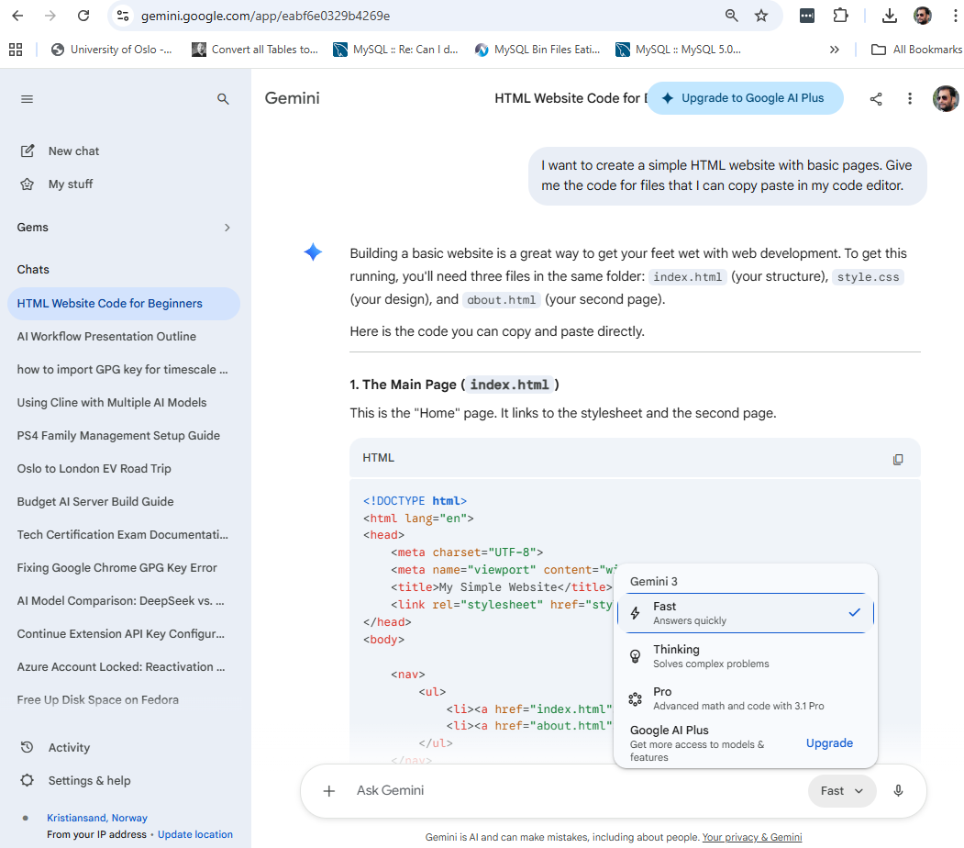
Basic web based usage: (Good place to start!)
Current context
Copy / Paste code
Memories (individual contexts)
LLM model being used

Slide 5
Personal AI Proficiency model / Where am I now?
Copy / paste hell
Level 0 | Not using AI
Level 1 | Browser based interaction with AI assistants (Chat GPT, Gemini, etc)
Level 2 | AI chat assistant in editor (VS/Code, etc)
Level 3 | CLI based interaction with AI assistants (copilot, claude, gemini, etc)
Level 4 | Ability to create or use MCPs, Skills, etc
Level 5 | Ability to create AI Agents for doing tasks on your behalf
Level 6 | Multiple AI assistants working together on a project
Gets 100% work done!

Slide 6

Single Project
Out of band management layer
AI Assistant (Claude / DeepSeek / Gemini / GH Copilot / … )
AGENTS.md + ai/
static-website
.git
index.html
css/style.css

Slide 7
Single Project (focussed - directory view)
AGENTS.md reads
Central AI policy files
in
~/Simple-AI-Workflow/
(ai-policy-web.md)
$ tree
.
|-- AGENTS.md
|-- ai/
| |-(ai context + state)
|
|-- .git/
| |-- (git internal stuff)
|
|-- index.html
|-- css/
`-- style.css

Slide 8
Anatomy of the “AGENTS.md”
$ cat AGENTS.md
# AI Bootstrap Entry Point
**IMPORTANT**: Update the central policy path below when using this file in your project.
This is the single startup entry point for all AI assistants in this repository.
Read in this order:
1. [central main policy file](/home/username/Projects/Personal/Simple-AI-Workflow/ai/ai-policy-cloud.md) - operating rules and guardrails. If unreachable, then read the local policy file mentioned in the next point.
2. [local main policy file](ai/ai-policy-cloud.md) - fallback if step 1 is unreachable; skip if step 1 succeeded.
3. [local policy override file](ai/ai-policy-override.md) - rules to override the main policy. **(optional; skip if not present)**
4. [ai/next-steps.md](ai/next-steps.md) - current resume point and live queue. **(optional; skip if not present)**
5. Latest file in [ai/daily-checkpoints/](ai/daily-checkpoints/) - daily recovery snapshot. **(optional; skip if not present)**
6. [ai/progress.md](ai/progress.md) - chronological execution history. **(optional; skip if not present)**
7. [ai/context.md](ai/context.md) - repository briefing and decisions. **(optional; skip if not present)**
After reading all accessible files above, acknowledge readiness and await the first user instruction.
. . .
$ cat AGENTS.md | wc -l
57
Location of the policy file that you want to use with this project
Notice very small size !

Slide 9
Policy files used by AGENTS.md
$ wc -l ai-policy-*.md
311 ai-policy-backend-api.md
319 ai-policy-cloud.md
308 ai-policy-frontend-web.md
285 ai-policy-linux-system-admin.md
$ grep \# ai-policy-cloud.md
# 🚫 DO NOT MODIFY THIS FILE
# AI Assistant Policy
## Scope
## Role Definition
### Core Responsibilities
### Project Authority
### Decision-Making Framework
## Instruction Precedence
## Project Reference Files
## Operational Restart and Checkpoint Contract
### Source-of-Truth Order
### Required Tracking Files
### Checkpoint ID Contract
### Immutable Checkpoint Semantics
### Mandatory Checkpoint Procedure
### Required Resume Block Schema
### Startup Consistency and Recovery
### End-of-Day Quality Gate
## Copilot Bootstrap Source Guardrails
## Operational Guardrails
## Security Policy
### Security Responsibilities
### Security Best Practices
### Incident Response
### Security Validation
. . .
The Do’s and Don’ts
This file is very long. These are just (some) headings!

Slide 10
Anatomy of the “ai/” directory
$ tree ai/
ai/
|-- README.md
|-- ai-policy-override.md
|-- context.md
|-- daily-checkpoints
| |-- 2026-02-26.md
| |-- 2026-02-27.md
| |-- 2026-03-13.md
| |-- 2026-04-07.md
| |-- 2026-04-08.md
| `-- 2026-04-09.md
|-- next-steps.md
`-- progress.md
The Memory!

Slide 11
Example of ai-policy-override.md
$ cat ai/ai-policy-override.md
# AI Policy Override
## Windows Shell Priority (Local Setup)
For terminal execution on this Windows machine:
1. Use Git Bash first for all commands by default.
2. Prefer Git Bash-compatible command forms and tools (`bash`, `rg`, `jq`, POSIX pipelines).
3. Use PowerShell only when the operation is truly Windows-native and no practical Git Bash equivalent is available.
4. When PowerShell is used, include a brief reason why Git Bash was not suitable.
5. Avoid unnecessary shell switching during a single task.

Slide 12
Out-of-Band Management => Security + Privacy
The Analogy: Just like the .git directory tracks your history without being part of your application code, Simple-AI-Workflow acts as an external intelligence layer - a dedicated brain and dedicated memory-system for this project only!
Key Benefit: No "AI clutter" or “AI noise” (prompts, logs, agent files, or state) spread all over the place inside your production repository.
Independence: The AI manages the project, but its own state exists outside the Git history, contained in a single git-ignored directory (“ai/”).
Privacy: Your thoughts, reasoning, decisions, way of working, details about project/clients/infrastructure that you discuss with AI assistant - all private. Nothing in git - ever!
Bonus: Does not need your directory to be a git repository either! Bring in your idea in a empty directory, bring in AI, start brainstorming / building!

Slide 13

Single Project
Out of band management layer
AI Assistant (Claude / DeepSeek / Gemini / GH Copilot / … )
AGENTS.md + ai/
Two git branches for same code base
static-website
Git branch
feature/add-menu-system
static-website
Git branch
feature/add-aboutus-page
index.html
css/style.css
Index.html
aboutus.html
css/style.css
Notice different state of files

Slide 14
The Architect
Out of band management layer
AI Assistant (Claude / DeepSeek / Gemini / GH Copilot / … )
AGENTS.md + ai/
static-website
.git + code
web-api
.git + code
infrastructure
.git + code
my-business-idea
docs

Slide 15
The Architect
AGENTS.md reads
Central AI policy files
in
~/Simple-AI-Workflow/
(ai-policy-cloud.md)
How a change in API effects the components of infrastructure , or, vice-versa ?
$ tree
.
|-- AGENTS.md
|-- ai
| `-- (ai context + state)
|
|-- infrastructure
| `-- (stuff)
|
|-- infrastructure-new
| `-- (stuff)
|
|-- static-website
| `-- (stuff)
|
`-- web-api
`-- (stuff)
How do I redesign the infrastructure based on GKE, instead of Azure ContainerApps ?
Find all PostgreSQL related components and copy them inside the “infrastructure-new” directory

Slide 16
Benefits of Architect-level AI setup
Visibility: Complete and full overview of everything / all related components
Cleanliness: Keeps your production repos lean and professional.
Portability: You don’t need to move your AI "brain" from one project to another. Nor do you have several disconnected brains (each project/directory having it’s own AI setup)
Contextual Power: Breaks the "silo" of single-repository AI tools. Has context of everything under it’s umbrella.

Slide 17
How to use this Workflow? (1 / 2)
Follow https://github.com/KamranAzeem/Simple-AI-Workflow
Clone this repository at a central location in your home directory
  E.g. ~/Projects/Personal/Simple-AI-Workflow
Copy AGENTS.md from this directory into the root of the target project on your local computer. (e.g. inside ~/Projects/Personal/static-website/
Update the absolute path for the appropriate policy file that you want to use in the AGENTS.md file:
  E.g. /home/username/Projects/Personal/Simple-AI-Workflow/ai/ai-policy-frontend-web.md
  Make sure to follow the OS specific way of writing the path.
When an AI assistant reads AGENTS.md, it will access the central policy directly from that path.
Write “/init using AGENTS.md” or “bootstrap using AGENTS.md protocol” in the AI chat window.

Slide 18
How to use this Workflow? (2 / 2)
Whenever you complete important activities, or take a pause, or before closing VScode or shutting down your computer:
  Use the instruction: “checkpoint” - which updates all AI related tracking files.
When you come back from pause, or may be a computer or VScode restart:
  Use the instruction: “load context” or “Where are we in this project?”
Everything related to AI: context, progress, todo, session-states, etc, all live in the “ai/” directory that is “git-ignored”.
  If you lose it, you can rebuild it with “/init” again.

Slide 19
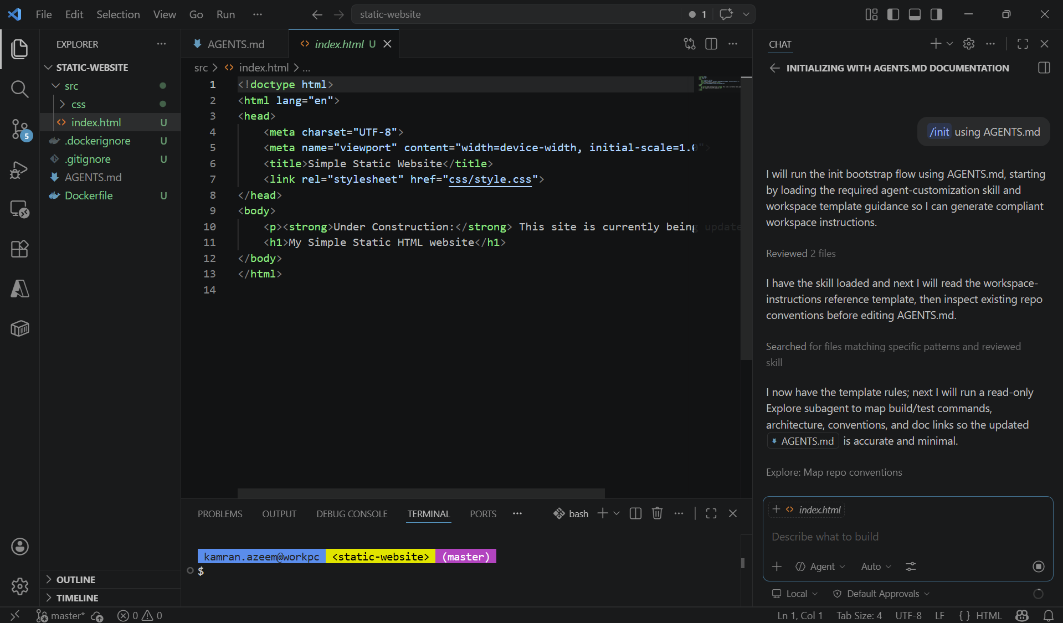
How to initialize a repo with AI?

Slide 20
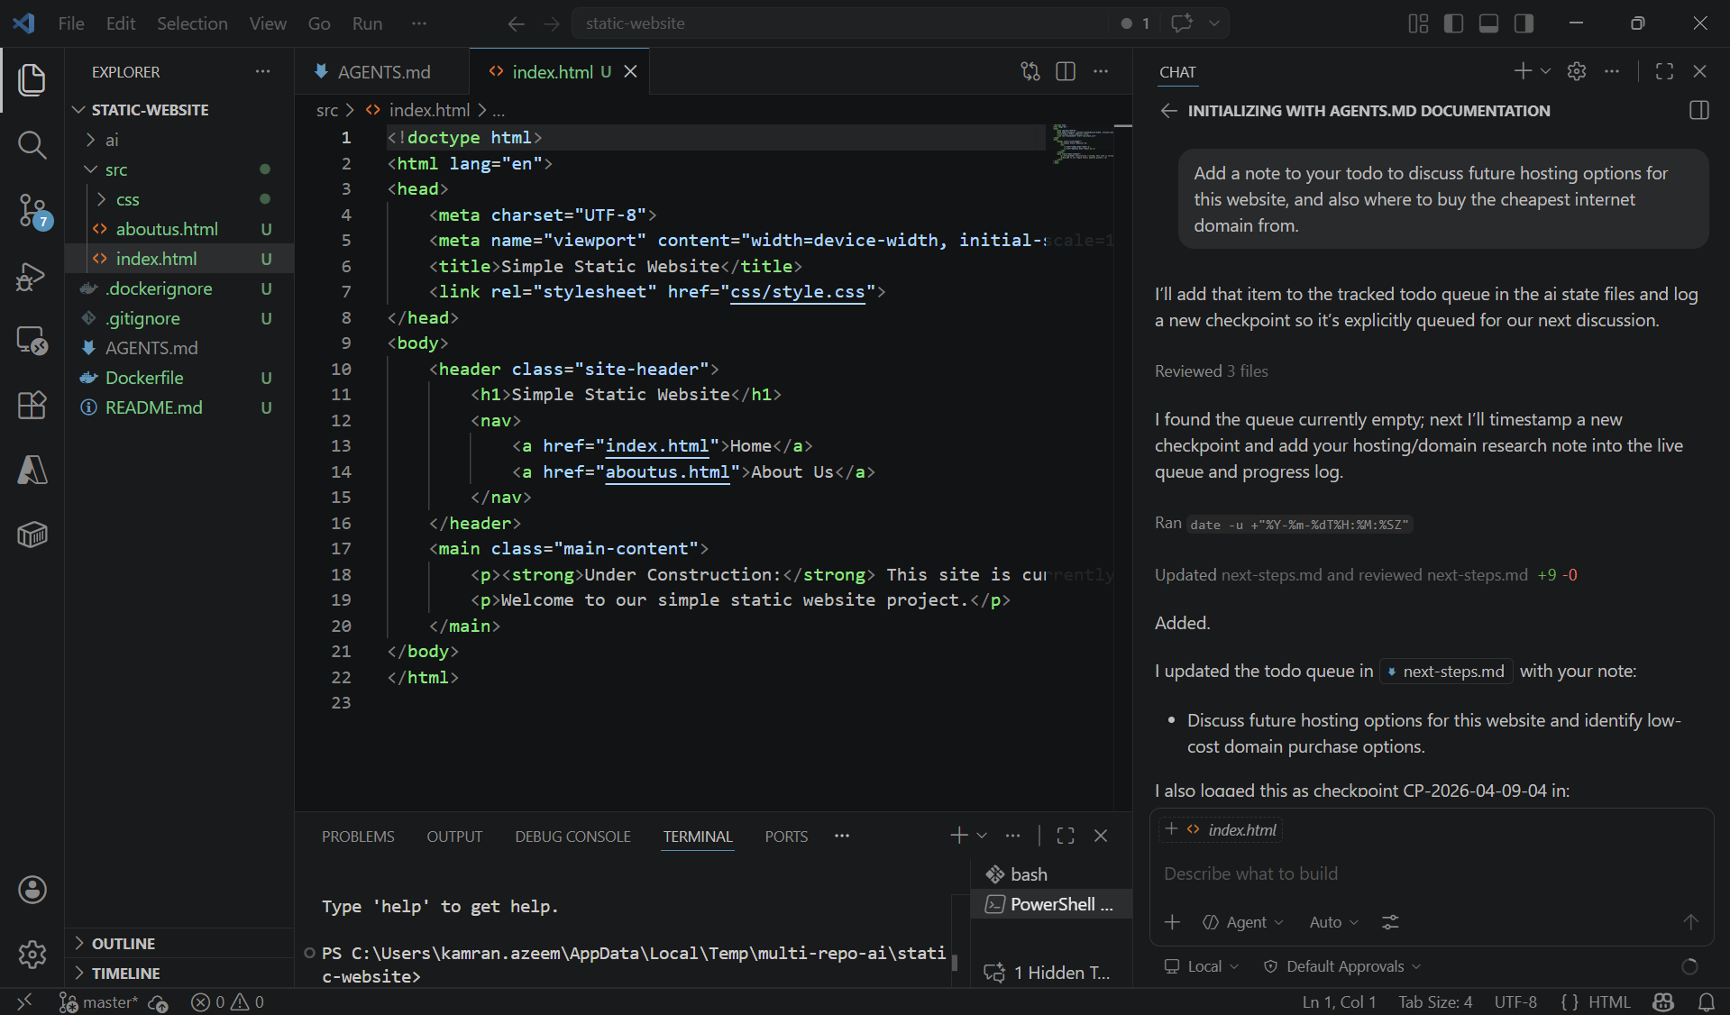
How to add “To do” to AI ?
New “to do” for AI

Slide 21
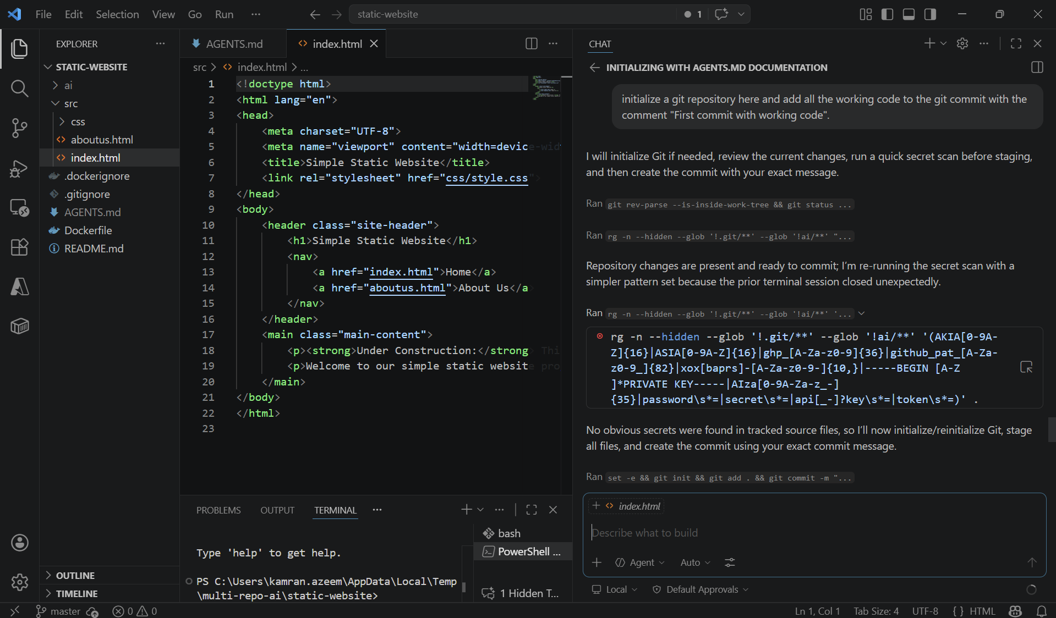
How to use git through AI?
New git repo!

Slide 22
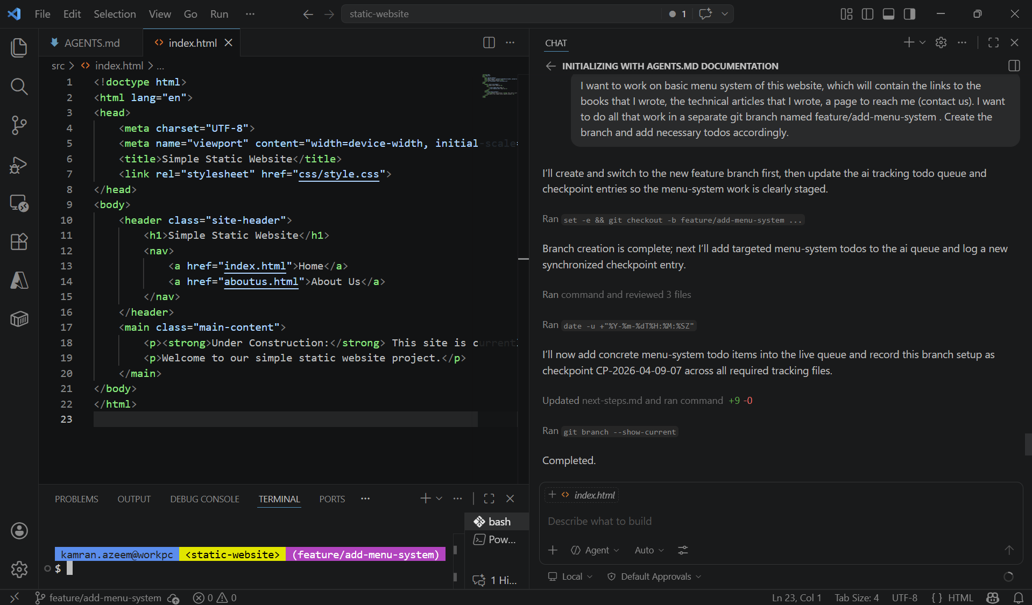
New git branch? No problem!
Create git branch through AI
Notice: AI state is out-of-band from rest of the repository, so AI sees everything irrespective of the git branch you are on!

Slide 23
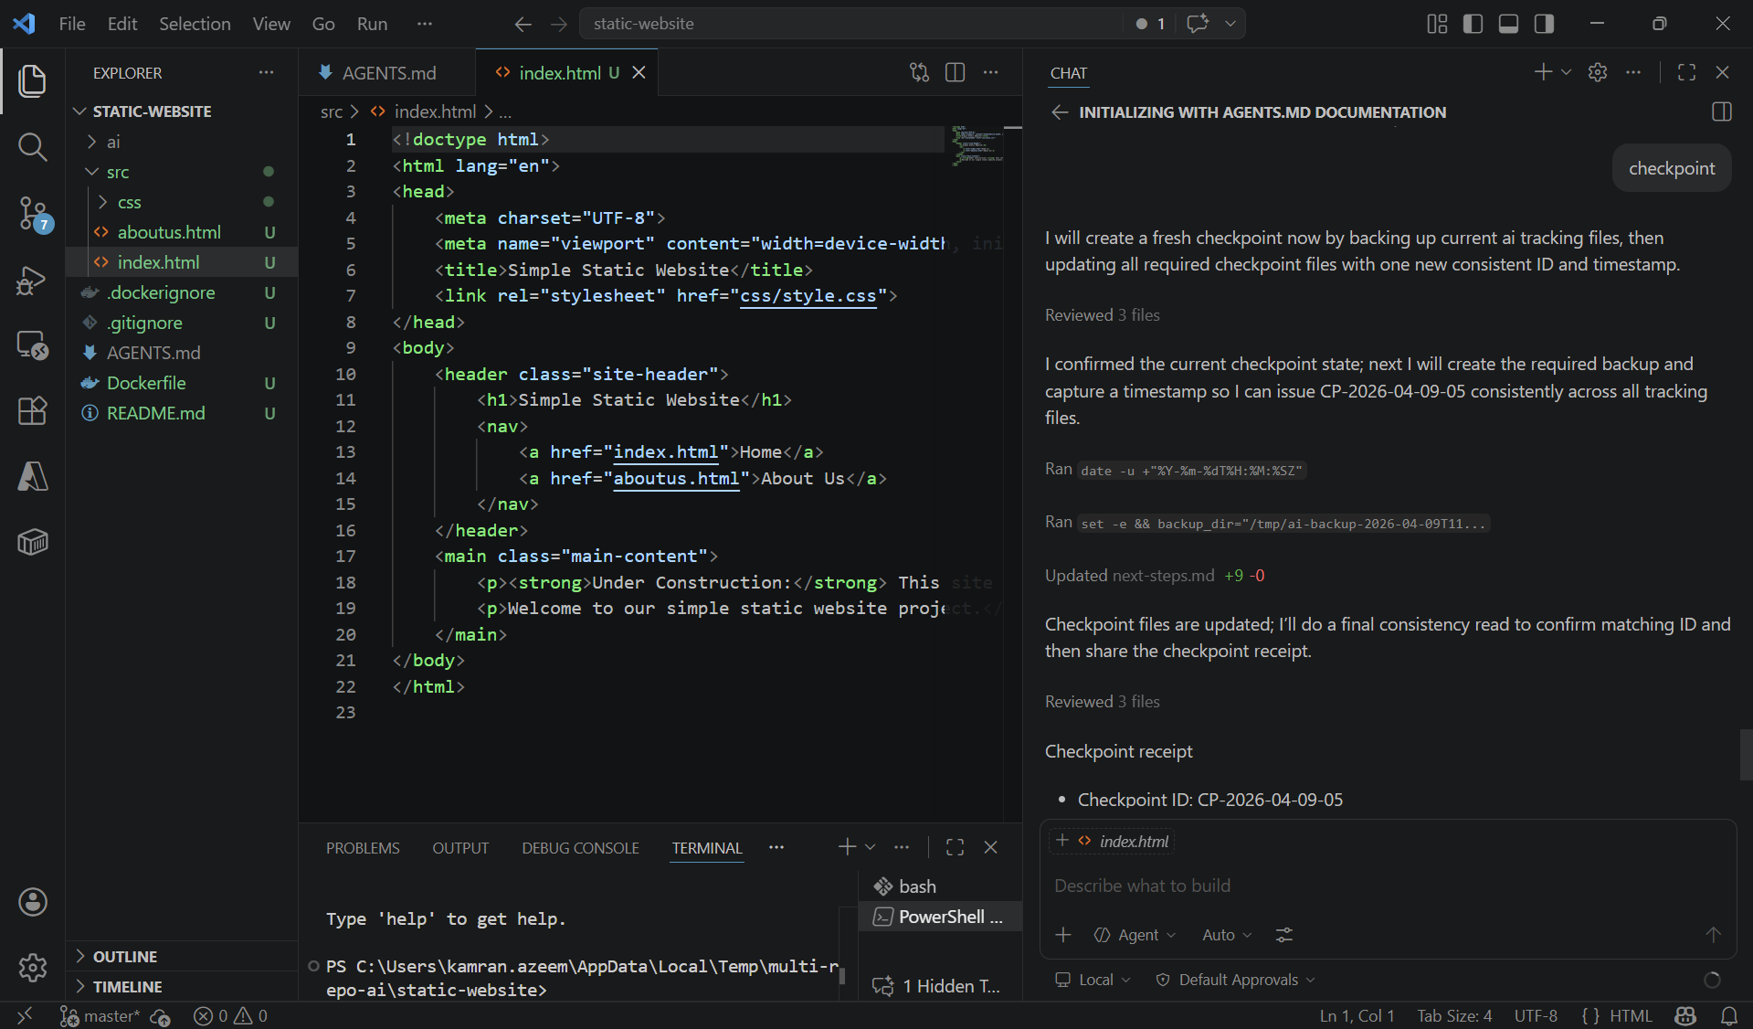
How to do checkpoint? (this is not a git commit)
checkpoint

Slide 24

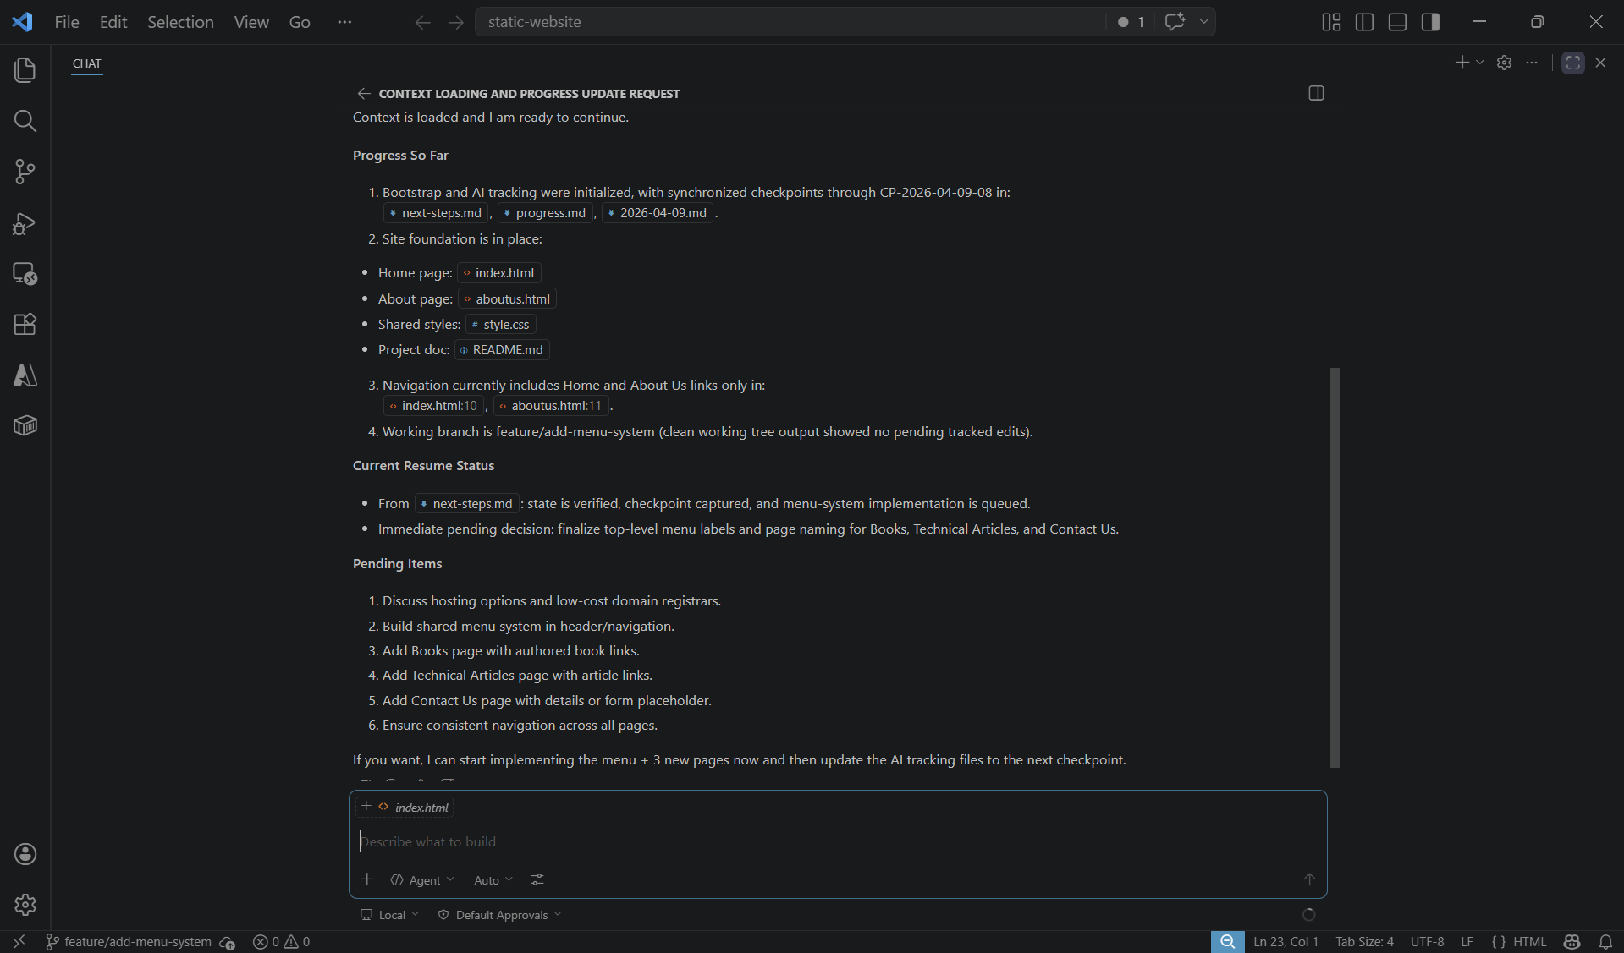
How to Resume work?
“load context” is enough!
AI Chat window expanded

Slide 25
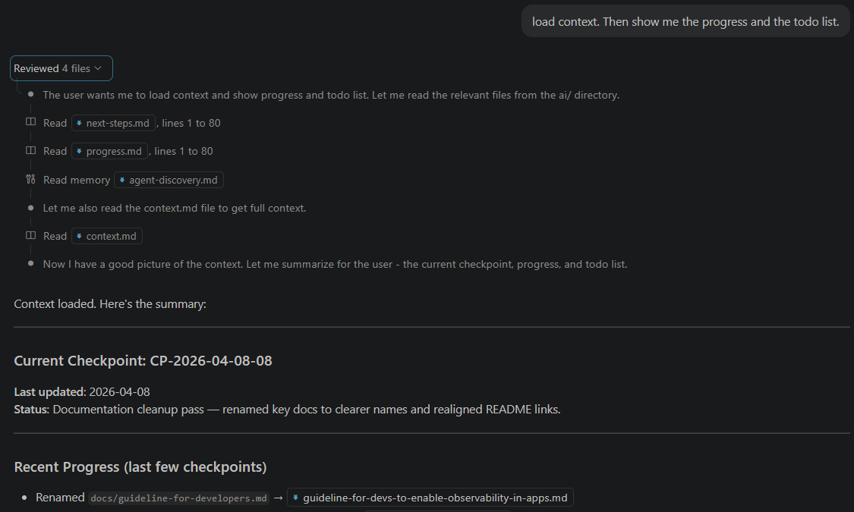
Background process when loading context:
“load context”

Slide 26
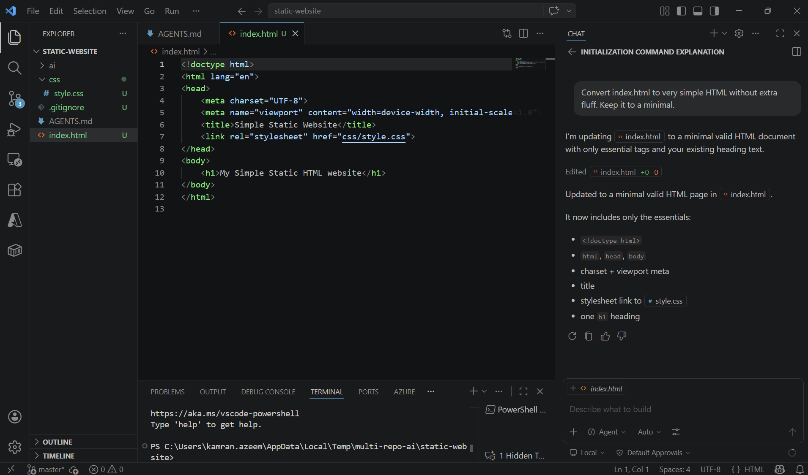
Fun stuff: Evolution of the size of AI chat window as you become proficient! (1 / 4)
Small window for AI chat

Slide 27
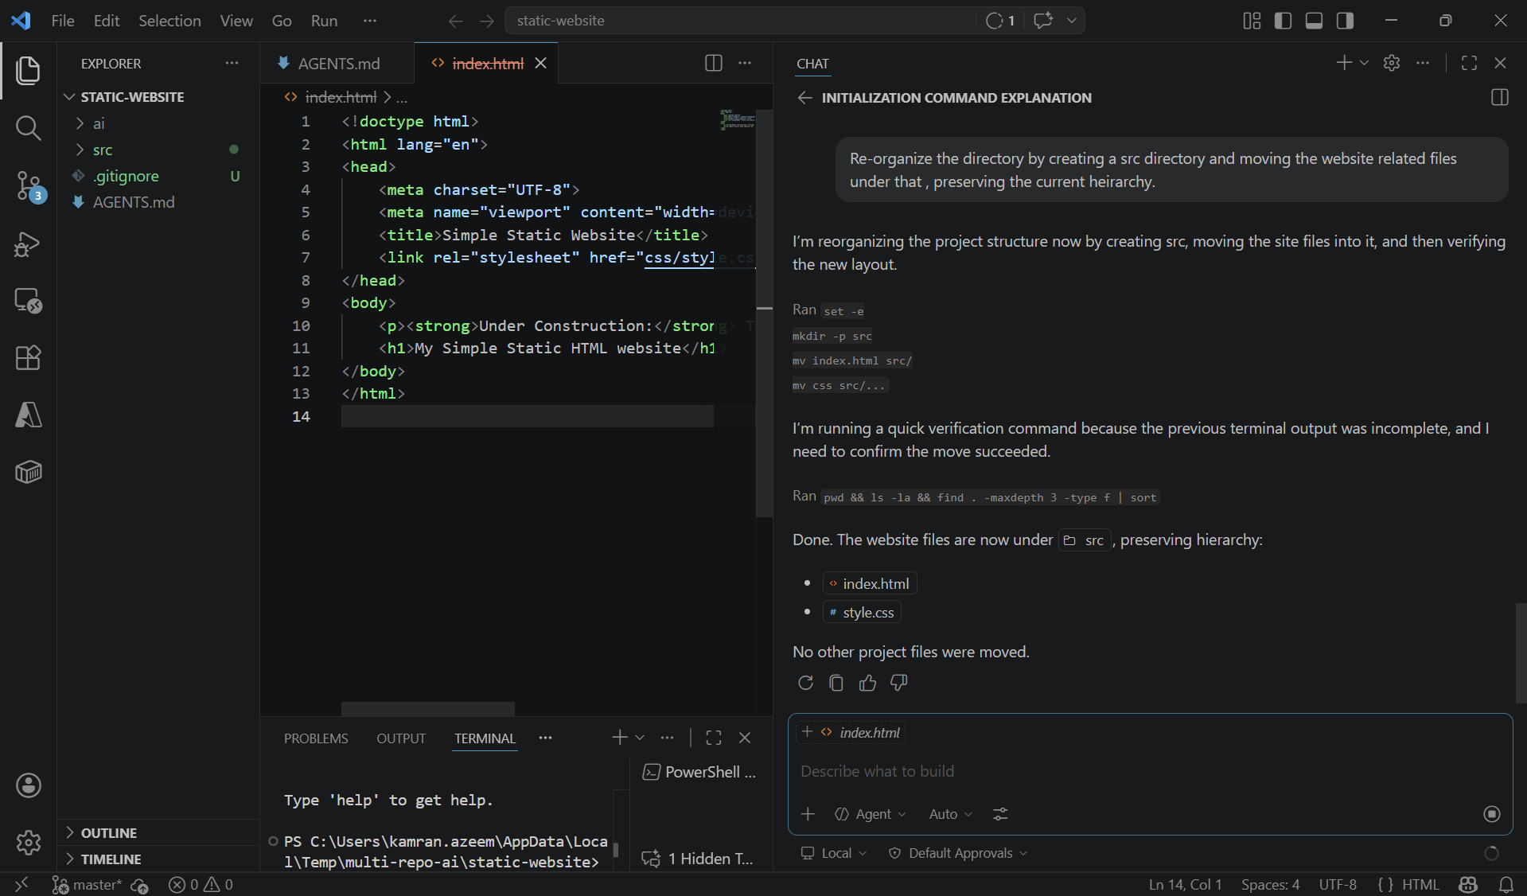
Fun stuff: Evolution of the size of AI chat window as you become proficient! (2 / 4)
Whats the point of looking at code when I am not doing anything with it directly?
Why waste screen space?
Trying to give more “respect” to AI chat window

Slide 28
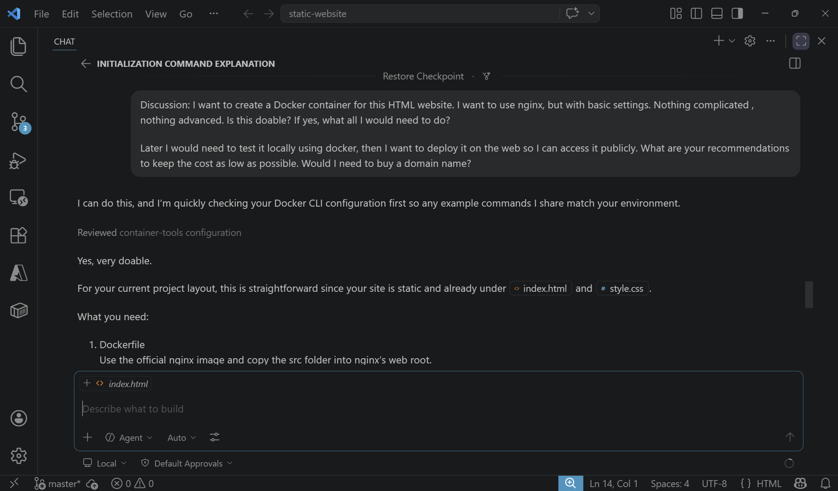
Fun stuff: Evolution of the size of AI chat window as you become proficient! (3 / 4)
Why not just talk to my AI colleague in a full / maximized window!

Slide 29
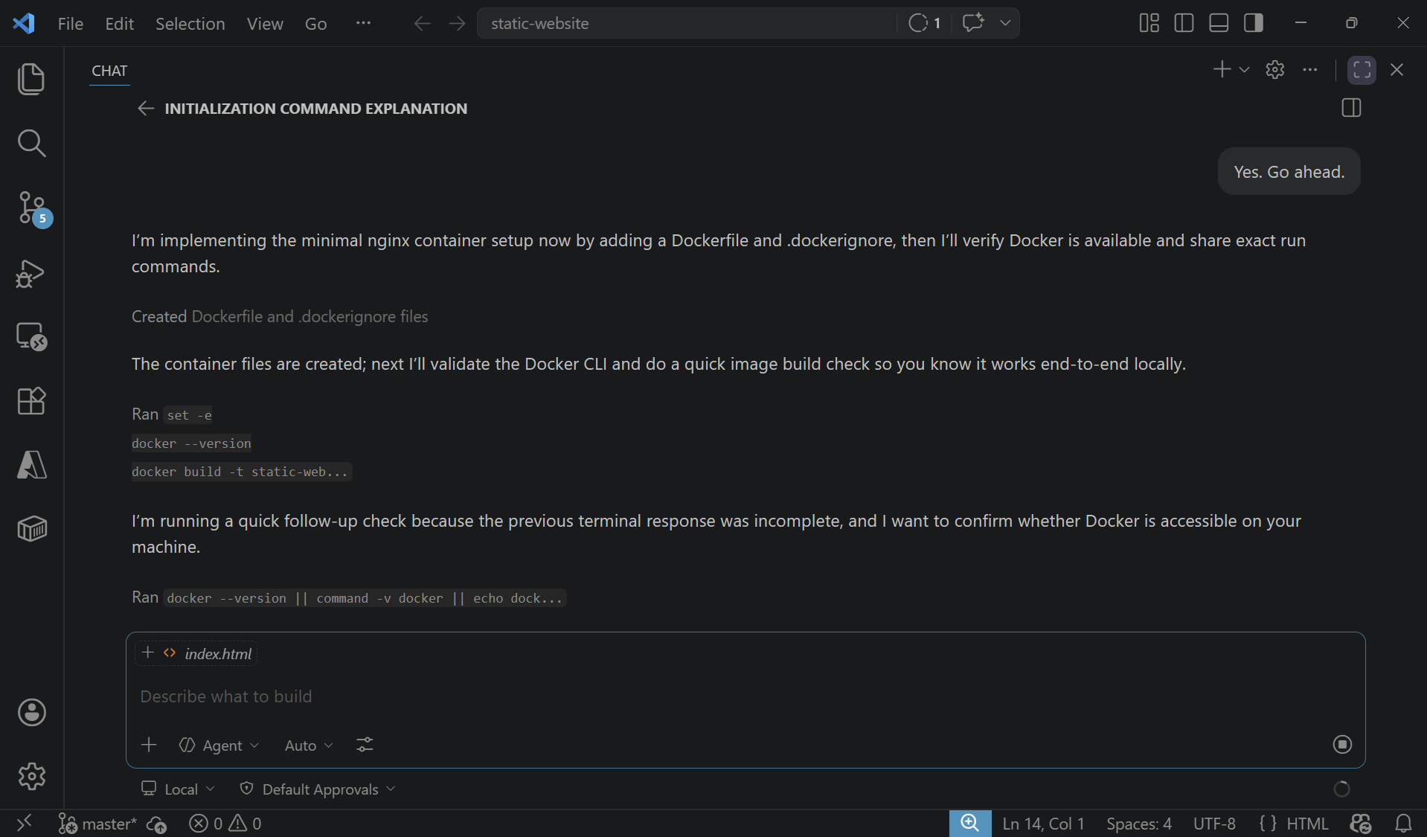
Fun stuff: Evolution of the size of AI chat window as you become proficient! (4 / 4)
Yes!
Go ahead!
( I am in heaven! )

Slide 30
Copilot users may (optionally) want to add this to VSCode file:
{{VSCODE_USER_PROMPTS_FOLDER}}/init.instructions.md
Linux: ~/.config/Code/User/prompts/init.instructions.md
MacOS: ~/Library/Application Support/Code/User/prompts/init.instructions.md
Windows: %USERPROFILE%\AppData\Roaming\Code\User\prompts\init.instructions.md
---
description: Use when bootstrapping a new repository with /init. Always read AGENTS.md first as the single source of truth.
applyTo: "**"
---
# /init Bootstrap Guide
When running `/init`, always:
1. Read AGENTS.md first — it is the single source of truth for AI file locations and policy hierarchy
2. GitHub Copilot files must go under `ai/github-copilot/`, never workspace root
3. If policy conflicts with init task, STOP and ask for clarification
Do not create copilot-instructions.md, *.prompt.md, or other GitHub Copilot customizations in workspace root.

Slide 31


